Slide 1
SIC Meeting
October 17, 2024

Slide 2
Welcome SIC Members
Heidi Dumm- Elected /Chair
Rebecca Parales-Proctor-Elected
Rocki Wells
Margaret Askins
Emily Grier
Ben Jackson

Slide 3
Purpose of SIC Working Together on Ways to Improve Our School Discussing Needs, Improvement Ideas, and Developing Goals for JMS

Slide 4
Comparison to Other Schools
ELA Grade | JMS | Hannah-Pamplico | Henry Sneed Middle | John W. Moore Middle | Southside Middle | Wallace Moore Middle | John Paul Truluck Middle | PHES/ Carvers Bay Middle | Conway Middle | Forest Brook Middle
Grade 5 | 40.8% | 47.1% |  |  |  |  |  | 56.8% PHES
Grade 6 | 51.2% | 38.5% | 47.6% | 58.9% | 46.7% | 26.2% |  | 48.2% | 52.5% | 58.4%
Grade 7 | 54.3% | 42.0% | 44.1% | 52.8% | 41.5% | 39.7% | 45.6% | 17.6% | 52.0% | 54.6%
Grade 8 | 52.7% | 33.8% | 35.8 | 55.2% | 43.6% | 42.5% | 51.4% | 31.4% | 55.4% | 50.2%

Slide 5
Comparison to Other Schools
Math Grade | JMS | Hannah-Pamplico | Henry Sneed Middle | John Moore Middle | Southside Middle | Wallace Moore Middle | John Paul Truluck Middle | PHES/ Carvers Bay Middle | Conway Middle | Forest Brook Middle
Grade 5 | 44.9% | 55.9% |  |  |  |  |  | 59.1% PHES
Grade 6 | 33.3% | 35.9% | 24.4% | 44.6% | 34.3% | 17.3% |  | 18.8% | 42.6% | 45.3%
Grade 7 | 39.4% | 25.9% | 22.2% | 31.2% | 27.0% | 27.0% | 10.0% | 5.9% | 34.7% | 38.8%
Grade 8 | 29.7% | 8.8% | 20.7% | 44.7% | 29.4% | 24.3% | 22.2% | 26.1% | 35.3% | 36.6%

Slide 6
Excellent
JMS Report Card Rating

Slide 7
ACADEMIC ACHIEVEMENT

Slide 8
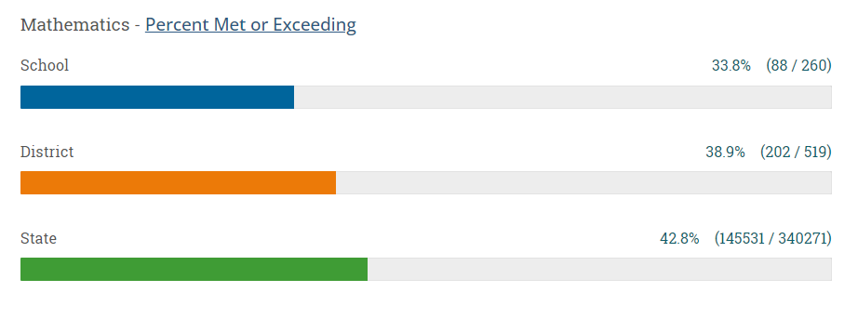
ACADEMIC ACHIEVEMENT

Slide 9
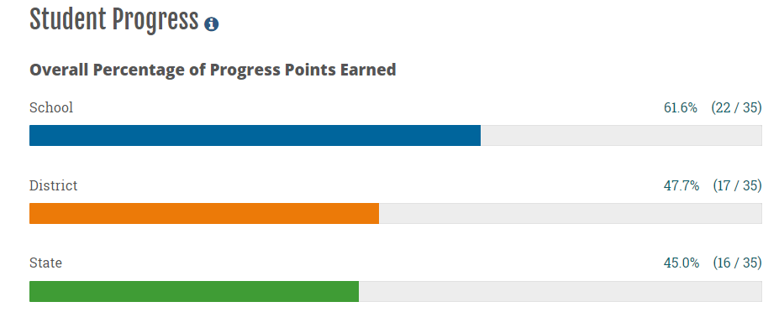
STUDENT GROWTH

Slide 10
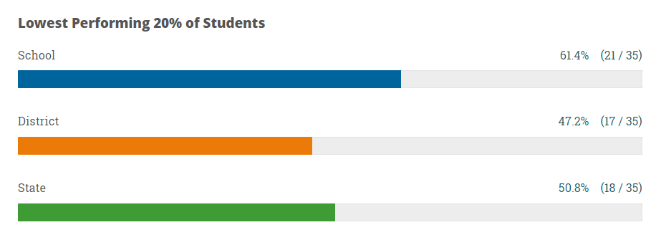
STUDENT GROWTH

Slide 11
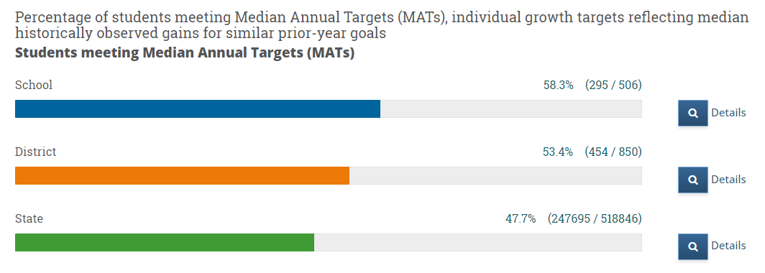
STUDENT GROWTH

Slide 12
Interesting Report Card Facts About JMS in Comparison to Others
350 middle schools in SC received report card ratings for the 23-24 school year.
Johnsonville Middle School is 37th by report card rating out of those 350 middle schools.
Johnsonville Middle School is the only middle school in Florence County to receive a rating of EXCELLENT for the 23-24 school year.
Only 43 middle schools in the state of SC scored EXCELLENT this year. 70 schools scored excellent last year.

Slide 13
Report Card Scores for Other Schools
Hannah Pamplico-Average
Carvers Bay Middle- Below Average
Conway Middle- Average
St. James-Average
Aynor Middle –Average
Waccamaw Middle- Excellent
North Myrtle Beach Middle- Excellent
Ocean Bay Middle-Excellent

Slide 14
IMPORTANT DATES
OCTOBER 23-PSAT
OCTOBER 30-PINK OUT DAY
NOVEMBER 5-ELECTION DAY/NO SCHOOL
NOVEMBER 7-PICTURE MAKE-UP DAY
NOVEMBER 25-29-THANKSGIVING BREAK
POSSIBLE PARENT TEACHERCONFERENCE DATE-JANUARY 9

Slide 15
FRUIT SALES Permission Slip Sent Home Monday, October 14 Sales/Brochures Start Tomorrow for Those Who Turned In Permission Slip Starts Friday, October 18 Handout on Incentives and Dates

Slide 16
Plans for Developing SIC Goals

Slide 17
Next SIC Meeting
Tuesday, November 19 at 6:00

