Slide 1


Voices for the Vision
Shared Decision Making Parent Meeting
Morningside Elementary School
March 25, 2025

Slide 2

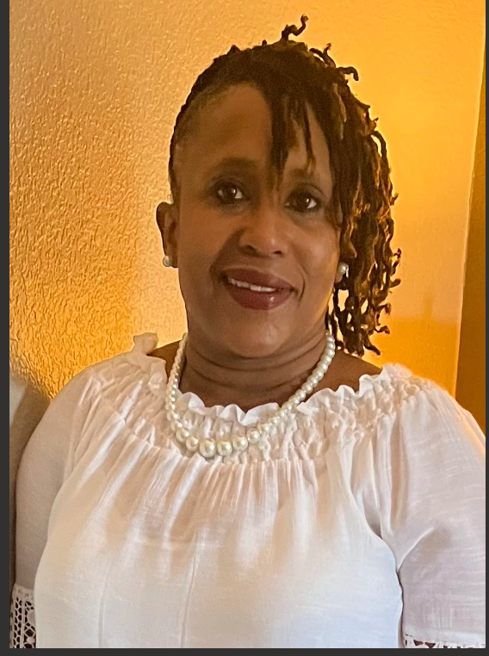

Welcome and Introductions
FEL – LaWanda Mason
Parents- Introduce yourselves and tell what grade level your child is in.

Slide 3

Agenda
Welcome & Introductions
Our FE Program (highlights)
Achievement Data
2025 Parent Survey Results
Family Engagement Plan
School-Family Compact
Program Supports
Parent Input Form

Slide 4
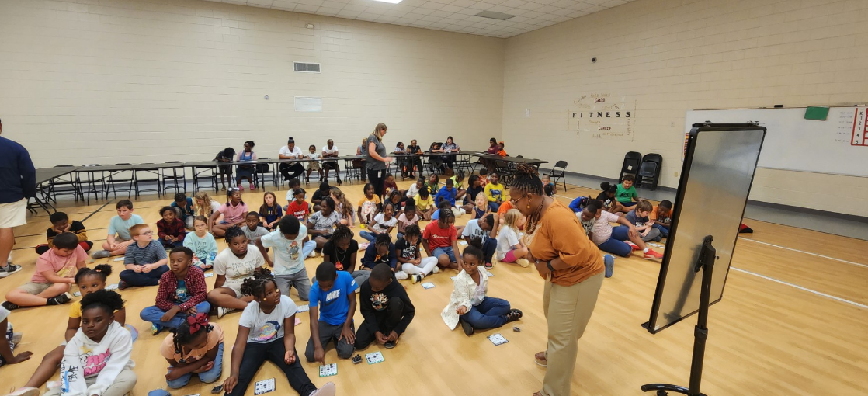
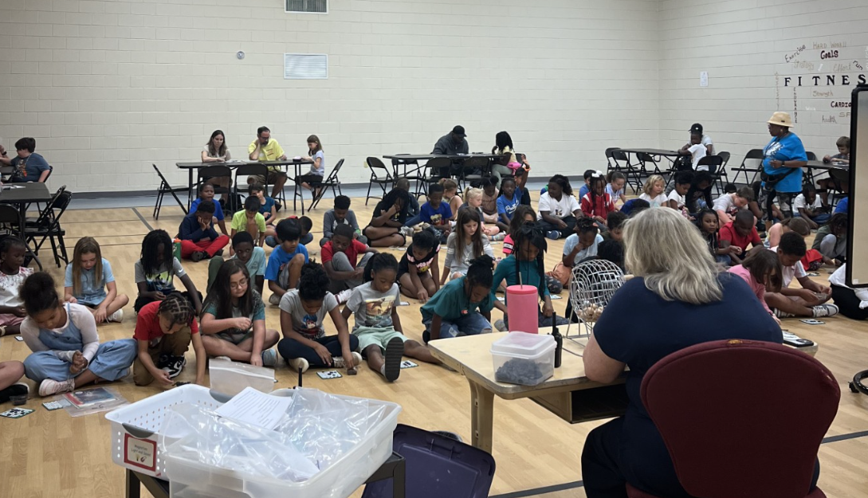
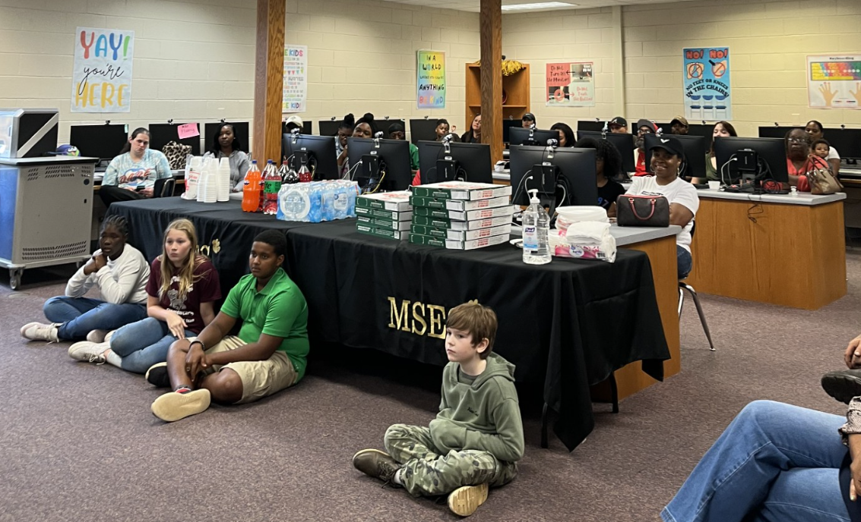
A Glimpse at Family Engagement at Morningside Elementary
Bingo for Books
Lunch and Learn

Slide 5


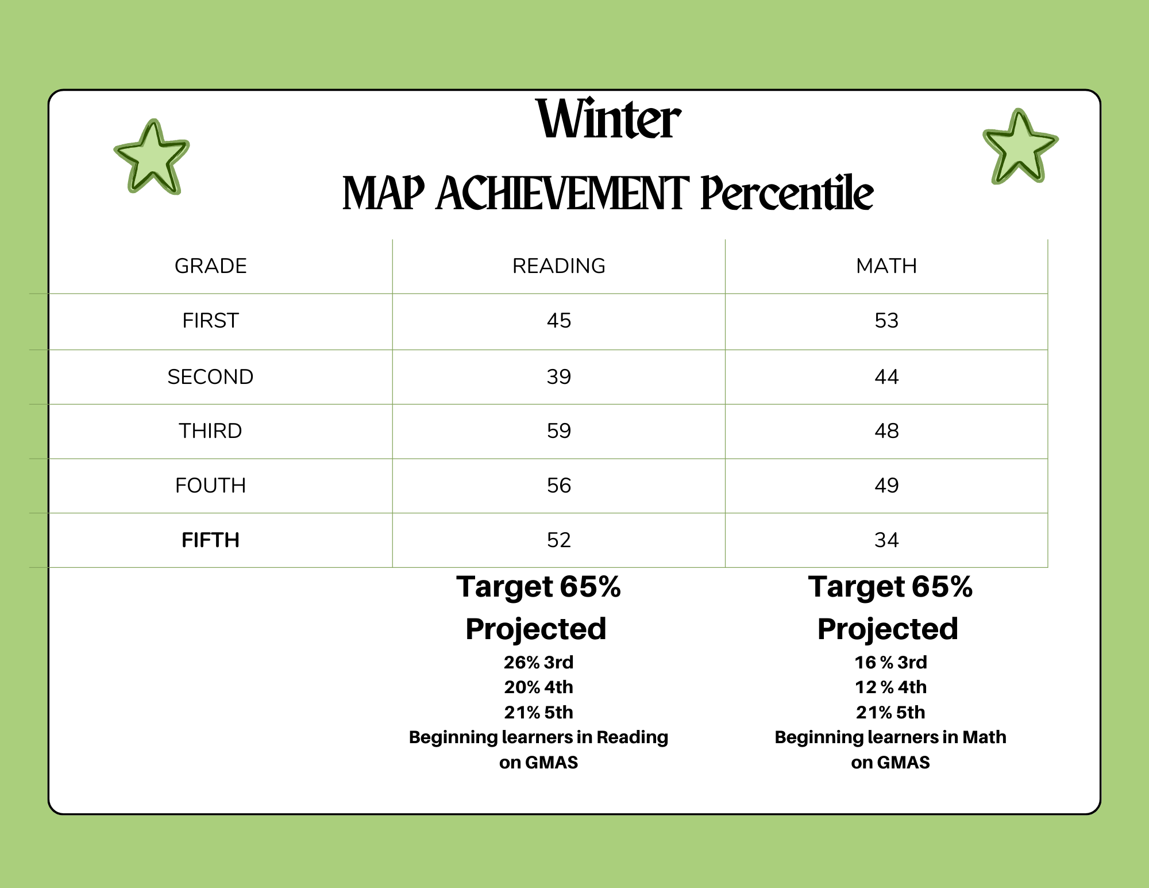
Achievement Data

Slide 6




2025 Parent Satisfaction Survey Results
Received Information about Academic Requirements
School Offers Parent Workshops
Preferred Method of Communication
Additional Support Needed to Assist my Student
Class Dojo – 75.00%
Email – 1.92%
Text Message – 14.42%
Help with Homework – 26.67%
Math – 42.22%
Reading Skill – 54.44%
All of the Time – 88.46%
Most of the Time –9.62%
All of the Time: 80.77%
Most of the Time – 12.50%
Some of the Time – 5.77%

Slide 7

The Connection
Family Engagement Plan
Events | Event Type | Date
Meet & Greet | WC | 7/31/2024
Open House | A | 8/24/2024
Grandparent Day/Title I Meeting | A | 9/6/2024
Bingo for Books | A | 9/19/2024
Parent & Students Reading Together | A | 9/3-25/2024
Parent & Teacher Conference | MP | 10/14/2024
Lunch and Learn | A | 11/7/2024
Merry Moments | WC | 12/6/2024
100 Day of School | A | 1/17/2025
Read with Someone You Love | A | 2/14/2025
Were you able to attend any of these family engagement events this year?
If so, in what ways can we improve the event(s)?
What other academic-based or family-fun type activities would you like us to consider offering?

Slide 8
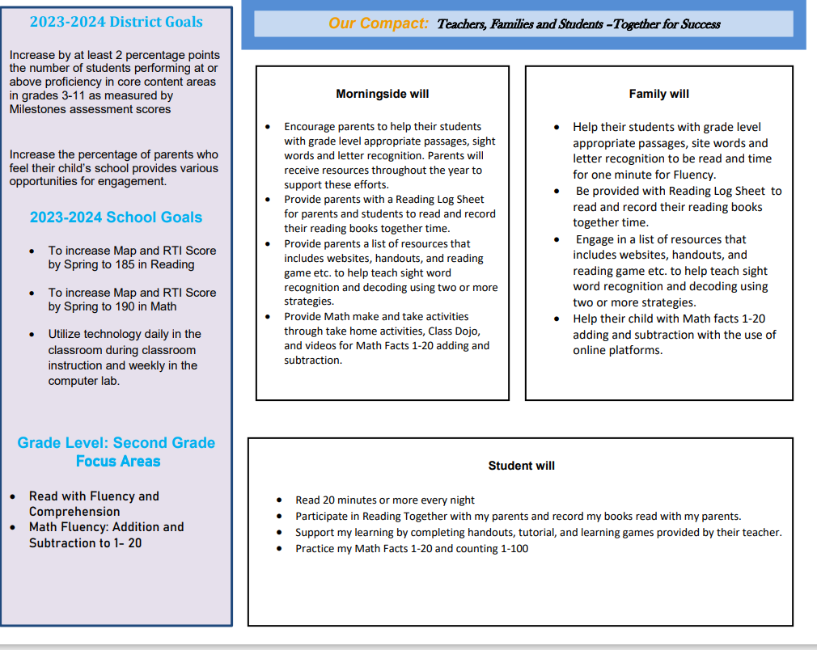
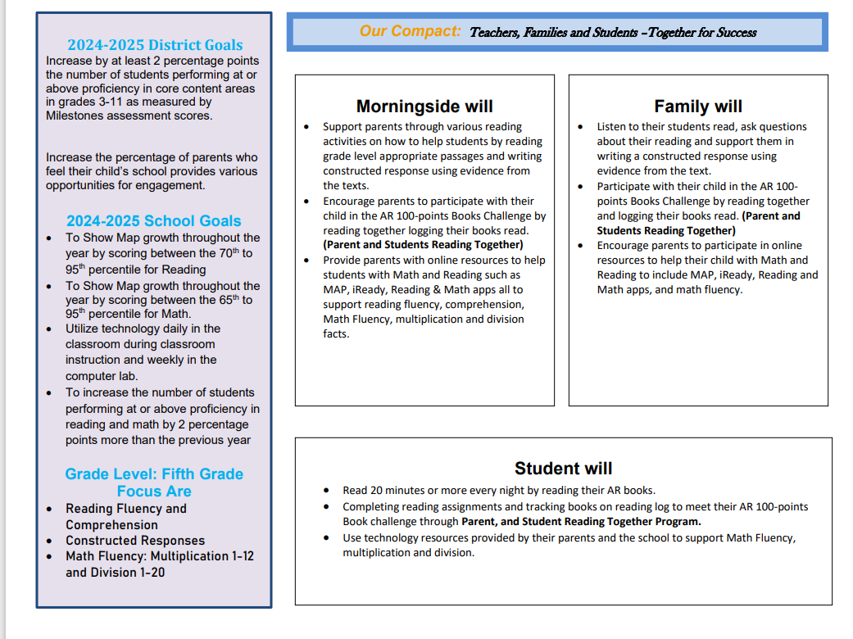

The Connection
School-Parent Compact
In what subject area or concept does your child have the most difficulty?
What can the school do to better support you and your child in that area?
What are some things you and your child would be willing to do in order to see improvement in that area?

Slide 9



Program Supports
How can we increase family engagement and participation?
Are you interested in joining our Parent Action Team or working with school staff on Professional Development?

Slide 10

Parent Input Form
Please complete the short Feedback Questionnaire. Your input is extremely important in helping us to improve our parent program.

Slide 11

FEL Contact Information
LaWanda Mason
lawanda.mason@hcbe.net
478-210-7857

