Slide 1
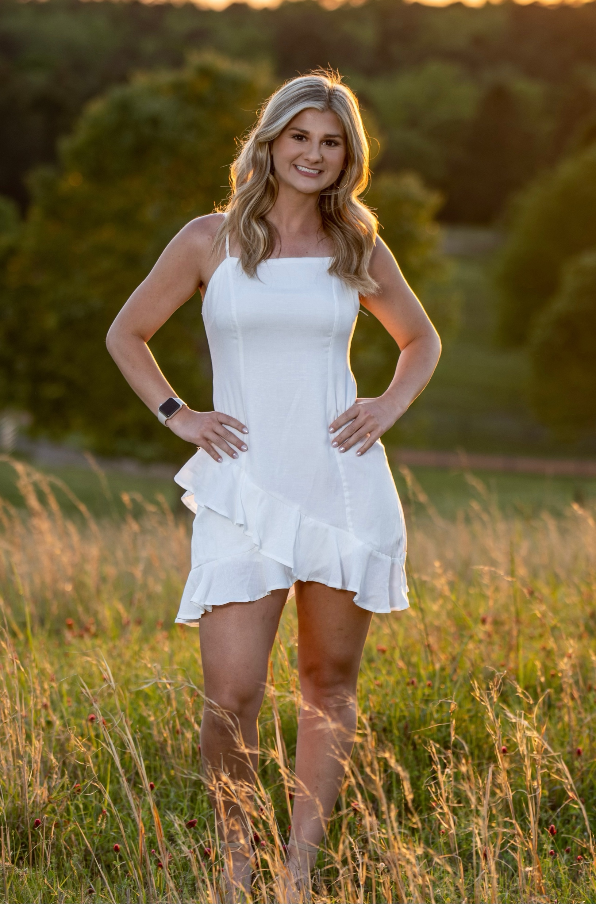
Welcome to third grade! My name is Mrs. Herring and I am so excited to be at Holtville Elementary.
I graduated from Auburn University at Montgomery with a degree in Elementary Education. I am the head volleyball coach and assistant softball coach at Holtville High School. I love to be outdoors, read, and I love iced coffee.
Drink: Alani/Coffee
Food: Pizza
Color: Blue/Pink
Candy: Sour gummy worms
Store: TJ MAXX
Movie: Frozen II
loryn.herring@elmoreco.com

