Slide 1
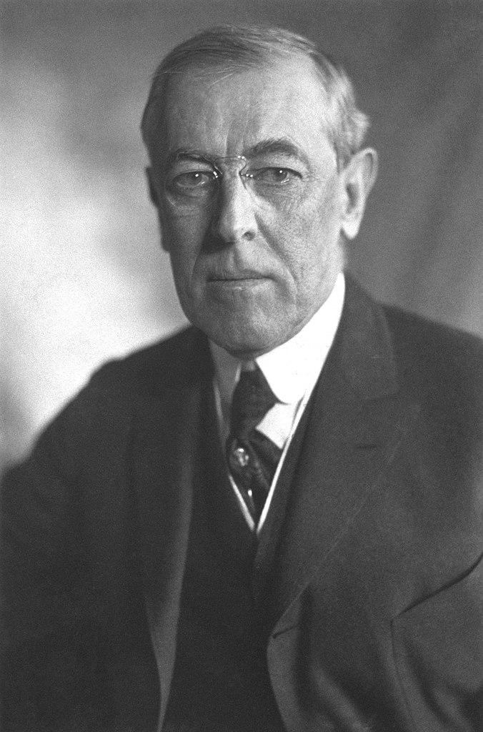
Women’s Suffrage, Woodrow Wilson & World War I

Slide 2
Women’s Suffrage 1848-1920
Seneca Falls Convention in 1848 was the first women’s right convention in the U.S.
In the 1870s women began attempting to vote illegally and then challenged their charges with lawsuits
The women’s suffrage movement tied their movement to support US entering World War I and making voting patriotic, this won the support of President Woodrow Wilson
Congress ratified the 19th Amendment giving women the right to vote in 1920
Notes:
Women’s Suffrage means women’s right to vote. Women fought for the right to vote beginning in 1848 at Seneca Falls in New York.

Slide 3
19th Amendment
The right of citizens of the United States to vote shall not be denied or abridged by the United States or by any State on account of sex.
Congress shall have power to enforce this article by appropriate legislation.

Slide 4
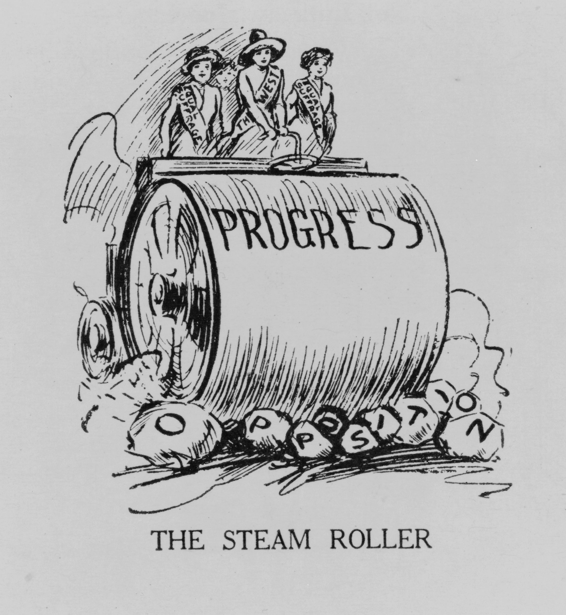
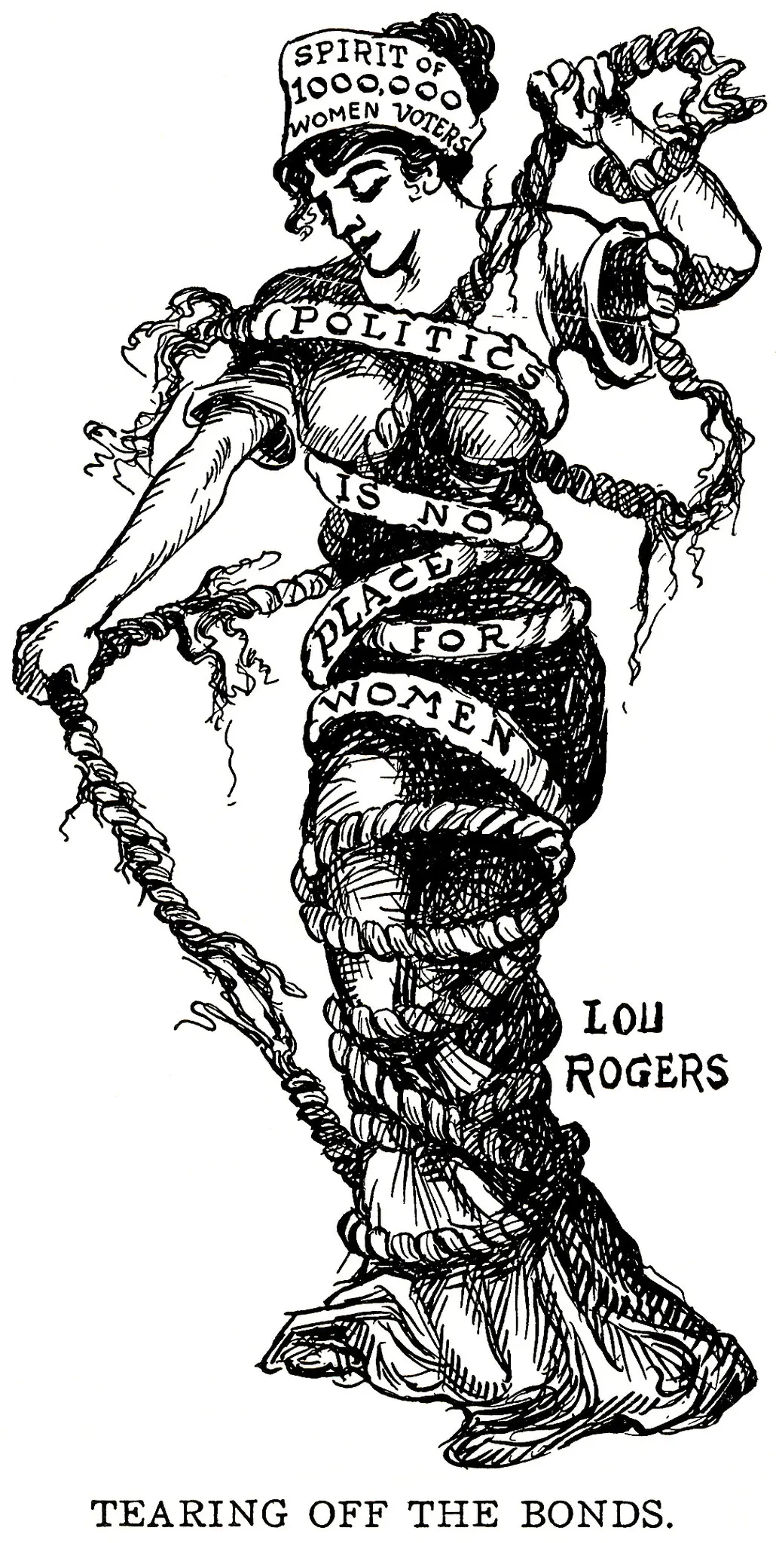

Slide 5
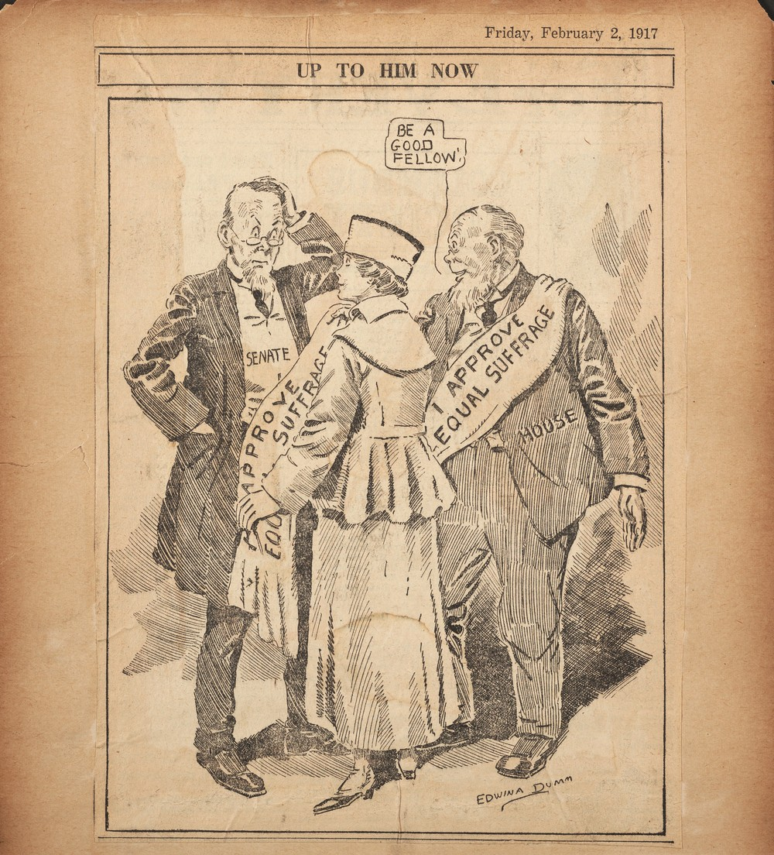
Political Cartoons

Slide 6
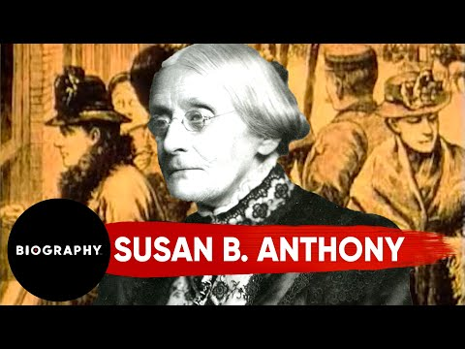
Susan B. Anthony

Slide 7
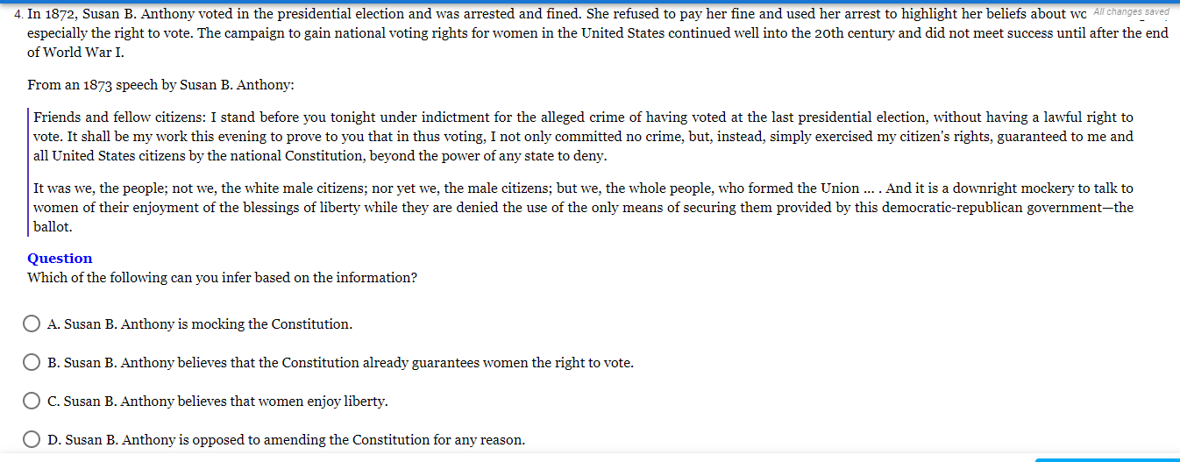
Notes:
Answer: B

Slide 8
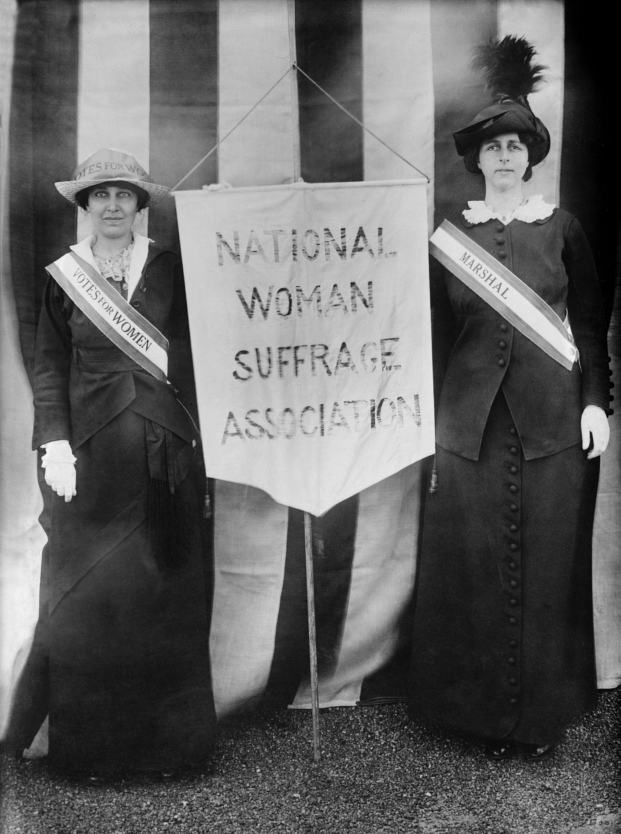
Notes:
Answer: C

Slide 9
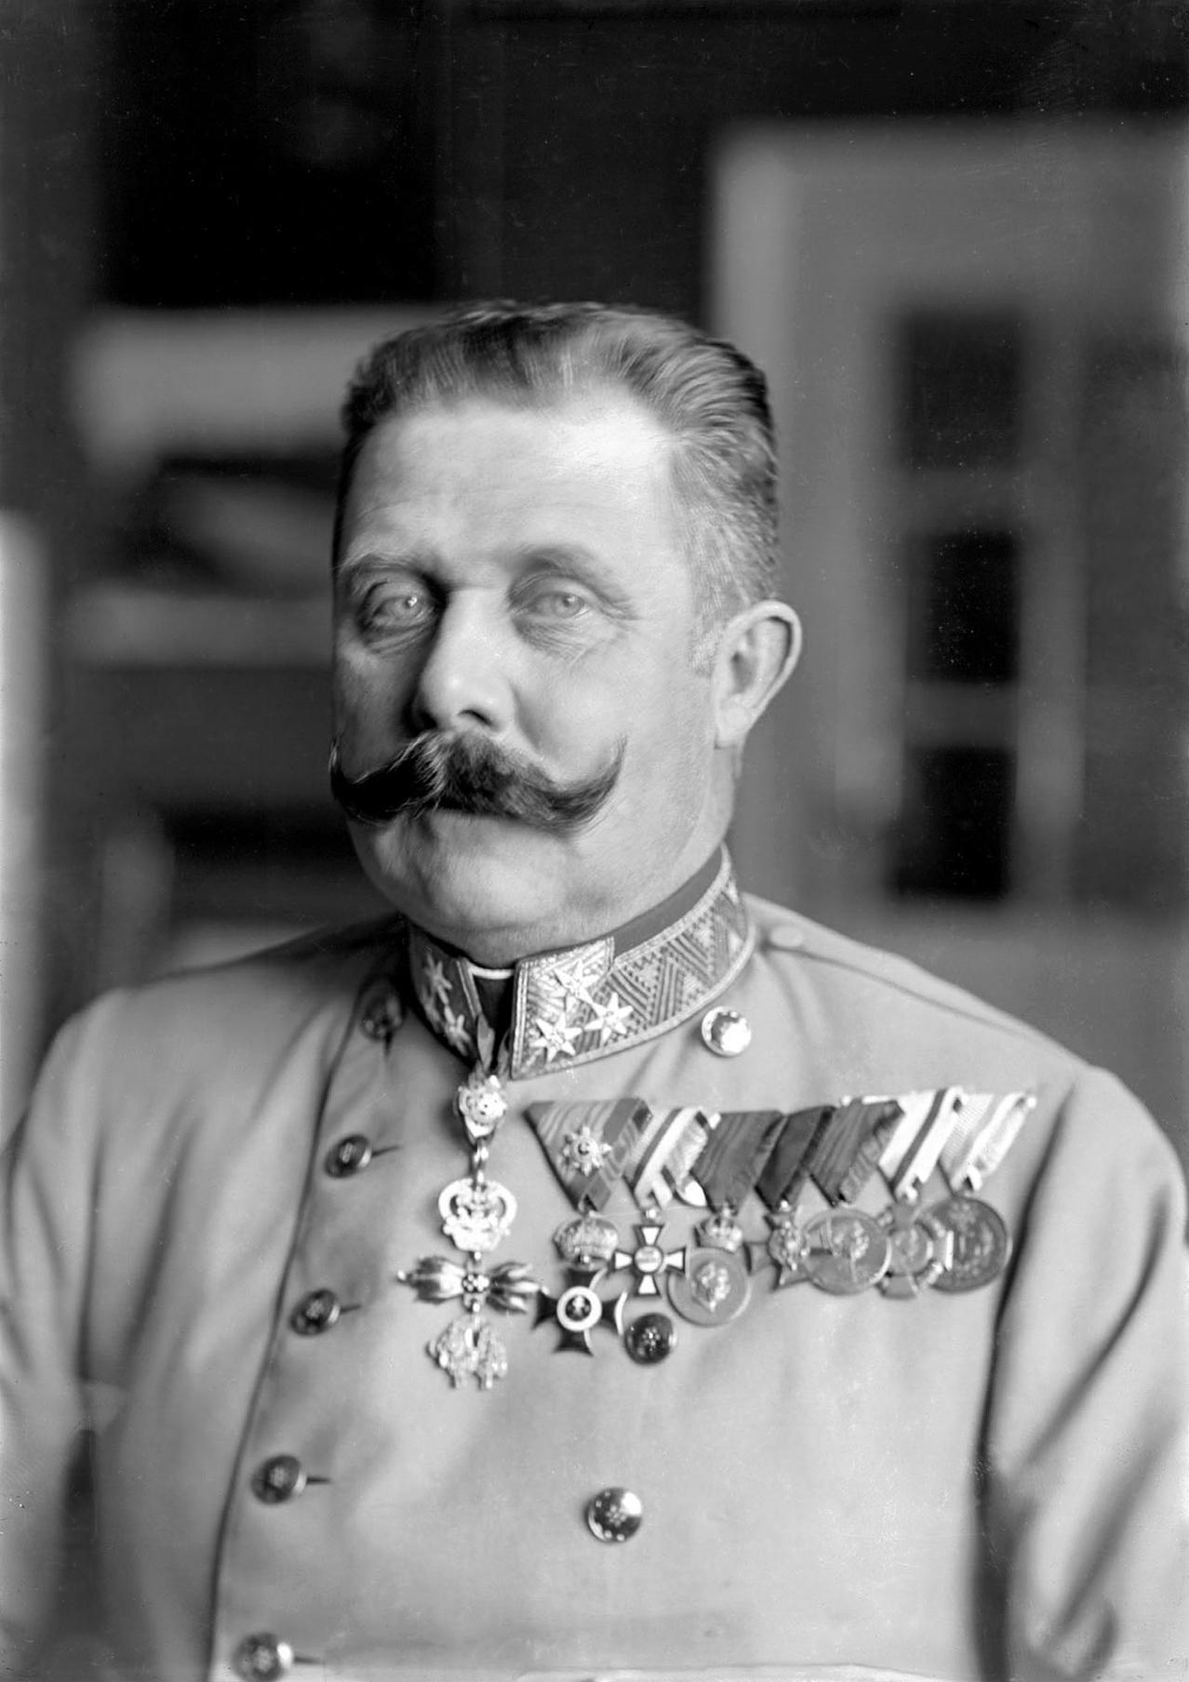
World War 1
Archduke Francis Ferdinand the heir to the Austria-Hungarian throne was assassinated in Bosnia
Germany blamed Serbia for the assassination

Slide 10
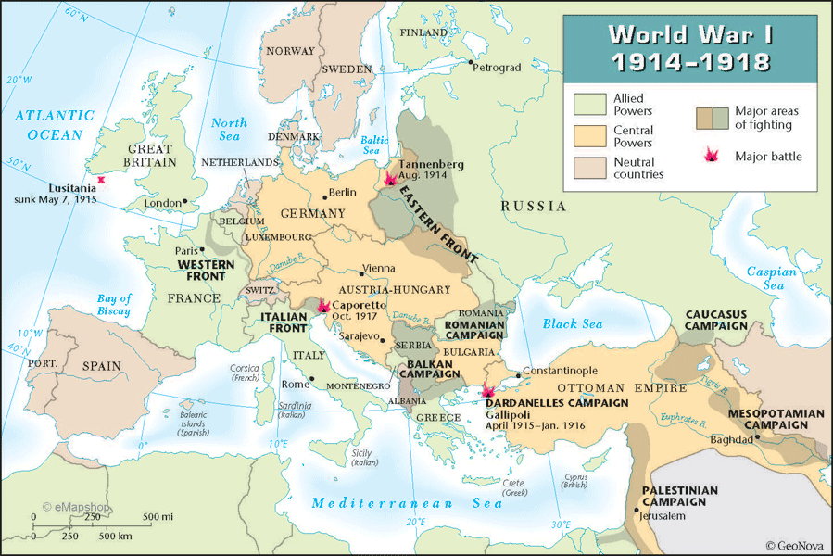
Notes:
Europe looked very different at the beginning of World War I than it does now. The Ottoman Empire included what’s now modern day Turkey and Palestine/Israel. Austria and Hungary were one as “Austria-Hungary”

Slide 11
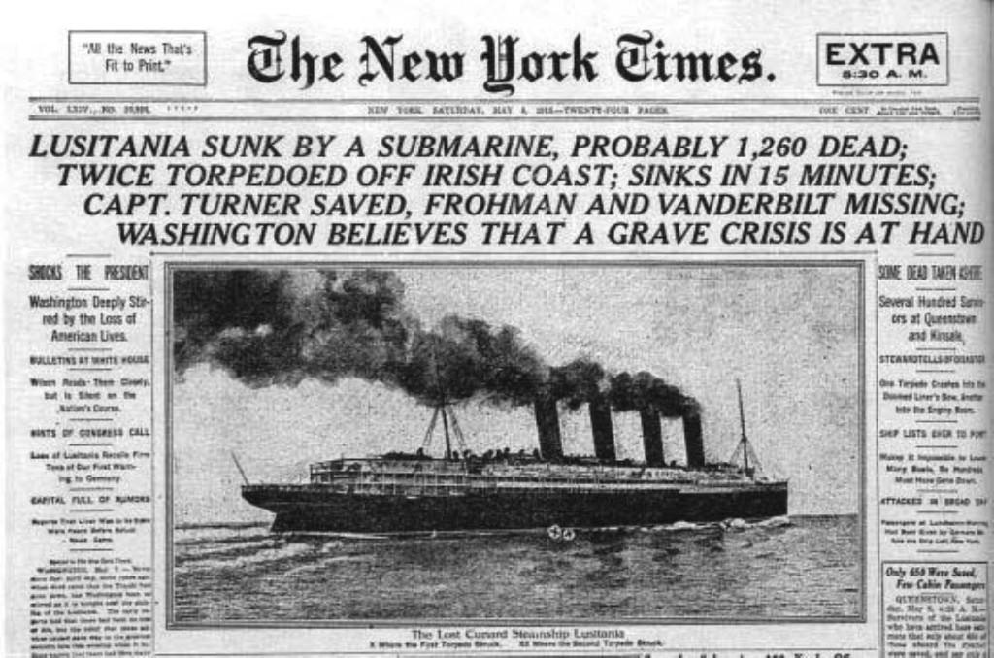
WORLD WAR I
1914-1918
Allies: Americans, British, & French
VS
Central Powers: Ottoman Empire, Germany, Austrian-Hungarian Empire

Slide 12
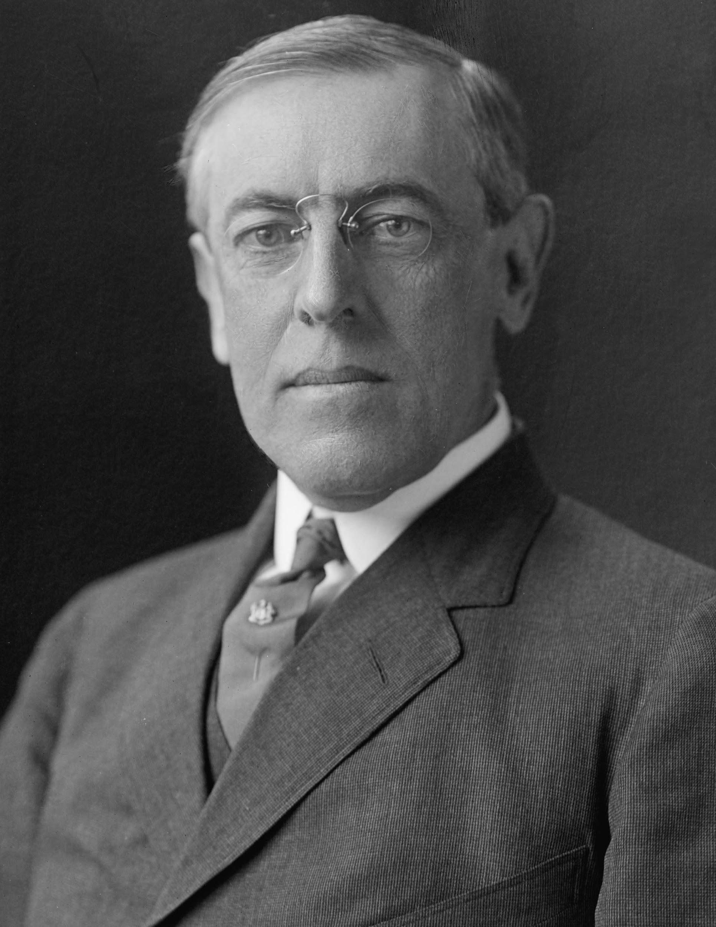
President Woodrow Wilson
First term focused on:
Improving conditions for workers
Curbed monopolies by creating Federal Trade Commission
Sought to use the government to regulate the economy
Missteps on Civil Rights:
Worked with Southern Democrats to segregate federal government
Ordered private screening of KKK propaganda film “Birth of a Nation”

Slide 13
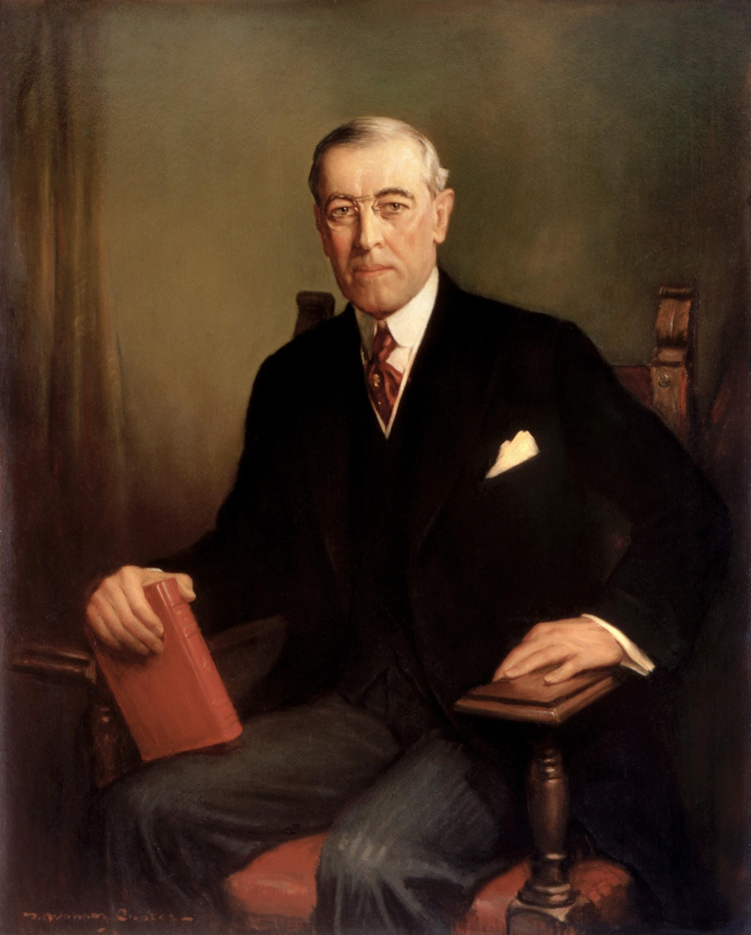
Woodrow Wilson and WWI
President Wilson did not want to go to war
German sinking of the Lusitania helped American public want to enter the war
The Zimmerman Telegram-Germany tried to win Mexico to join them to retake former Mexican territory in US
Mexico didn’t take the telegram seriously, but it made the American public angry

Slide 14
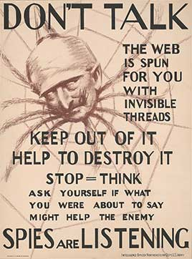
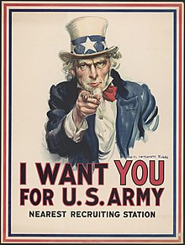
Committee on Public Information launched propaganda campaigns to link support for US involvement in World War I with patriotism
Propaganda-used to promote or publicize a particular political cause or point of view

Slide 15
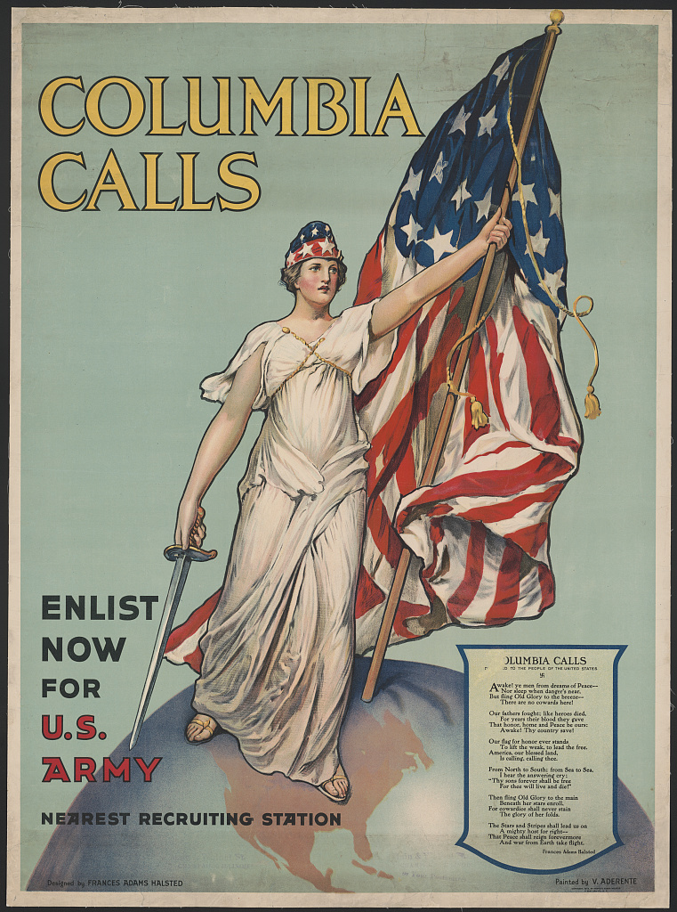
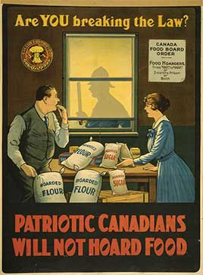

Slide 16
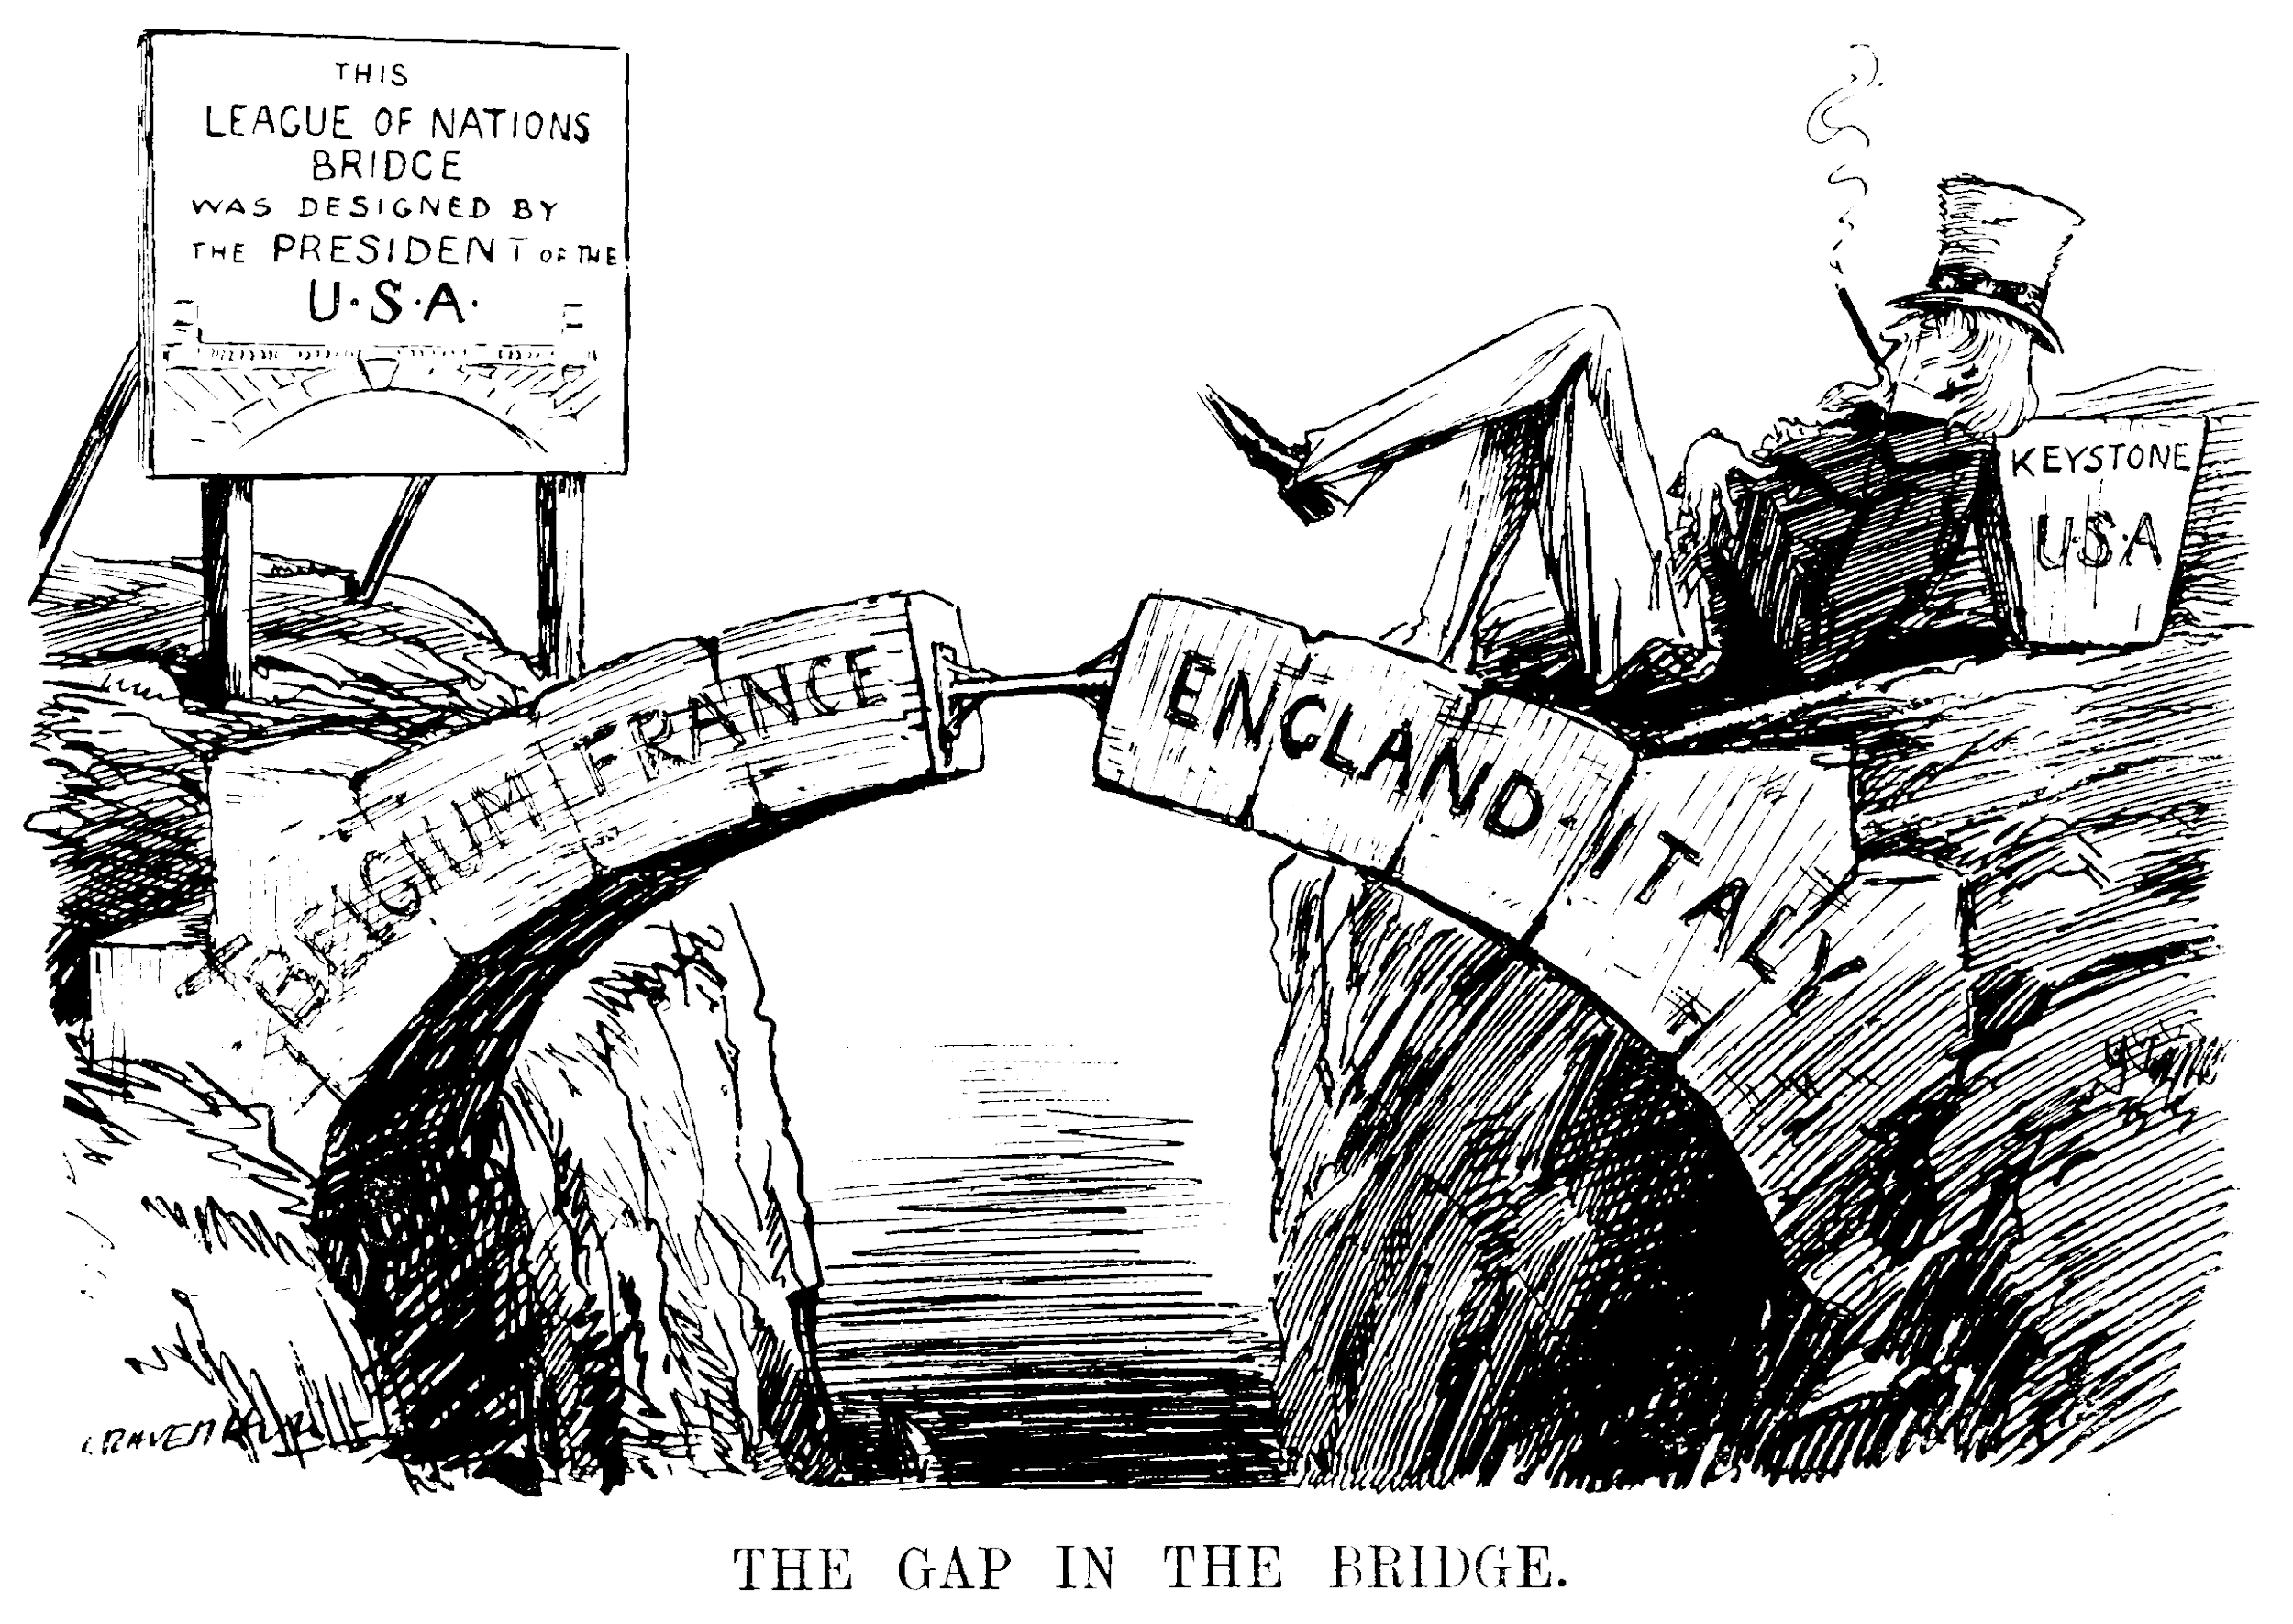
Woodrow Wilson’s 14 Points
Free trade through the Atlantic
National self determination -dismantling empires and creating new states
General association of nations-a League of Nations to prevent another World War

Slide 17
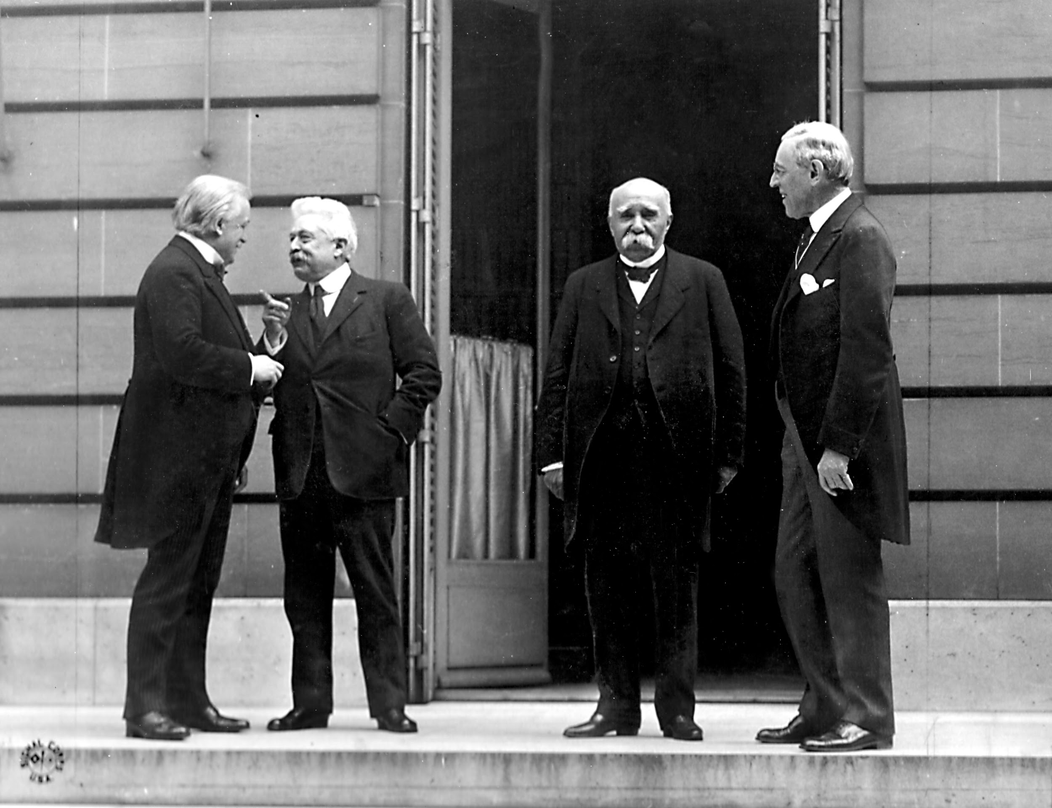
Treaty of Versailles
Blamed Germany for World War I
Forced Germany to pay reparations in $400 billion
Limited Germany’s army to 100,000
Germany couldn’t have submarines or equipment
Germany lost their colonies in Pacific, China, and Africa
Set up League of Nations
New independent countries: Finland, Austria, Czechoslovakia, Yugoslavia, Poland, Hungary, Latvia, Lithuania and Estonia.

Slide 18
Notes:
Answer: D

Slide 19
Notes:
Answer: A

Slide 20
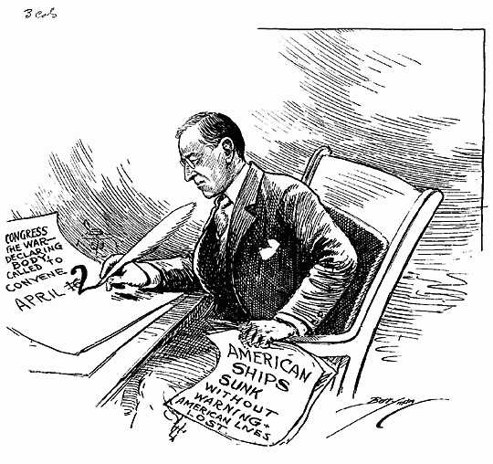

Slide 21
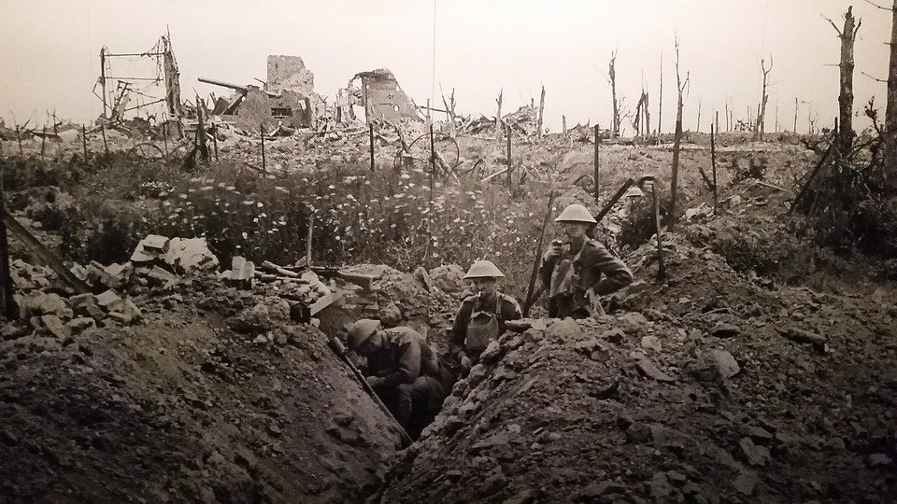
Extra Material

Slide 22
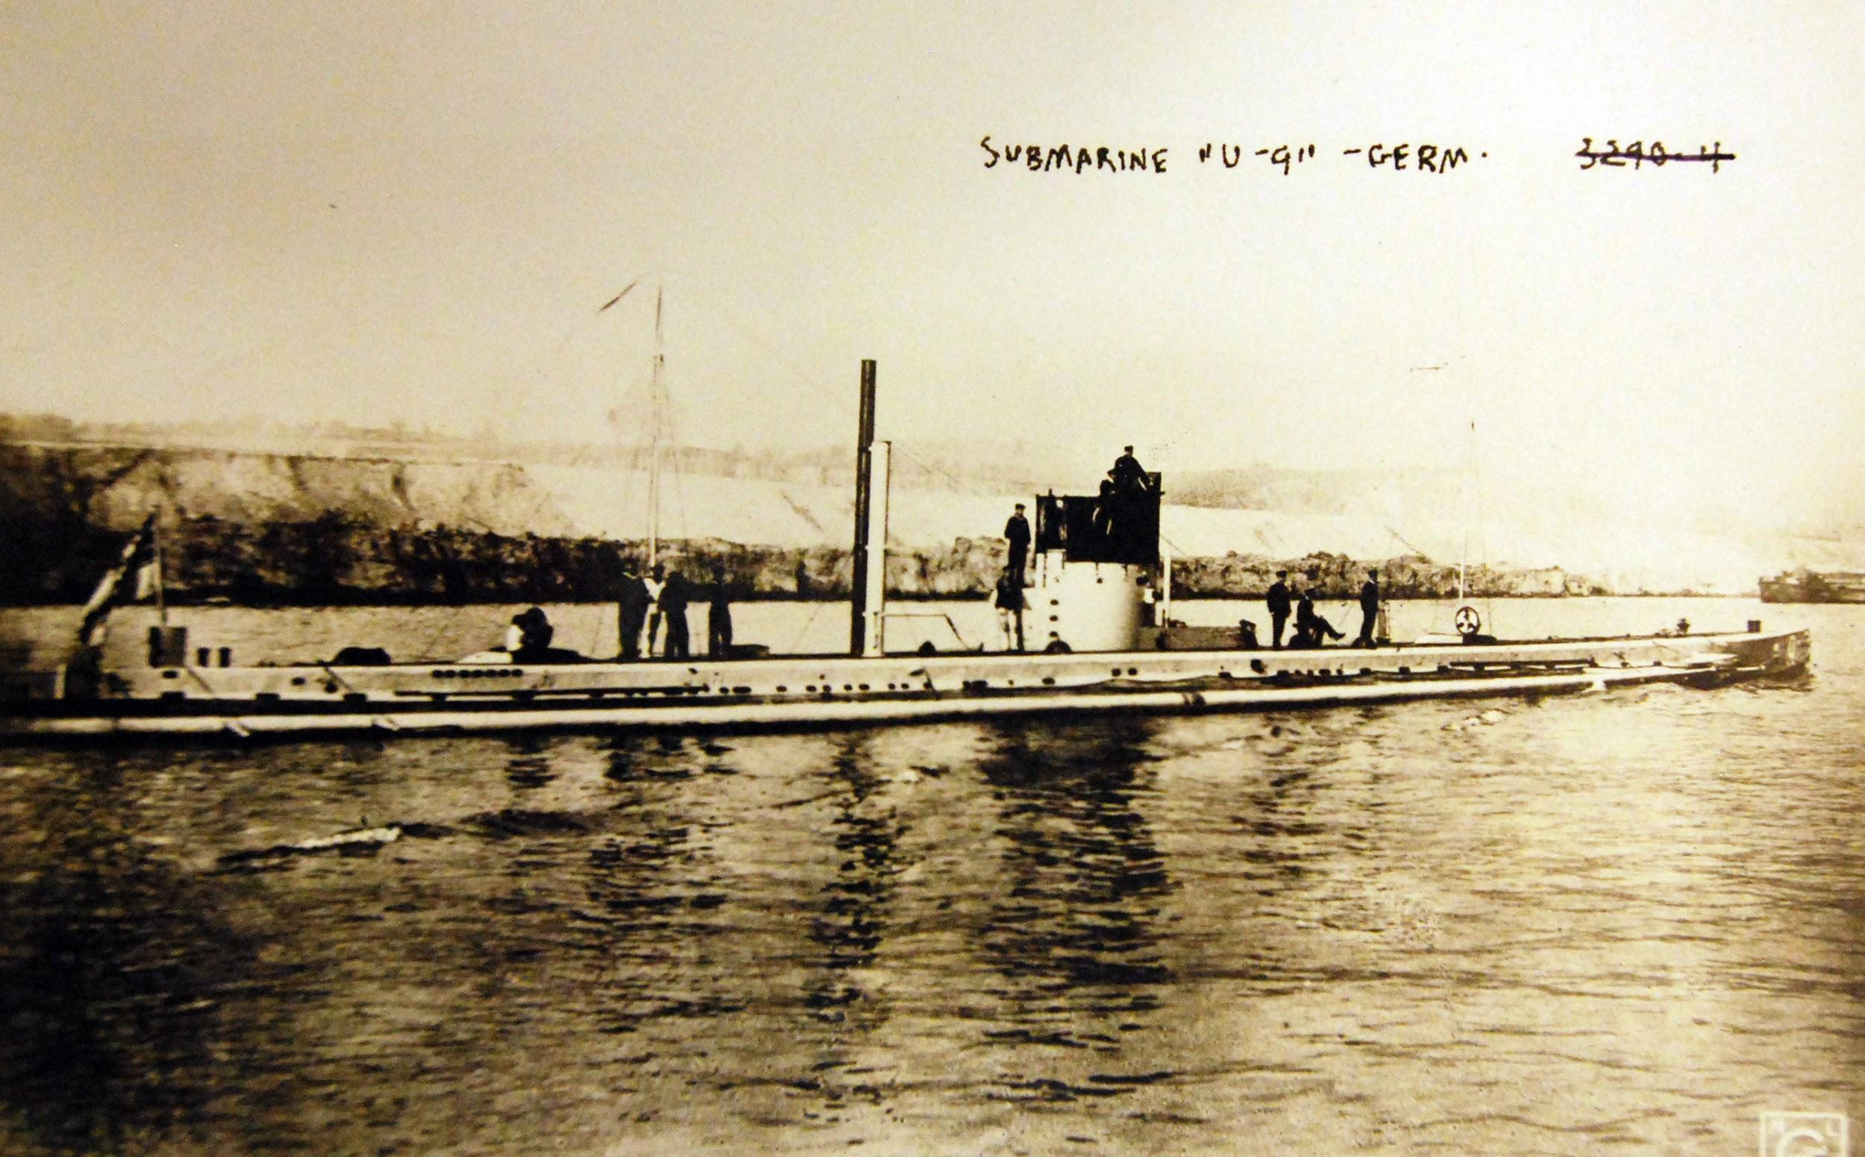
Germany invaded Belgium to try to conquer France in 1914
Belgium had an alliance with Great Britain
Germany thought it would conquer France and war would be over quickly
Germany uses submarines to sink ships in Atlantic including American passengers aboard the Lusitania
British ships and German ships battle & end in stalemate in Jutland-Germany never recovered
Notes:
The British government had a treaty with Belgium that Belgium would be neutral. So when Germany invaded Belgium it was a violation of their neutrality. Can anyone tell me what a treaty is? Germany had a bunch of submarines called U boats in the Atlantic that they used to engage in “unrestricted warfare”. In 1916 German U boats sank 2 million tons of Allied shipping. 128 Americans were killed on the Lusitania, but after the Battle of Jutland a lot of Germany’s fleet was damaged and they never recovered.

Slide 23
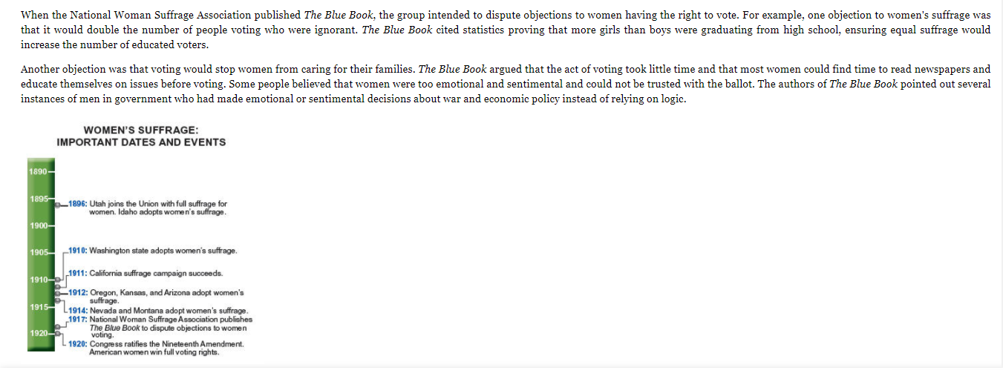
Notes:
Answer: B

Slide 24
Notes:
Answer: D

Slide 25
Notes:
Answer: B

Slide 26
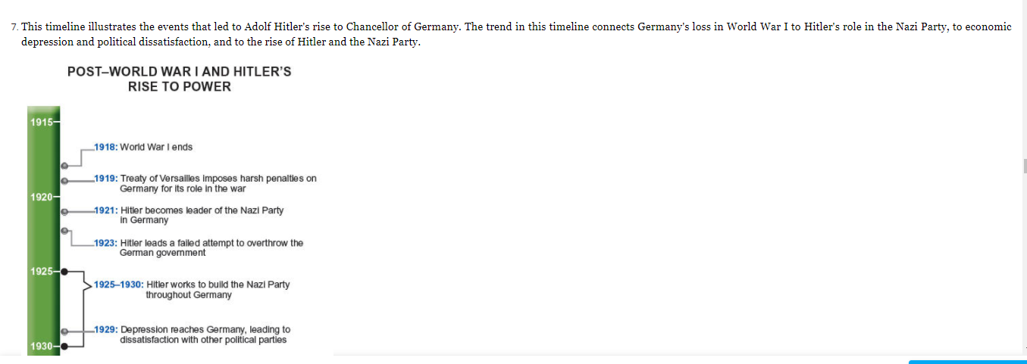
Notes:
Answer: A

Slide 27
Notes:
Answer: C

