Slide 1
Welcome to
Curriculum Night!
Welcome to
Curriculum Night!

Slide 2
Grading Policies
Reading and Language Arts will be explained on the following slides.
Math:
Major Grades: Topic test
Minor Grades: Weekly skill sheet
Science and Social Studies:
S (satisfactory), N (needs improvement), U (unsatisfactory)
Autauga County Retention Policy: Regular education students in grades one (1) through (3) will be retained if they do not pass Reading, Language Arts and Mathematics in a given school year. A yearly numerical average of 60% or above constitutes a passing grade.

Slide 3
Open Court Reading
There are three “bands” of Open Court that are taught daily.
Foundational Skills Phonics Phonemic Awareness | Reading & Responding Comprehension Vocabulary | Language Arts Spelling Grammar Writing

Slide 4
Reading Grades
Major-Unit Test (3 each nine weeks)
Minor- Lesson Test
(These assess Lesson’s Phonics skills and High-Frequency Words)
Unit 2-Read the words begins
(Individual Assessment)

Slide 5
Language Arts Grades
Dictation Assessment- Sounds: Your child earns one point for every sound spelled correctly. Skill Words: Your child earns one point for every sound spelled correctly, and one point for spelling the entire word correctly. Red “Sight” Words: Your child earns one point for every red word spelled correctly. Sentence: Your child earns points for capitalization, organization, punctuation, and spelling. Spelling: Traditional Spelling Test beginning at a later date.

Slide 6
Spelling/Handwriting Grading Procedures
1 point deduction for all letter reversals.
1 point will be deducted for each letter that is capitalized unless it is a proper noun.
Each spelling test will consist of a Spelling grade (0-100) and a Handwriting grade (S, N, U).
Handwriting will be assessed for correct letter formation and use of handwriting lines.

Slide 7
Correspondence
Daily Binder:
Please initial your child’s daily behavior square.
All correspondence will be sent home in the Home Folder in your child’s Take-Home Binder. My weekly newsletter will be sent home every Monday. You will find curriculum information, important dates and information, and homework assignments. Reading Homework is also placed in the Take Home Binder. Please complete only the highlighted information. Do not work ahead.
Please send all money in a labeled envelope. Field trip forms, notes, etc. should also be placed in your child’s zippered pouch inside the binder. I suggest giving them a “heads up” when placing something in their binder. It helps them remember to place it on my table in the mornings.
Tuesday Folder:
Graded papers are placed in the folder every Tuesday.
Please sign by the date received & return all graded papers.

Slide 8
Technology
My Path-
Students can engage in learning activities that target skills in both Math & Reading.
Powerschool-
Grades are entered weekly.
You may check your child’s grades and average in each subject.

Slide 9
Accelerated Reader
Students will check out books from the library on their reading level.
Once they have read the book thoroughly, they may take a quiz on the computer at school. I recommend reading the book at least 3 times because some of the questions ask specific details.
Students may read the book with their parents or independently.
Each nine weeks the students will have a goal.
If your child meets their goal, they will be rewarded.

Slide 10
Attendance
Prattville Primary expects families to ensure their children are in school and on time every day, all day. This is an important life skill! Missed instruction can affect your child’s overall success in first grade.
If your child is absent, please send in a written excuse or doctor’s excuse within three days.
Check outs may not occur after 2:30. All parents must present identification when entering the school building.

Slide 11
Snack and Lunch
The snack cart visits classrooms daily from 7:45am-8:05am. Each item is 75 cents. We sell water, juice, chips, goldfish and fruit snacks.
On some Fridays, we will sell a special snack for $1. Please look for the given schedule to know what is offered.
Birthday celebrations- Please let me know in advance if you plan on providing a special snack for your child’s birthday. It helps me plan the day. Parents may only send in one special treat per child. The treats should be store bought or individually wrapped. Parents are asked to send the treats with the student. No presents, balloons, etc. will be allowed. Parents are not allowed to join us for the birthday snack.
Lunch: Please discuss with your child whether they are getting lunch at school or one is provided from home.
We are planning for parents to have the opportunity to eat lunch with their children at PPS. Our class has been assigned specific dates for inviting parents to lunch. Parents will not be allowed to come sporadically. We will have to adhere to the schedule. More information to come!

Slide 12
Leader in Me
PPS is committed to developing and cultivating student leaders. We will focus on teaching the 7 Habits throughout the year.
Habit 1 Be Proactive
Habit 2 Begin with the End in Mind
Habit 3 Put First Things, First
Habit 4 Think Win-Win
Habit 5 Seek First to Understand, Then to be Understood
Habit 6 Synergize
Habit 7 Sharpen the Saw
Students may earn a Positive Office Referral for living out the Leader in Me lifestyle!

Slide 13
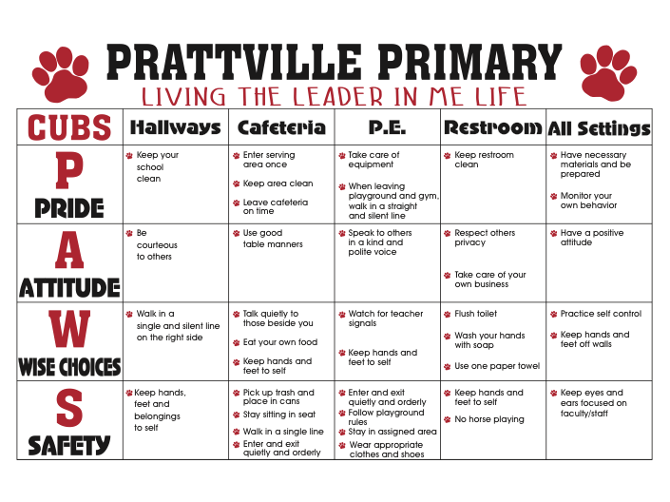
School Wide Expectations

Slide 14
Important Resources
Mrs. Coker- School Nurse
Please contact her at Jeannie.coker@acboe.net for any health concerns.
Mrs. Hardy- School Guidance Counselor
Mrs. Hardy focuses on services that address academic, career, and social/emotional development.
Children may face difficulties, which can prevent them from doing their best in school. These difficulties can include school adjustment issues, family change, fears, grief, or difficulties with friendships. Having support through tough times can be essential to a child’s educational success. Please contact Mrs. Hardy at veronica.hardy@acboe.net for assistance.
Coming Soon-Reading Specialist
Mrs. Schooley- Parent Resource Center
If your child is struggling, we have many learning resources in our Parent Resource Center. You may check them out to use at home. Please contact me or use the link on our website if you would like to utilize this resource. Mrs. Schooley is happy to help us!

Slide 15
THANK YOU for coming!

