Slide 1
EMAIL:
PHONE:
ROOM:
dyunker@mcpss.com
251-2211040
319
Deutsch
Get in touch !
I respond to Schoology messages the quickest!
Frau Yunker
Bring to class every day:
Chromebook
pencil or pen
lined paper
open ears, open mind
CURRICULUM & SUPPLEMENTS
MOSAIK 1 and VHL supersite
Flangoo (online readers)
Gimkit / QUIZLET for vocabulary study
Duolingo
Podcasts /Music/Cultural Lessons from Goethe institute
ZDF (German broascasting system) TiVi show // Peppa Pig // Bluey
EdPuzzle
GRADING
A different language is a different vision
of life.
Interpretive Reading
Interpretive Listening
Presentational Writing
Presentational Speaking
Formative Assessments
Most of your grade (60%) will be based on your performance summative assessments: reading, writing, speaking, and listening.
The remainder of your grade (40%) will be based on formative assessments, which include all of the activities we do in class and at home. Most of these activities will be graded for completion or effort.
- FEDERICO FELLINI
O u r
A T
A
g l a
N
c e
Y e a r
1st semester | 2nd semester
MOSAIK 2, Kapitel units 1-4 + Supplementary Units | MOSAIK 1, Kapitel units 5-8 + Supplementary Units

Slide 2
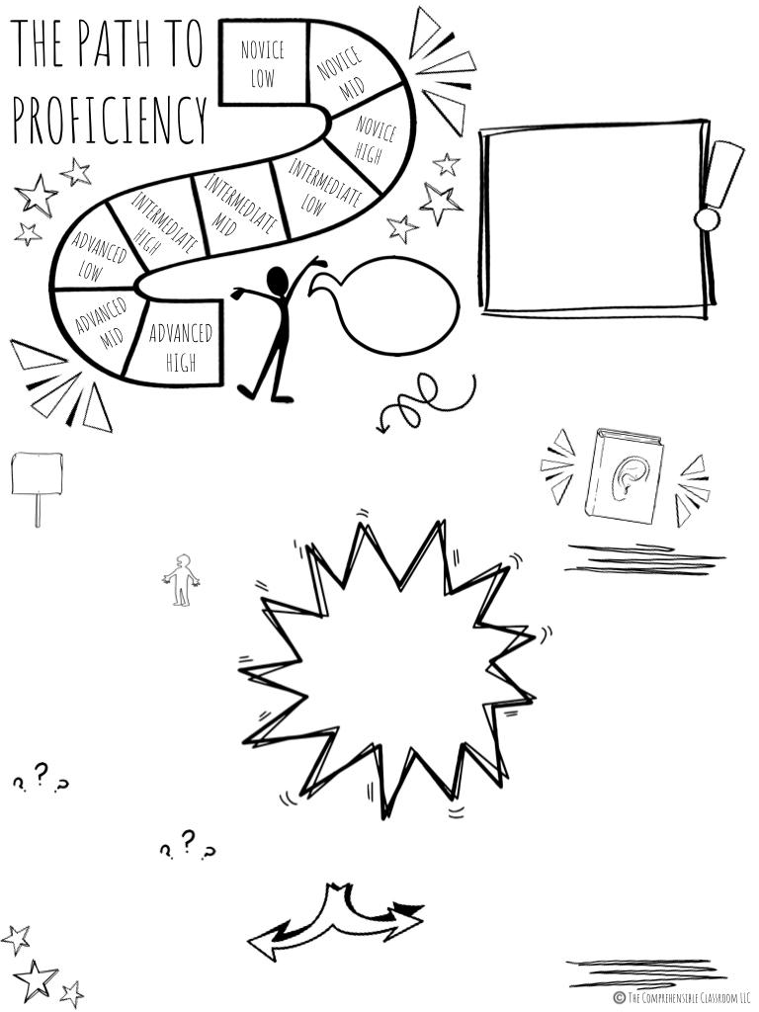
As you acquire language, you become more PROFICIENT. You are able to accomplish more and more tasks, communicate about more topics, and make yourself better understood.
We become more proficient in any language through communication: interpreting, expressing, and negotiating the meaning of messages in the language that we are learning.
Ich spreche deutsch!
In particular, LISTENING and READING to language that you can make sense of will help you to make the biggest gains on the Path to Proficiency, and so that is what instruction in this course is geared toward.
EXPECTATIONS
Stick with it.
STUDENT + TEACHER
Take care of our self, each other, and our surroundings.
Even after several
years of language classes, most learners are only in the Intermediate range of proficiency.
ACTIVITIES
STUDENT
Show up to class
with materials
willing to participate.
listen to songs
create stories
discuss our lives
watch short films
read current events
play games
listen to stories
explore German-speaking cultures
Show up to class
with a plan
willing to adapt.
TEACHER
Ask questions when you don't understand.
STUDENT
Ask questions to see whether students understand & adjust teaching as needed!
HOMEWORK & MAKE UP WORK
TEACHER
Check the daily folder
in Schoology
when you are
absent and be sure
to make up any assignments that were submitted that day!
We are going to work hard in class every day. You can expect minimal homework but you MUST study your vocab daily.
…alles auf Deutsch!

Slide 3
POLICIES & PROCEDURES
ABSENCE POLICY
SEATING POLICY
If you are absent, check the Schoology folder on your first day back to see what work needs to be made up. Make-up work must be completed within 5 days of your return from school. After 5 days, you will receive a 0 and will not be allowed to make up the assignment(s). All assessments must be made up in the classroom.
You will be assigned a new assigned seat periodically. Your table mates are your study buddies. If you are absent, ask them what you missed and/or what assignments were completed in Schoology. Speak German to one another in class and check each other’s work when appropriate. You are a team, and your goal is to help each other meet the class standards! Work together to ensure that everyone is successful.
TARDY POLICY
TRANSITIONS
You are considered tardy to class if you are not in your assigned seat with your phone put away when the bell rings. If you are in the classroom but you are not in your assigned seat and/or your phone is visible, you will be considered tardy. After 3 tardies to class, your guardian will be contacted and you will be referred for disciplinary action. For each tardy after that, you will receive an additional guardian contact and discipline referral.
Throughout the semester, I will use several call-and-response exchanges to get your attention. I will say something, the whole class will say something in response, and then everyone will be quiet with their eyes on me, ready for my instructions. For example, if I say, “Wo seid ihr?”, you will respond “Wir sind hier” and then become silent to listen for instructions. We will practice this procedure at the beginning of the semester.
ENTERING CLASS
LANGUAGE USE
These things should all be done before the bell rings:
Put your phone on silent and away.
Take out your Chromebook.
Borrow a pencil and paper, if needed.
Sit in your assigned seat.
You are expected to demonstrate maturity by doing these things independently without being asked by Frau Yunker.
Since this class is all about acquiring German, we will use German in the classroom the majority of the time. If Frau Yunker asks a question in German, you are expected to answer in Geramn. If Frau Yunkerasks a question in English, you may answer in German or English. If you MUST say something in English, you must first ask, “Auf Englisch, bitte” Excessive use of English in class and/or refusal to participate will negatively affect your grade.
LEAVING CLASS
COURSEWORK
These things should all be done before leaving class:
Return borrowed materials.
Clear your table and the floor around it.
Put your chair back and line up before dismissal
You should complete all of the assignments for the day before leaving class. If you do not finish in class, you will complete these as homework. You must use a school-issued device for all coursework in this class. No personal laptops or iPads are allowed.

