Slide 1
Department of Instruction
Budget Presentation
2025-2026
January 15, 2025

Slide 2
New Milford Public Schools Mission Statement and Ideas We Live By
The mission of the New Milford Public Schools, a collaborative partnership of students, educators, family and community, is to prepare each and every student:
To compete and excel in an ever-changing world;
To embrace challenges with vigor;
To respect and appreciate the worth of every human being,
and contribute to society by providing effective instruction and dynamic curriculum, offering a wide range of valuable experiences, and inspiring students to pursue their dreams and aspirations.

Slide 3
Mission of the Department of Instruction
The Department of Instruction provides coherency and consistency of learning systems to support leaders and teachers in building knowledge. (FOCUS)
Our goal is to create a risk free environment for educators so that they feel empowered to engage as collaborative partners in learning, supporting our colleagues in understanding the why behind our curricular and instructional decision making and the impact on student learning. (CREATIVITY)
As a department we create a partnership with leaders and stakeholders to ensure that New Milford Public School’s instructional core stays at the forefront, threading adult and student learning theory into practice in order to heighten both staff and student engagement within the New Milford Ideas We Live By and Instructional Keystones.(HEART)
We work with all departments to be proactive in building shared ownership of appropriate and fair learning experiences for all students. We don’t wait until students or teachers fail – we equip all with the necessary tools to prevent failure and support success. (COLLABORATION)
This ensures that we as the educator community can focus on what matters most—advocating for every child’s success and fostering a high-quality education.

Slide 4
Roles and Responsibilities
Office of the Assistant Superintendent
Secretary 1.0
Assistant Superintendent Instructional
Assistant Superintendent
Operational
Curriculum Development Coherence K-12
Science of Reading K-3 Onboarding
Assessment Alignment
Data Collection
Regular Education and Special Education Curriculum Alignment
K-5 Report Card Development
Credit Accumulation Programming
Instructional Round and Lab Classroom Model
Multi-Tiered Systems of Support - Intervention
Residency
Title IX
Title I
Title II
Title IV
Professional Learning
Educator Evaluation
Adult Education
State Dept of Ed District Test Coordinator
McKinney-Vento
Teacher Induction and Support
504
Multilingual Learners
Community Partnerships
Policy Implementation

Slide 5
Supporting Teaching and Learning
Curriculum
Science of Reading - Focus on Comprehension, Fluency, and Vocabulary
iReady Classroom Mathematics - Year Two Implementation and Delivery Student Center Learning
Science of Reading Year Two - Continued Redesign and Pacing
Alignment of 6-8 Mathematics Curriculum
Middle School Math Acceleration
High School Pathways Curriculum
K-5 STEM Units of Study
K-5 NGSS Units of Study
Instruction
Using data to support instruction
Learning walks done by teachers and leaders to examine our tier one instructional practices
Model Classrooms for Teacher Learning in Literacy K-5 and Numeracy at K-8
Professional Learning
Deepening our Understanding Progression of Skills
Data Informed Instruction through Formative Assessments
5-12 Discipline Literacy
Vocabulary
Comprehension
Strategies to Support Multilingual students

Slide 6
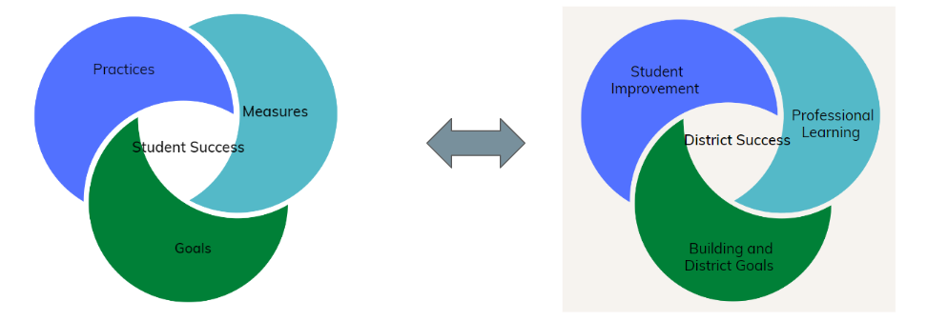
Systems for Coherence
Insert Quote

Slide 7
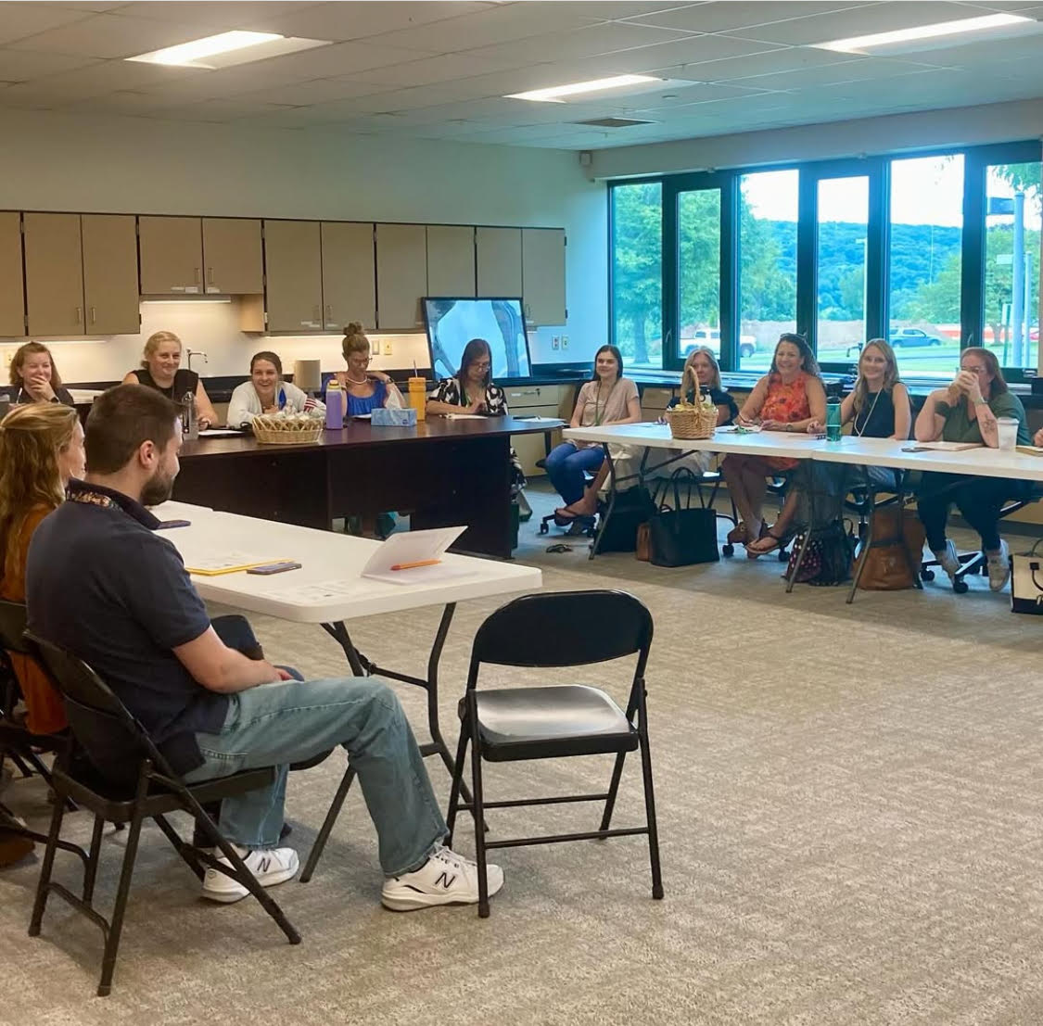
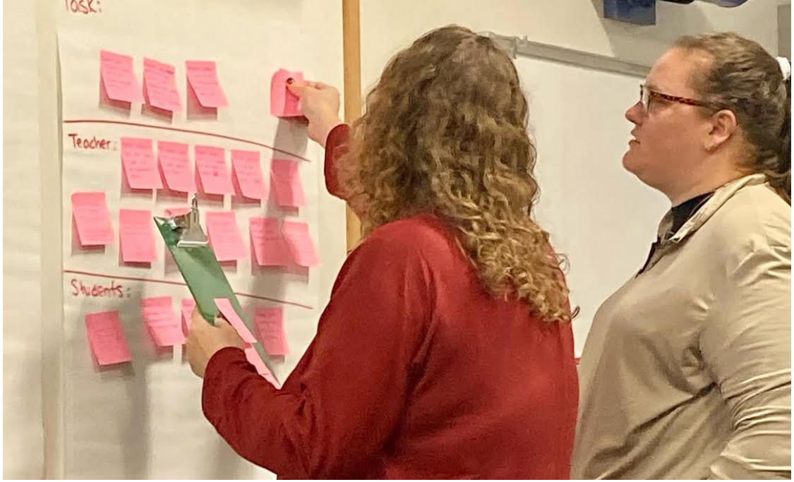
Teacher Leadership
Leaders of Learning
“For every ounce of accountability, there needs to be an ounce of support.” Richard Elmore
K-5 Lab Classrooms
K-5 Report Card Committee
K-12 Mathematics Vision Work
Instructional Rounds
Classroom Walkthrough Model

Slide 8
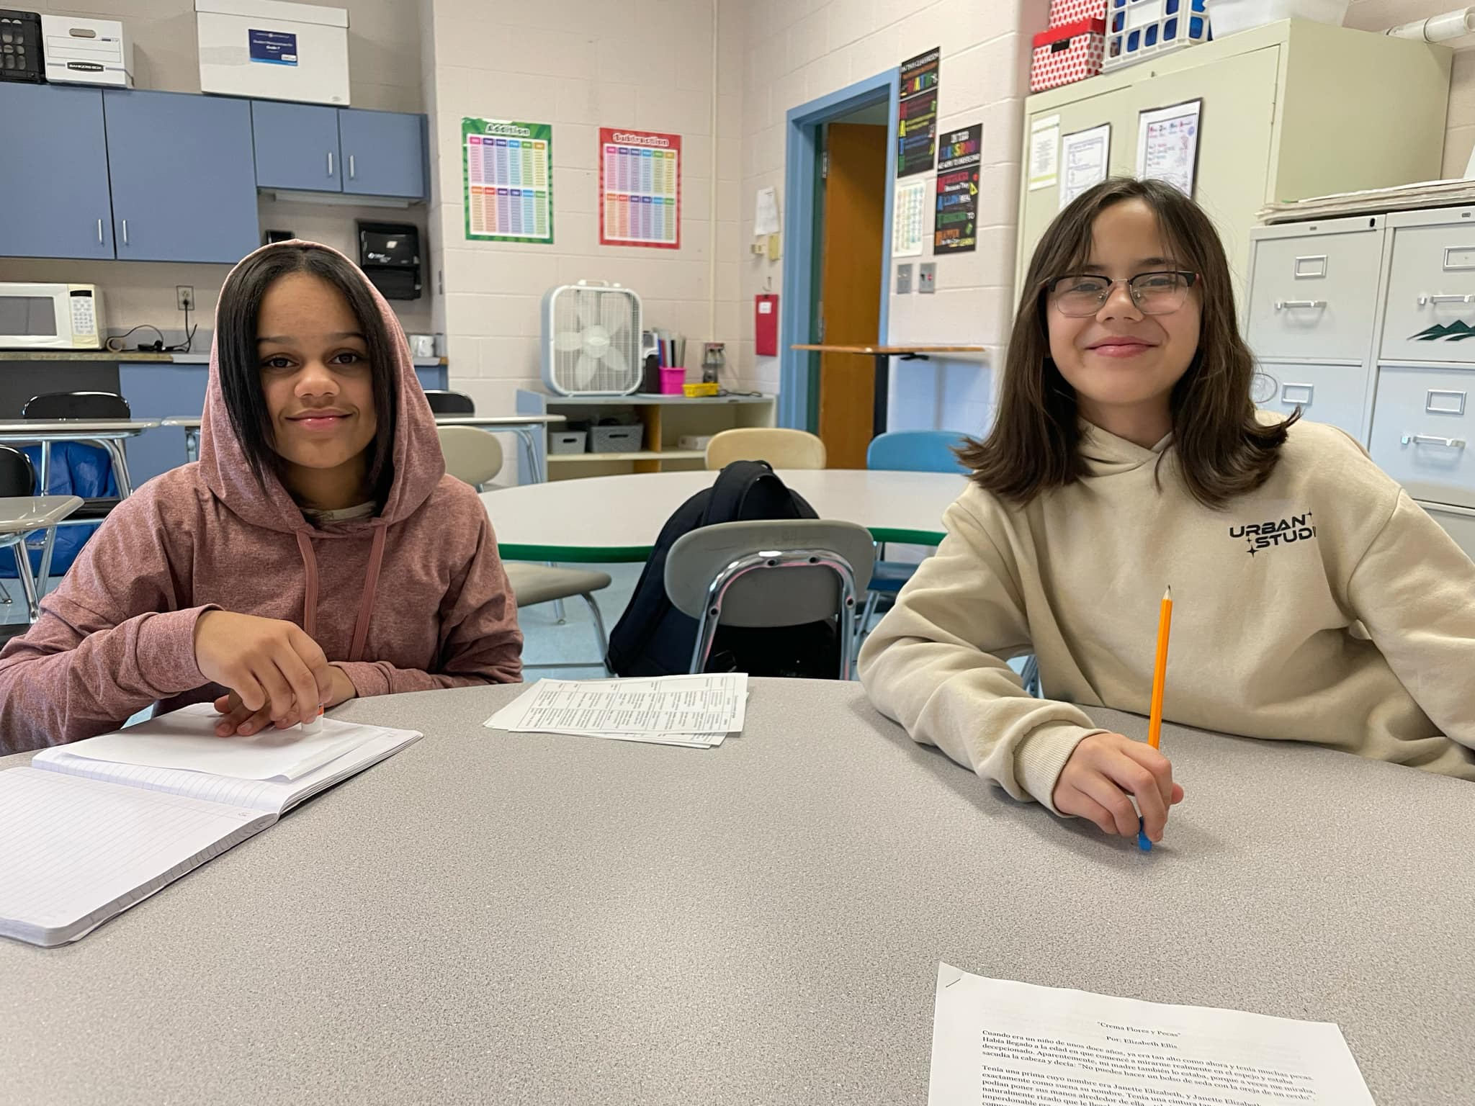
Multilingual Learners

Slide 9
Multilingual Learners
Programs and Services for ELs/MLs
English language development is Tier 1 instruction, no matter where or with whom the instruction takes place. The Civil Rights Act of 1964, Title VI, and the Office of Civil Rights require that every identified English learner/multilingual learner must receive services for English language development, even those who are also identified with a disability. The only exceptions are those students whose parents/caregivers have opted them out of language services. However, districts should monitor these students closely.
CT SDE Guidelines for Administrators

Slide 10
Historical Look
Year | Number of Students to Be Served
2003-2004 | 84
2004-2005 | 78
2005-2006 | 93
2006-2007 | 100
2007-2008 | 110
2008-2009 | 107
2009-2010 | 108
2010-2011 | 117
2011-2012 | 111
2012-2013 | 96
2013-2014 | 123
2014-2015 | 105
2015-2016 | 105
2016-2017 | 101
2017-2018 | 125
2018-2019 | 144
2019-2020 | 170
2020-2021 | 163
2021-2022 | 224
2022-2023 | 268
2023-2024 | 316
2024-2025 | 337
17+ Language
337* Students
*Numbers are reviewed monthly as our MLs are a
transient population.

Slide 11
Systems of Support
Clarity and Consistency in Identification - Registration
K-12 Curriculum
Building Based Programming to Support Graduation
Translation Tools
State Mandates

Slide 12
Current Level of Support
School | Numbers (as of 1/1/25) | Number of Teachers
HPS | 63 | 2.0
NES | 38 | 1.0
SNIS | 87 | 2.0 / 1 PT Tutor
SMS | 75 | 1.0 / 1 PT Tutor
NMHS | 74 | 2.0

Slide 13
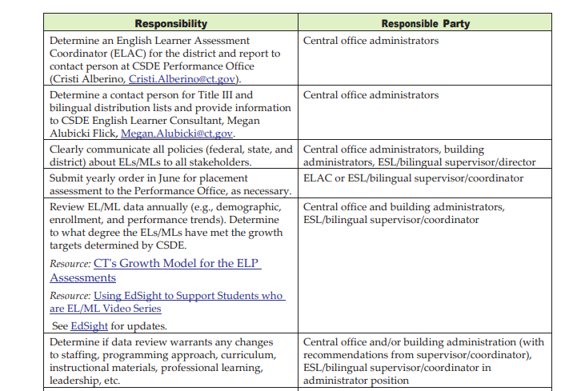
District Responsibilities to MLs and Their Families

Slide 14
Audit of our Programming
Our district completed an audit of its current practices, curriculum, and services. Areas reviewed included:
Intake process
Classroom placement procedures
Review of curriculum
Progress monitoring/Intervention systems/Dually identified students
Data collection and goal setting for current teachers of MLs
Staffing/program models
Professional development recommendations
Commendations:
TESOL/ML staff have a thorough understanding of the population’s linguistic, academic, and cultural needs
Staff have knowledge of best practices for ML students and are flexible and responsive to changing demographics
Evidence of scientific, research-based curriculum that supports the linguistic and cultural needs of ML students at the secondary level
Additional support staff are available to provide native language supports (Portuguese and Spanish) for translation when required
Tier I support utilizing an individualized pull out model for English language instruction

Slide 15
Adult Education

Slide 16
Structures and Systems of Adult Education
Program Staffing
Program Director - 1
Program Facilitator - 1
Guidance Counselor - 1.5
Secretary - 1
Adult Education Evaluator - 1
Teachers - 12

Slide 17
By the Number
Year | 2023 | 2024 | 2025
Number of Students | 88 | 78 | 88

Slide 18
Services and Offerings
Provide in person and remote credit diploma programs allowing a student to earn up to 10 credits per year
Provide computer instruction for GED in English and Spanish
Provide in person ESL instruction in multiple levels
Provide remote instruction options for ESL in multiple levels
Provide programs that earn certificates in Digital Literacy, OSHA 10 workplace safety and employability skills
Provide opportunities for credit in CTE in career pathways (Cosmetology, Culinary, etc.)

Slide 19
Grants
INSTRUCTIONAL INNOVATION -$30,000
Innovation is the core of adult education. This funding allows us to develop and experiment with new and creative instructional approaches to meet the demonstrated needs, demands and interests of a cohort of our students. Activities align with both the objectives of Workforce Innovation and Opportunities Act and current labor market needs.
TRANSITION, CAREER NAVIGATION AND SUPPORT-$50,000
To promote the self-sufficiency of adult education students and to strengthen their response to the needs of a rapidly changing labor market; to provide exposure to, and experience in, relevant industry sectors/career pathways as identified in the Workforce Development Board local plans, and to ensure that Connecticut has workers with the necessary skills, competencies and credentials to be successful in the 21st century workplace including broadening opportunities for students in adult education by creating a bridge between adult education programs, employment, postsecondary education and training opportunities.
*This is a four year grant.
Notes:
WIOA - workforce innovation and Opportunities Act

Slide 20
Budget Overview for Adult Education
Major Object Code | 24-25 Budget | 25-26 Budget | Budget to Budget Change | Budget to Budget Change
Salary | 98,421 | 121,081 | 22,660 | 23.02%
Professional Services | 6,400 | 6,400 | 0 | 0.00%
Other Services | 1,400 | 1,500 | 100 | 7.14%
Supplies | 15,878 | 15,878 | 0 | 0.00%
Total | 122,099 | 144,859 | 22,760 | 18.64%

Slide 21
Tuition

Slide 22
Arigricience, Magnet and Career Technical School Budget
Shepaug Agriscience 9-12
29 Seats
Total Tuition Cost to New Milford for Agriscience: $197,867
Western Connecticut Academy of International Studies (K-5) in Danbury
18 Seats
Tuition Cost to District per seat: $2,194.50
Total Tuition Cost to New Milford for Magnet School: $39,501
Henry Abbott Technical High School
17 seats on average from SMS with anywhere from 70-100 district-wide
Notes:
the total number of seats in the 24/25 budget is 31 total at $6,823 per. We actually have 30 students currently and the cost is $3957 per student because the state gave more to Region 12.
I asked if they anticipate this next year, and my contact did not know. She thought it best to plan on the full rate for 25-26 which is $6,823 per.
Using current enrollment moved forward we will have 7 in 12th, 7 in 11th and 7 in 10th for 25/26. To get the projected enrollment for 9th we have to use the 3 year average (current year and 2 prior).
The current year we have 7 in 9th. Last year (2023) we had 8 in 9th and in 2022 we had 7 in 9th with the average being 7.33. So all together we will budget 8 (rounded up),7,7,7 for 25/26 for a total of 29. This is 2 less than the current year budget.

Slide 23
Impact on the Budget

Slide 24
Staying the Course
Continue to commit to high quality data driven decisions for teaching and learning
Continue to address the State Department of Education standards, regulations, and continual changes in best practices
Enact the district’s four year Right to Read literacy plan with an emphasis on programming to support phonemic awareness, phonics, fluency, vocabulary and comprehension
Support the vision for mathematics from short-term knowledge of procedural fluency to conceptual understanding, long-term procedural fluency and mathematical reasoning through the continued refinement of K-5 iReady Classroom Mathematics
Continue our 6-12 math alignment with a focus on 6-8 core materials
Support teachers as learners through high-quality professional learning as part of our Educator Evaluation Plan
Continue to formally build teacher leadership

Slide 25
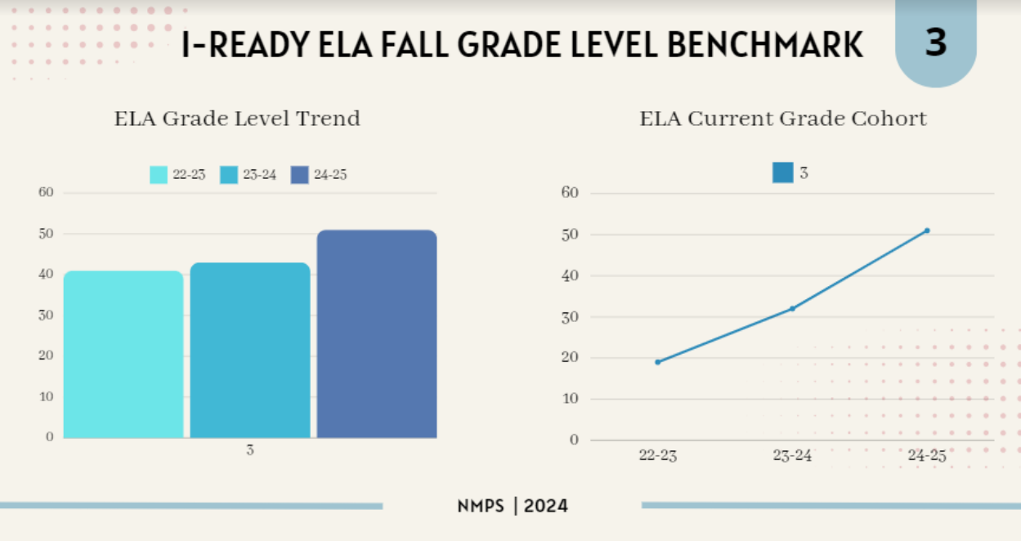
UFLI and Heggerty

Slide 26
Notes:
We’ve tried hard to create instructional strategies to improve these areas, but we are not seeing it improve our scores
Background knowledge vocabulary, language structures

Slide 27
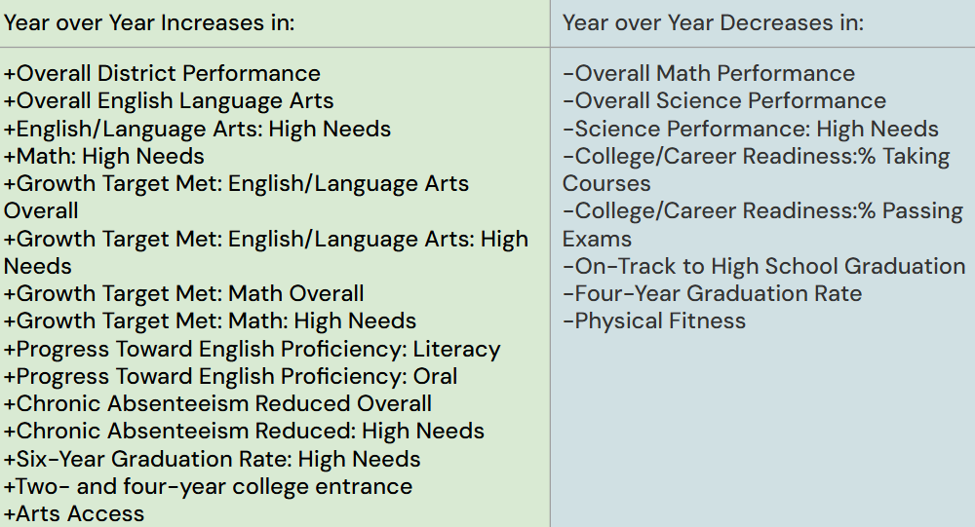
24-25 vs. 23-24 District Accountabilty Indicators

Slide 28
Budget Overview for the Department of Instruction
Major Object Code | 24-25 Budget | 25-26 Budget | Budget to Budget Change | Budget to Budget Change
Salary | 1,028,690 | 1,200,089 | 171,399 | 16.66%
Professional Services | 465,053 | 486,053 | 21,000 | 4.52%
Other Services | 303,614 | 290,968 | -12,646 | -4.17%
Supplies | 124,335 | 134,335 | 10,000 | 8.04%
Dues & Fees | 7,989 | 8,489 | 500 | 6.26%
Total | 1,929,681 | 2,119,934 | 190,253 | 9.86%

Slide 29
Questions for the Department of Instruction

