Slide 1
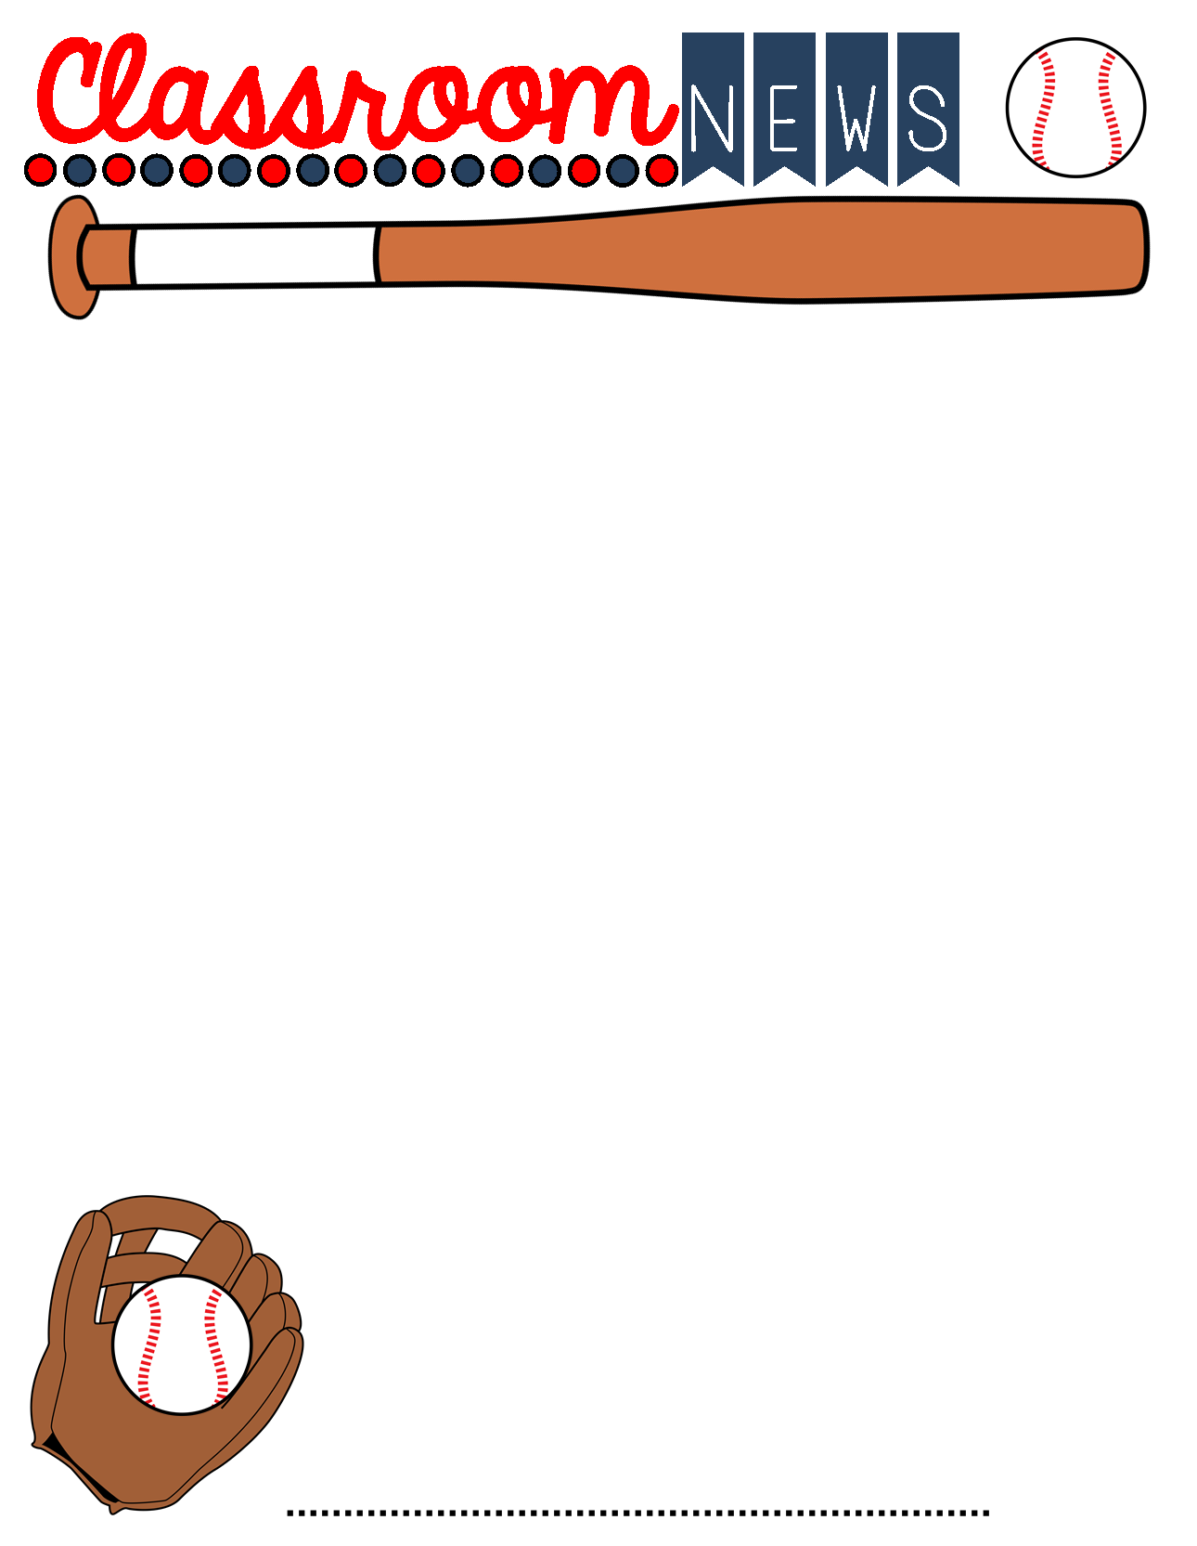
October 18th-22nd
Important Info
Calendar
Parents,
Thank you for volunteering to send in items for our Solar Ovens. We are super excited to begin this project. Please remember, as we are at the beginning the 2nd quarter, retests are available for one reading and one math major grade per quarter. This is for grades 60 or below.
If you have any questions or concerns, please contact me: pphillips@mcpss.com
Please be sure to send a note if your child is absent. After three days, it’s an unexcused absence.
Please check your child’s take-home folder on Monday each week.
Please Note:*Quiz = Minor grade *Test= Major grade
Tuesday, October 18th -homework assigned and sent home
Wednesday, October 20th - ICE CREAM DAY ($1.00)
Friday, October 22nd - Homework Due
October 25th-29th- Red Ribbon Week- More details to come!
Friday, October 29th- School Dance 6pm-8pm
November 4th- Santa Pictures
November 12th- Veteran’s Day Holiday - No School
*Every morning students can buy a snack. Chips are 50 cents.
What We Are Learning this Week
Reading –Review Theme, Summarizing, and Characterization. Focus Skill: Point of View- Quiz Thursday Reading Test #1- Friday
Language Arts-Capitalization and Informal Writing Part 1 Quiz Wednesday
Math- Two Digit x Two Digit Multiplication – Quiz Friday
Multiplication Drill Tuesday (will include 10,11, and 12 facts)
Alabama History-Frontier Alabama: Life, Roads, Homes and Travel Quiz Friday
Things to Know
*Please encourage your child to READ and practice their Multiplication Facts EACH NIGHT.
**Behavior Folders come home every Friday and are due each Monday, signed by a parent or guardian.
*All Major tests will have a study guide.
Items Needed for Science: Shoebox or pizza box, aluminum foil, graham crackers, Large Marshmallows, Hershey Chocolate Bars
Mrs. Phillips 4th Grade

