Slide 1
Effective Questioning
Focus on Knowledge, Skill, & BIG Idea

Slide 2

Notes:
How did we get here? Data Retreat and primary concern was rigor. The critical pieces of rigor include questioning and engagement so we are focusing on questioning right now.

Slide 3

Knowledge Questions
Recall of fact, information, or procedure.
arrange, calculate, define, draw, identify, list, label, illustrate, match, measure, memorize, quote, recognize, repeat, recall, recite, state, tell-who-what-where-when-why
Notes:
Knowledge Questions prompt students to demonstrate that they can remember information they have learned. They are frequently closed questions. (High Impact Instruction pg. 160). Most of these are considered closed because there is a finite number of answers.
Closed and open

Slide 4
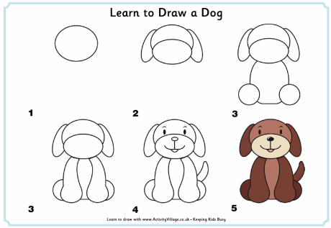
Skill Questions
Engages mental process beyond habitual response using information or conceptual knowledge. Requires 2+ steps
Apply, categorize, determine cause-and-effect, classify, collect and display, compare, distinguish, estimate, graph, identify patterns, infer, interpret, make observations, modify, organize, predict, relate, sketch, show, solve, summarize, use context clues
Notes:
Skill Questions prompt students to apply their knowledge to new situations or settings. Skill questions prompt people to explain how to do something. Can be both open or closed. (High Impact Instruction pg. 160) In skill questions, students begin to apply the knowledge they’ve learned.

Slide 5
Skill Question Example
What have you learned about transportation west from old photos and diaries?
Notes:
Why would this qualify as a skill question example? The student is being asked to interpret or make observations about old photos and diaries.
Select what you believe is a skill question from your list, share with your partner/group and justify why you think it qualifies as a skill level question.

Slide 6

BIG Idea
Requires reasoning, developing a plan or a sequence of steps, some complexity more than one possible of answer, higher level of thinking than previous 2 levels
Apprise, assess, site evidence, critique, develop a logical argument, differentiate, draw conclusions, explain phenomena in terms of concepts, formulate, hypothesize, investigate, revise, use concepts to solve non-routine problems
Notes:
Big Idea questions communicate the themes, concepts, overarching ideas, and content structures that recur throughout a course. Big Idea questions prompt students to demonstrate that they comprehend the implications of the information they have learned. (High Impact Instruction pg. 161). Almost never a multiple choice question. It requires explanation and use across content areas.

Slide 7
Big Idea Question Example
How does weather affect us?
Notes:
The part in black is an example from one of the teachers in the district. Pull out your big idea questions, modify/adjust to create a solid big idea example.

Slide 8
Effective Question Should…
Address the Standard
Match the purpose of the lesson
Begin Unit Planning with Big Ideas (Question Stems)
Use the Question Stems to generate Knowledge and Skill Questions
Be Intentionally Planned and Readily Available
Notes:
1. Address the Standard: some standards do not lend themselves to a BIG IDEA question, they may stay at the knowledge and/or skill level. At times, you may be able to group several standards together in order to generate a BIG IDEA.

Slide 9
Lesson Purpose Hints at the type of Questions to use – What kind of learning are you involved in?
Exploratory, Class Discourse/Dialogue, Teacher as Facilitator
Review, Gauging Prior Knowledge, Explicit Modeling, Direct Instruction, Strategic Instruction
Question Format: Closed
Question Kind: Right or Wrong
Question Level: Knowledge/Skill
# of Questions: Up to more than 4 per minute
Question Format: Open
Question Kind: Opinion
Question Level: Big Idea
# of Questions: 1 to 5
Notes:
High Impact Instruction pg. 165 – Most skilled teachers use both – however, many don’t intentionally incorporate question types in column 1
Discuss that each type of instruction is valuable and have their place.
Create a culture in which “I don’t know” is not acceptable.
Restate, Rephrase, Reduce, Reach Out

Slide 10
TPGES Domain 3
3B – Questioning and Discussion Techniques

