Slide 1
PUBLIC MEETING FOR
TAXES PAYABLE IN 2023-2024
Presented for Jackson County Central ISD 2895
Maria Bezdicek, Business Manager
Barry Schmidt, Superintendent
December 4th, 2023
Notes:
Certified in December 2023 for payment by taxpayers in CY24, money to be used in FY25

Slide 2
Agenda
Factors Affecting Taxes
Big Picture
Your Property Classification and Value
School District Factors Affecting Pay ’24
Putting it All Together and Questions
Notes:
These are the factors affecting property owners proposed property taxes which are addressed in this PowerPoint presentation

Slide 3

Big Picture

Slide 4
Why have a
Truth in Taxation Meeting?
Truth in Taxation Law, passed in 1989
Two major requirements:
    Tax Statements
    Counties must send out proposed property tax statements in November based on proposed tax levies set by all taxing jurisdictions (counties, cities, townships, school districts, etc.)
    Public Hearing
    Most taxing jurisdictions must hold a public hearing prior to certifying the final levy and discuss:
      Payable 2024 levy
      Fiscal year 2024 budget
      Public comments
This is the school district’s
annual required hearing
Notes:
A district could literally have two slides to fulfill the TNT requirements. One showing the Pay 24 levies and one showing the FY24 budget. However, this is a chance to tell the story of your district and educate your citizens in a public meeting. Take advantage of that!

Slide 5
Who sets the School Levy?
Components of a District Tax Levy are either:
Set By State Formula By Legislature
  General Education Formula, Operating Capital, Career & Technical, Reemployment, etc.
Voter Approved as Authorized by the State
  Operating Referendum or Building Bonds

Slide 6
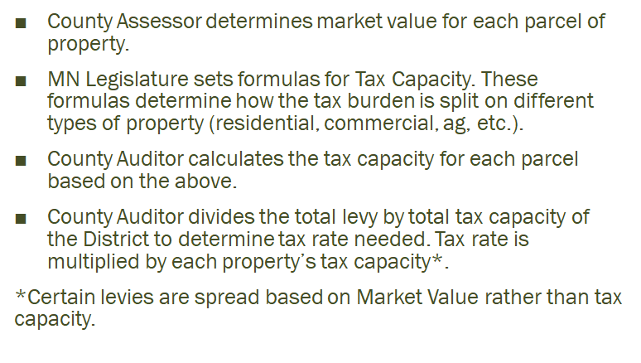
How is my property tax determined?
Notes:
Operating Referendum and LOR is based on Referendum Market Value
School Bonds, Capital Project Levy, and Long-term Facilities Maintenance Revenue are based off Net Tax Capacity
Net Tax Capacity affects all parcels of property in the district. Commercial Industrial has higher tax burden than Homesteaded properties.
Referendum Market Value not all properties pay. Properties valued the same would pay the same rates. Agriculture properties (excluding house, garage, and one acre) and seasonal rec properties are not included.
The county collects the money and distributes it to the schools.

Slide 7
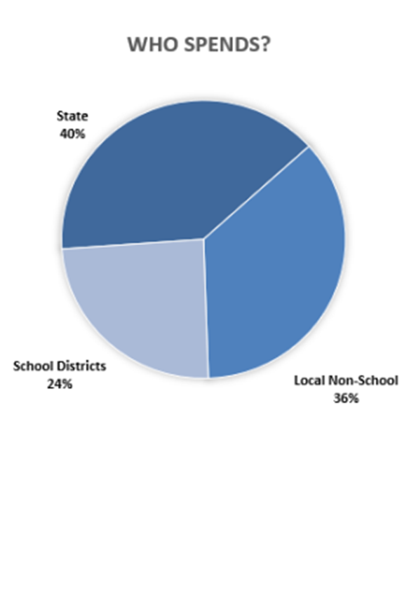
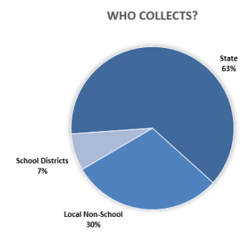
State Aid Impact
(Data source, MN Department of Management and Budget-Price of Government, 2023)
Notes:
In FY 2023, of all payments Minnesotans will make in taxes, fees and charges, the state will collect 63 percent. Counties, cities, and townships will collect about 30 percent, while school districts will collect about 7 percent. However, once intergovernmental aids are considered, the state will spend only 40 percent of the total, while non-school local governments will spend 36 percent, and school districts will spend 24 percent.

Slide 8
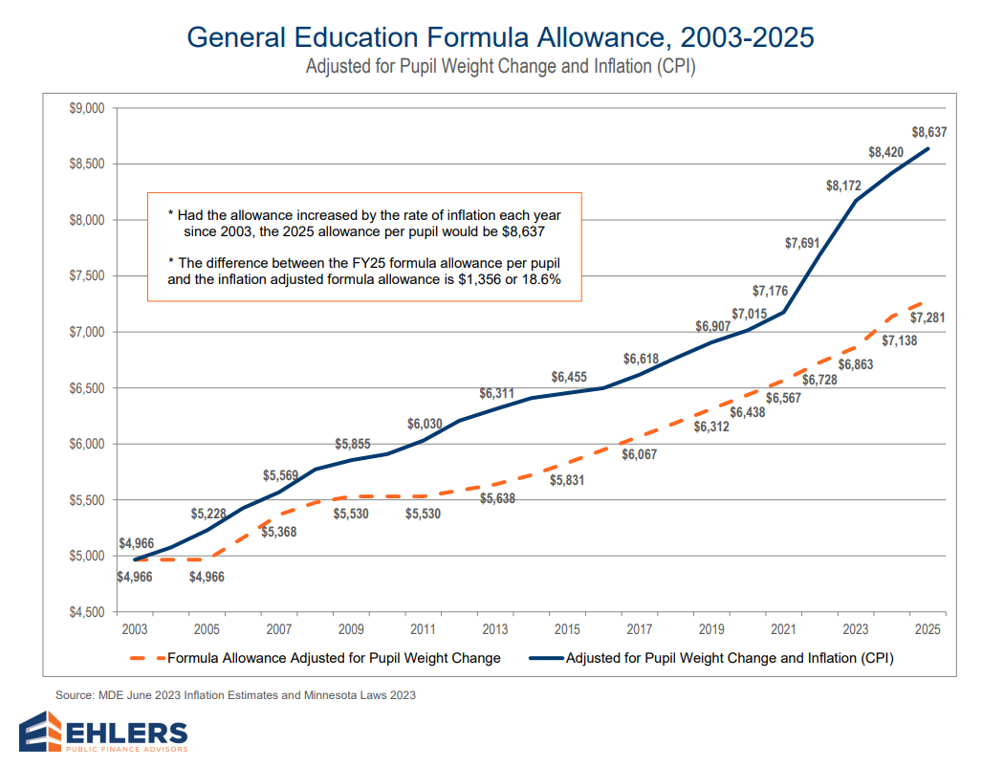
Funding will trail inflation by $1,282 per pupil in FY24 and $1,356 per pupil in FY25
Notes:
This shows that your General Education Formula Allowance has been increasing but is not keeping up with inflation. Remember that starting in FY26 that there is an automatic inflationary increase of between 2% and 3% on the Basic Formula Allowance. This should help districts keep up with inflation as long as it is between 2 and 3%.

Slide 9
LEGISLATIVE CHANGES THAT AFFECT THE 2024 LEVY
State approved 4% and 2% increase FY 24 and FY 25
Reduces disparities in opportunities to fund costs of facilities maintenance projects
A 10-year, board approved plan is required to receive revenue
FY22 : 2.45% ($6728) FY 23: 2% ($6863) FY24: ($7138) FY 25: ($7281)
ESSL, Unemployment, FMLA and more mandates to coming years.

Slide 10
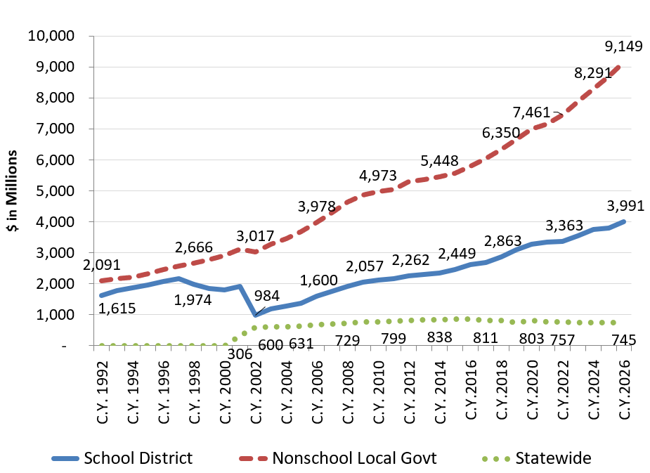
Property Tax Levies: School vs Non School Payable 1992-2026
*data source MDE Minnesota Prek-12 Education Finance System Overview: MSBA-Summer Conference July 2022
Notes:
School districts account for a significant portion of overall property tax levies in Minnesota(blue line), but the school share of levies has decreased significantly since the late 1990s.
Notice that school taxes have approximately doubled while non-school Local Govt. (red line)taxes have risen close to 4 times during this period.
The green statewide property tax is on Commercial/Industrial property and seasonal residential recreational property.
Two stories could be told here:
1. School Levies have not been rising as fast as county or township levies. Remember they do not need to go to the public for a vote on their levies, where you in many instances may need to. You may have citizens coming to your meeting to complain about how their taxes were increase greatly only to find out that it wasn’t the school portion that increased.
2. Because you have not been keeping up with inflation on Basic Formula Allowance it has forced districts to rely more on referendums or levies to continue to educate students at a high level.
Taken from Daley Lehmann at MDE

Slide 11
Result: Growing Dependence on Referendum Revenue
In 1992-93, 65% of districts had operating referendum revenue averaging $332 per pupil
For 2020-21, all Minnesota districts have referendum revenue and/or local optional revenue levy authority averaging $1,475 per pupil
  JCC Operating ($460)and LOR is ($724) totaling $1,184 per pupil.
Referendum revenue including Local Optional Revenue (LOR) provides 13.2% of General Fund operating revenue
Of this amount, $751 is a voter approved operating referendum, and $724 is Local Optional Revenue (LOR)

Slide 12


Property Classifications and Value

Slide 13
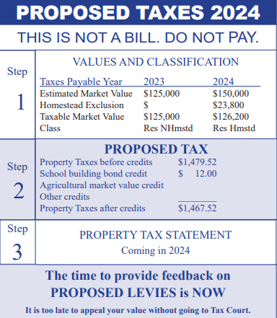
Know Your Valuation
Property classification and market value
Sent Spring 2023; cannot change value
Watch for 2024 statement in SPRING and where to appeal
Notes:
Step 1 happened last spring, Step 2 is what is happening now, and Step three will happen next spring
Taxpayers may come to the meeting and want to have a change in their taxes this year. This slide shows the process. To change valuation, they need to do it in the spring of the year when the valuation notice comes out. Most local and county appeals take place in April, May, June after the notice is given out.
Updated by mid October- Property tax statement instructions for county treasurers- property tax statement sample
Taken from Truth in Taxation | Minnesota Department of Revenue (state.mn.us)

Slide 14
Effective Tax Rates
Property Classification | 2023 Estimate
Farm | 0.48%
Seasonal Rec | 0.79%
Residential Homestead | 1.14%
Apartment | 1.43%
Public Utility | 2.50%
Commercial-Industrial | 2.59%
Source: Jared Swanson House Research
Notes:
The Effective Tax Rates are statewide averages of the property classification. Note that Farm is among the lowest, and Commercial Industrial is the highest rate. So, in general farmers are getting a break relative to the value of their property.
Even at a lower rate, increases in value translates to higher property taxes. You multiply the Market Value of a property by its Effective Tax Rate you get an estimate of net taxes paid on a property.
Example: $1,000,000 * .0259 = $25,900 for Commercial vs.
$1,000,000 * .0114 = $11,400 for Residential

Slide 15
Share of Tax Liability
Property Classification | Market Value Share (2022 Assessment) | Share of Net Taxes (Payable in 2023)
Farms | 16.7% | 6.4%
Seasonal Rec Residential | 4.1% | 2.6%
Commercial and Industrial | 12.8% | 29.4%
Residential Homes | 59.8% | 54.2%
Other Residential | 6.6% | 7.6%
Source: Jared Swanson House Legislative Analyst
Notes:
You can see the dramatic difference classification make. The two biggest disparities are Farms(farms are productive ag land) and Commercial and Industrial. Commercial has a 12.8% of the market share but pays 29.4% of the taxes. On the flip side Farms have 16.7% of the market value but pay only 6.4% of the taxes.
This slide shows net property taxes paid to all jurisdictions- city, county, schools, townships.
Just incase someone asks :)
Farms include Ag HGA, Ag Hmstd. land, Ag Non-Hmstd.
Commercial Industrial includes Com/Ind hi tier, Com/Ind Lo tier, Publ U: Elec Gen, Publ U:Other and Miscellaneous.
Residential includes Res Homestead and Res Non-Hmstd.
Other Residential includes Apartments and Low-income apartments
Seasonal Rec-Seasonal Rec
You can see the dramatic difference classification make. The two biggest disparities are Farms(farms are productive ag land) and Commercial and Industrial. Commercial has a 12.8% of the market share but pays 29.4% of the taxes. On the flip side Farms have 16.7% of the market value but pay only 6.4% of the taxes.
This slide shows net property taxes paid to all jurisdictions- city, county, schools, townships.
Just incase someone asks :)
Farms include Ag HGA, Ag Hmstd. land, Ag Non-Hmstd.
Commercial Industrial includes Com/Ind hi tier, Com/Ind Lo tier, Publ U: Elec Gen, Publ U:Other and Miscellaneous.
Residential includes Res Homestead and Res Non-Hmstd.
Other Residential includes Apartments and Low-income apartments
Seasonal Rec-Seasonal Rec

Slide 16
AG2SCHOOL BOND CREDIT
Permanent law enacted in 2017
Affects all existing Fund 7 debt levies, except OPEB bonds
Reductions for farmers and timber owners
Scheduled to scale to 70% in 2024
The revenue for Ag2School comes from state income, sales and other tax revenue
Notes:
This is one reason why bonds and capital projects have been passing in Rural Minnesota at a higher rate lately.
The credit that goes directly to farmers and timber owners which reduces their taxes by 70% for the building bond. The school district receives payment from the state in the form of School Building Bond Agricultural Credit Aid.
This was an MREA initiative.

Slide 17
Pay 2024
70% Ag Tax Credit on Bonds
Payable Year | Percent Increase | Total Credit Percent
2022 | 5% | 60%
2023 | 10% | 70%
2024 | 0% | 70%
Notes:
To find your LOR revenue look at line 172 of Levy limitation and Certification Reports worksheet on MDE's Data Reports and Analysis then Click Minnesota Funding Reports (MFR) . Line 240 and 241 shows state aid that a district receives in each tier for LOR
To find Operating Referendum revenue look at line 204 of Levy worksheet. . Line 262 and 263 shows state aid that a district receives in each Tier 2 for an Operating referendum.
This is where property value increases because of inflation have been hurting districts. As property values are increasing districts are not seeing as much state aid.
Need to contact Jen for update

Slide 18
Find Your Ag2School Credit
Truth in Taxation Notice:
Calculated on each
parcel statement
Sum all parcels for total
Because paid by state,
it does not show up
on Levy Certification
Report
Notes:
The credit is a replacement of locally collected taxes paid by farm and timber landowners with payments from the State General Fund. The state’s general fund revenues come primarily from income and sales tax collections. This is NOT a shift from any other local property taxpayers.

Slide 19
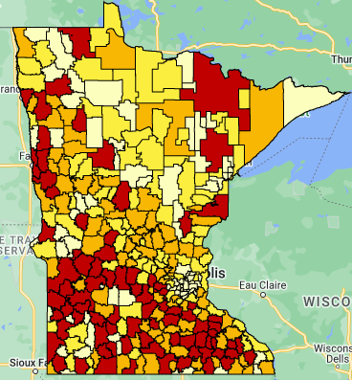
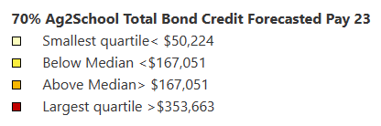
Ag2School in Pay 2023
How does our
school district compare
in total Ag2School credit?
MNREA Maps (mreavoice.org)
Notes:
- Since it is a credit to individual taxpayers it will not show up on your levy reports. Check on your neighbors by clicking on the link in the slide.
- These are finalized numbers from FY2023. The projected numbers for FY24 were incomplete. This is one of the few maps we do with total dollars because it may be good to show tax payers how much they saved with this credit.
-When you click on your district the number on the left side is that number that farmers in your district saved as a tax credit
From Whitney Somers Revenue Tax Research

Slide 20
EQUALIZATION FACTORS FOR
LOR & Operating Referendums
 | LOR & Referendum Allowance Levels | Equalizing Factors
Tier 1 LOR | Up to $300/pupil | $880,000/RPU
Tier 2 LOR | $300 up to $724/pupil | $587,244/RPU
Tier 1 Op Ref | Up to $460/pupil | $567,000/RPU
Tier 2 Op Ref | $460 up to $1,520.25/pupil | $290,000/RPU
Ag Land and Seasonal Rec Properties are exempt from Op Ref and LOR levies.
Notes:
To find your LOR revenue look at line 172 of Levy limitation and Certification Reports worksheet on MDE's Data Reports and Analysis then Click Minnesota Funding Reports (MFR) . Line 240 and 241 shows state aid that a district receives in each tier for LOR
To find Operating Referendum revenue look at line 204 of Levy worksheet. . Line 262 and 263 shows state aid that a district receives in each Tier 2 for an Operating referendum.
This is where property value increases because of inflation have been hurting districts. As property values are increasing districts are not seeing as much state aid.
Need to contact Jen for update

Slide 21
Information on School Funding & District Budget

Slide 22
Notes:
Show your own data on this slide
One point you want to make is that Levies are only one part of your overall revenue.

Slide 23
Your School District Tax Levy
Possible reasons for changes to your parcel:
Change in value or classification to your property
Change in enrollment numbers
Change in valuation of property in district
Equalization aid depends on district property wealth per pupil
Local decisions and requirements
Adjustment for prior years (estimate to actual)
Legislative changes (Local Optional Revenue)

Slide 24
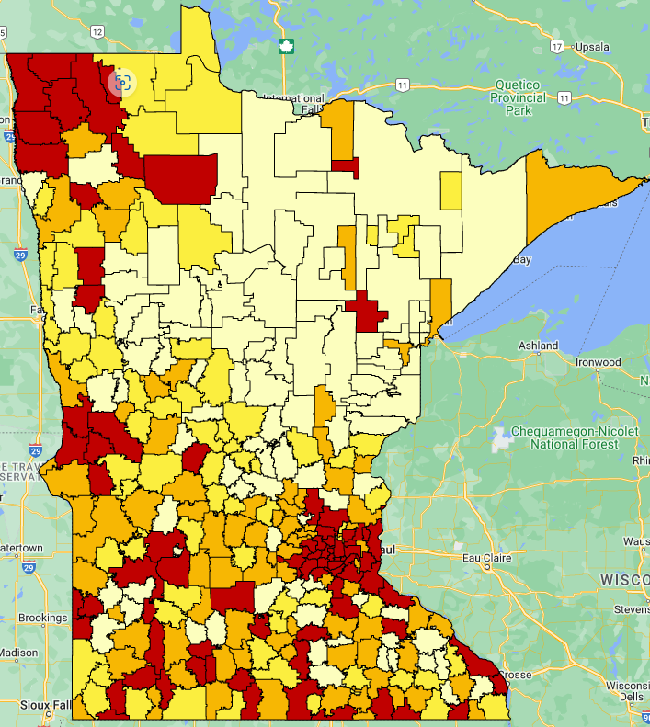
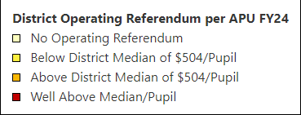
Referendum Picture
How does our district compare in Operating Referendum Revenue?
MNREA Maps (mreavoice.org)
Our District:
$559,516 per APU
Median district: $504
Upper Quartile of Referendums>$1038
94 districts: $0
Notes:
-This data does not reflect the referendums elections passed this November 2023.
-For interactive maps to look up your district open the link on the slide. The number on the left after you click on your district is you amount per pupil
-Median is based on all districts including ones with no operating referendum. If we looked at only the districts who passed operating referendums the median would be $739/Pupil
For your Referendum authority look at line 203 for per pupil. Your total projected revenue would be line 204 on Page 4

Slide 25
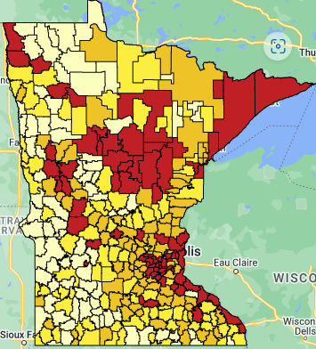
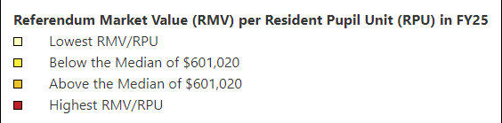
Property Wealth Picture
How does our district
compare in Referendum
Market Value per Residential Pupil Unit?
MNREA Maps (mreavoice.org)
Our District:
$ (559,516.18) per RPU
Median District:
$601,021/RPU
Notes:
Go to interactive maps to look up your district and others. Click on the Blue link in this slide
For your RMV/RPU: Levy report line 235 p 5. MDE calculates RMV/RPU for FY25 by taking RMV from 2022 and dividing by RPU in FY25.
Levy ratios for Operating Referendum Tier 1 line 257, Tier 2 line 258 Pg 6. The aid is the inverse of the levy ratios. If tier 1 ratio is .91000, then your levy is 91% and aid portion is 9%.
The Median RMV/RPU continues to rise throughout the state. This year it rose over $93,000/RPU from last year. This reduces the amount of equalization dollars a district receives.

Slide 26
Referendum Market Values 2006-2020
for the JCC School District
Notes:
This information is provided by the MN Dept of Revenue
Referendum Market Value means-the market value of all taxable property except seasonal rec and ag (except for ag homestead-house, garage and 1 acre)-MN Statute 126C.01
Referendum aid/levy breakdown is based on referendum market value, so a higher amount means more levy and less state aid.
The referendum market values for the JCC district as has gone from
272,884,350 in 2005 to $581,329,640 in 2019
This is an increase of $308,445,290 45%

Slide 27
BUDGET INFORMATION
All school districts’ budgets are divided into separate funds, based on purposes of revenue, as required by law.
Our district currently has 5 funds
General Fund
Food Service Fund
Community Service Fund
Debt Service Fund
Building Fund

Slide 28
JACKSON COUNTY CENTRAL
FUND BALANCE PROJECTIONS
November 21, 2023
 |  | ACTUALS | ACTUALS |  | 24 ORIG | 24 ORIG
 | FUND BALANCE | Revs & Transfers | Exp. & Transfers | FUND BALANCE | Revs & Transfers | Exp. & Transfers | FUND BALANCE
FUND | 6/30/2022 | 2022-23 | 2022-23 | 6/30/2023 | 2023-24 | 2023-24 | 6/30/2024
GENERAL UNAPPR. | $2,399,493.63 | $13,834,313.61 | $13,923,179.41 | $2,310,627.83 | $14,309,748.00 | $14,309,179.00 | $2,311,196.83
Student Activities | $36,600.49 | $61,957.67 | $54,454.01 | $44,104.15 | $53,220.00 | $61,800.00 | $35,524.15
Assigned funds-General | $64,429.10 | $53,890.07 | $93,836.81 | $24,482.36 | $34,300.00 | $34,300.00 | $24,482.36
Assigned funds-Cap. Out. | $43,136.41 | $25,000.00 | $44,159.35 | $23,977.06 | $0.00 | $20,000.00 | $3,977.06
Safe Schools | $36,360.64 | $45,830.16 | $10,374.86 | $71,815.94 | $42,190.00 | $56,200.00 | $57,805.94
Staff Development | $53,183.21 | $170,435.74 | $170,036.51 | $53,582.44 | $175,000.00 | $184,025.00 | $44,557.44
Integration | $0.00 | $121,356.90 | $121,356.90 | $0.00 | $127,000.00 | $127,000.00 | $0.00
Third Party Pay | $47,852.70 | $104,965.40 | $53,326.23 | $99,491.87 | $40,000.00 | $45,175.00 | $94,316.87
Long Term Facilities | $488,763.70 | $454,315.07 | $456,461.36 | $486,617.41 | $441,910.00 | $457,000.00 | $471,527.41
Learning & Dev. | $8,524.66 | $248,834.57 | $249,857.29 | $7,501.94 | $244,000.00 | $244,000.00 | $7,501.94
Basic Skills-Ext. Year | $16,031.76 | $0.00 | $0.00 | $16,031.76 | $0.00 | $5,000.00 | $11,031.76
Capital Outlay | $360,286.61 | $384,771.47 | $355,462.33 | $389,595.75 | $284,000.00 | $271,330.00 | $402,265.75
GENERAL FUND BAL. | $3,554,662.91 | $15,505,670.66 | $15,532,505.06 | $3,527,828.51 | $15,751,368.00 | $15,815,009.00 | $3,464,187.51
Food Service Fund | $541,227.29 | $775,609.51 | $984,876.08 | $331,960.72 | $922,910.00 | $852,500.00 | $402,370.72
Comm. Ed. Unappr. | $3,894.52 | $55,062.79 | $55,595.61 | $3,361.70 | $26,500.00 | $30,845.00 | ($983.30)
Comm. Ed. Appr. | $116,194.80 | $417,403.46 | $386,629.78 | $146,968.48 | $414,610.00 | $386,495.00 | $175,083.48
ECFE | ($322.32) | $65,599.01 | $62,666.88 | $2,609.81 | $63,500.00 | $65,530.00 | $579.81
Learning Readiness | ($41,054.83) | $163,235.11 | $209,633.93 | ($87,453.65) | $149,830.00 | $241,820.00 | ($179,443.65)
Swimming Pool | $44,697.72 | $186,078.33 | $178,237.80 | $52,538.25 | $183,220.00 | $193,470.00 | $42,288.25
Community Ed Fund | $123,409.89 | $887,378.70 | $892,764.00 | $118,024.59 | $837,660.00 | $918,160.00 | $37,524.59
Debt Redemption | $418,350.90 | $2,156,940.74 | $2,122,100.00 | $453,191.64 | $2,400,000.00 | $2,245,633.00 | $607,558.64
TOTALS | $4,637,650.99 | $19,325,599.61 | $19,532,245.14 | $4,431,005.46 | $19,911,938.00 | $19,831,302.00 | $4,511,641.46
Notes:
Show your own data on this slide
One point you want to make is that Levies are only one part of your overall revenue.

Slide 29
2022-23 Actual Revenues and Expenses
 | FY 23 Beginning Balances | FY 23 Revenues | FY 23 Expenses | FY 23 Ending Balance
General Fund-Restricted, Committed , Assigned | 1,159,767 | 1,932,956 | 2,089,402 | 1,003,321
General Fund-Other | 2,394,896 | 13,572,715 | 13,458,783 | 2,508,828
Food Service | 541,228 | 775,610 | 984,876 | 331,962
Comm Ed | 123,410 | 887,379 | 892,764 | 118,025
Debt Service | 418,351 | 2,156,941 | 2,122,100 | 453,192
Building Fund | 10,878,349 | 1,845,106 | 10,129,570 | 2,593,885
TOTALS | 15,516,001 | 21,170,707 | 29,677,495 | 7,009,213

Slide 30
2022-2023 Revenue by Source

Slide 31
2022-2023 Revenue by Fund

Slide 32
2022-2023 Expenditures by Program

Slide 33
More Information
State of Minnesota for Property Tax Relief
1-800-652-9094
County Auditor
(insert address)
Auditor's Office Phone: (Insert Phone Number)
Treasurer's Office Phone: (Insert Phone Number)
School District Contact

Slide 34
Comments & Questions

