Slide 1
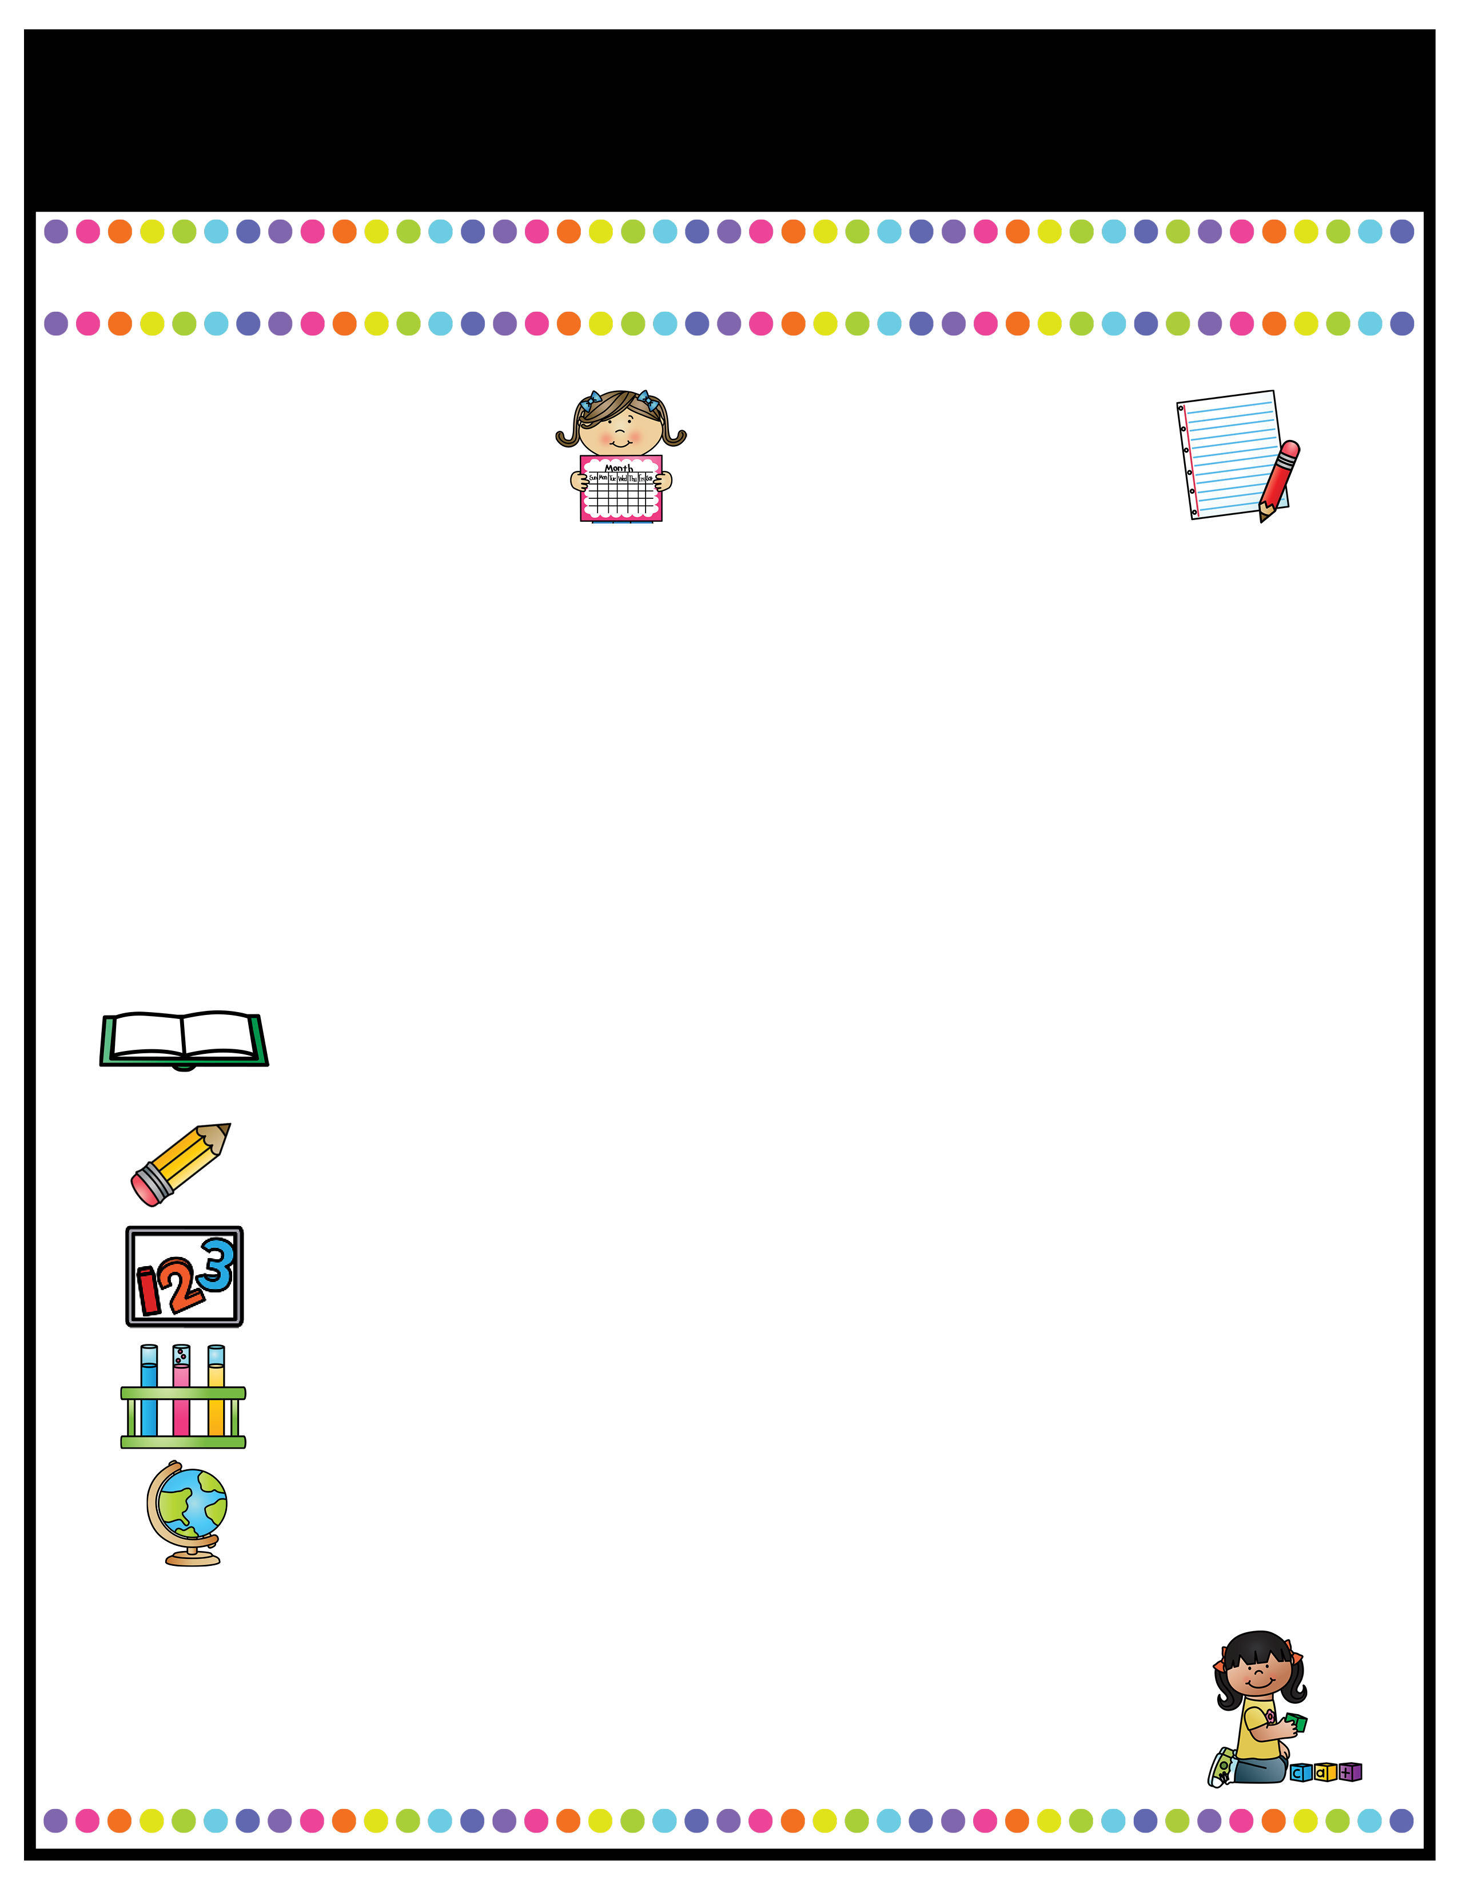
Our Classroom News
Week of: August 14 - 18th
What’s Happening
This Week
A Note From
Mrs. Cook
Math- Topic 1: Understanding Addition & subtraction
1-1: Add to
1-2: Put Together
1-3: Both Addends Unknown
1-4: Take From
Science/Social Studies:
All About Me, Leader In Me
All About Me Posters are due by Monday, August 21st.
Aug. 29th- Curriculum Night​ from 5:30-6:30 for parents to better understand 1st grade, tests, and grading.
A Peek At What We Are Learning
Language Arts: See Unit 1 Lesson 1 family newsletter (This will come home each week with homework attached. Homework is due each Friday.) -Kindergarten Review Sight Words -Handwriting letters Aa-Hh -Review rules & expectations during “workshop time” and "small group time" -Decodable Reader books- when these are sent home, they are yours to keep. This is a great way to review and learn skills we are learning. Your child should practice until mastery.
Check BLACK binders DAILY for notes, stamps, behavior problems, and classwork. Please join ParentSquare if you have not done so already! This will be the main form of communication. Our "Classroom News" will come home every Monday.

Slide 2

Our Classroom News
Week of:
What’s Happening
This Week
A Note From
Mrs. Jones
Type event here.
Type event here.
Type event here.
Type event here.
Type your teacher note here.
A Peek At What We Are Learning
Reading | Type your information here.
Writing | Type your information here.
Math | Type your information here.
Science | Type your information here.
Social Studies | Type your information here.
Spelling Words
Type your weekly spelling words here.

Slide 3

January News
What’s Happening
This Month
A Note From
Mrs. Jones
Type event here.
Type event here.
Type event here.
Type event here.
Type your teacher note here.
A Peek At What We Are Learning
Reading | Type your information here.
Writing | Type your information here.
Math | Type your information here.
Science | Type your information here.
Social Studies | Type your information here.
Spelling Words
Type your weekly spelling words here.

Slide 4
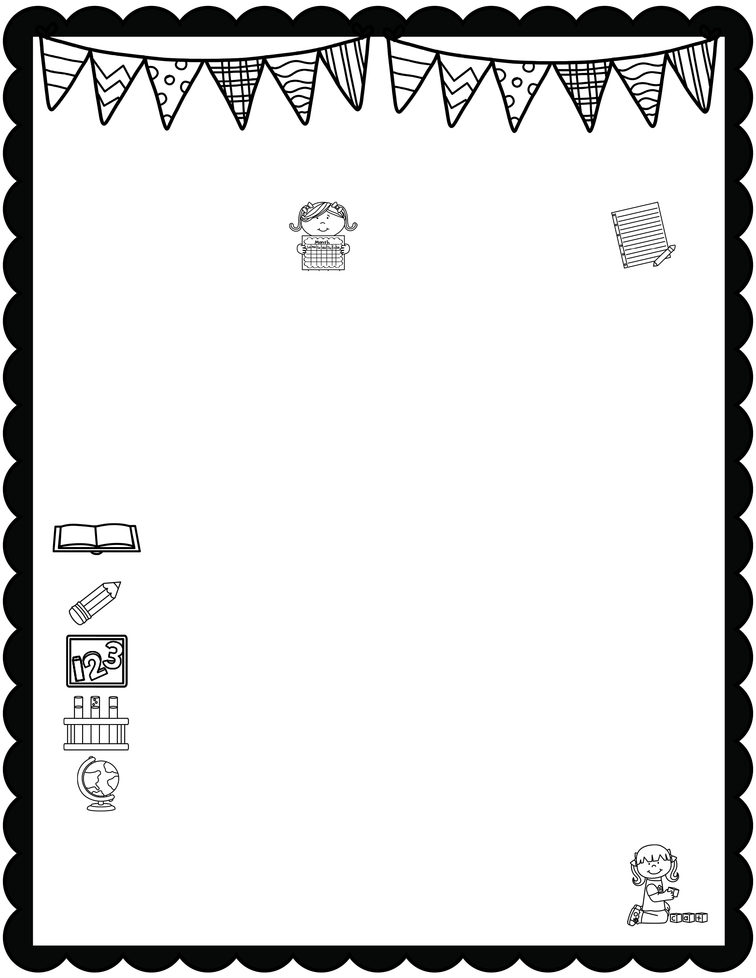
January News
What’s Happening
This Month
A Note From
Mrs. Jones
Type event here.
Type event here.
Type event here.
Type event here.
Type your teacher note here.
A Peek At What We Are Learning
Reading | Type your information here.
Writing | Type your information here.
Math | Type your information here.
Science | Type your information here.
Social Studies | Type your information here.
Spelling Words
Type your weekly spelling words here.

Slide 5

Our Classroom News
Week of:
What’s Happening
This Week
A Note From
Mrs. Jones
Type event here.
Type event here.
Type event here.
Type event here.
Type your teacher note here.
A Peek At What We Are Learning
Reading | Type your information here.
Writing | Type your information here.
Math | Type your information here.
Science | Type your information here.
Social Studies | Type your information here.
Spelling Words
Type your weekly spelling words here.

Slide 6

Our Classroom News
Week of:
What’s Happening
This Week
A Note From
Mrs. Jones
Type event here.
Type event here.
Type event here.
Type event here.
Type your teacher note here.
A Peek At What We Are Learning
Reading | Type your information here.
Writing | Type your information here.
Math | Type your information here.
Science | Type your information here.
Social Studies | Type your information here.
Spelling Words
Type your weekly spelling words here.

Slide 7

January News
What’s Happening
This Month
A Note From
Mrs. Jones
Type event here.
Type event here.
Type event here.
Type event here.
Type your teacher note here.
A Peek At What We Are Learning
Reading | Type your information here.
Writing | Type your information here.
Math | Type your information here.
Science | Type your information here.
Social Studies | Type your information here.
Spelling Words
Type your weekly spelling words here.

Slide 8

January News
What’s Happening
This Month
A Note From
Mrs. Jones
Type event here.
Type event here.
Type event here.
Type event here.
Type your teacher note here.
A Peek At What We Are Learning
Reading | Type your information here.
Writing | Type your information here.
Math | Type your information here.
Science | Type your information here.
Social Studies | Type your information here.
Spelling Words
Type your weekly spelling words here.

