Slide 2
Integumentary System
Integumentary system consists of:
Skin
Accessory Organs
Hair
Nails
Sweat glands
Sebaceous (oil) glands

Slide 3
Functions of Skin
Skin is first and foremost a barrier
Its main functions include:
Protection
Body temperature regulation
Cutaneous sensations
Metabolic functions
Blood reservoir
Excretion of wastes

Slide 4
Protection
Constitutes three barriers:
Chemical barrier
Low pH
Physical barrier
Water blocked by lipids
Biological barrier
Phagocytes and macrophages
Melanain-sunscreen

Slide 5
Body Temperature Regulation
Heat Regulation
Insensible perspiration vs Sensible perspiration
Cold Regulation
Dermal blood vessels constrict to help body core stay warm
Skin temperature drops to slow passive heat loss

Slide 6
Cutaneous Sensations
Cutaneous sensory receptors are part of the nervous system
Temperature
Touch
Pain

Slide 7
Metabolic Functions
Skin can synthesize vitamin D needed for calcium absorption
Fights some carcinogens
Keratinocytes can activate some hormones

Slide 8
Blood Reservoir
Skin can hold up to 5% of the body’s total blood volume
Skin vessels can be constricted to shunt blood to other organs, such as an exercising muscle

Slide 9
Excretion
Sweating can cause salt and water loss.
Skin can secrete limited amounts of nitrogenous wastes.

Slide 10
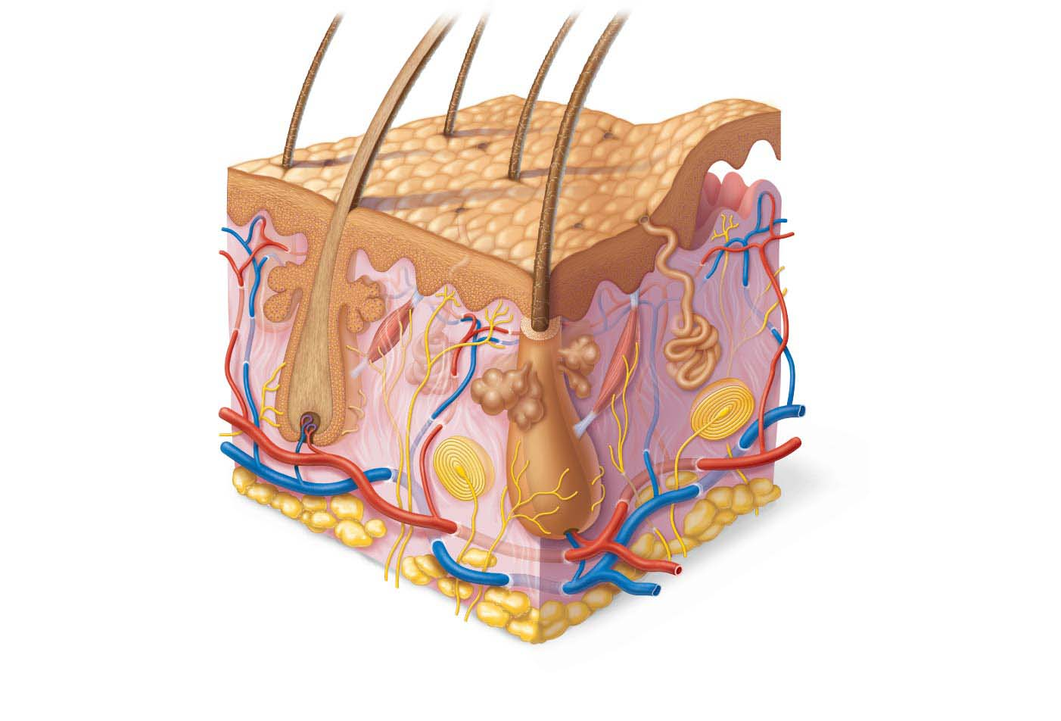
Structure of skin
Skin consists of two distinct regions:
Epidermis: superficial region
Consists of epithelial tissue and is avascular
Dermis: underlies epidermis
Mostly fibrous connective tissue, vascular
Epidermis
Papillary
layer
Dermis
Reticular
layer

Slide 11
Figure 5.1 Skin structure.
Hair shaft
Dermal papillae
Epidermis
Subpapillary
plexus
Papillary
layer
Sweat pore
Dermis
Appendages of skin
Reticular
layer
• Eccrine sweat gland
• Arrector pili muscle
• Sebaceous (oil) gland
• Hair follicle
• Hair root
Hypodermis
(subcutaneous
tissue; not part
of skin)
Cutaneous plexus
Nervous structures
• Sensory nerve fiber
with free nerve endings
Adipose tissue
• Lamellar corpuscle
• Hair follicle receptor
(root hair plexus)

Slide 12
Structure of the Skin
Hypodermis
Not part of skin but shares some functions
Mostly adipose tissue that absorbs shock and insulates
Anchors skin to underlying structures: mostly muscles
Hypodermis

Slide 13
Epidermis
Cells of the Epidermis
Epidermis consists mostly of
keratinized stratified squamous epithelium
Four cell types found in epidermis:
Keratinocytes
Melanocytes
Dendritic Cells
Tactile Cells

Slide 14
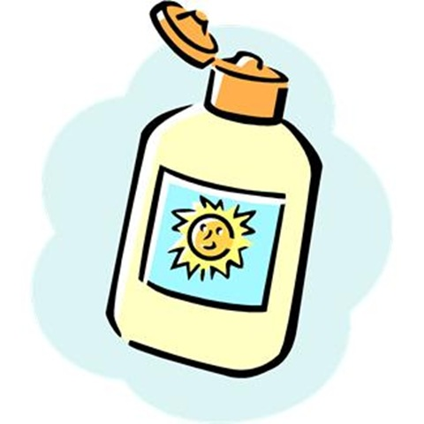
Cells of the Epidermis
Keratinocytes
Produce keratin (protein that gives skin its protective properties)
Majority of epidermis
Millions shed every day
Melanocytes
Spider-shaped cells located in deepest epidermis
Produce pigment melanin
Help protect against UV damage

Slide 15
Cells of the Epidermis (cont.)
3. Dendritic (Langerhans) cells
Star-shaped macrophages that patrol deep epidermis
Are key activators of immune system
4. Tactile (Merkel) cells
Sensory receptors that sense touch

Slide 16
Layers of the Epidermis
Epidermis is made up of four or five distinct layers
Thick skin = five layers (strata), palms and soles
Thin skin contains only four strata
Five layers of skin
Stratum basale
Stratum spinosum
Stratum granulosum
Stratum lucidum (only in thick skin)
Stratum corneum

Slide 17
Layers of the Epidermis (cont.)
Stratum basale (basal layer)
Deepest of all epidermal layers (base layer)
Single layer of stem cells
Mitosis
One daughter cell travels to surface in 25-45 days
Other daughter cell remains a stem cell
AKA stratum germinativum
10–25% of layer also composed of melanocytes

Slide 18
Layers of the Epidermis (cont.)
Stratum spinosum (prickly layer)
Several cell layers thick
Keratinocytes in this layer appear spikey, so they are called prickle cells
Also melanosomes (packages of melanin) and dendritic cells

Slide 19
Layers of the Epidermis (cont.)
Stratum granulosum (granular layer)
Cell appearance changes
Cells flatten, nuclei and organelles disintegrate
Keratinization begins
Cells also accumulate granules that provide water resistance
Cells above this layer die (apoptosis)
Too far from dermal capillaries to survive

Slide 20
Layers of the Epidermis (cont.)
Stratum lucidum (clear layer)
Found only in thick skin
Consists of thin, translucent band of two to three rows of clear, flat, dead keratinocytes
Lies superficial to the stratum granulosum

Slide 21
Layers of the Epidermis (cont.)
Stratum corneum
20–30 rows of flat, anucleated, keratinized dead cells
Accounts for three-quarters of epidermal thickness
Though dead, cells still function to:
Protect
Prevent water loss

Slide 22
Figure 5.2 Epidermal cells and layers of the epidermis.
Keratinocytes
Stratum corneum
Most superficial layer; 20–30 layers of dead
cells, essentially flat membranous sacs
filled with keratin. Glycolipids in
extracellular space.
Stratum granulosum
Typically one to five layers of flattened
cells, organelles deteriorating; cytoplasm
full of lamellar granules (release lipids) and
keratohyaline granules.
Stratum spinosum
Several layers of keratinocytes unified by
desmosomes. Cells contain thick bundles
of intermediate filaments made of
pre-keratin.
Stratum basale
Deepest epidermal layer; one row of actively
mitotic stem cells; some newly formed cells
become part of the more superficial layers.
See occasional melanocytes and dendritic
cells.
Dermis
Dermis
Melanin
granule
Sensory
nerve
ending
Tactile
(Merkel)
cell
Desmosomes
Melanocyte
Dendritic cell

Slide 23
Dermis
Strong, flexible connective tissue
Contains nerves, blood vessels, and lymphatic vessels
Contains epidermal hair follicles, oil glands, and sweat glands

Slide 24
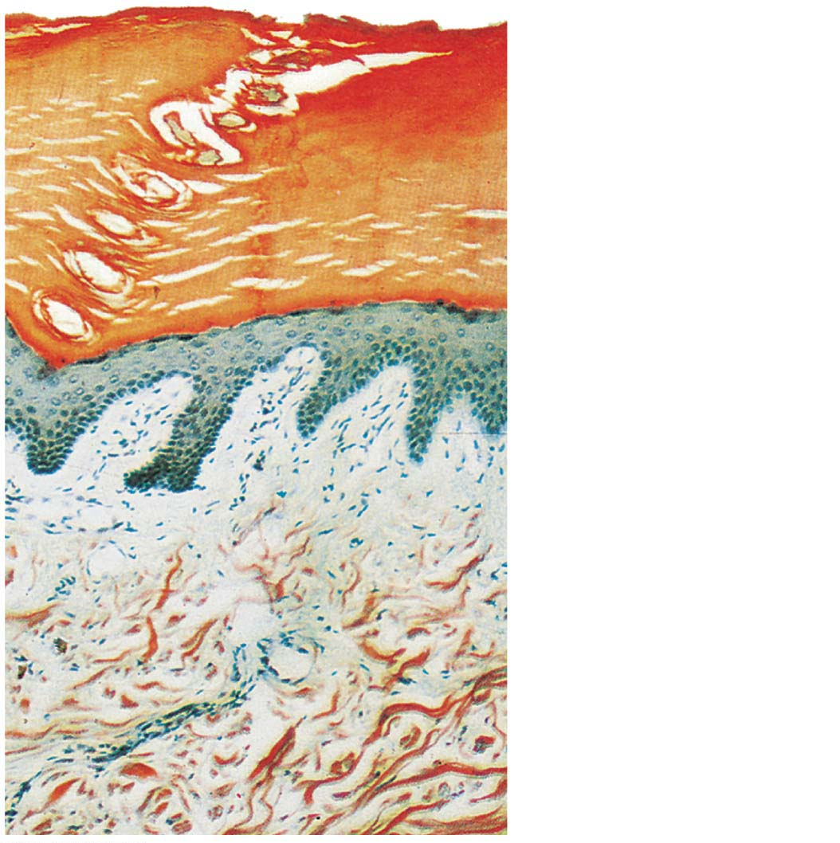
Figure 5.3 Two Layers of the Dermis
Epidermis
Papillary
layer
Dermis
Reticular
layer

Slide 25
Papillary Layer
Superficial layer of areolar connective tissue
Phagocytes to patrol for microorganisms
Dermal papillae: fingerlike projections

Slide 26
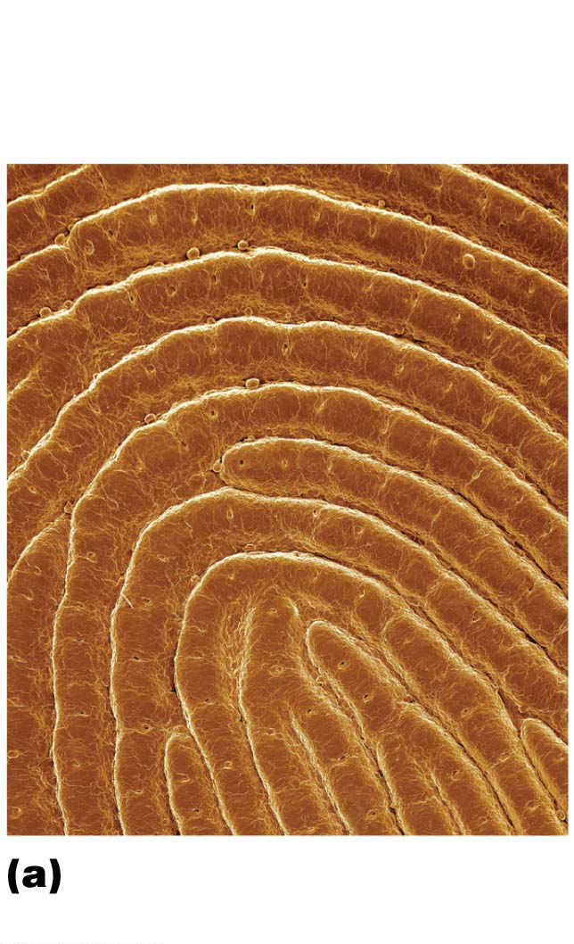
Papillary Layer (cont.)
Openings of
sweat gland
ducts
Friction
ridges
Dermal ridges give rise to epidermal ridges
Collectively ridges are called friction ridges
Enhance gripping ability
Contribute to sense of touch
Sweat pores in ridges leave unique fingerprint pattern
Friction ridges of
fingertip (SEM 12⋅)

Slide 27
Reticular Layer
Makes up ~80% of dermal thickness
Consists of coarse, dense fibrous connective tissue
Pockets of adipose cells

Slide 28
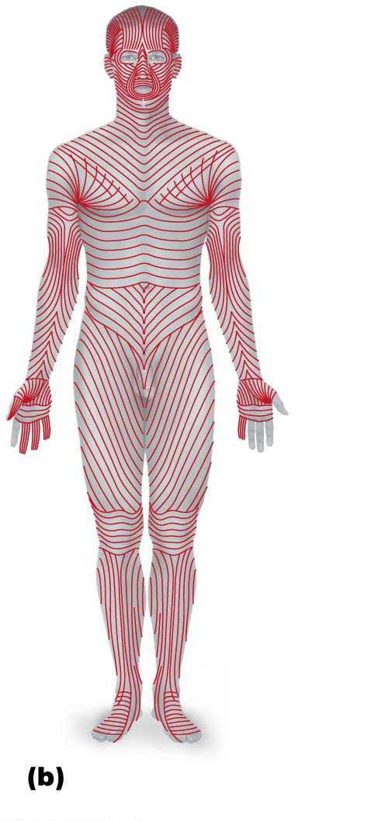
Reticular Layer (cont.)
Cleavage (tension) lines caused by many collagen fibers running parallel to skin surface
Externally invisible
Important to surgeons because incisions parallel to cleavage lines heal more readily

Slide 29
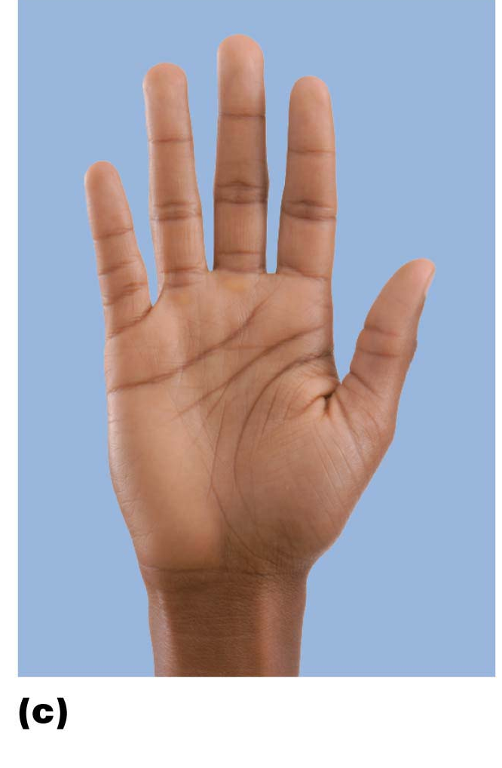
Reticular Layer (cont.)
Flexure lines of reticular layer are dermal folds at or near joints
Dermis is tightly secured
Keeps skin from sliding

Slide 30
Skin Color
Three pigments contribute to skin color
Melanin
Only pigment made in skin; made by melanocytes
Help shield DNA from sunlight
Sun exposure stimulates melanin production
Skin color differences

Slide 31
Skin Color
Carotene
Yellow to orange pigment
Most obvious in palms and soles
Accumulates in stratum corneum
Vision and epidermal health
Hemoglobin
Pinkish hue of fair skin is due to lower levels of melanin
Skin of Caucasians is more transparent, so color of hemoglobin shows through

Slide 32
Hair
Consists of dead keratinized cells
Functions:
Warn of insects on skin
Hair on head guards against physical trauma
Protect from heat loss
Shield skin from sunlight

Slide 33
Structure of a Hair
Hairs (also called pili): flexible strands of dead, keratinized cells
Produced by hair follicles
Contains hard keratin, not like soft keratin found in skin

Slide 34
Hair continued
Regions:
Shaft: area that extends above scalp, where keratinization is complete
Root: area within scalp, where keratinization is still going on

Slide 35
Figure 5.6cd Skin appendages: Structure of a hair and hair follicle.
Follicle wall
• Peripheral
connective tissue
(fibrous) sheath
• Glassy membrane
• Epithelial root sheath
• External root sheath
• Internal root sheath
Hair root
• Cuticle
• Cortex
• Medulla
Hair matrix
Hair papilla
Melanocyte
Subcutaneous
adipose tissue
Diagram of a longitudinal view of the expanded hair
bulb of the follicle, which encloses the matrix
Photomicrograph of longitudinal view
of the hair bulb in the follicle (150⋅)

Slide 36
Structure of a Hair Follicle (cont.)
Hair matrix: actively dividing area of bulb that produces hair cells
As matrix makes new cells, it pushes older ones upward
Arrector pili: small band of smooth muscle attached to follicle
Responsible for “goose bumps”

Slide 37
Structure of a Hair (cont.)
Hair pigments are made by melanocytes in hair follicles
Combinations of different melanins (yellow, rust, brown, black) create all the hair colors

Slide 38
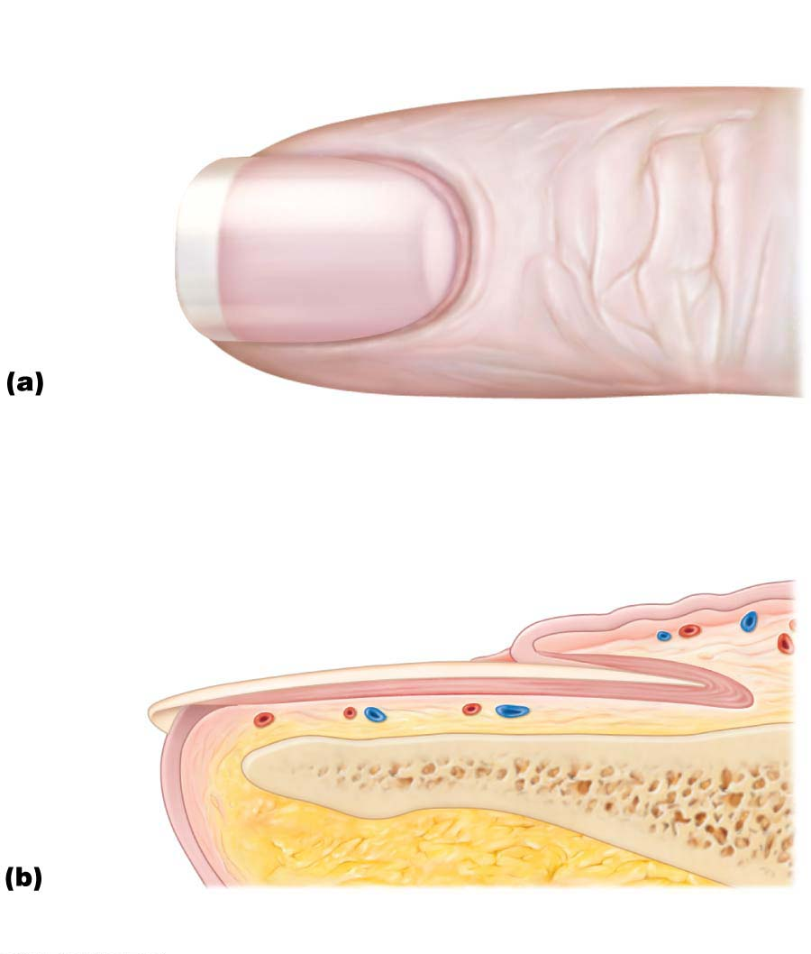
Nails
Lunule
Lateral
nail fold
Scale-like modifications of epidermis that contain hard keratin
Act as a protective cover for distal, dorsal surface of fingers and toes
Consist of free edge, nail plate, and root
Nail bed is epidermis underneath keratinized nail plate
Nail matrix: thickened portion of bed responsible for nail growth
Free edge
of nail
Body
of nail
Eponychium
(cuticle)
Root of nail
Proximal
nail fold
Nail
matrix

Slide 39
Sweat Glands
Also called sudoriferous glands
Two main types
Eccrine (merocrine) sweat glands
Apocrine sweat glands

Slide 40
Eccrine (Merocrine) Sweat Glands
Most numerous type
Abundant on palms, soles, and forehead
Ducts connect to pores
Function in thermoregulation
Secrete sweat

Slide 41
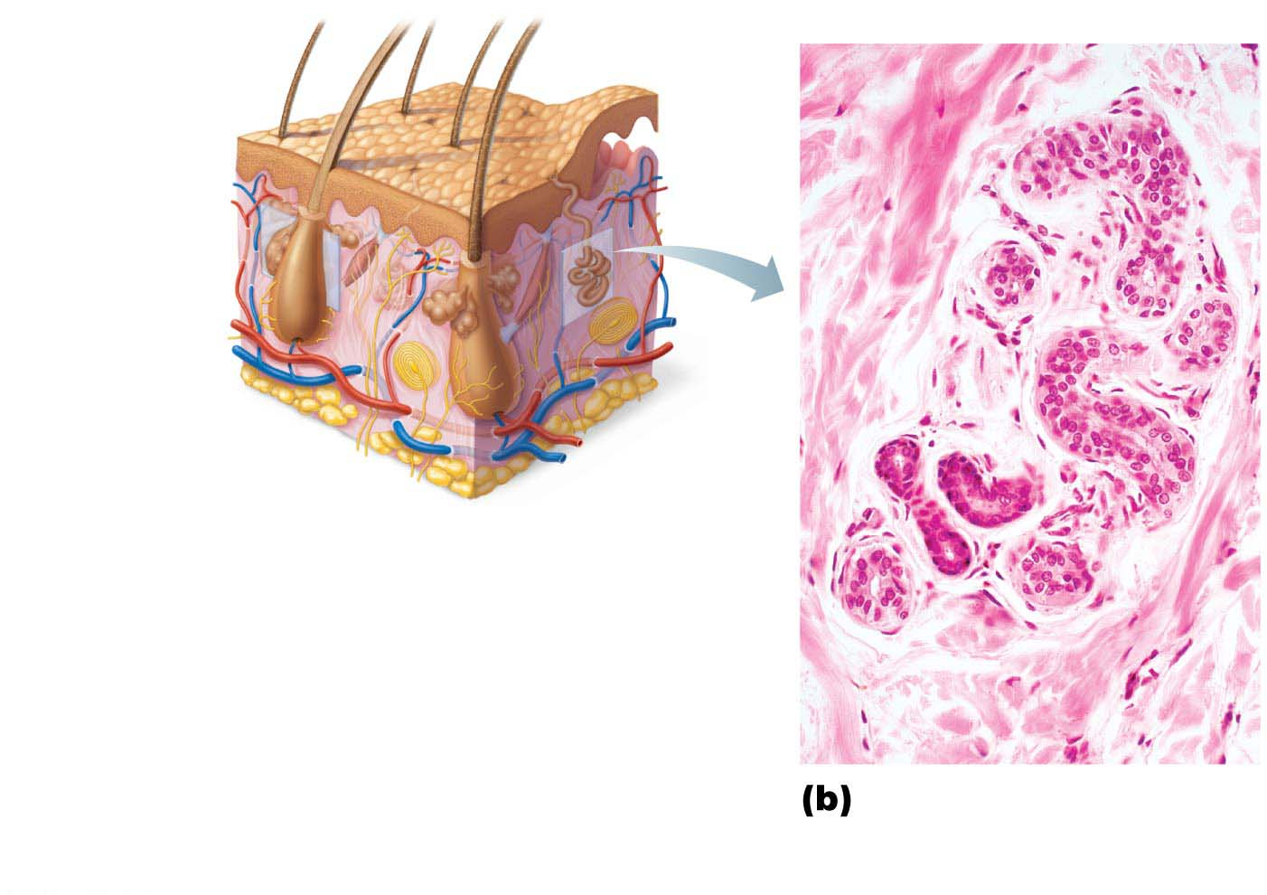
Figure 5.8b Skin appendages: Cutaneous glands.
Sebaceous
gland
Sweat
pore
Eccrine
gland
Duct
Dermal connective
tissue
Secretory cells
Photomicrograph of
a sectioned eccrine
gland (140⋅)

Slide 42
Apocrine Sweat Glands
Confined to axillary and anogenital areas
Secrete viscous milky or yellowish sweat that contains fatty substances and proteins
Breakdown leads to body odor
Larger than eccrine sweat glands with ducts emptying into hair follicles
Begin functioning at puberty

Slide 43
Sebaceous (Oil) Glands
Widely distributed, except for thick skin of palms and soles
Most develop from hair follicles and secrete into hair follicles
Secrete sebum
Oily secretion
Softens hair and skin

Slide 44
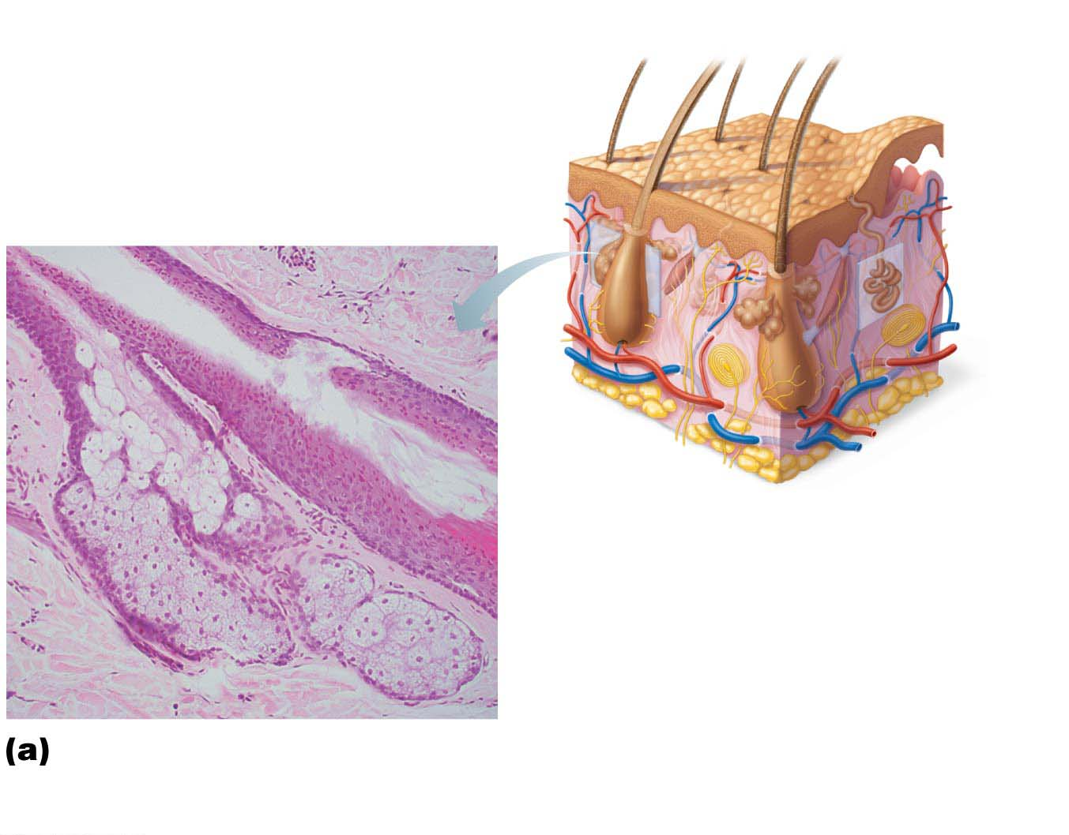
Figure 5.8a Skin appendages: Cutaneous glands.
Dermal
connective
tissue
Sebaceous
gland
Sweat
pore
Sebaceous
gland duct
Hair in
hair follicle
Eccrine
gland
Secretory cells
Photomicrograph of a
sectioned sebaceous
gland (90⋅)

Slide 45
Clinical – Homeostatic Imbalance 5.6
Whiteheads are blocked sebaceous glands
If secretion oxidizes, whitehead becomes a blackhead
Acne is usually an infectious inflammation of the sebaceous glands, resulting in pimples

Slide 46
Skin Cancer and Burns
Skin can develop over 1000 different conditions and ailments
Less common, but more damaging, are:
Skin cancer
Burns

Slide 47
Skin Cancer
Most skin tumors are benign (not cancerous) and do not spread (metastasis=spreading)
Risk factors
Overexposure to UV radiation
Frequent irritation of skin
Three major types of skin cancer
Basal cell carcinoma
Squamous cell carcinoma
Melanoma

Slide 48
Skin Cancer (cont.)
Basal cell carcinoma
Least malignant and most common
Stratum basale cells proliferate and slowly invade dermis and hypodermis
Basal cell carcinoma

Slide 49
Basal Cell Carcinoma

Slide 50
Skin Cancer (cont.)
Squamous cell carcinoma
Second most common type; can metastasize
Involves keratinocytes of stratum spinosum
Usually is a scaly reddened papule on scalp, ears, lower lip, or hands
Squamous cell
carcinoma

Slide 51
Skin Cancer (cont.)
Melanoma
Cancer of melanocytes
Most dangerous type because it is highly metastatic and resistant to chemotherapy
Melanoma

Slide 52
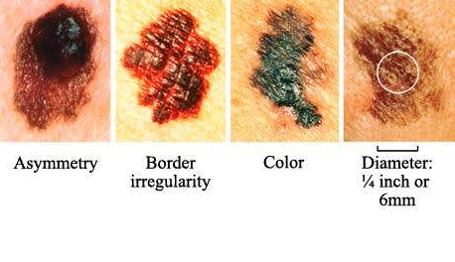
ABCDE rule
A: asymmetry; the two sides of the pigmented area do not match
B: border irregularity; exhibits indentations
C: color; contains several colors (black, brown, tan, sometimes red or blue)
D: diameter; larger than 6 mm (size of pencil eraser)
E: evolve

Slide 53
Burns
Tissue damage caused by heat, electricity, radiation, or certain chemicals
Immediate threat is dehydration and electrolyte imbalance
Rule of Nines
Evaluates burns
Used to estimate volume of fluid loss

Slide 54
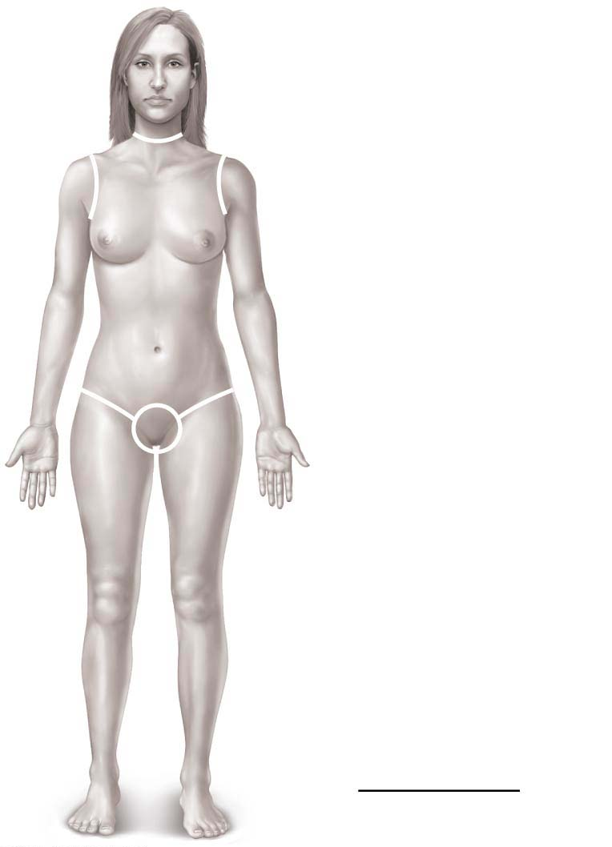
Figure 5.11 Estimating the extent and severity of burns using the rule of nines.
Totals
4¹⁄₂%
Anterior and posterior
head and neck, 9%
Anterior and posterior
upper limbs, 18%
4¹⁄₂%
4¹⁄₂%
Anterior and posterior
trunk, 36%
Anterior
trunk, 18%
9%
9%
Perineum, 1%
Anterior and posterior
lower limbs, 36%
100%

Slide 55
Burns (cont.)
Burns can be classified by severity
First-degree
Epidermal damage only
Localized redness, edema (swelling), and pain
Second-degree
Epidermal and upper dermal damage
Blisters appear
First- and second-degree burns are referred to as partial-thickness burns because only the epidermis and upper dermis are involved
1st-degree
burn
2nd-degree
burn
Skin bearing partial-thickness
burn (1st- and 2nd-degree burns)

Slide 56
Burns (cont.)
Burns can be classified by severity (cont.)
Third-degree
Entire thickness of skin involved (referred to as full-thickness burns)
Skin color turns gray-white, cherry red, or blackened
No edema is seen and area is not painful because nerve endings are destroyed
Skin grafting usually necessary

Slide 57
3rd-degree
burn
Skin bearing full-thickness
burn (3rd-degree burn)

Slide 58
Burns (cont.)
Burns are considered critical if:
>25% of body has second-degree burns
>10% of body has third-degree burns
Treatment includes:
Debridement (removal) of burned skin
Antibiotics
Temporary covering
Skin grafts

