Slide 1
Shirley Hills Elementary Open House
2022-2023
Ms. Nieves, Mrs. Harthorne, Mrs. Steeh, Ms. Simpson,
Mrs. Ussery, and Dr. Descartes

Slide 2
Schedule

Slide 3
I/E Time
At Shirley Hills, “Learning is Required” and all students must be on grade level. Therefore, every student will participate in a thirty-minute period of Intervention/Extension (I/E) time. At this time, students will rotate classrooms and will be provided with targeted instruction by one of our kindergarten teachers. During I/E time, different instructional strategies will be used to meet your child’s needs. Teacher(s) will track your child’s progress over time to monitor his/her success throughout the year. Groups are often flexible and may change based on your child’s progress.

Slide 4
Reading Expectations
-Students will know all letters and letter sounds by the end of October
-Students will be able to answer questions about texts read aloud
-Students will be reading on a level G by the end of the school year
To Help:
-Please have your student read from their bag of books at least 20 minutes a day
-Please ask your students questions about what they are reading

Slide 5
Reading Expectations
By the end of the school year students should be able to:
- listen and differentiate two sounds
- identify and produce rhyming words
- count out the syllables in words
- break apart the beginning, middle, and ending sounds in words

Slide 6
Reading Resources
Letter & Sound Practice with Songs and Movement:
https://www.youtube.com/watch?v=4rt1syuknWE
https://www.youtube.com/watch?v=dLReNTmMkKA
https://www.youtube.com/watch?v=TTb4Dkyt2pA
https://www.youtube.com/watch?v=qwOQvh_mJ4w
https://www.youtube.com/watch?v=WP1blVh1ZQM&t=168s
Students can also go to ABCYa.com to practice skills in reading and math, or work on Iready. Student login is needed for this resource. Please see your child’s teacher for this.

Slide 7
Math Expectations
- Students will be able to count to 30 by 1s by September 9th
-Students will be able to count out 12 objects in a row by September 9th
- Students will be able to write digits 0-10 by September 9th
To Help:
- Please have your student count out loud by 1s and 10s daily
- Please have your student practice counting objects they see
- Please have your student practice writing their digits daily

Slide 8
Math Expectations
By the end of the school year students should be able to:
- count to 100 by 1s and 10s
- sort objects by size, shape, and color
- count out up to 20 objects in a pile, line, circle, or rectangular array
- write the matching number to a set of objects
- identify 2D and 3D shapes
- compare two digits and sets of objects
- fluently answer addition and subtraction problems within 10 (student will show or explain how they reached an answer)

Slide 9
Math Resources
1) Search ‘Jack Hartmann Kindergarten math songs’ on youtube.com
2) Count and sort everyday objects (i.e. pennies, pencils, socks, etc.)
3) Write numbers 0-20 in highlighter and have your student trace in pencil
4) abcya.com is a free website with several games linked to our math standards
5) Contact your child’s teacher for resources

Slide 10
Writing Expectations
- Students should by able to write their own name by the end of August
- Students should be able to write all upper and lowercase letters by the end of September
- Students should be able to draw a picture and explain their drawing to another person (picture should match students’ words)
To Help:
- Please have your student practice writing their name daily
- Please have your students practicing writing the letters of the alphabet daily
- Please ask your students about the pictures they draw

Slide 11
Writing Expectations
By the end of the school year students should be able to:
- Draw and write on a five-page booklet
- Students will be able to read their booklet
- Students will use phonetic spelling for complex or unknown words

Slide 12
Writing Resources
ABCYa.com is an app/website that has many educational games.
Handwriting Wizard is a free app that help students learn how to write letters, numbers, and words.
LetterSchool-Learn to Write is a free app that has stimulating games to help with writing and phonics.
Search Jack Hartmann handwriting on Youtube.
For more additional resources, you may contact your child’s teacher.

Slide 13
Behavior Expectations
Shirley Hills Elementary Behavioral Expectations:
1. Be Safe
2. Be Caring
3. Be Respectful
4. Be Responsible
5. Be Mindful

Slide 14
Vision at Shirley Hills
At Shirley Hills Elementary, our vision is through the implementation of the PBIS framework, we will create a caring and positive school culture where each student and staff member feels safe, supported, and celebrated in a safe and nurturing learning environment where ALL can learn and grow at high levels.

Slide 15
PBIS at Shirley Hills
PBIS is an approach in behavior management on a school wide level, in a specific setting such as the playground, halls, cafeteria, bathrooms, the classroom, or with an individual student. PBIS methods are research-based and have been proven to significantly reduce the occurrence of problem behaviors. One of the keys to success is to focus on prevention. It is based on the idea that when students are taught clearly defined behavioral expectations and provided with predictable responses to their behavior, both positive and corrective, 80-85% of students will meet these expectations.

Slide 16
School Wide PBIS Acknowledgements
1. Mustang Points (DOJO): Students earn Class Dojo points for following school wide expectations. All staff members including bus drivers may give out Class Dojo points..
2. Mustang Celebration: At the end of each month, all students who followed school wide expectations, earned required Class Dojo points and did not have a PFI, ISS or OSS will participate in the PBIS Mustang Celebration. At the end of each semester, students who have met the requirements for monthly celebrations and Class Dojo points will attend the VIP Celebration.
3. Mustang Mall: At certain intervals throughout the school year, students will bring their earned Mustang Points to purchase items at the mall.
4. Mustang Student of the Month: Each homeroom teacher will select a student who has followed all school wide expectations for the month. This student will receive a special reward for making the right choices.

Slide 17
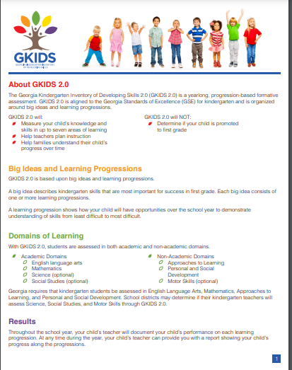
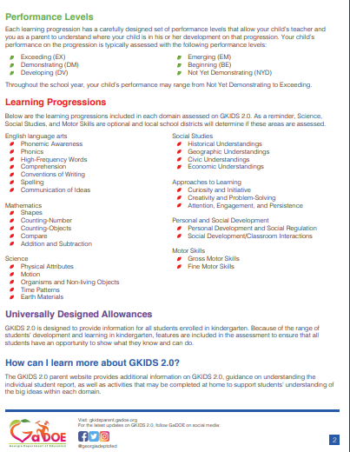
GKIDS
- Kindergarten students are currently completed the GKIDS Readiness Assessment which is based off the Pre-K standards (GELDS) on where they are coming into kindergarten.
- GKIDS Readiness assess students on Pre-Kindergarten skills
- GKIDS 2.0 is an assessments completed all throughout the school year in Reading, Math, Writing, and Behavior.
Parent Website:
https://gkidsparent.gadoe.org/Pages/Home.aspx

Slide 18
Priority Standards

Slide 19
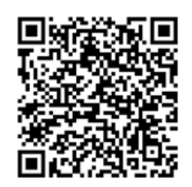
Thank you for coming!!! Please complete the parent survey below: https://forms.office.com/r/zgXYBuSLPM

