Slide 1
Dr. Jacquelyn Pope
7/28/2022
4:00 PM
Houston Virtual

Slide 2
Welcome to Third Grade!!
Brielle Brown
Allyson Gilmore
Cannie Lester
Shi Hong Lin
Cassidy Lopez
Isabelle Ray
Jack Stoner
Miracle Terrell
Garrett Upthegrove
Undre Williams
Alayna Wooten

Slide 3
Greetings
Virtual learning
Schedule
Breakfast
Schedule
Subjects/lessons
Rules and Expectations
Assessments
Homework
Supplies
Technology
Communication
Reminders
Questions

Slide 4
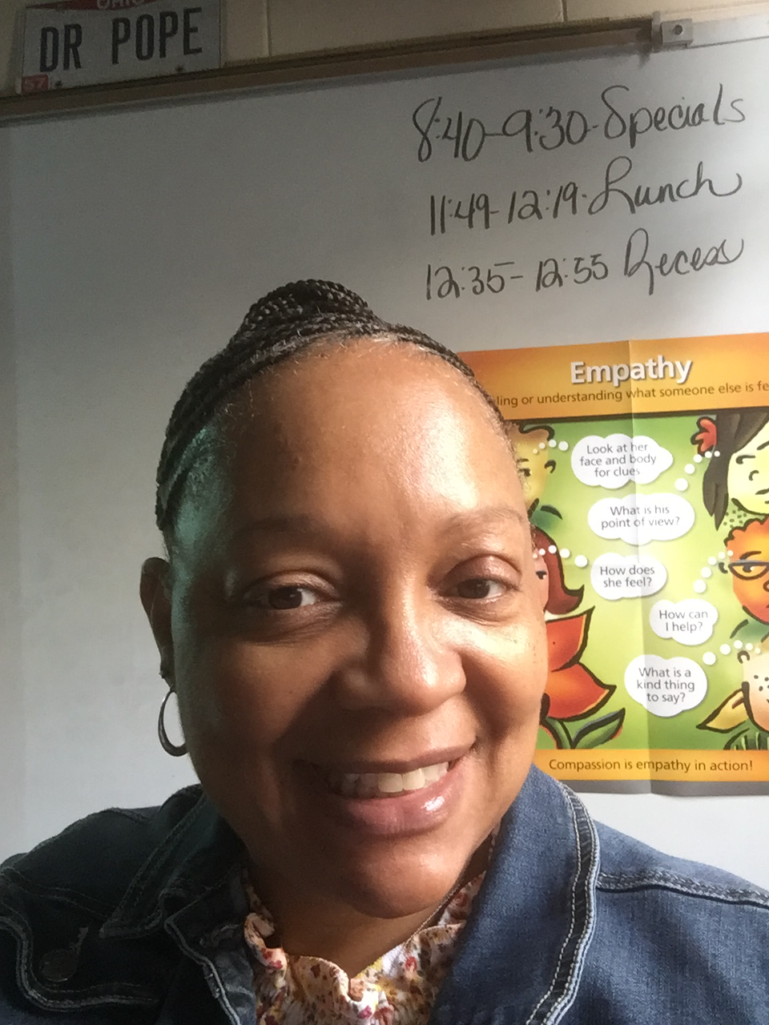
Dr. Jacquelyn Pope
24 years of teaching experience (K-8)
5th year teaching at Bonaire
Bachelor of Science-Elementary Education
Masters in Education
Ph.D. Curriculum and Instruction
Reading Endorsement
Married 32 Years
Three daughters, one son
Five grandchildren

Slide 5
Virtual learning is exactly what it sounds like: classrooms and subject materials are all covered virtually.
For virtual learning to work effectively, the content must be of a very high standard tailored to the online learning environment. This is what promotes students’ academic success.

Slide 6
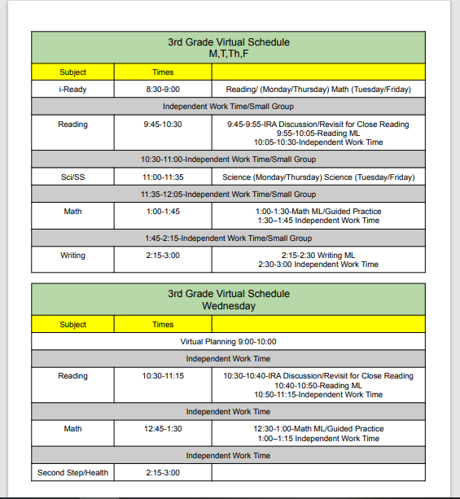

Slide 7
Students should have breakfast before we begin at 9:25 AM
Students are welcome to have a snack near during sessions

Slide 8
Start Time
Students will have morning work and I-Ready to complete (M, T, Th, F)
Morning work on Wednesdays
Class begins at 9:25 AM
Wednesday’s Focus is on ELA and reviewing lessons

Slide 9
We will have a daily morning meeting to provide the opportunity for students to pose questions, concerns or just to share information

Slide 10
Will include three components:
Interactive read aloud
Mini lesson
Phonic/word study

Slide 11
Unit 1
Crafting True Stories

Slide 12
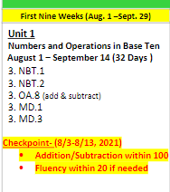

Slide 13
Ecosystems
Ask questions to differentiate between plants, animals and habitats found in Georgia

Slide 14
Unit 1
Connecting Themes
I can statement(s):
● I can explain rules by…
● I can discuss beliefs that are important to me.
● I can be a responsible citizen of my school by…..

Slide 15
12:05-12:35
Remaining time used to complete assignments

Slide 16
3 PM
Remaining time used to complete assignments
Homework

Slide 17
SOAR
S-Safety First
O-On Task
A-Awesome Attitude
R-Respectful and Responsible

Slide 18
Informative Assessments:
Quizzes
Reflection writing
Discussions
Homework
I-Ready
Summative Assessments
GMAS
MAP

Slide 19
Mathematics practice
Repeated reading passage
Silent reading 20 minutes per day

Slide 20
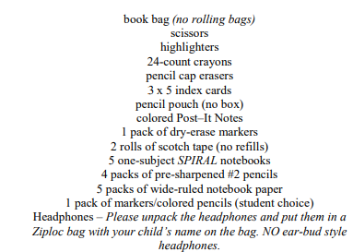

Slide 21
All Houston County Students will receive a Chromebook
Houston County Career Academy 1311 Corder Road Warner Robins, GA 31088
Wednesday, July 27, 2022 8:30 AM-11:00 AM 1:00 PM-4:00 PM
Thursday, July 28, 2022 8:30 AM-11:00 AM 1:00 PM-4:00 PM

Slide 22
Resources
Math
Fun Math Activities for 3rd, 4th & 5th Grade | Houghton Mifflin Harcourt (hmhco.com)

Slide 23
Class Dojo
Jacquelyn.pope@hcbe.net
(478) 929-7826
JPope741@gmail.com
937-243-2935

Slide 24
Days for teacher/student interaction in person
Dates will be determined soon

Slide 26
Zoom link in class dojo for 8/1/22
Class will begin at 9:25 daily

