Slide 1


Welcome to our Hive!
Mrs. Boshell’s 2nd Grade Class

Slide 2

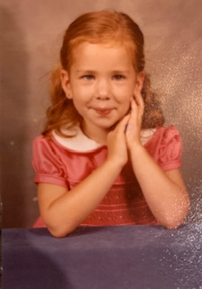
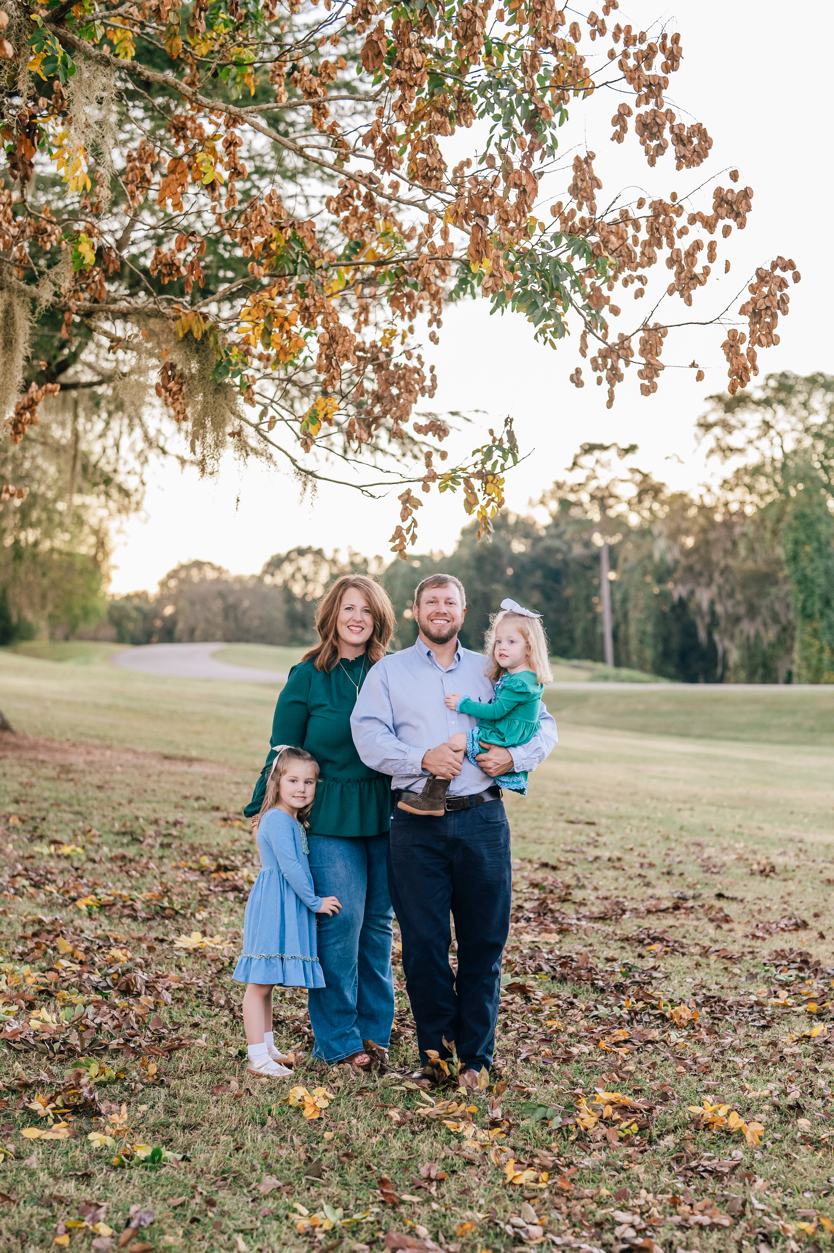

Meet Mrs. Boshell
This is my 21st year teaching. I have taught 2nd grade for 17 years.
My Family
Mrs. Boshell
in 2nd grade

Slide 3

Supplies and Fees
*This year basic school supplies have been purchased for every student, but there are some additional items that parents will need to purchase.

Slide 4

Extras and Lunchroom prices
Extra items to purchase
PPS t-shirt-$15.00
PPS tote bag-$15.00
(book bags are not allowed at PPS)
Lunchroom Information
All Autauga County Students will receive free breakfast. Lunch will be $2.75 daily.

Slide 5

Orientation Packet Pick-Up
2nd grade Open House:
August 3rd from 4:00-5:30
Please make every effort to pick up your child’s folder. It contains all the beginning of school paperwork and important information. You may send the completed folder with your child on the first day of school.

Slide 6
Orientation Information
In addition to the PPS videos (found on our website) There is a lot of information in your Orientation Folder.
Back to School Paperwork
Classroom Handbook
Car Rider Sign
Transportation tag
**It is very important that your child wears this tag the first week whether they are a bus rider or a car rider. Please send in the completed forms and money on the first day of school.

Slide 7
First Week of School
The first day of school is August 9th .
All parents of 1st graders and 2nd graders will be allowed to walk their child to class this year with a staggered start schedule.
Yellow hall students will use the Wetumpka Street entrance.

Slide 8
Get Ready for an
Un “Bee”lievable
Year!

