Slide 1
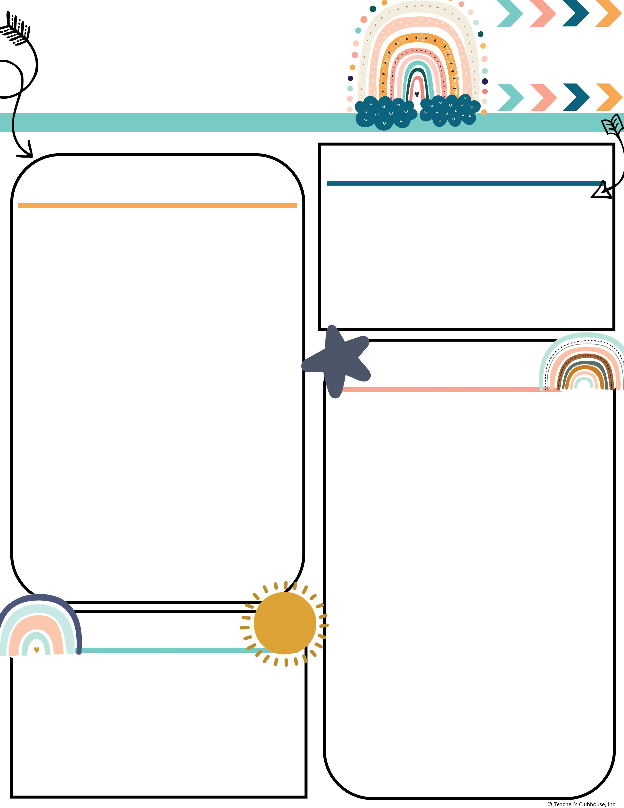
Every Student Empowered. Every student succeeds.
Second Grade, E122
334.285.0273
Remind App @6bc96eg
joan.johnston@elmoreco.com
Ms. Johnston’s
Newsletter
Week of October 21-25, 2024
Upcoming Events
A Peek at Our Week
October 21st ~ Be a champ reading logs are due
October 22nd ~ PTO Meeting @ 6pm
October 23rd ~ Wonderful Wednesday Snack. All items $2.
October 25th ~ Booster Thon Run Fundraiser
October 28th ~ Happy Birthday Roderick!
October 28 – November 1 ~ Red Ribbon Week
October 31st ~ Candy Grab! Send a bucket with your child.
Reading:
Reading:
Benchmark
r controlled vowel → ar
  EX: farm, charm, scar
Great link to decodable books! I encourage you to utilize this free resource:
https://portal.flyleafpublishing.com/learners-resources/
Word Study: car, march, farm, shark, garden, smart, hard, star, large, yard
Grammar:
Irregular verbs ~
  EX: come ~ came; go ~ went
Comprehension:
Identify Main Topic and Key Details
Describe a Connection Between a Series of Events, Ideas, Concepts, or Steps
Compare and Contrast Key Points in Two Texts on the Same Topic to Make Connections Across Texts
Math:
Solving addition problems using different strategies
Writing/Language:
Writing complete sentences
Informative/Explanatory Essay
Science/Social Studies:
Code.org; Lady Liberty, American flag, government
Weekly Homework
Please check your child's folder for their homework that will be due on Friday
Tests this week
Math ~ Topic 2 Test on Arrays Wednesday
Untimed Math Addition Facts Test (Thursday)
Quarter 2 Sight Words:
Week 1: again, below, carry, does, eight, find, house, laugh, mother, school
Week 2: move, their, never, too, once, walk, round, where, small, year
Week 3: all, done, away, even, better, found, by, learn, change, only
Week 4: long, through, now, upon, our, was, some, when, them, work
Week 5: always, draw, any, four, blue, great, buy, how, city, live
Week 6: another, from, boy, hurt, could, out, every, over, far, these
Reminders
Attendance Matters! Be Present, Be Powerful!
Please send in bags of candy for the candy grab!
Every Wednesday is Wonderful Wednesday Snack. All items are $2. Every Friday is hat day for $1.

