Slide 1
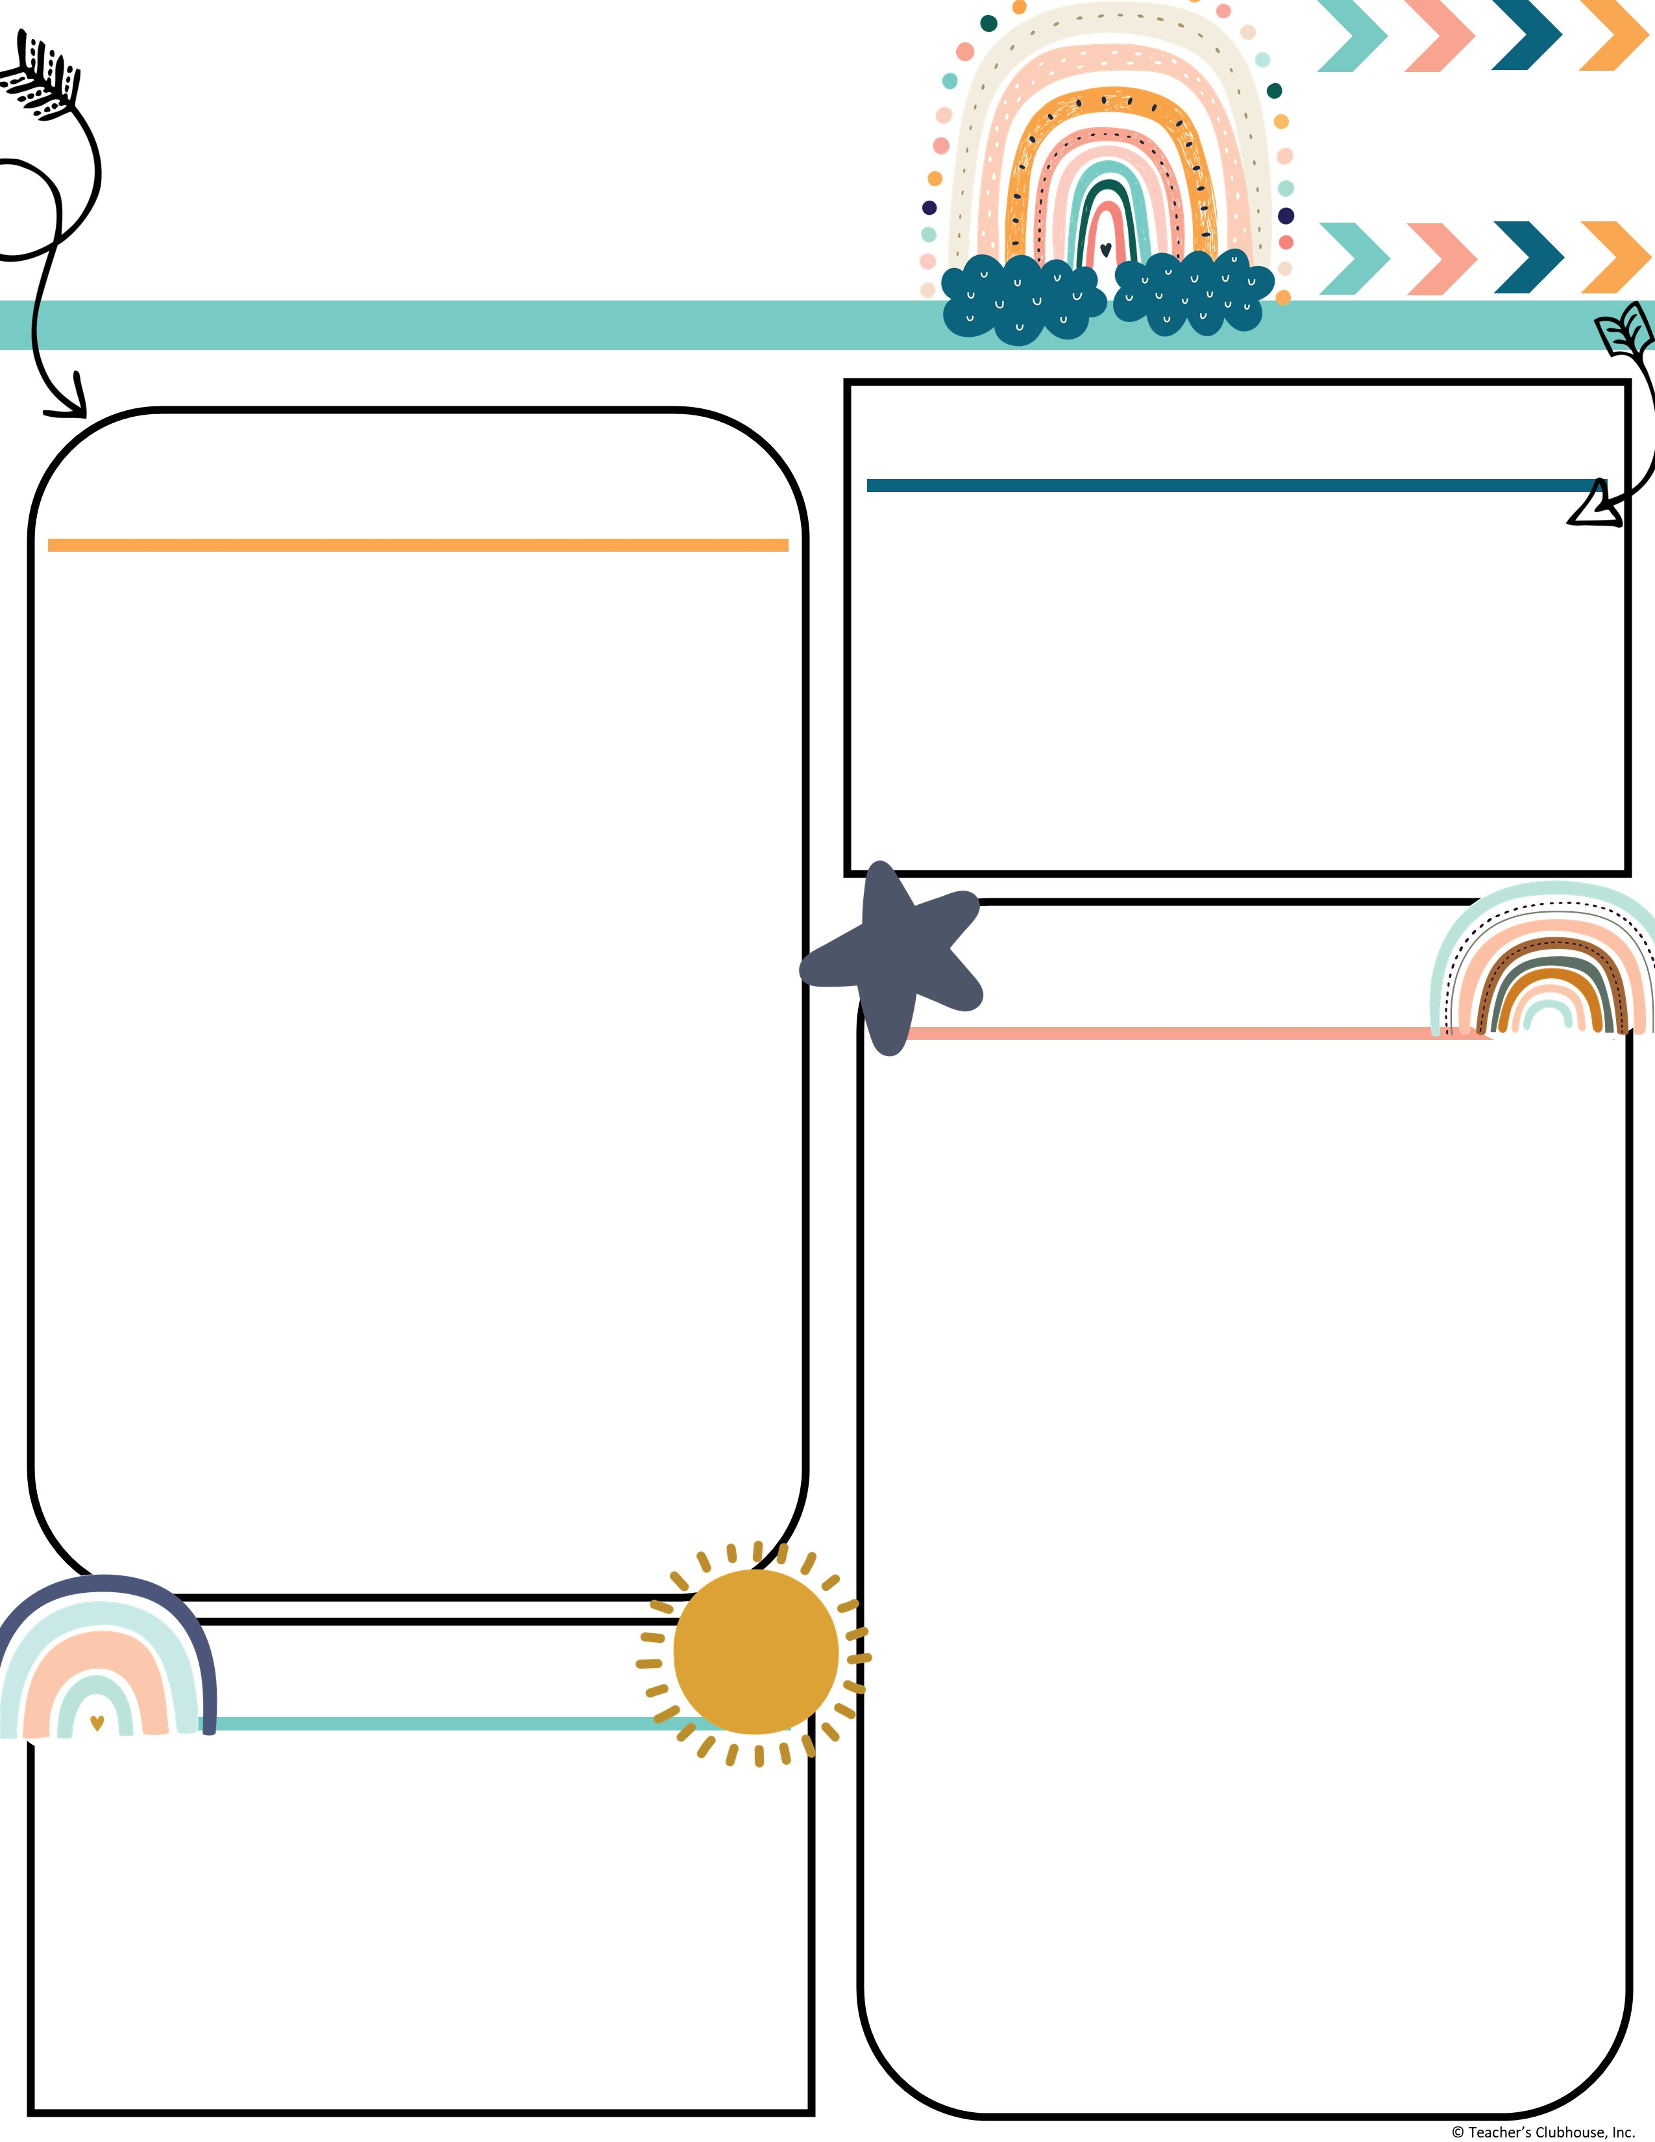
Every Student Empowered. Every student succeeds.
Second Grade, E122
334.285.0273
Remind App @6bc96eg
joan.johnston@elmoreco.com
Ms. Johnston’s
Newsletter
Week of November 4-8, 2024
Upcoming Events
A Peek at Our Week
November 6th – Wonderful Wednesday Snack ($2)
November 8th – STEM day
November 11th – No school Veteran’s Day
November 12th – Turkey Disguise Project Due and Math/STEM Night
November 14th – Progress Reports and Happy Birthday Steelman!
November 19th – Friendsgiving Lunch at 12:10
November 25th – 29th – No School
December 5th – Field Trip
Reading:
Reading:
Benchmark
r controlled vowel → er, ir, ur
  EX: fern, bird, turn
Great link to decodable books! I encourage you to utilize this free resource:
https://portal.flyleafpublishing.com/learners-resources/
Word Study: bird, never, burn, nurse, girl, shirt, her, third, hurt, winter
Grammar:
Adjectives/Adverbs
Comprehension:
Use Illustrations and Words to Demonstrate Understanding of Characters, Setting, or Plot
Acknowledge Differences in the Points of View of Characters
Math:
Two Digit Addition → Solving addition problems using different strategies (Number line, hundreds chart, break apart number, partial sums, mental math)
Writing/Language:
Writing complete sentences
Informative/Explanatory Essay
Science/Social Studies:
Government
Weekly Homework
Please check your child's folder for their homework that will be due on Friday
Tests this week
Reading Comprehension Test 3 ~ Wednesday and Thursday
Math ~ 3 minute Timed Math Addition Facts Test (Friday)
Quarter 2 Sight Words:
Week 1: again, below, carry, does, eight, find, house, laugh, mother, school
Week 2: move, their, never, too, once, walk, round, where, small, year
Week 3: all, done, away, even, better, found, by, learn, change, only
Week 4: long, through, now, upon, our, was, some, when, them, work
Week 5: always, draw, any, four, blue, great, buy, how, city, live
Week 6: another, from, boy, hurt, could, out, every, over, far, these
Reminders
Attendance Matters! Be Present, Be Powerful!
Please send in bags of candy for the candy grab!
Every Wednesday is Wonderful Wednesday Snack. All items are $2. Every Friday is hat day for $1.

