Slide 1
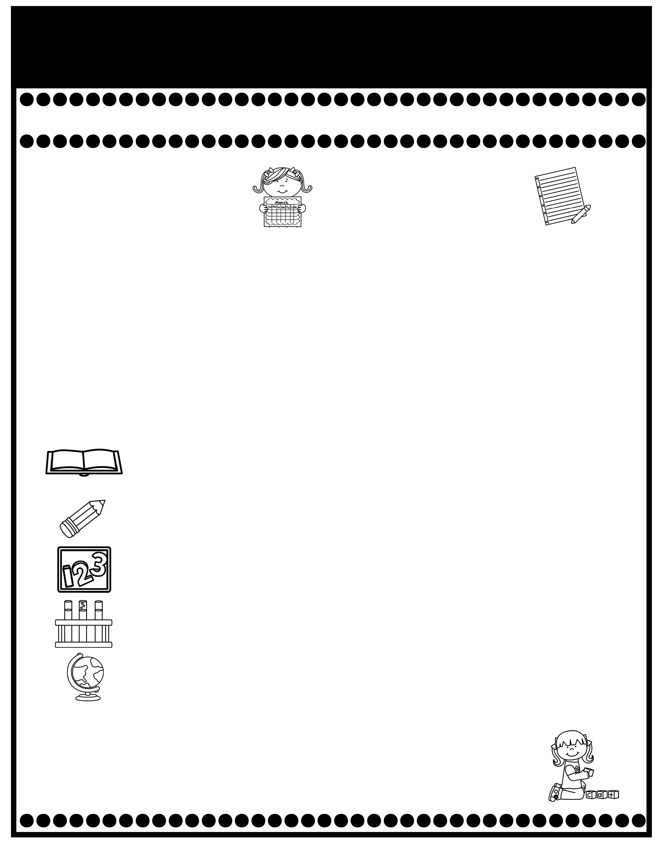
Branning’s Buzz
Week of: February 9-13, 2026
What’s Happening
This Week
Upcoming Events
Tuesday Folders will be sent home Tuesday. Please sign and return.
Please read A.R. books for our PPS Reading Olympics! It runs
from Feb. 6-20. Students must have at least a 90% avg. in A.R.
The top three point earners in each grade will win medals.
The cost for snack is $1.00 each. Please send exact change.
A Weekly Reading Overview page will be sent home each week to help you practice skills and vocabulary words with your child. Also, nightly reading homework will be assigned in your child’s Take Home Binder. Please don’t remove pages.
We are now taking A.R. tests to meet the school wide challenge. Library books are now allowed to go home each night with your child but must be returned to school each day. A Reading Log was placed in your child’s Take Home Binder. Please sign the log when your child has read the book 3 times and is ready to test. Students need to take at least 2 tests a week to meet their goal. Thank you for helping your child.
February 9: Leadership Sessions in the Auditorium
February 12: Send in items for party.
February 13: Send in Valentine’s cards
February 16: Teacher Work Day (No school)
February 17: Progress Reports
Please review test papers & return them to school. Sign the back of the folder. Please don’t take the test papers out. I keep them on file for the entire year. You don’t have to sign each test paper, unless I have stamped it.
If you have questions or concerns, you may email me at Wendy.branning@acboe.net.
A Peek At What We Are Learning
Reading | Phonics: _y (long e sound), ie, ey Comprehension: Classify & categorize, Captions Vocabulary: remote, transportation, population, responsibilities, cooperation 2/13 Dicatation
Writing/ Grammar | Summaries Penmanship: Lowercase letters u, m, v, w, k, & z 2/13 Minor Grammar Grade (Subject/verb agreement)
Math | Complete Topic 8: Tens and Ones 2/10 Topic 8 Test (Review pages will be sent home Monday)
Science | We rotate Science and Social Studies
Social Studies | George Washington Unit
Spelling Words
No Spelling Test will be given until Unit 7.
.

