Slide 1
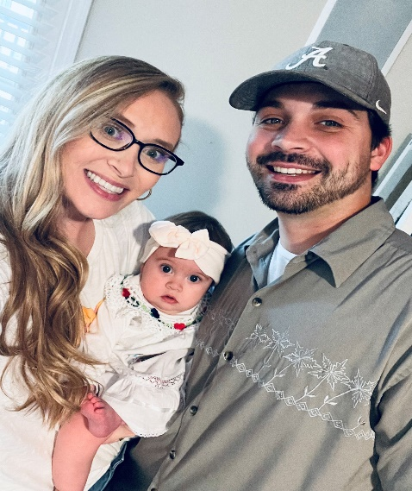
Meet Your Teacher
ABOUT ME
Hello, my name is Mrs. Michael and I am 30 years old. I am currently attending troy university to obtain my masters degree. I am married to my high school sweet heart, have a daughter named zoe kate and a maltese. I am excited for the 2024-2025 school year! My love for teaching is surreal.
MY FAVORITES
Color: Pink
Food: zaxby’s
Movie: legally blonde
Drink: Coffee and sweet tea
Season: spring and summer
Candy: anything sour
Thing to do: spend time with my family and visit the beach!
HOBBIES
CONTACT INFORMATION
I love to go on walks with my daughter and fur baby.
I like to play board games with my husband.
I love to visit the beach.
Coosada Elementary School, Room c101
334-285-0273
sarah.Michael@elmoreco.com
Remind app

