Slide 1
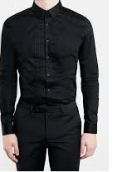
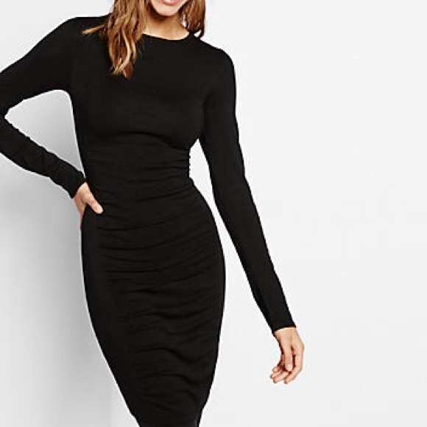
MMS Band Concert Uniform
Black long sleeve dress shirt or sweater
Black Dress Slacks or Dress
Black Dress shoes (no heels or wedges – for safety)
Parents will purchase the uniform pieces on their own from any store.

