Slide 1
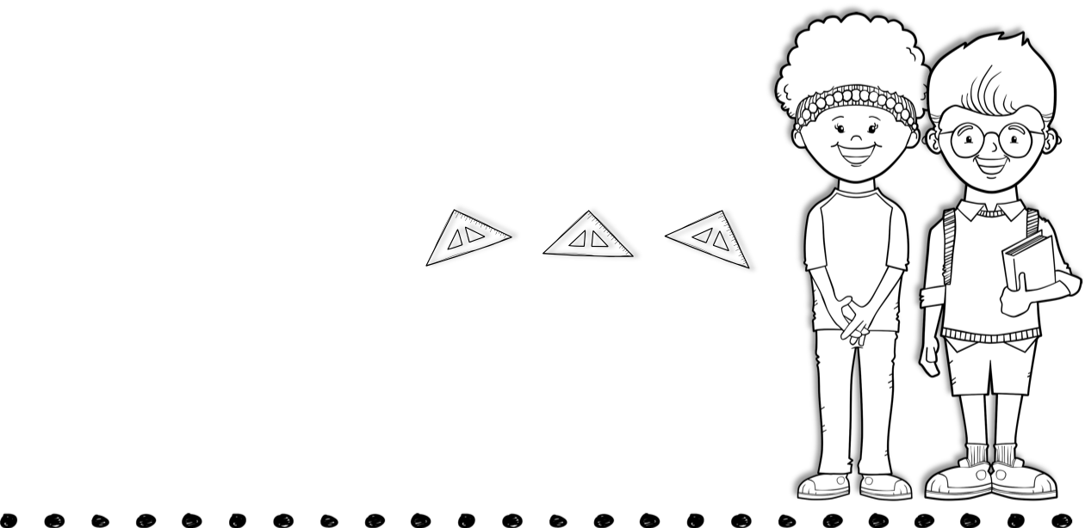
November 8th-12th
Skills for the Week
Contact Me
Reading- asking and answering questions, text features, identifying the main purpose of a text, & main idea
Writing-informative text
Math- word problems & adding and subtracting with regrouping
Language-pronouns
662-429-9117
mariann.word@dcsms.org
Text
Vocabulary Words
Tests
No vocabulary words this week!
Spelling, reading, and math test this week.
Spelling Words
last bill fact
quilt wish came
shave like stone
June farmer shook
tool feet meet
do does don’t
didn’t do
Upcoming Events
November 16th- Progress Reports
November 22-26- Thanksgiving Holiday

