Slide 1
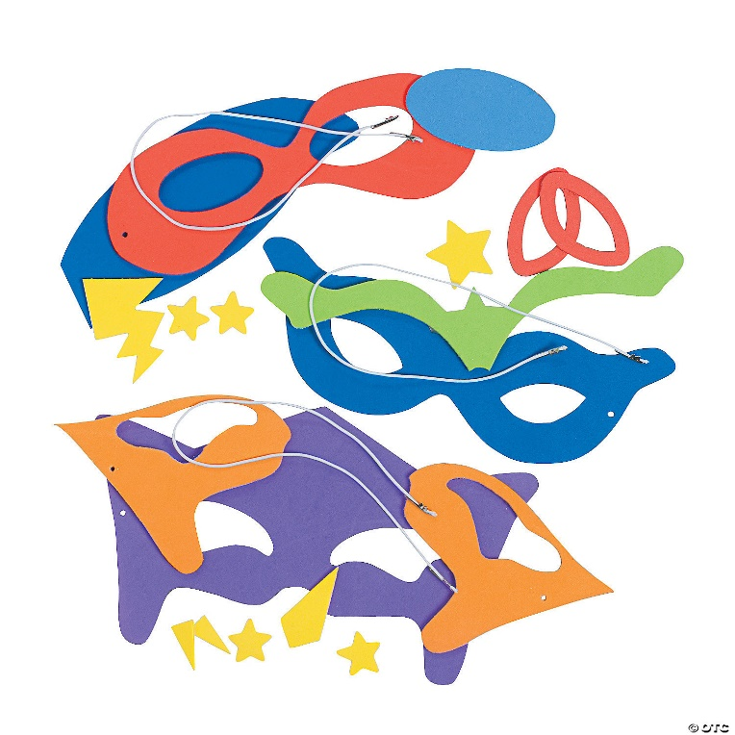
Making of a Superhero
Students create their own superhero masks and wrist cuffs in this make and take writing workshop. Brainstorm a superhero name and discover their superhero powers. Workshop culminated with engineering a Superhero kites and fliers.
Grades: Pre-k-2

