Slide 1
Mrs. Kicklighter’s 2nd Grade Class Orientation
Created by: Ashley Magee, firstgradebrain.com Graphics © ThistleGirlDesigns
Notes:
SAVE THIS FILE WITH A DIFFERENT NAME TO PRESERVE THE ORIGINAL FILE FOR FUTURE USE! Click the text box to add your name, school name, date, etc. After saving with a different file name, delete any slides you do not plan to use. Add new slides (see blank slides at the end of the presentation). Drag the slides to re-order them to fit your needs.
*

Slide 2
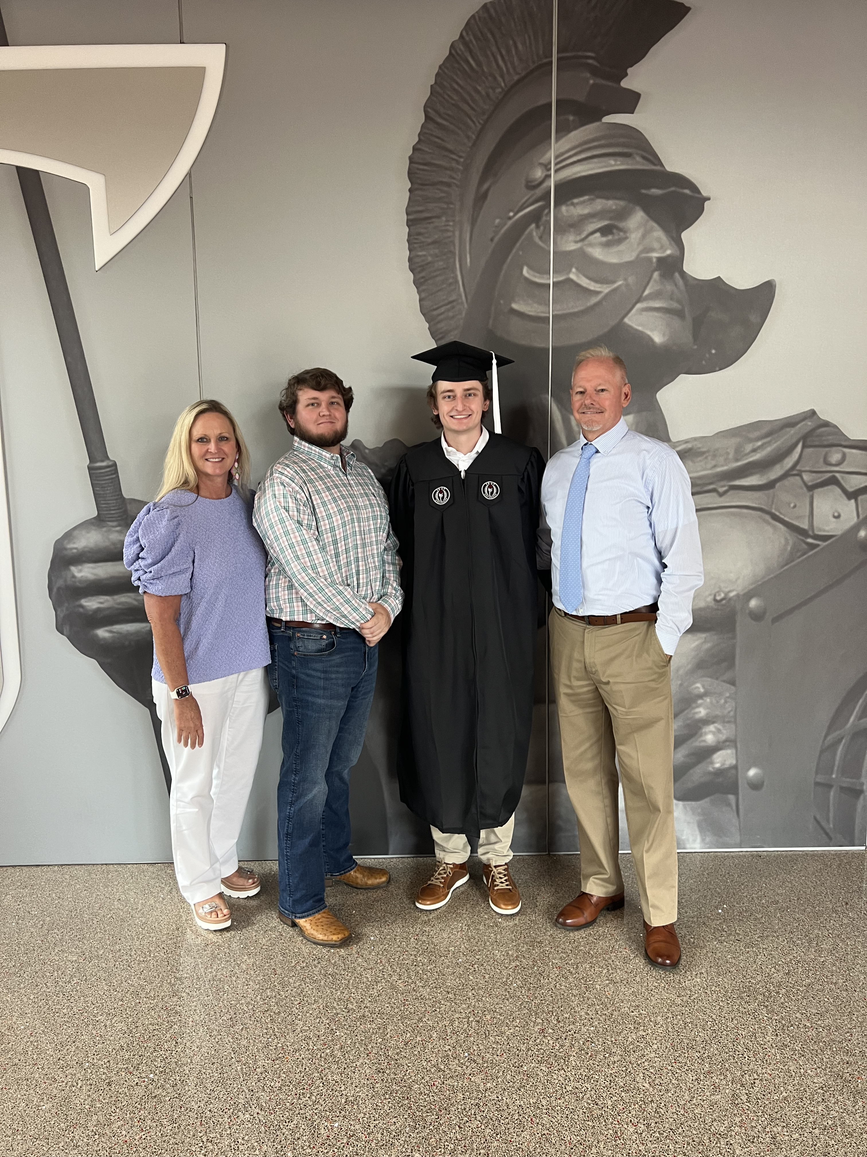
Meet Mrs. Kicklighter
This is my 20th year teaching 2nd grade at Prattville Primary School. I have 27 years of teaching experience.
The Kicklighters
Notes:
All text can be changed on these slides. Blank slides are included at the end if you need more slides or prefer to have your slides not have the header with the fish and shells at the top.
*

Slide 3
Orientation
August 5rd 4:00-5:30
Parents and students may “pop in” their classroom anytime between 4:00- 5:30. . Parents will have an opportunity to purchase t-shirts, tote bags, etc..
Students will receive a free popsicle!
Notes:
Explain what students will be required to learn/do in reading this year. You might want to talk about Daily 5/Literacy Centers/Workstations if you use them in your classroom. In fact, you might want to duplicate this slide and add your center information to a separate slide.
*

Slide 4
First Week of School
August 7th--First Day of School
Option first day staggered star--8:45-9:45 Parents may walk with their child to his/her classroom. Please sign up for a time! Your child may still ride the bus or be a car rider the morning of the first day, if you’d prefer. Car Riders may be dropped off starting at 7:15 each morning.
Dismissal-- All students need to wear their transportation tags each day. Car riders- Please make sure your Car Rider Tag is visible!
Purple Hall students will use the Northington Street entrance for drop off and dismissal
Notes:
Explain what students will be required to learn/do in science this year.
*

Slide 5
Supplies and Fees
School T-shirt--$15.00
School Tote Bag--$15 (Backpacks are not allowed)
School Contribution--$15.00 (This money is used for school improvements, cleaning supplies, and classroom materials. Any amount is appreciated!)
Basic supplies have been purchased to start the school year off. (Extra supplies included in next slide)
Notes:
Include your class rules on this slide
*

Slide 6
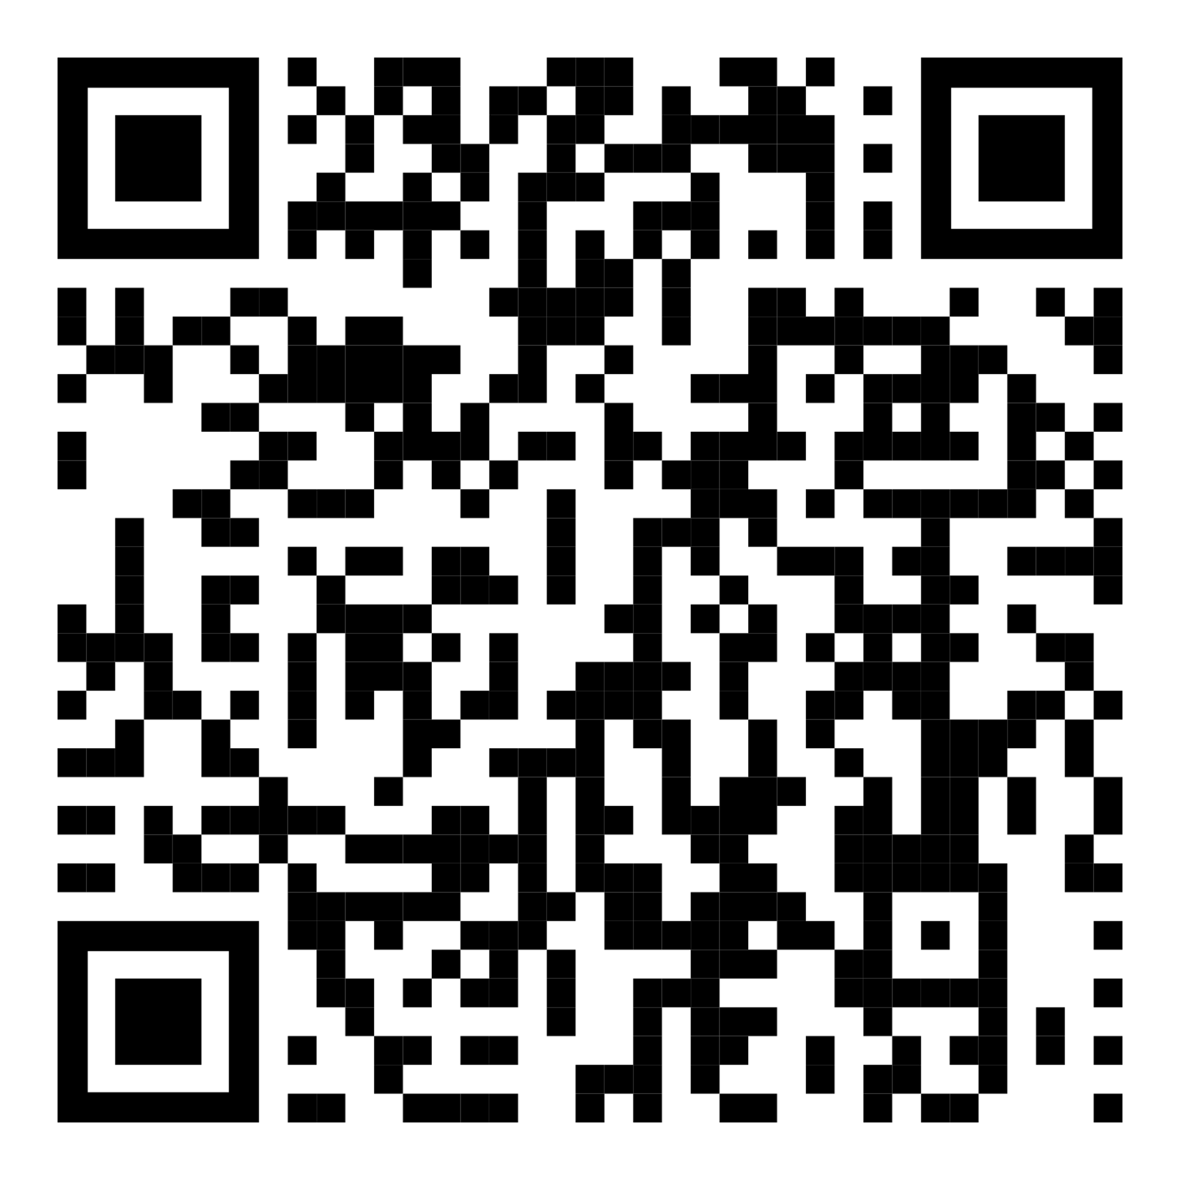
Supplies
Jumbo glue sticks
Box of Kleenex
Girls: Foaming hand soap
Boys: Tall Kitchen Trash Bags
Extra Supplies will be asked for as needed throughout the year.
Amazon Class Wish List
Notes:
Include your class rules on this slide
*

Slide 7
Extras and Lunchroom Prices
Juice and Snack--$.75 each
Breakfast--Free
Lunch--Free
Please remember that carbonated drinks are not allowed and food from home can’t be heated for students.
All money sent to school should be placed in an envelope labeled with your child’s name, what it is for, and my name.
Notes:
Explain your method of managing behavior. Do you use a clip chart? Card pulling system? Something else? Include a picture if you can!
*

Slide 8
Behavior Plan
Ladybug Behavior Clip Chart:
Flying High!—All students start on this level. Behavior calendar will be stamped with a PowerPaw.
Watch Out!—Student who have been redirected/warned several times will clip down to this level. Behavior calendar will be stamped with a smiley face.
Spotty Choices!—Students who continue to make undesirable choices will clip down to this level. Behavior calendar will be stamped with a straight face.
Grouchy Ladybug!—Students who continue to make undesirable choices after redirection and intervention will clip down to this level and receive a SBR. Behavior calendar will be stamped with a sad face.
Notes:
Include your class rules on this slide
*

Slide 9
Behavior Plan
“Paw”sitive Behavior
Classroom Celebrations will be based on the number of PAW print stamps needed for the month.
(For example: extra recess, free choice center……)
Classroom Rules
Respect others and their belongings.
Work quietly
Obey the teacher
Follow all school rules
Notes:
Include your class rules on this slide
*

Slide 10
Stay Connected!
Friday-Upcoming Weeks Newsletter through PowerSquare
Take-Home Binders Daily/Monthly Behavior Calendar—Check Daily—Initial Daily
Tuesday Folders—Sign Parent signature page
ParentSquare--Communication Tool
PowerSchool—Grades: Log In Information will be sent home.
My email address:
Pamela.Kicklighter@acboe.net
School Website: https://www.prattvilleprimary.com/ (Pam Kicklighter)
School Phone: 334-365-6277
Notes:
Add your contact information to this slide!
*

Slide 11
Welcome to a great year in 2nd Grade!
Notes:
Click to edit the text and change 1st grade to your grade!
*

