Slide 1
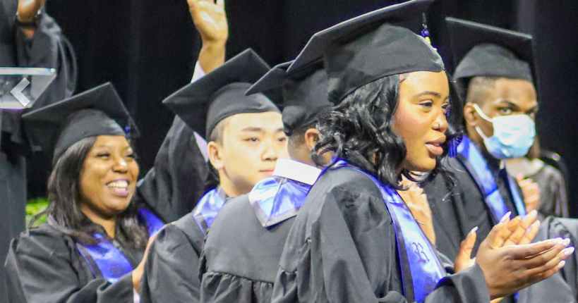
Class of 2023
Roosevelt STAY Opportunity Academy
Senior Meeting
November 2022

Slide 2
Agenda
Graduation Requirements
Community Service Hours
Letters Of Understanding (LOU’s)
Naviance (Senior Exit Survey)
FREE Money $$$
FAFSA
DC Tag
DC Futures
Mayor Scholars
Scholarships
Post-Secondary Plans
College
Workforce

Slide 3
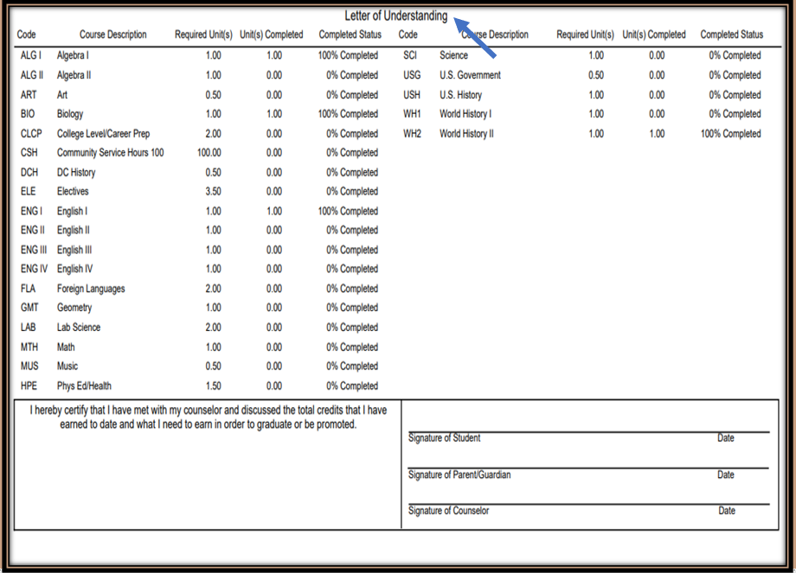
Can you graduate if you don’t complete your Community Service Hours (CSH’s)?
What is an LOU and why do I need it?
Completing Letters Of Understanding (LOU): informs students of their graduation status and allows us to plan any necessary interventions.
CSH’s are only waived for students whose First Ninth grade School Year (FNSY) = 2016-17 and 2017-18, because these students would have graduated during the Pandemic.

Slide 4
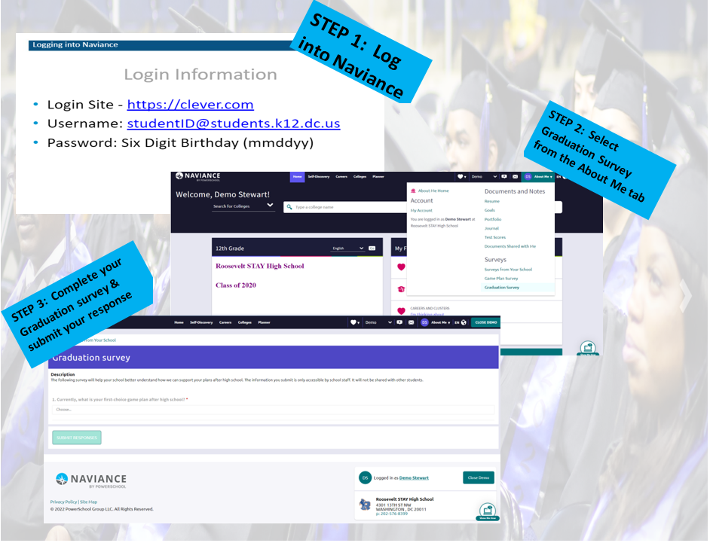
Full Page Image

Slide 5
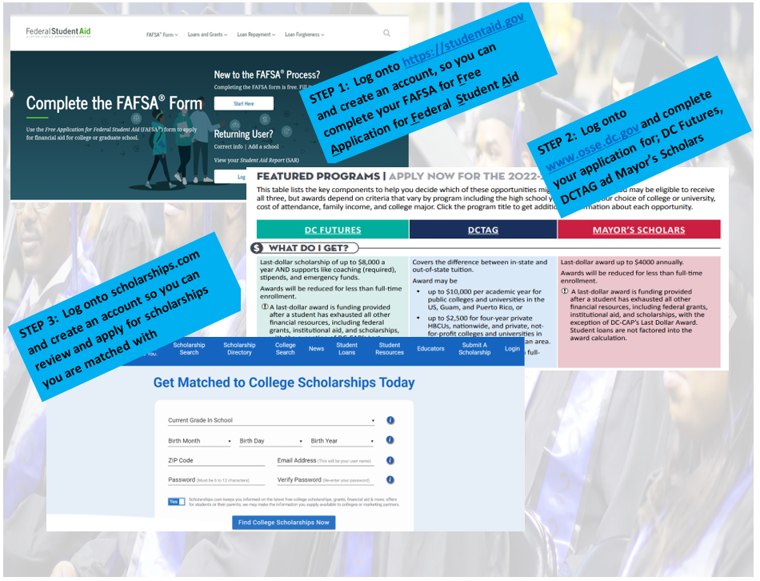
Full Page Image

Slide 6
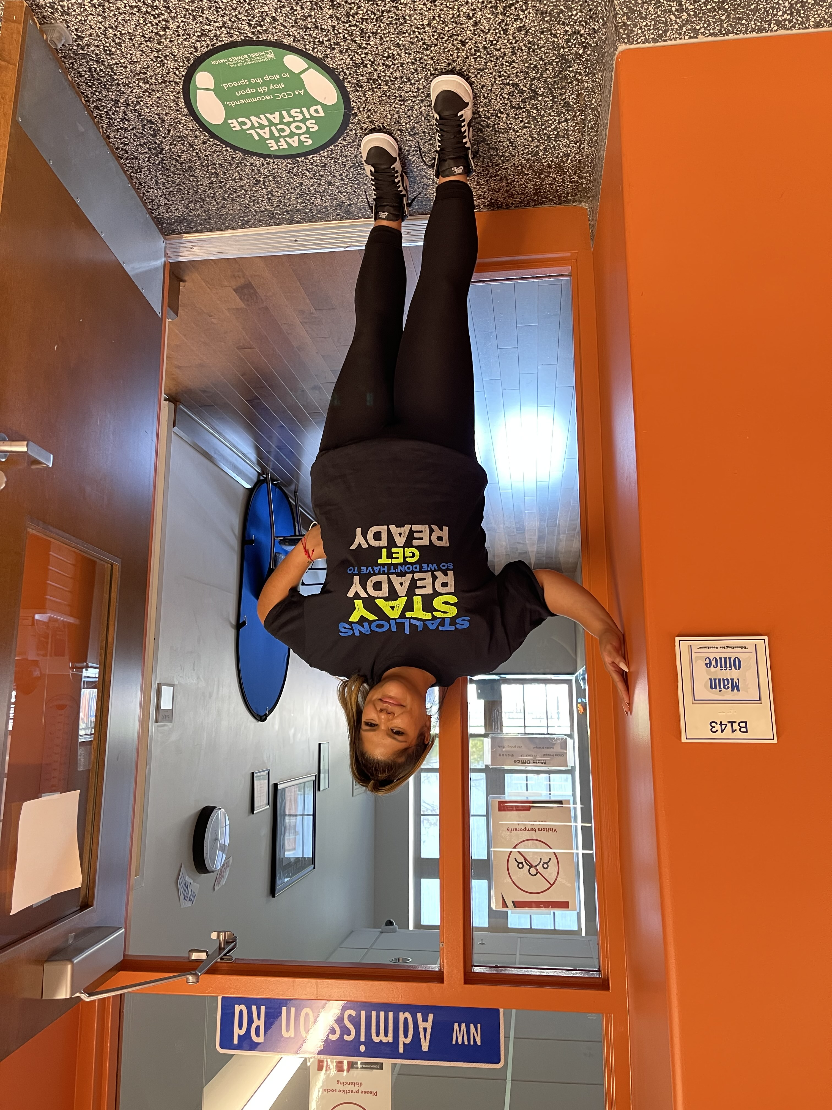
Additional Contacts:
Ms. V (Elizabeth.Villatoro@k12.dc.gov)
Community Service Opportunities & Workforce help
Ms. Stuart (tiescheka.stuart@k12.dc.gov)
Internships & Job Opportunities
Ms. Doty (Corease.Doty@k12.dc.gov)
Community Service Opportunities & Workforce help

Slide 7
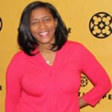
Counselors Info:
Ms. Hurt (Carletta.Hurt@k12.dc.gov)
ALL Virtual, Project Infinity and Evening Students
RSTAY at Roosevelt Campus
4301 13th St., NW, Wash DC 20011
Ms. Stewart (Lekishia.Stewart@k12.dc.gov)
Last Names: A-Ji
RSTAY at Garnet Patterson (GP) Campus
2001 10th St., NW, Wash DC 20001
Ms. Cruz (Claudia.Cruz@k12.dc.gov)
Last Names: Jo-Z
RSTAY at Garnet Patterson (GP) Campus
2001 10th St., NW, Wash DC 20001

