Slide 1
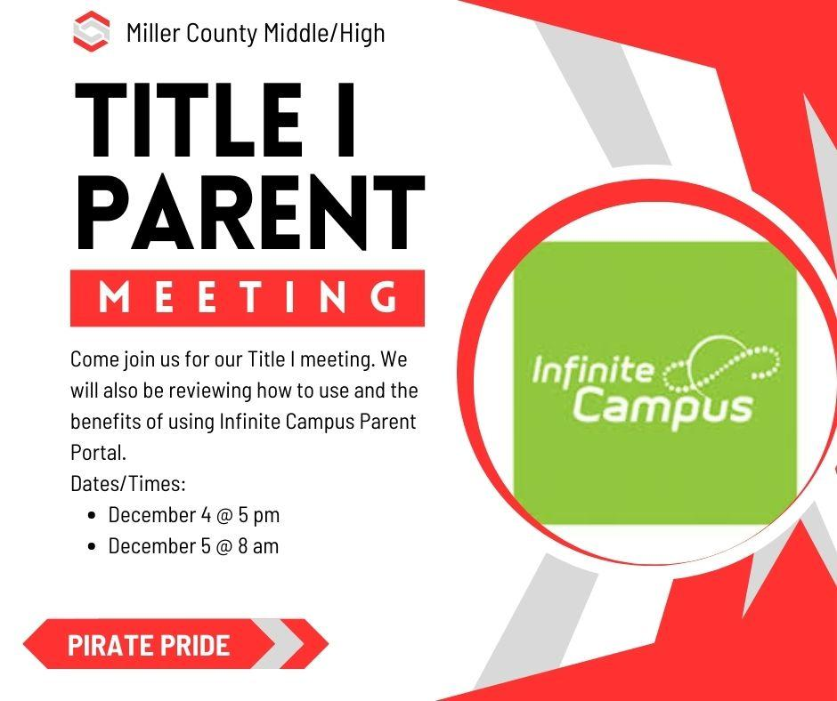

Slide 2
Annual Title I Parent Meeting
MCHS Library - December 4 & 5, 2023
Agenda
Robert Green, Federal Programs Director
What is a Title I school?
How does our school spend Title I money?
How is Title I Parent and Family Engagement money spent?
What are our school’s Title I requirements?
What is required by law for parent and family engagement?
Does my child’s teacher meet professional qualifications?
Kristan Houston MCMS Academic Coach
What curriculum does our school use?
Review curriculum used at MCES
What tests will my child be taking?
MAP, iLearn, Istation, Write Score, GMAS
What are our school wide goals?
Review School Improvement Plan/Goals
What opportunities does the school provide for family engagement?
Parent Surveys, Parent Information Sessions
Jointly developed School Compact
School, Parent and Family Engagement Policy
How responsive will the school be to my questions when staff is contacted?
Closing Remarks- Cleve Roland, MCMS Principal
Question/Answer session
Adjourn Title I Meeting
Parent Engagement Activity: Infinite Campus with Mrs. Keumele Keown, MCMS Counselor

Slide 3
MCMS
Curriculum and Assessment Information
(Title 1 Annual Parent Meeting)
December 4th & 5th, 2023

Slide 4
MCMS 2023 Title 1 Reward School

Slide 5
MCMS CURRICULUM
GA Standards of Excellence
McGraw Hill Curriculum:
Reveal Math
Inspire Science
Study Sync ELA/Reading
Social Studies Weekly
Online Programs used to supplement the curriculum:
ALEKS (used for filling in learning gaps and to determine growth)
IXL (used for filling in learning gaps and to determine growth)
Progress Learning

Slide 6
Informative Videos
McGraw Hill at Home
IXL at home
MAP Family Report
https://mms.miller.k12.ga.us/ >Staff & Faculty> Academic Coach’s Corner

Slide 7
Aligns to MCMS’ SIP Action of improving student proficiency in mathematics
ALEKS is a research-based, online learning program that offers course products for our math students.
Rooted in 20 years of research and analytics, ALEKS is a proven, online learning platform that helps educators and parents understand each student's knowledge and learning progress in depth, and provides the individual support required for every student to achieve mastery.
ALEKS is the most effective adaptive learning program.
Constantly adapting to update each student’s knowledge state, ALEKS guides students to precisely what they are ready to learn at all times.
ALEKS helps students master course topics through a continuous cycle of mastery, knowledge retention, and positive feedback. Each student begins a new course with a unique set of knowledge and prerequisite gaps to fill. By determining the student's baseline of knowledge, ALEKS creates an individual and dynamic path to success where students learn and then master topics. ALEKS has helped over 25,000,000 students and counting.
ALEKS has patented a machine learning technology called ALEKS Insights to promptly alert educators to at risk students.
ALEKS Insights provides email notification to instructors calling attention to students
(a) who are not succeeding
(b) who cease succeeding
(c) who are excessively procrastinating
(d) who are learning unrealistically fast.
These formative insights enable instructors to take timely action to help the students that need it the most.
The bottom line: ALEKS is a personalized way for students to learn at their own pace.

Slide 8
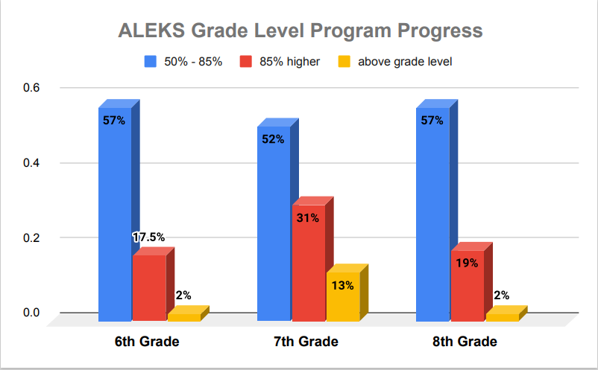
Students receive certificates and Facebook recognition when meeting 85% & 100% program completion goals.
Upon 100% grade level program completion, students move to the next grade level program.

Slide 9
IXL is a personalized learning platform that is proven to improve learning outcomes for all students. IXL’s comprehensive K-12 curriculum, Real-Time Diagnostic, personalized guidance, and actionable Analytics work together seamlessly to give teachers everything they need to differentiate instruction and help students grow.
IXL offers comprehensive coverage of pre-K through 12th grade curriculum, with more than 8,500 skills aligned to the Common Core and all state standards.
Each IXL skill automatically differentiates learning by generating questions based on students’ understanding of the material.
The IXL Real-Time Diagnostic assesses students at a deep level, providing reliable insights on students’ grade level proficiency on key math and language arts strands.
With this portrait of student knowledge always in hand, teachers can make smarter decisions about how to reach every student where they are.
IXL uses insights from student work in the curriculum and the Real-Time Diagnostic to power personalized guidance for every learner.
IXL’s personalized action plans seamlessly link students to the skills that will help them build on their current knowledge as well as remediate any gaps in understanding.
IXL Analytics is an essential daily tool that helps teachers deliver data-driven instruction and support every student at the right level.
Analytics uncovers insights that help teachers use their limited class time more effectively, respond to individual needs quicker, and ultimately make better instructional decisions every day.
Taken from https://www.ixl.com/press/IXL-Product-Facts-Sheet.pdf

Slide 10
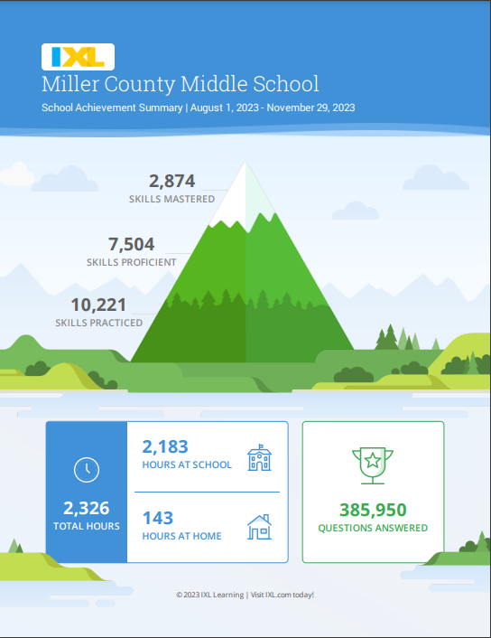
Students MAP RIT scores are entered into IXL to create personalized individual skills plans
Teachers create assignments to support instruction and reinforce standard-based skills
IXL is accessible to students from home

Slide 11
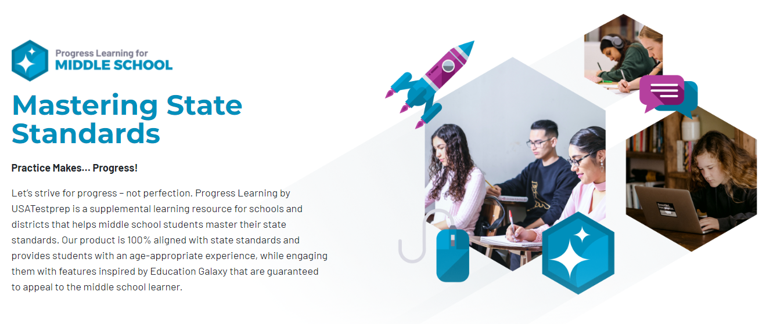
Progress Learning
Benchmarks for Science & Social Studies
Administered 3 times per year

Slide 12
MAP ASSESSMENT

Slide 13
PURPOSE MAP
MAP stands for Measures of Academic Progress® (MAP®)
MAP is a suite of assessments that deliver data you need to make a difference in student progress; assessments are given three times throughout the school year (beginning of year, mid-year and end of year).
MAP® Growth™—measures areas that are related to our math and ELA standards
MAP® Skills™—identifies gaps and helps students to master specific skills within a hierarchy of foundational skills

Slide 14
How does the MAP assessment work?
Adaptive assessment that adjusts to students’ knowledge
Administered in math, reading, and language usage for grades 6-8
Norm referenced comparing students in the same grade across the country
Assigns projected achievement for Georgia Milestones
Assigns a RIT score
A specific RIT score represents the level where a student is ready to learn. The test finds that level by pinpointing where a student would just as likely answer incorrectly as correctly, the point between knowing and not knowing answers.
RIT scores are entered into Exact Path in order to assign Learning Paths to fill in gaps
Exact Path identifies individual weaknesses and provides acceleration for students working beyond grade level
RIT scores are also entered into IXL where individualized skill plans are developed
IXL skills are aligned to the NWEA® MAP™ Growth assessment.

Slide 15
Georgia Milestones Assessment
Who & What are Assessed?
Grade Level | ELA | Math | Science | Social Studies
6th
7th
8th

Slide 16
Parent Resources for GMAS
Georgia Milestones Resources GADOE
GaConnects
GMAS Preparation for Parents K. Houston

Slide 17
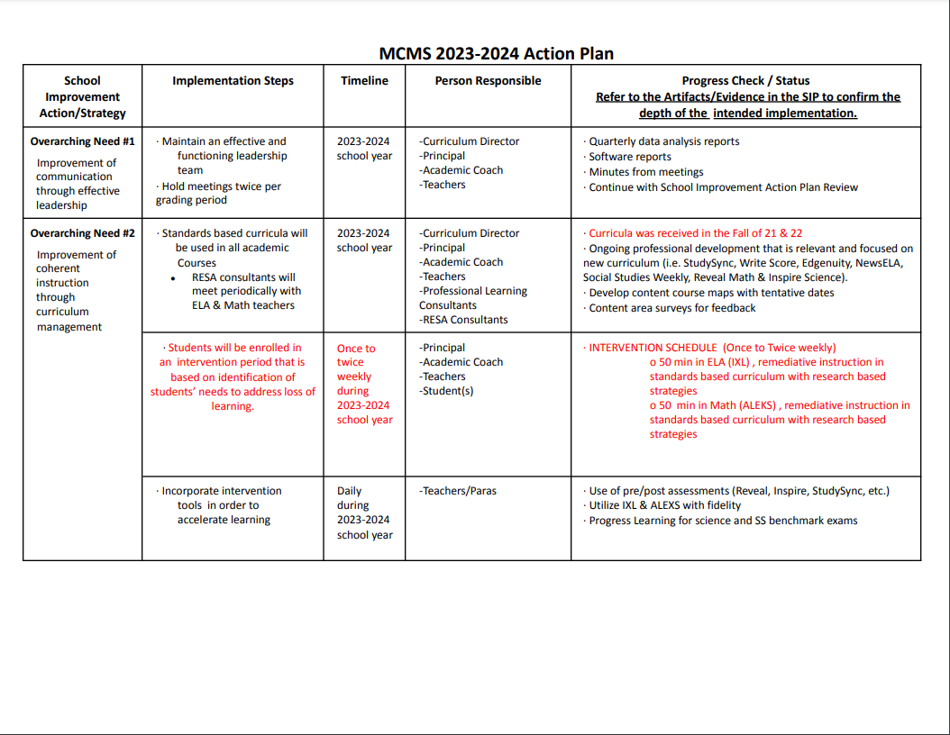

Slide 18
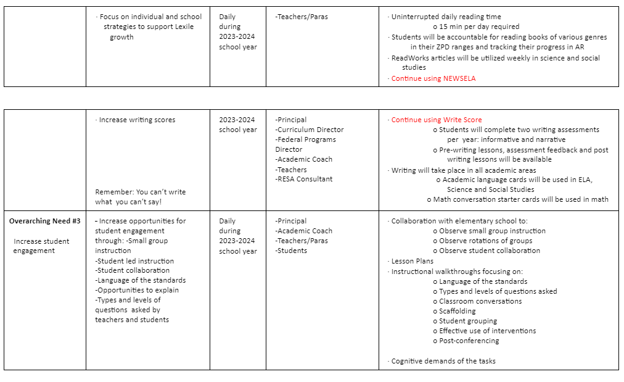

Slide 19
Family & Community Engagement
Family Engagement Policy - Miller County School District
https://www.miller.k12.ga.us/annualmeetingforparents
School Parent and Family Engagement Policy Miller County Schools (MCES, MCMS, MCHS) 2023-2024 Revised

Slide 20
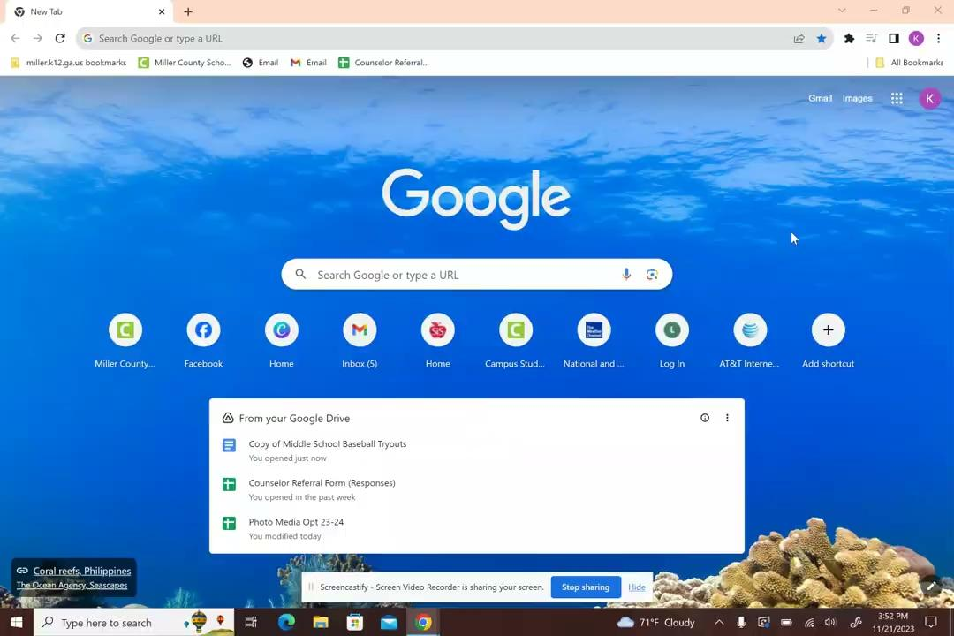
Infinite Campus- Parent Portal

Slide 21
Infinite Campus for Parents
MCMS Benefits of Infinite Campus

