Slide 1
America in the Internet Age

Slide 2
Bill Clinton
Elected President in 1992 and 1996
Democrat
Former Governor of Arkansas

Slide 3
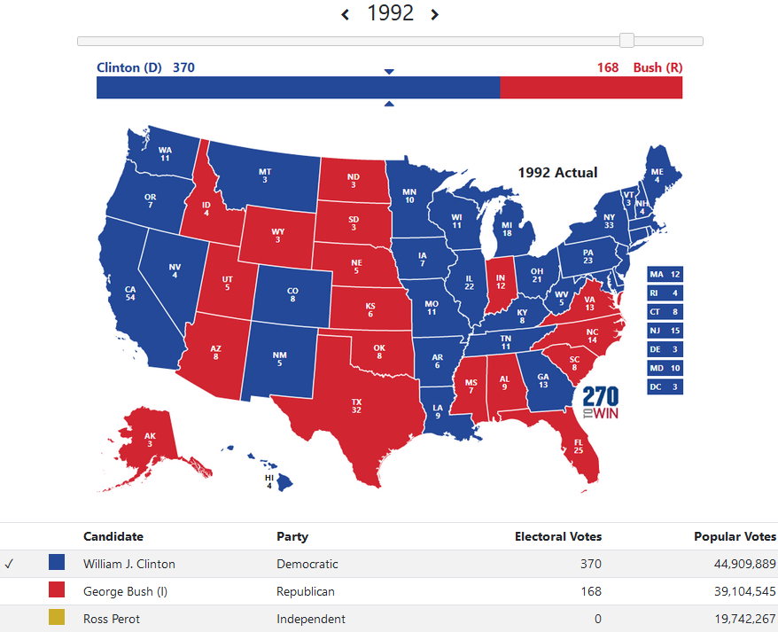

Slide 4
Contract With America
1994 midterm elections
Led by Newt Gingrich
Lower taxes, welfare reform, tougher crime laws
Republicans won a majority in both houses of Congress

Slide 5
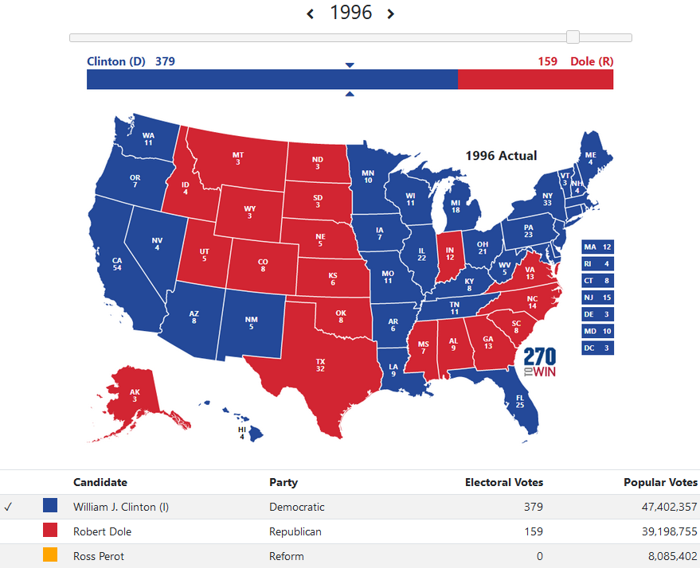

Slide 6
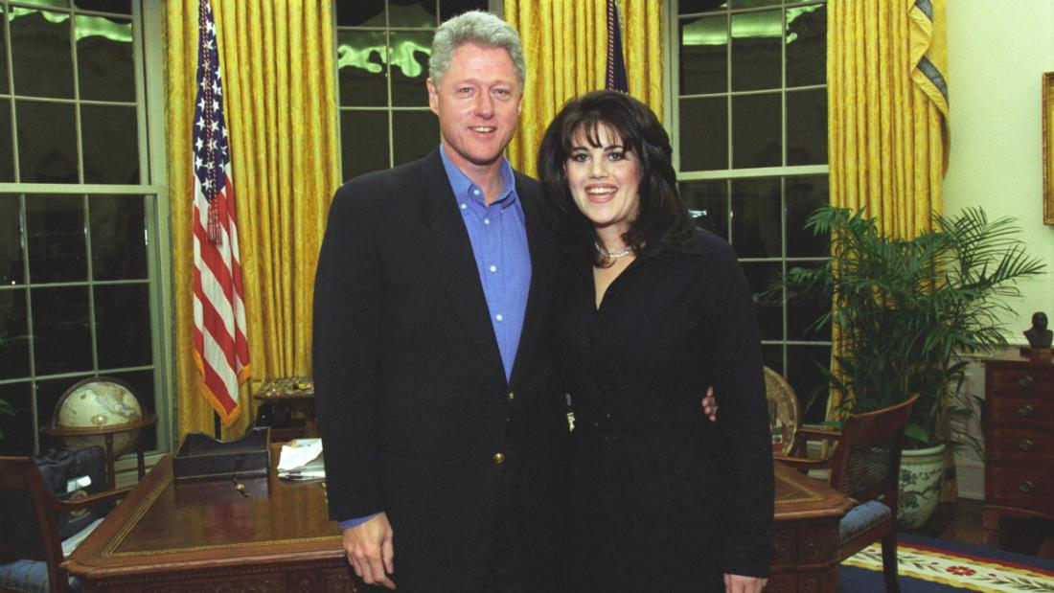
Clinton Impeached
1998
Perjury – lying under oath
Clinton lied under oath about relationship with Monica Lewinsky
Impeached by House but acquitted by Senate

Slide 7
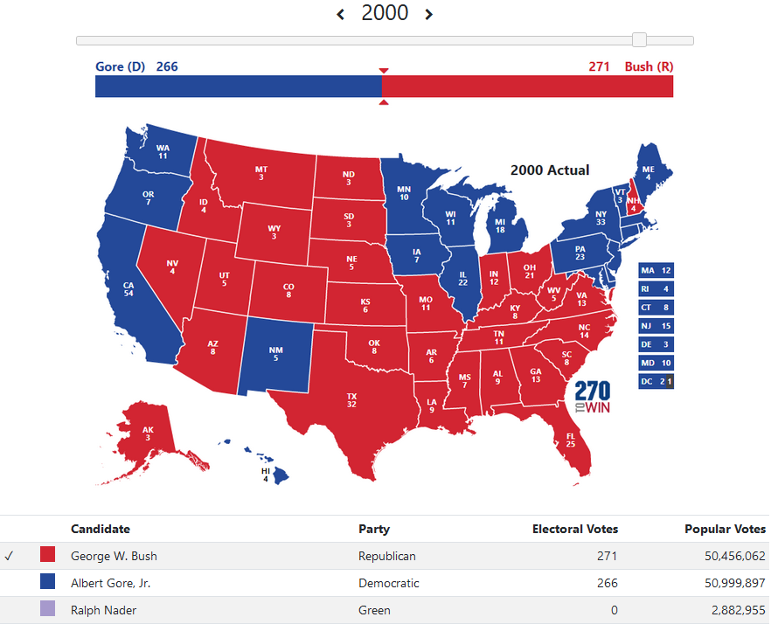
Close election with multiple recounts
Election went to Supreme Court
Bush v. Gore

Slide 8
George W. Bush
Elected President in 2000 and 2004
Republican
Son of President George H.W. Bush
Former Governor of Texas

Slide 9
No Child Left Behind
2001
Set high standards and establishing measurable goals to education
States had to give tests in order to receive federal funds

Slide 10
September 11th
2001
Also called 9/11
19 members of Al-Qaeda hijacked 4 planes
2 planes hit Word Trade Center
1 plane hit Pentagon
2,996 killed

Slide 11
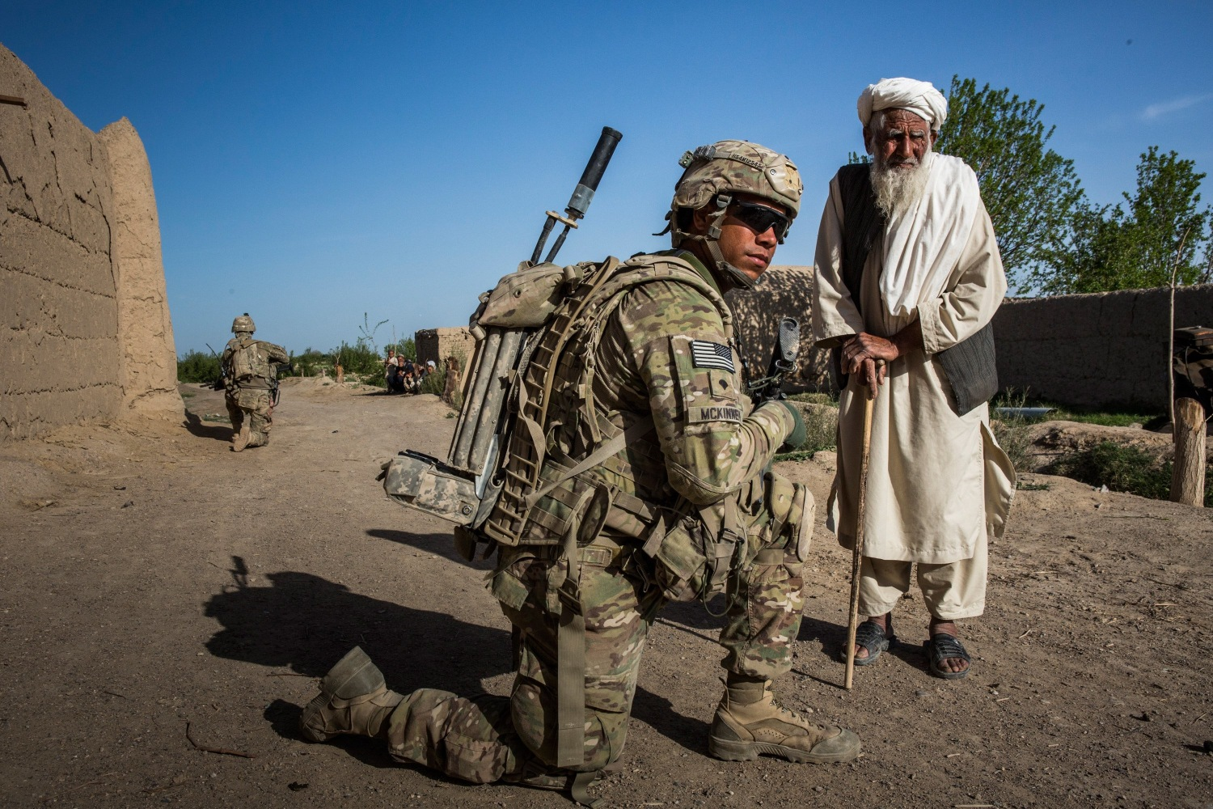
War in Afghanistan
2001 – 2021
Part of the “War on Terror”
Al-Qaeda’s leader was Osama Bin Laden
Osama Bin Laden and Al-Qaeda’s base of operations were in Afghanistan
Afghanistan was and is controlled by Taliban

Slide 12
Patriot Act
2001
Designed to make it easier to track terrorists
Expanded surveillance capabilities of gov’t
2002, Department of Homeland Security created

Slide 13
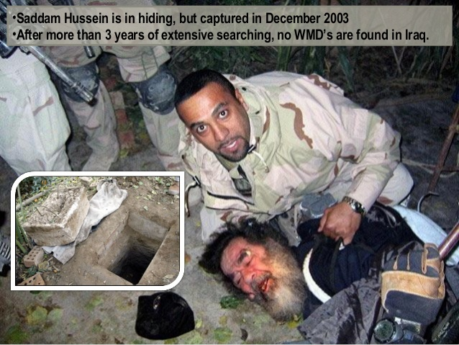
War in Iraq
Operation Iraqi Freedom
2003 – 2011
Part of the “War on Terror”
U.S. claimed Saddam Hussein had WMDs (weapons of mass destruction)
Hussein captured
No WMDs were found

Slide 14
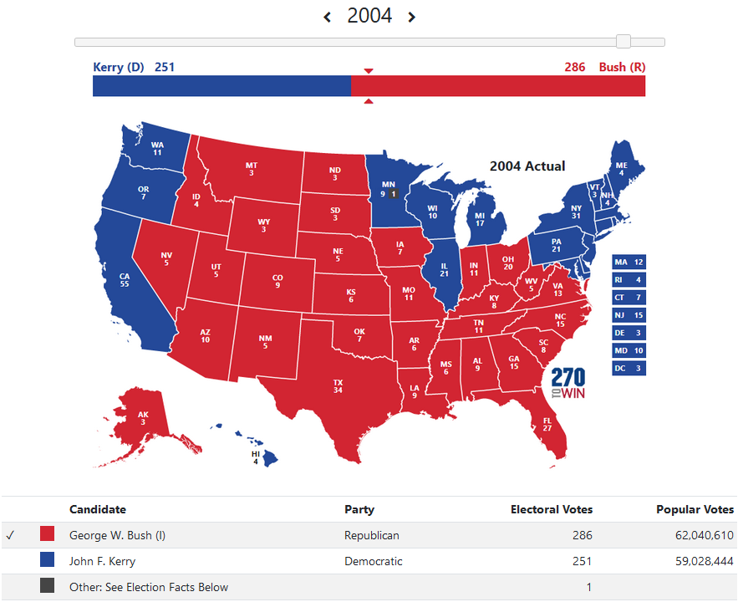

Slide 15
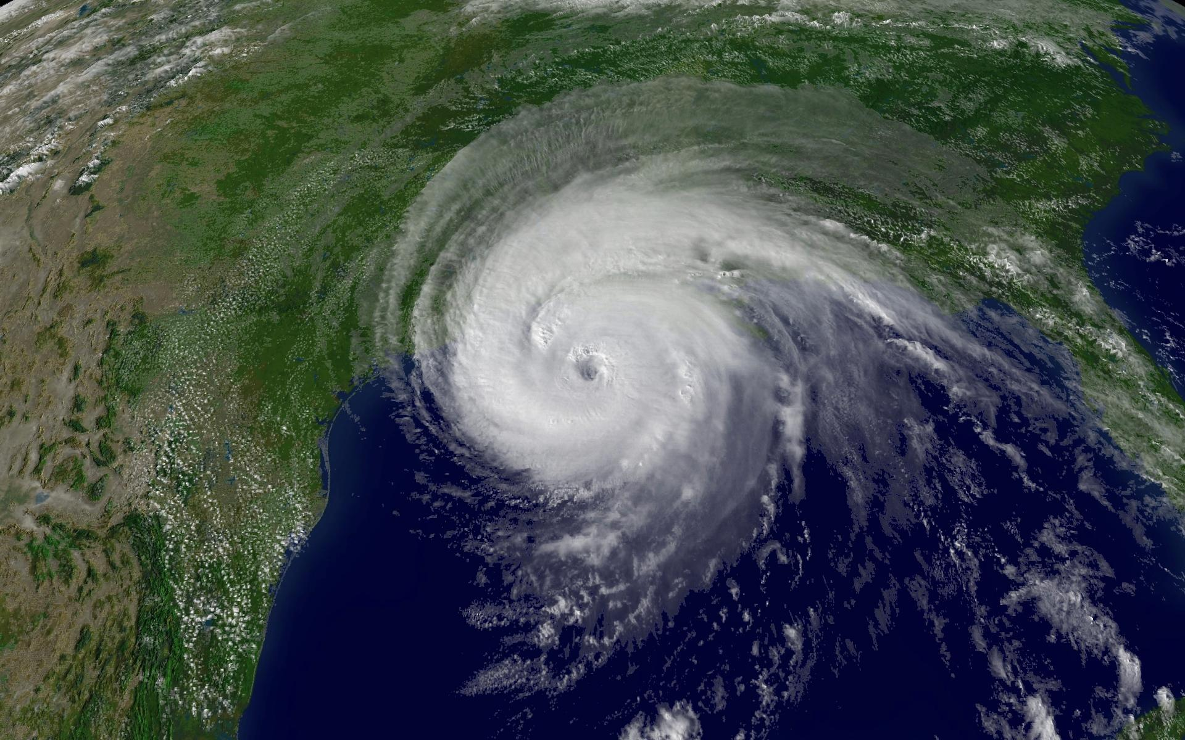
Hurricane Katrina
2005
Hit Gulf Coast including New Orleans
1,800 deaths
$160 billion in damage
Exposed problems with FEMA

Slide 16
Eminent Domain
the power of the government to take private property for public use, with payment.
2005 Supreme Court said was ok
Kelo v. City of New London

Slide 17
Barack Obama
Elected President in 2008 and 2012
Democrat
1st black President
Former Senator from Illinois

Slide 18
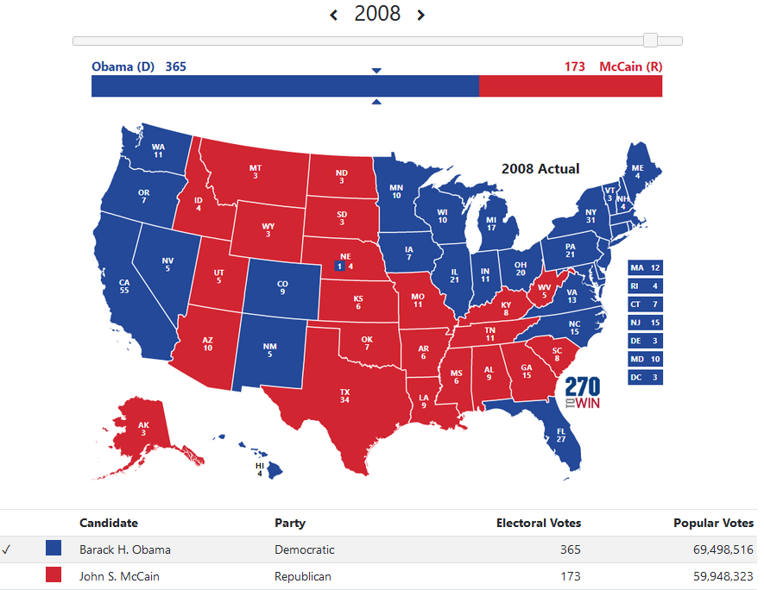

Slide 19
Affordable Care Act
2010
known as Obamacare
reformed health insurance laws

Slide 20
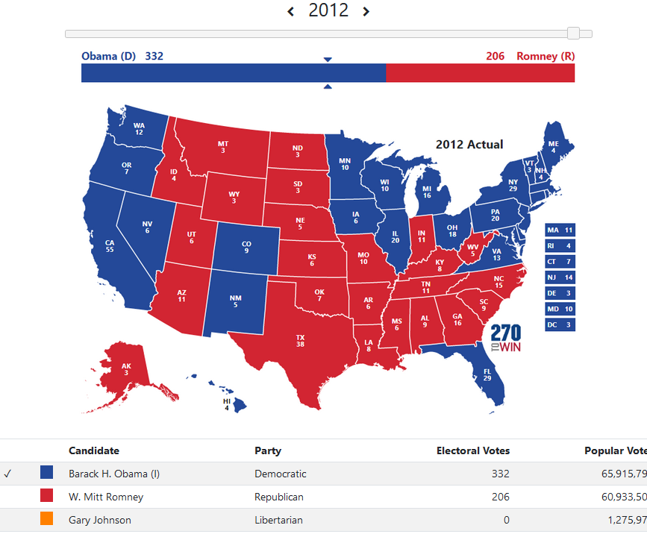

Slide 21
Donald Trump
Elected President in 2016
Republican
Former businessman and celebrity

Slide 22
