Slide 1

Annual Title I Parent Meeting
September 17, 2026 @ 5:30 pm
Centerville Elementary School

Slide 2


Slide 3




It means that we receive additional federal funding to provide a quality education for all of our students.
What does this mean for Centerville?
This funding helps school offer improved programs such as a family engagement liaison, instructional & technology resources, activities/workshops for families, intervention specialist teacher, and professional development for teachers.

Slide 4

How does Centerville spend Title I funds?
• Two part-time intervention teachers
• Classroom libraries and other resources
• Instructional supplies
• Technology (software programs)
• Professional development and learning opportunities for staff
• Family Engagement Liaison

Slide 5








Centerville Elementary Schoolwide Goals
Increase
Increase the percentage of students reading on or above grade level as measured by GA Milestones by 3%.
Increase by at least 3% the number of students in grades 3-5 scoring a 2, 3, or 4 in English Language Arts, Math, and Science measured by GA Milestones.
Increase
Develop a strong, positive culture to improve behavior and academic performance by decreasing the percentage of students having an office referral by 3%.
Implement
Decrease the amount of SWD falling in the Beginning Learner level range in ELA and Math as measured by the GA Milestones by 2%.
Decrease

Slide 6









Programs to Support our Students
EIP
ESOL
Intervention Teachers
Read United
IXL. BrainPOP, Quaver, i-Ready
New Instructional Resources
Positive Behavioral Intervention and Supports

Slide 7










What programs/curriculum are your students using?
Soical Studies for 3rd-5th
Soical Studies for K-2ND

Slide 8
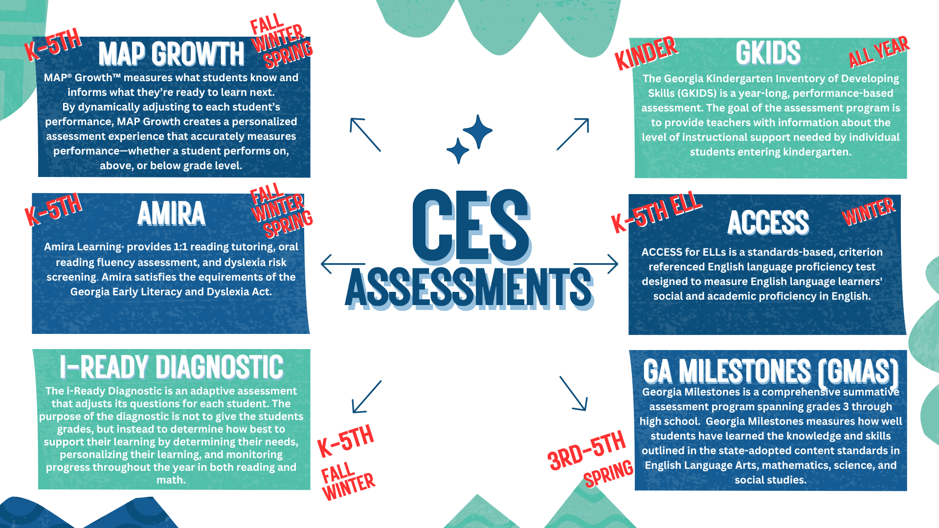
What tests will my child take?

Slide 9


WE ARE MUSTANGS
WITH MUSTANG PRIDE!

Slide 10

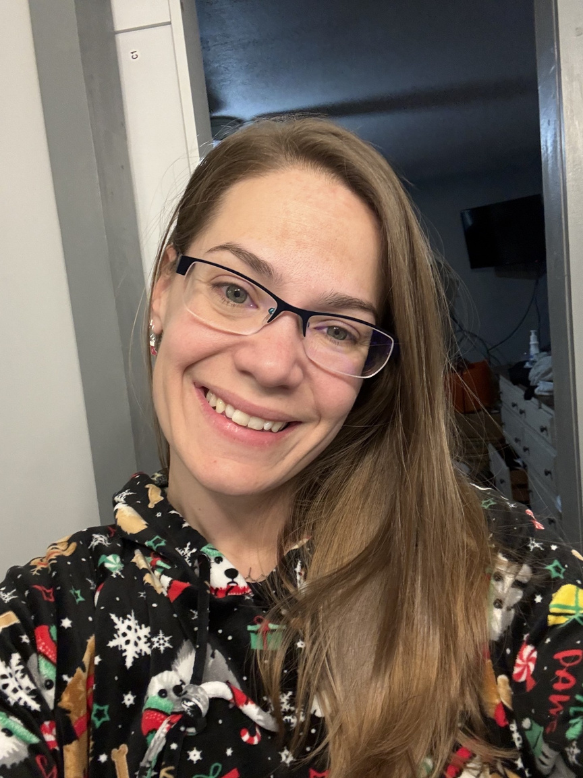

💙🐴 Meet Your Family Engagement Liaison! 🐴💙
Our Family Engagement Liaison is Mrs. Jessica Gardner! She is here to help connect our Mustang families with the school, resources, and support they need. 🏫✨
📍 Available in the office during regular school hours
📧 jessica.gardner@hcbe.net
📞 478-953-0400, Ext. 1328
Have a question or need some help? Mrs. Gardner is here for you! 💙📚

Slide 11

The law requires a 1% set-aside of Title I Funds be allocated for a District Parent and Family Engagement Program
I.
Parent and Family Engagement Coordinator
II.
Technology to support student learning
Requirements for Family Engagement
III.
Workshop materials
IV.
Conferences
V.
Programs that will improve student achievement and include ways to help parents help their children succeed (Building Capacity)
VI.
Parent input in the development of a written Parent & Family Engagement Plan
VII.
Shared decision-making opportunities
VIII.
Title I Guidebook
IX.
Parent & Family Engagement Plan
X.
School-Parent Compact

Slide 12



What is a school-parent compact?
A school-parent compact is an agreement that explains how parents, teachers and students will work together to make sure all students reach grade-level standards.
This agreement was jointly developed by stakeholders and is reviewed/revised annually based on feedback from all stakeholders. Compacts will be discussed during parent-teacher conferences.

Slide 13





2026-2027 District Goals
Our Compact:
Teachers, Families and Students -Together for Success
📚 Grade-Level Compacts
Each grade level has its own School-Parent Compact that explains how families, students, and teachers will work together to support student success.
You can view all grade-level compacts on our school website under the Family Engagement tab, then select Handbooks. 💙🐴
Increase by at least 3 percentage points the number of students performing at or above proficiency in core content areas in grades 3-11 as measured by Milestone assessment scores.
CES Staff will
CES Families will
Provide Families a monthly newsletter that features literacy skills covered in the classroom.
Practice literacy skills with their child, using the skills covered in the monthly newsletter, provided by the teacher.
2026-2027 School Goals
Provide families appropriate level books to read nightly to improve fluency and word recognition.
Listen to their child read nightly from appropriate level books to improve fluency and word recognition.
Increase the percentage of students reading on or above grade level as measured by the milestones Assessment.
Conduct Academic Events focusing on literacy skills and word recognition.
Attend Academic Events for strategies focusing on literacy skills and word recognition.
Increase by at least 3 percentage points the number of students in grades 3-5 performing at eh distinguished learner level in all subjects measured by milestone assessment scores.
Distribute [Ready Math, Amira, and Canvas log on information to use at home.
Assist your child with logging on to [Ready Math, Amira, and Canvas.
Grade Level: K
Focus Areas
Phonemic and Phonological Awareness
Word Recognition and Literacy skills
CES Students will
Practice literacy skills nightly by using the skills provided in the monthly newsletter.
Read nightly for at least 10 minutes from appropriate level books.
Give parents flyers, newsletters and all other correspondents.
Remind their parents about upcoming Academic Events.
Practice your skills using [Ready Math, Amira, and Canvas.

Slide 14


Go to the system website (https://ces.hcbe.net/familyengagement); then select Parent and Student Tab followed by Title I Family Engagement.
Parent Information on the CES Website
You will be able to view Centerville Elementary Family Engagement Paperwork.
We want your feedback! Please email us through the website or attend academic events throughout the school year.

Slide 15



Is my child’s teacher qualified? What is right to know?
All CES teachers are highly qualified.
(Parent’s Right to Know*)
📚 Parents’ Right to Know
Parents have the right to ask about the qualifications of their child’s teacher or paraprofessional.
You may request information about:
  🍎 Your child’s teacher’s certification and qualifications.
  📚 Whether the teacher is certified to teach their grade or subject.
  ✏️ The qualifications of any paraprofessional who works with your child.
This information is available to parents upon request.

Slide 16

How is Title I Parent & Family Engagement money spent?
  Family Engagement Liaison
  Family/Academic events
  Resources for instructional activities with families.
  Modes of communication with families

Slide 17

PARENT & FAMILY ENGAGEMENT OPPORTUNITIES
BUILDING CAPACITY
VOLUNTEERS
• Homework Workshop
• Reading/Writing Workshop
• Milestones Workshops
• Technology Talk Workshop
• Community Resource Fair
  Classroom volunteers
  Media Center
  PTO
  Milestones Proctors
  READ United
SHARED DECISION MAKING
FAMILY ENGAGEMENT
• School council
• Shared decision making (Spring)
• Parent Action Team
  Check and sign agendas, EVERYDAY!
  Attend Parent Conferences
  Read to or listen to your child read, EVERYDAY!
  Stay in contact with your child’s teacher!

Slide 18
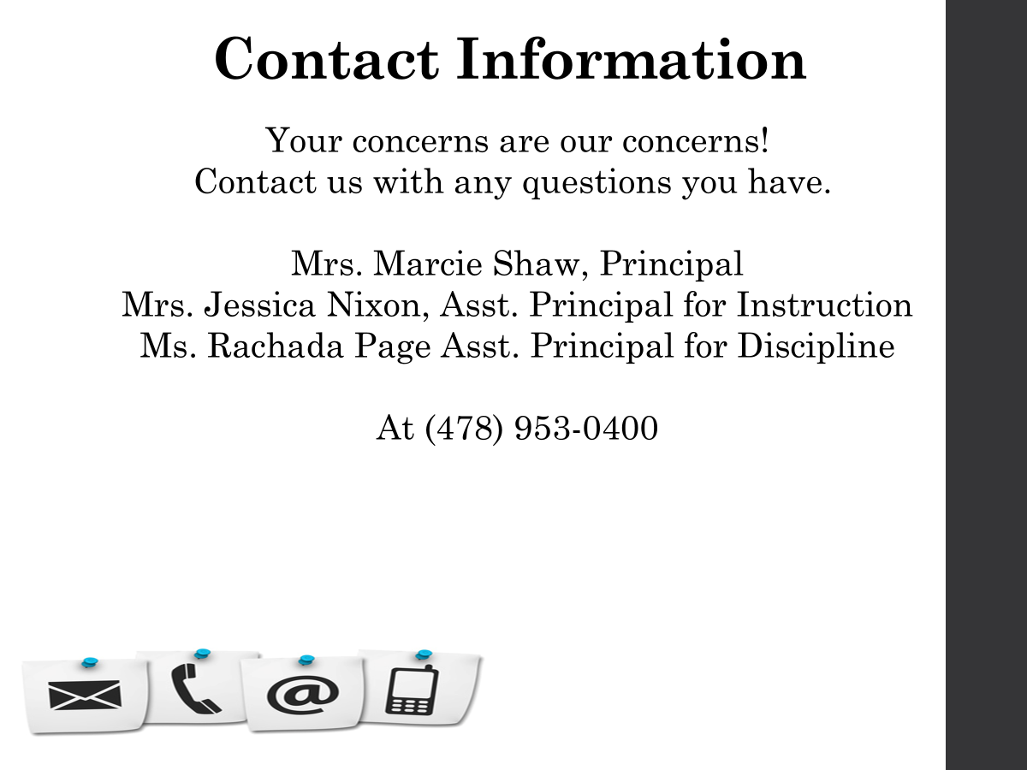

Slide 19


Other Federal Programs
For more information about these programs contact:
✔ Patricia Lane- McKinney-Vento Program
✔ Rosalin Rodriguez - ESOL
✔ Dalymarie Torres-Gonzalez - ESOL Parent/Student Liaison
✔ Aricelli Ulmer - Migrant Education
Located at the Central Registration

Slide 20





BULLYING & TITLE IX
ELEMENTARY

Slide 21



TITLE IX & BULLYING
    ALL THE ADULTS IN THIS BUILDING WANT TO CREATE A SAFE LEARNING ENVIRONMENT FOR EVERYONE.
    BEING UNKIND TO ANYONE IS NOT ALLOWED

Slide 22







    Comments about someone’s body
    Saying unkind words that are not true about another student
    Telling jokes or stories that make others feel uncomfortable
THERE ARE 3 KINDS OF HARASSMENT
Verbal Harassment
    Drawing any pictures of someone’s body parts covered by a swimsuit
    Sending inappropriate pictures or messages on cell phones, apps, or computers
Non-Verbal Harassment
    Grabbing or touching someone’s body where their swimsuit covers them
    Any touching that is unwanted, uncomfortable, embarrassing, or offensive
Physical Harassment

Slide 23



WHAT IS BULLYING?
THREATING TO HARM SOMEONE
CAUSING HARM TO SOMEONE
Repeated
and
One-sided
MAKING SOMEONE FEEL AFRAID
PERSISTENT & PERVASIVE

Slide 24








WHERE CAN BULLYING OCCUR?
CLASSROOM
PLAYGROUND
LUNCHROOM
GYM
RESTROOMS
CELLPHONES
COMPUTERS

Slide 25

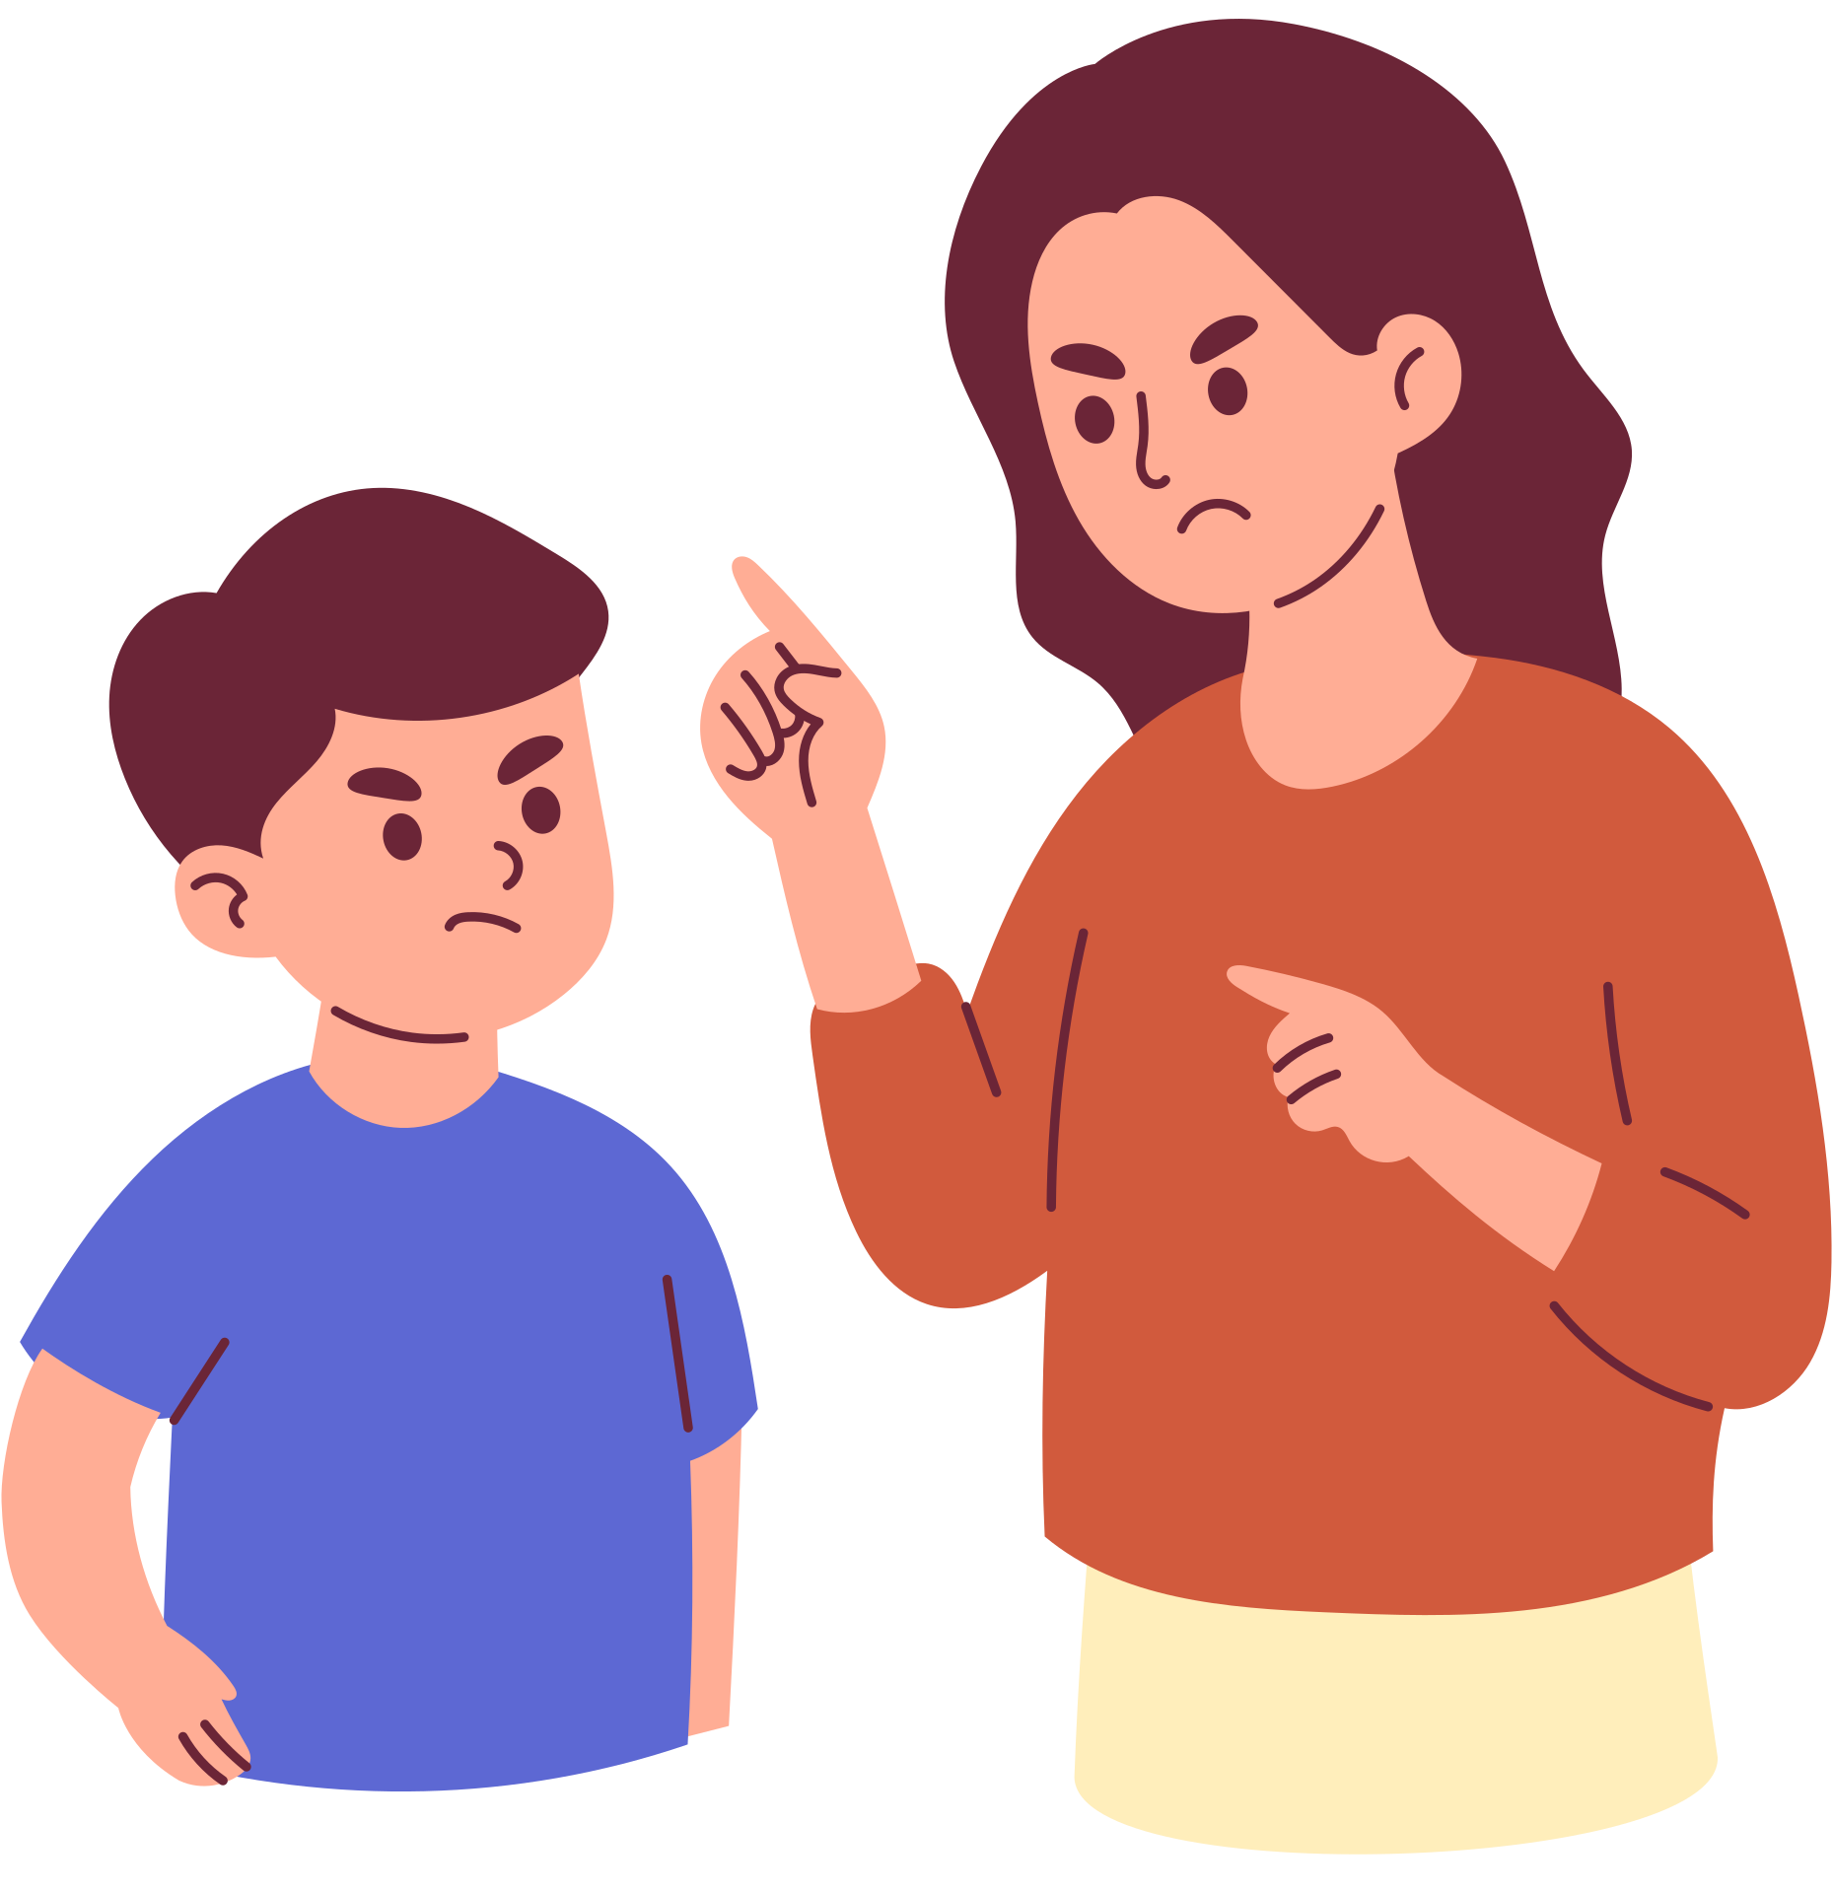
CONSEQUENCES
    ACTS OF BULLYING SHALL BE ASSIGNED CONSEQUENCES THROUGH OUR PROGRESSIVE DISCIPLINE PROCESS.
    THESE CONSEQUENCES MAY BE DETENTION, ISS, OSS,THE ALTERNATIVE PROGRAM, OR OTHER CONSEQUENCES AT THE DISCRETION OF THE PRINCIPAL.

Slide 26








REPORTING HARASSEMENT & BULLYING
Who should you tell about harassment or bullying?
anonymous
alerts
TELL
A TEACHER
TELL
AN
ADMINISTRATOR
TELL
YOUR
COUNSELOR
1
2
3
4

Slide 27




IF YOU SEE SOMETHING, HEAR SOMETHING OR KNOW SOMETHING,
SAY SOMETHING!

