Slide 1
Third Grade Retention Law
Gen. Assembly passed in 2021

Slide 2
Current Third Grade Students
Based on this year’s Third Grade TCAP Third Grade students must be ON GRADE LEVEL (in ELA) to be promoted.
Four Performance Levels: Mastered On-Track Approaching Below

Slide 3
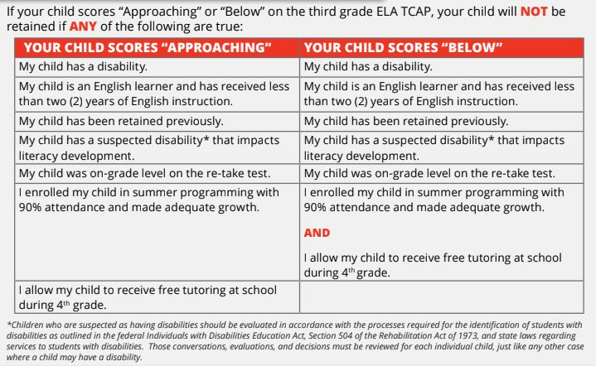
Will my child/student be retained?

Slide 4
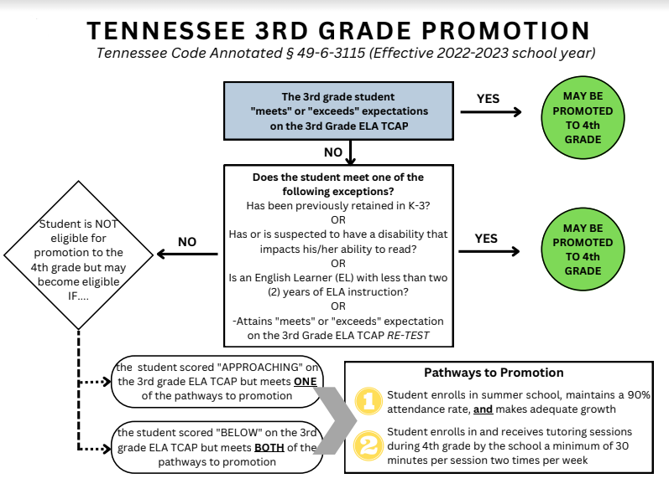

Slide 5
Current 3rd Grade Students with a “APPROACHING” score MUST:
Student is retested and scores Proficient
OR
Student attends a summer learning camp
Student Maintain 90% attendance
Student demonstrates adequate growth on testing at end of camp
OR
Student participates in After School Tutoring in 4th Grade

Slide 6
Current 3rd Grade Students with a “BELOW” score MUST:
Student is retested and scores Proficient
OR
Student attends a summer learning camp
Student Maintain 90% attendance
Student demonstrates adequate growth on testing at end of camp
AND:
Student participates in After School Tutoring in 4th Grade

Slide 9
Issues & Concerns with the law
We want all students performing on grade level on TCAP.
Roughly, 30% of 3rd grade students performed on grade level last year.
No local control - Huntingdon Special School Board was not involved.
No Parent input - no options to appeal to HSSD, but to TN commission.
Student / Family stress

Slide 10
Our Plan
Education and Knowledge (Keep you informed)
Support students and families if not successful.
Provide students with opportunities to be successful through tutoring.
Continue to read to students / Promote Reading at school and at home!

Slide 11
TCAP Success Events
TCAP Boot Camp Dress Up Days in April to promote fun and doing our best! TCAP Pep Rally Reward Event for doing their best!

Slide 12
When will I know if this applies to my student?
We expect third grade TCAP scores to be returned to the district in late May. We will contact parents with their student’s third grade scores immediately following their release, along with the options for summer school and/or tutoring.
The law states that a student be retained in fourth grade if they do not make adequate progress on the fourth grade TCAP. Following the completion of the required supports, the decision on whether or not a student will be retained will be made following the fourth grade TCAP assessment.
The Tennessee Department of Education (TDOE) is required in the law to define adequate progress. TDOE has not yet released such information.

