Slide 2
English Learners
Identification Process

Slide 3
Identification Process
Definition of an English Learner
Home Language Survey (HLS)
Language Indicator and Interpreters
Timeline and Flowchart
Screening Potential English Learners
*English learners are one of our protected groups so please be sure to register them immediately. You can assist them with any documentation that they are missing. Please refer to the Facts sheet for more information.

Slide 4
Definition of an English Learner
In Alabama, the definition of an English learner is taken from federal regulations: Under the Elementary and Secondary Education Act (ESEA) as amended by the Every Student Succeeds Act (ESSA), the law uses the term English learner (EL) to refer to students whose primary language is other than English and whose level of English proficiency is progressing to the level needed to participate effectively in U.S. mainstream classrooms. Previously, the terms, “limited English proficient” (LEP) and “English language learner” (ELL) have been used.

Slide 5
Definition of an English Learner
Under ESSA, an English learner means an individual –
who is aged 3 through 21;
who is enrolled or preparing to enroll in an elementary school or secondary school;
who was not born in the United States, or whose native language is a language other than English;
whose difficulties in speaking, reading, writing, or understanding the English language may be sufficient to deny the individual

Slide 6
Home Language Survey (HLS)
ELs must be identified at the time of enrollment through a Home Language Survey (HLS) administered during the enrollment/registration process.
The HLS is a requirement for every student entering schools in Alabama.
If the HLS indicates the use of a language other than English by the student or any individual in the home, the student is considered a potential EL, and a screener must be used to determine the student’s English language proficiency level.

Slide 7
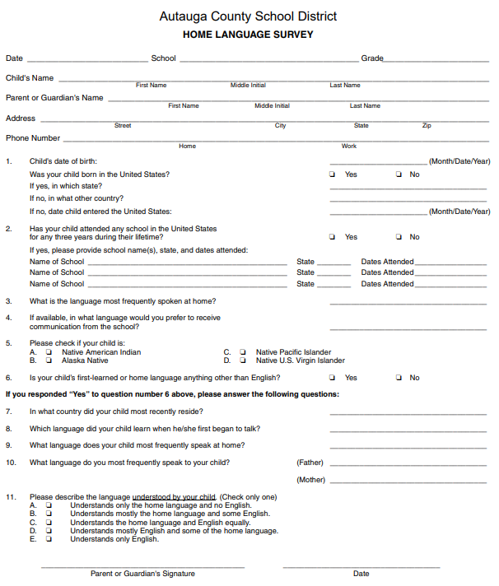
Home Language Survey (HLS)
Home Language Surveys are available in many languages.
They can be located on the ESL website at www.acboe.net/eslcontacts.
If you are unsure of which language is spoken, please refer to language chart indicator.

Slide 8
Timeline and Flowchart
Potential ELs who enroll during the summer, or the first day of school, must be assessed for English language proficiency within 30 days of enrollment.
Potential ELs who enroll after the first day of school must be assessed for English language proficiency within 10 days of enrollment.
When all responses on the HLS indicate that English is the only language used by the student and the individuals in the home, then the student is considered an English-only speaker without the need for EL services.

Slide 9
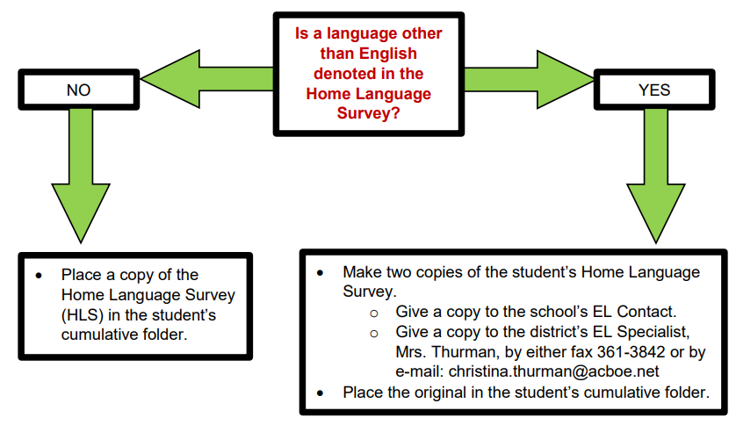
Timeline and Flowchart

Slide 10
Timeline and Flowchart
EL Contacts (counselors) are responsible for screening potential English learners.
When new students to our school districts are registering from another school in the United States, please check their withdrawal paperwork from their previous school for any EL test scores. Test names vary by state but some of the most common are:
WIDA Screener
WIDA ACCESS
WIDA MODEL
W-APT
When students withdrawal from our school system, their future school will need copies of their EL test scores and EL status.

Slide 11
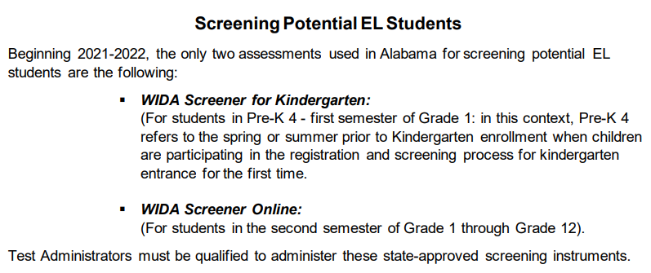
Screening Potential English Learners

Slide 12
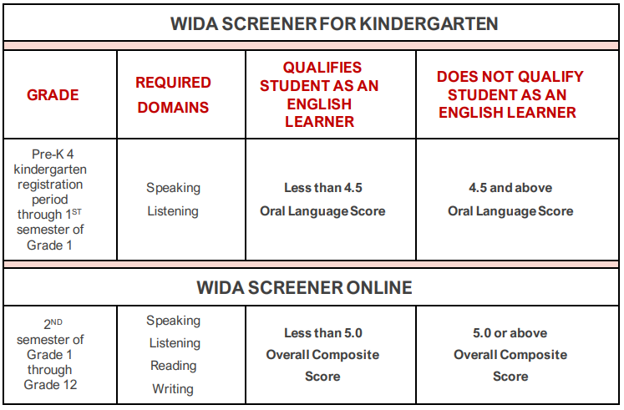
Screening Potential English Learners

Slide 13
More Information
EL Enrollment Flowchart
Autauga County Schools EL District Plan and Guidebook
ALSDE Student Assessment Resource Guide for ELs

Slide 14
More Information
Christina Thurman
christina.thurman@acboe.net
www.acboe.net/eslcontacts

