Slide 1
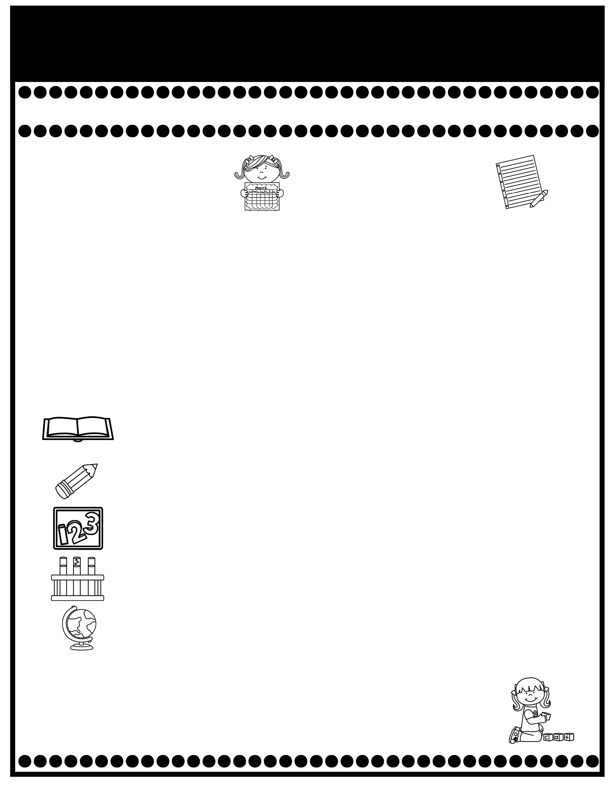
Branning’s Buzz
Week of: January 26-30, 2026
What’s Happening
This Week
Upcoming Events
Thank you for sending in items for our 100th Day Snack.
Tuesday Folders will be sent home Tuesday. Please sign & return
The cost for snack is $1.00 each.
A Weekly Reading Overview page will be sent home each week to help you practice skills and vocabulary words with your child. Also, nightly reading homework will be assigned in your child’s Take Home Binder. Please don’t remove pages.
We are taking A.R. tests to meet the school wide challenge. Library books must be returned to school each day. A Reading Log was placed in your child’s Take Home Binder. Please sign the log when your child has read the book 3 times and is ready to test. Thank you for helping your child.
Jan. 28: Davis Theatre Field Trip/CiCi’s Pizza
Jan. 30: PPS Spirit Day: “Around the World Day”
Please review test papers & return them to school. Sign the back of the folder. Please don’t take the test papers out. I keep them on file for the entire year. You don’t have to sign each test paper, unless I have stamped it.
If you have questions or concerns, you may email me at Wendy.branning@acboe.net.
A Peek At What We Are Learning
Reading | Phonics: e_e, ee, ea Comprehension: Main idea and details, setting Vocabulary: check, equipment, station, spread, worry
Writing/ Grammar | Persuasive Poster Penmanship: Lowercase letters 1/30 Dictation & Persuasive Writing
Math | Topic 8 Tens and Ones 1/30 minor grade
Science | We rotate Science and Social Studies
Social Studies | Social Studies Weekly: Citizens
Spelling Words
No Spelling Test will be given until Unit 7.
.

