Slide 1









Passport to Success
STMS Annual Title 1 Meeting
2026-2027
In Person Meeting
September 21, 2026
4:00-4:30

Slide 2
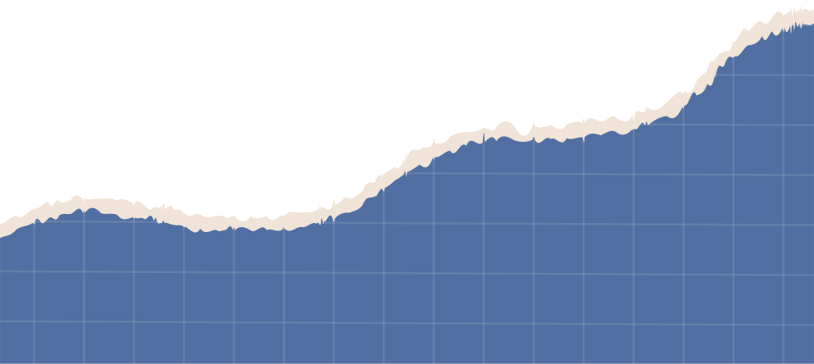



WELCOME
STMS is proud to be a partner with parents in education our community’s children.

Slide 3
Presenters
Jessica Helms, Principal
Jill Singleton, Assistant Principal
Kim Scott, Academic Coach
Vielka Flowers, Translator
Tarsha Brown, Title 1 Family Engagement Coordinator

Slide 4



Agenda
  What is a Title I School?
  How does our district/school spend Title I money?
  How is Title I Parent and Family Engagement money spent?
  What is required by law for Parent and Family Engagement?
  What are our school’s Title I Schoolwide requirements?
  Schoolwide Program participation – Past and Present
  What are our Schoolwide goals?
  What programs/supports are in place to help students?
  What is the state’s grades report for our school?
  What curriculum does our school use?
  What tests will my child be taking?
  Does my child’s teacher meet professional qualifications and a parent’s right to know?
  What opportunities does the school provide for family engagement?
  How responsive will the school be to my questions when staff is contacted?
  McKinney-Vento Education for Homeless Children and Youth
  Closing and evaluations
  BOE Contact Information

Slide 5
What is a Title 1 School?
Title I is the largest federally funded program for elementary, middle, and high schools.
The U.S. Department of Education provides each state with an allocation based on census poverty data.
The focus of the Title I program is on helping all students meet the same high standards expected of all children.
For more information visit Georgia Department of Education website at www.gadoe.org.
All of Tattnall County’s schools are Title I schools.

Slide 6

Title 1 Money
  Title I funds may only be used to supplement, not supplant existing services.
  Our district/school utilizes the 1% of our Title I funds for parent engagement – this pays for printing, parent communication, parent newsletters, parent and family engagement activities, translations and interpretation, family resource centers, and other parent resources.
  Title I meeting supplies/materials.
  If you have any questions about the Title I budget for the county, please contact David Tucker at 557-4726.

Slide 7

Title 1 Parent & Family Engagement Requirements
  District Parent and Family Engagement Policy
  (Available at www.tattnallschools.org under Departments tab then select Federal Programs from drop down.)
  Available in the Student Handbook
  School Parent and Family Engagement Policy (copies provided on table)
  School-Parent Compact (copies provided on table)
  Annual Title I Parent Meeting (prior to November 1st)
  Annual Evaluation
While the ESSA has many requirements, there is a strong focus throughout the law on parent and family engagement notification and involvement…..

Slide 8
LEA Parent and Family Engagement Policy ESSA Section 1116 (a) (2)
Each Local Educational Agency (LEA) that receives Title I funds must jointly develop, and agree on with, and distribute to parents and family members of children receiving services a written parent and family engagement policy. The LEA parent and family engagement policy outlines how the district will implement programs, activities, and procedures for the engagement of parents in Title I programs. The policy will establish the district’s expectations for parent and family engagement and how the district will carry out the parent and family engagement requirements.

Slide 9
School Parent and Family Engagement Policy
ESSA Section 1116 (b) and (c)
Each school that receives Title I funds must jointly develop, agree on with, and distribute to parents and family members of children receiving services a written parent and family engagement policy. The school parent and family engagement policy describes how the school will carry out the parent and family engagement requirements to ensure effective engagement of parents and to support a partnership among the school, parents, and the community to improve student academic achievement.

Slide 10
School-Parent Compact
ESSA Section 1116 (d)
Each school that receives Title I funds must jointly develop and revise with parents a school-parent compact as part of the school-level parent and family engagement policy. The school-parent compact is an agreement that outlines how parents, the entire school staff, and students will share the responsibility for improved student academic achievement and the means by which the school and parents will build and develop a partnership to help children achieve the state’s high standards.

Slide 11
Annual Title I Parent Meeting
ESSA Section 1116 (c) (1)
Convene an annual meeting, at a convenient time, to which all parents of participating children shall be invited and encouraged to attend, to inform parents of their school’s participation under this part and to explain the requirements of this part, and the right of the parents to be involved.

Slide 12
Annual Evaluation
ESSA Section 1116 (a) (2) (D) & (E)
Each Local Educational Agency (LEA) that receives Title I funds must conduct an annual evaluation of the content and effectiveness of the parent and family engagement policy in improving the academic quality of the Title I schools, including identifying possible barriers to greater participation of parents in activities and programs.

Slide 13
Title I Schoolwide Program requirements & participation
  A Title I Schoolwide Program (SWP) addresses the educational needs of all students with comprehensive strategies for improving the whole school so that every student achieves high levels of academic proficiency.
  SWP can improve academic achievement throughout a school so that all students, particularly the lowest-achieving students, demonstrate proficiency related to the state's academic content standards.
  SWP builds on schoolwide reform strategies, rather than separate, add-on services.
  The Title I Annual Schoolwide Plan is developed with input from various stakeholders.
  Title I districts and schools are required to conduct a comprehensive needs assessment to identify student and staff needs and to determine appropriate programs, services and activities.

Slide 14
STMS Schoolwide Goals
Smart Goal #1: To reduce the percentage of Beginning Learners (Level 1 on GMAS EOG) by decreasing the number of students reading below grade level by 10% and increase the number of students above grade level by 5% in the 2026-2027 school year as compared to 2025-2026 school year.
Smart Goal #2: With continued implementation of the Multi-Tiered System of Supports, we will decrease the number of students receiving office discipline referrals by 3% during the 2026-2027 school year as compared to 2025-2026 school year.

Slide 15
Schoolwide Programs/Supports
  iReady - Reading/Math
  Delta Math
  Progress Learning
  Class size reduction teachers
  Free Breakfast/Lunch program
  6th Grade Orientation
  7th/8th Grades Open House
  School Council
  Grade Night
  Literacy Night
  Georgia Bridge Program
  Migrant Paraprofessional
  Co-Teachers/Inclusion Support
  CTAE Courses - Computer Science
  Lightbox Learning
  Academic Recognition
  Telehealth
  Multi-Tiered Systems of
  Support (MTSS): Behavior & Academics
  Behavior Recognition
  Educator’s Handbook
  Professional Learning:
  New Teacher Academy & Mentor Program
    Classroom Management
    High Leverage Practices
    Literacy
    Data Analysis
    Poverty
You, as Title I parents, have the right to provide input in the development of the schoolwide improvement plan. You are encouraged to submit suggestions at any time throughout the school year to the school principal.

Slide 16


School State Report Card
STMS Report Card: 24-25: Lagging Data
https://public.gosa.ga.gov/noauth/extensions/SchoolGrades-Georgia/SchoolGrades-Georgia.html?lang=English&SchoolName=south-tattnall-middle-school

Slide 17
STMS Curriculum & Testing
Our Curriculum is guided by GADOE’s
Georgia Standards of Excellence.
Georgia's academic content standards establish high expectations for all students. The Georgia Standards identify what your child needs to know and be able to do in all content areas by grade levels. The Georgia Standards form the framework of everything taught at school.
Resources can be found for Georgia Standards through GaDOE Inspire
ACCESS for ELLs is the WIDA's set of summative English language proficiency
assessments. ACCESS is taken annually by English learners in kindergarten through
grade 12. ACCESS generally starts in January.
Georgia Milestones measures how well students have learned the knowledge and skills
outlined in the state-adopted content standards in English Language Arts, Mathematics,
Science, and Social Studies. Our dates are:
April 26: ELA 1 April 28: Math 1 & 2
April 27: ELA 2 & 3 April 29: Science 1 & 2 (8th Grade Only)
April 30: Social Studies 1 & 2 (8th Grade Only)

Slide 18
Student Academic Expectations
How do these tests measure my child’s progress? The EOG GA Milestones
measures how well students have learned the knowledge and skills outlined in the state
adopted content standards in ELA, Math, Science ,and SS. ACCESS is a language proficiency
test used to measure Els’ social and academic proficiency in English.
The GAA 2.0 enables the demonstration of achievement and progress relative to selected skills
that are aligned to the GA curriculum for SWD.
What proficiency levels is my child expected to meet? For the EOG GA
Milestones: Levels 1-4 (Beginning, Developing, Proficient & Distinguished)
ACCESS: Levels1-6 (Entering – Reaching)
GAA 2.0: Levels 1-4
How to access previous test performance, standards, and attendance about
my child using the Statewide Longitudinal Data System (SLDS) through the
school’s parent portal--Login to your Powerschool account and click SLDS Portal
button. You can look at performance/assessment, attendance, etc.

Slide 19

Parents’ Right to Know
In compliance with the requirements of the Every Student Succeeds Act, parents may request professional qualifications of student’s teacher(s) and/or paraprofessional(s).
A copy of notification can be viewed on Tattnall County Schools district page by selecting Departments and Federal Programs from drop down. Copy of notice is located under Parent and Community section.
If you wish to request information concerning your child’s teacher(s) and/ or paraprofessional’s qualifications, please contact the principal at your child’s school or Mrs. Gwenda Johnson at the Tattnall County Board of Education (912)-557-4726.

Slide 20
Family Engagement Opportunities
  July 30th: 6th Grade Orientation
  July 30th: 7th & 8th Grade Open house
  September 21st: Grade Night
  September 21st: Annual Title 1 Parent Meeting
  November 16th-18th: Pastries with Parents
  February 1st: Grade Night/Literacy Night
  April 5th: Title 1 Input Meeting
  April 5th: Grade night
  May 2027: Comprehensive Needs Assessment (CNA) Meeting
  Athletic Events
  Club Organizations
  Quarterly School Council Meetings
  Parent Surveys: Throughout the year
  Parent Volunteer & Engagement Survey

Slide 21
STMS Contact Information
South Tattnall Middle School
721 East Barnard Street
Glennville, Ga. 30427
Phone: 912-654-1467 Fax: 912-654-1300
Website: https://stms.tattnallschools.org/
Principal: Jessica Helms jhelms@tattnall.k12.ga.us
Assistant Principal: Jill Singleton Jsingleton@tattnall.k12.ga.us
Counselor: Sherri Williams swilliams@tattnall.k12.ga.us
Academic Coach: Kim Scott kimscott@tattnall.k12.ga.us

Slide 22
McKinney-Vento Education for Homeless Children and Youth
McKinney-Vento Training
https://drive.google.com/file/d/1T21Zo_6PG5xodssfAcZWi5D8vIpXqr8z/view
Potential Indicators of Homelessness
https://drive.google.com/file/d/1eFuJ40wlmlbyvCFuYek0GE9L6JXhTzr8/view
Common Signs of Homelessness
https://drive.google.com/file/d/1ro70vBtiVCRFks_Kvec3yYEAUA_1M7gA/view

Slide 23
Who do I contact for help?
The local Homeless Liaison is David Tucker. You can contact him at any time with questions or concerns.
(912) 557-4726
dtucker@tattnall.k12.ga.us
146 West Brazell St. Reidsville, Ga
(Board of Education)

Slide 24
Tattnall County BOE Contact Information
Dr. Kristen Waters,
Superintendent
kwaters@tattnall.k12.ga.us
Dr. Carla Waters,
Assistant Superintendent
cwaters@tattnall.k12.ga.us
Mr. David Tucker
Federal Programs Director
dtucker@tattnall.k12.ga.us
Ms. Tarsha Brown,
Family Engagement Coordinator
tarshabrown@tattnall.k12.ga.us
Address:
146 West Brazell St.
Reidsville, GA 30453
557-4726
557-3036 (fax)
Central Office Hours:
Monday - Thursday (8:00-4:30)
Friday
(8:00-4:00)

Slide 25
Tattnall County Schools www.tattnallschools.org
North Tattnall Elementary School https://ntes.tattnallschools.org/
South Tattnall Elementary School https://stes.tattnallschools.org/
North Tattnall Middle School https://ntms.tattnallschools.org/
South Tattnall Middle School https://stms.tattnallschools.org/
Tattnall County High School https://tchs.tattnallschools.org/
Georgia Department of Education www.gadoe.org
U.S. Department of Education www.ed.gov
Georgia Standards www.georgiastandards.org

Slide 26

“Whatever It Takes”
The Tattnall County School District is committed to doing whatever it takes to ensure a quality education that affirms ALL students' value and worth and will lead to high school graduation and productive citizenship.

Slide 27
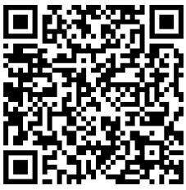
Questions/Evaluations
  Please complete the survey at the following link or use the QR Code.
  The results of this survey will be utilized to help in the development of the Title I School-Level Parent and Family Engagement Plan and future parent and family engagement activities and events.
  If you have a question or suggestions, please contact your child’s school at the number previously provided.
Evaluation Survey
Thank You For Your Support

