Slide 1


Parent Meeting
An important opportunity to communicate and share information between schools and families.
MCHS Title 1 Meeting
Thursday August 15
5:15 PM
Location: MCMS/HS Media Center
996 Phillipsburg Road
Colquitt, GA
We look forward to seeing our Pirate Parents!

Slide 2
What Is Title I?
Title I, Part A of the Elementary and Secondary Education Act of 1965 is a federal program that provides additional funding to school districts to help students from low-income families. The goal of Title I is to ensure that all children receive a high-quality education and meet challenging state academic standards, while also closing achievement gaps.
In order that each student receives equal benefit of Title I services, each school in the district operates a Schoolwide Title I School. The services provided by Title I in each school are outlined in the School Improvement Plan

Slide 3
About Parent Engagement & Resources for Parents
District Family & Community Engagement Policy
School Family Engagement Plan
School Compact
GADOE Parent Capacity Resources
The 1% set-aside is a requirement for school districts that receive more than $500,000 in Title I, Part A funds. This requirement is outlined in Section 1118 of Title I of the Elementary and Secondary Education Act (ESEA). The set-aside funds must be allocated as follows:
1%: Set aside for parent and family engagement
90%: Allocated to all Title I schools in the LEA

Slide 4

MCHS
Curriculum and Assessment Information
(Title 1 Annual Parent Meeting)
August 15, 2024

Slide 5
MCHS CURRICULUM
GA Standards of Excellence & GA K-12 Mathematics Standards
McGraw Hill Curriculum:
Reveal Math
Inspire Science
Study Sync ELA/Reading
Social Studies McGraw Hill & Ramsey’s Foundations in Personal Finance
Online Programs used to supplement the curriculum:
    ALEKS (used for filling in learning gaps and to determine growth)
    IXL (used for filling in learning gaps and to determine growth)
    Progress Learning

Slide 6
MCHS Testing Schedule (1st Semester)
Test | Subject | Date | Additional Info.
MAP BOY | Rdg, ELA & Math | 8/6 - 8/16 | teachers can choose a time during this window to administer
Progress Learning Benchmark BOY | Science, Social Studies, & AMDM | 8/6 - 8/16 | teachers can choose a time during this window to administer
Imagine Learning Benchmark | ESOL | 8/6 - 8/16 | Academic Coach will administer
Write Score Asses. #1 | ELA | 11/4 - 11/15 | Writing & reading assessment must BOTH be administered in this 2 week window (Allotted times apply) Explanatory Essay LaTonya will schedule with company
MAP MOY | Rdg, ELA & Math | 12/3 - 12/19 | teachers can choose a time during this window to administer

Slide 7
Informative Videos
McGraw Hill at Home
IXL at home
MAP Family Report
https://mhs.miller.k12.ga.us/ >Staff & Faculty> Academic Coach’s Corner

Slide 8

Aligns to MCMS’ SIP Action of improving student proficiency in mathematics
ALEKS is a research-based, online learning program that offers course products for our math students.
  Rooted in 20 years of research and analytics, ALEKS is a proven, online learning platform that helps educators and parents understand each student's knowledge and learning progress in depth, and provides the individual support required for every student to achieve mastery.
ALEKS is the most effective adaptive learning program.
  Constantly adapting to update each student’s knowledge state, ALEKS guides students to precisely what they are ready to learn at all times.
  ALEKS helps students master course topics through a continuous cycle of mastery, knowledge retention, and positive feedback. Each student begins a new course with a unique set of knowledge and prerequisite gaps to fill. By determining the student's baseline of knowledge, ALEKS creates an individual and dynamic path to success where students learn and then master topics. ALEKS has helped over 25,000,000 students and counting.
ALEKS has patented a machine learning technology called ALEKS Insights to promptly alert educators to at risk students.
  ALEKS Insights provides email notification to instructors calling attention to students
    (a) who are not succeeding
    (b) who cease succeeding
    (c) who are excessively procrastinating
    (d) who are learning unrealistically fast.
  These formative insights enable instructors to take timely action to help the students that need it the most.
The bottom line: ALEKS is a personalized way for students to learn at their own pace.

Slide 9

IXL is a personalized learning platform that is proven to improve learning outcomes for all students. IXL’s comprehensive K-12 curriculum, Real-Time Diagnostic, personalized guidance, and actionable Analytics work together seamlessly to give teachers everything they need to differentiate instruction and help students grow.
IXL offers comprehensive coverage of pre-K through 12th grade curriculum, with more than 8,500 skills aligned to the Common Core and all state standards.
Each IXL skill automatically differentiates learning by generating questions based on students’ understanding of the material.
The IXL Real-Time Diagnostic assesses students at a deep level, providing reliable insights on students’ grade level proficiency on key math and language arts strands.
With this portrait of student knowledge always in hand, teachers can make smarter decisions about how to reach every student where they are.
IXL uses insights from student work in the curriculum and the Real-Time Diagnostic to power personalized guidance for every learner.
IXL’s personalized action plans seamlessly link students to the skills that will help them build on their current knowledge as well as remediate any gaps in understanding.
IXL Analytics is an essential daily tool that helps teachers deliver data-driven instruction and support every student at the right level.
Analytics uncovers insights that help teachers use their limited class time more effectively, respond to individual needs quicker, and ultimately make better instructional decisions every day.
Taken from https://www.ixl.com/press/IXL-Product-Facts-Sheet.pdf

Slide 10
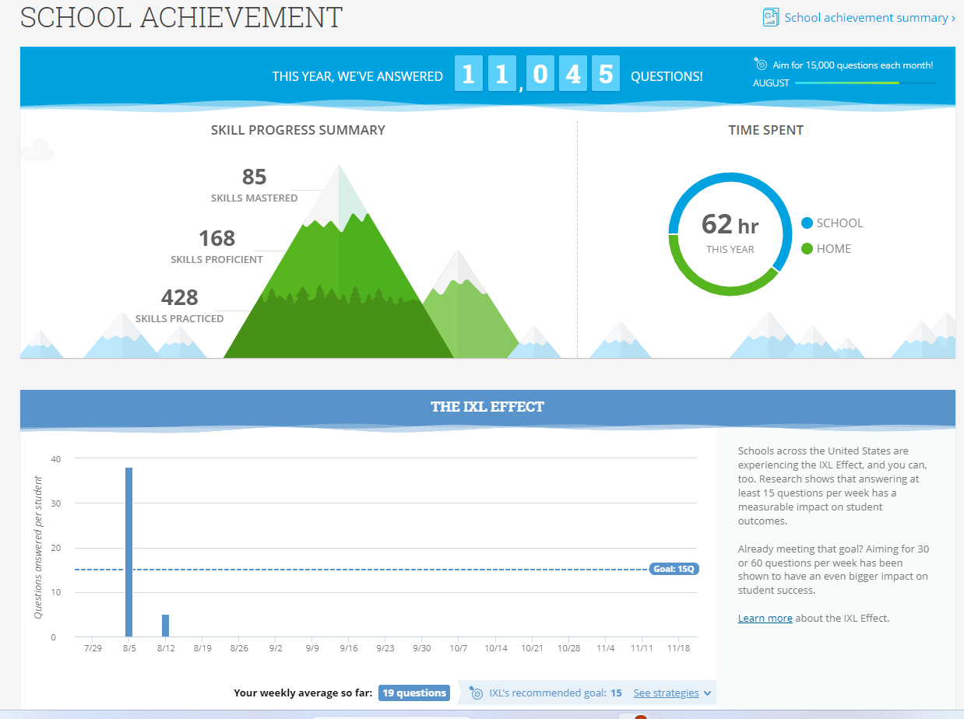
Students MAP RIT scores are entered into IXL to create personalized individual skills plans
Teachers create assignments to support instruction and reinforce standard-based skills
IXL is accessible to students from home

Slide 11

Progress Learning
Benchmarks for Science & Social Studies
Administered 3 times per year

Slide 12
MAP
ASSESSMENT

Slide 13

PURPOSE MAP
MAP stands for Measures of Academic Progress® (MAP®)
MAP is a suite of assessments that deliver data you need to make a difference in student progress; assessments are given three times throughout the school year (beginning of year, mid-year and end of year).
MAP® Growth™—measures areas that are related to our math and ELA standards
MAP® Skills™—identifies gaps and helps students to master specific skills within a hierarchy of foundational skills

Slide 14
How does the MAP assessment work?
Adaptive assessment that adjusts to students’ knowledge
Administered in math, reading, and language usage for grades 6-8
Norm referenced comparing students in the same grade across the country
Assigns projected achievement for Georgia Milestones
Assigns a RIT score
  A specific RIT score represents the level where a student is ready to learn. The test finds that level by pinpointing where a student would just as likely answer incorrectly as correctly, the point between knowing and not knowing answers.
  RIT scores are entered into Exact Path in order to assign Learning Paths to fill in gaps
    Exact Path identifies individual weaknesses and provides acceleration for students working beyond grade level
  RIT scores are also entered into IXL where individualized skill plans are developed
    IXL skills are aligned to the NWEA® MAP™ Growth assessment.

Slide 15
Georgia Milestones Assessment
Who & What are Assessed?
Grade Level | ELA | Math | Science | Social Studies
9th |  | ALG: C&C
10th |  |  | BIO
11th | American Lit. |  |  | US History

Slide 16
Parent Resources for GMAS
Georgia Milestones Resources GADOE
GaConnects
GMAS Preparation for Parents K. Houston

Slide 17
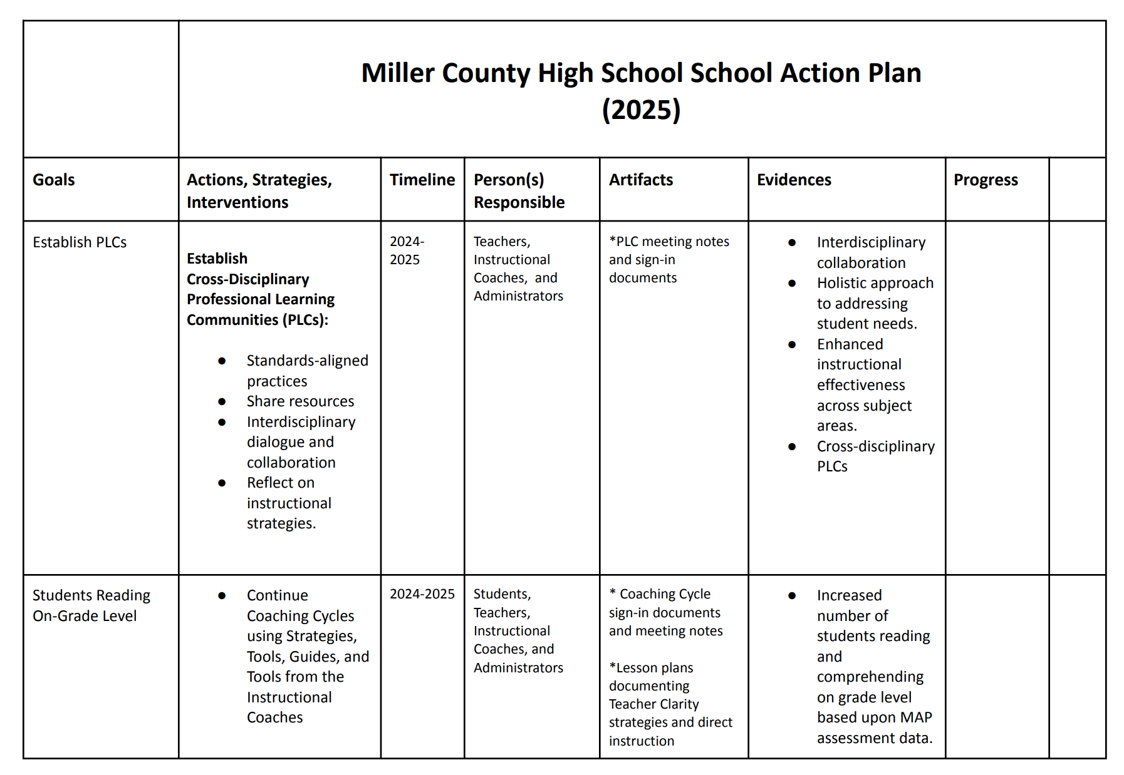
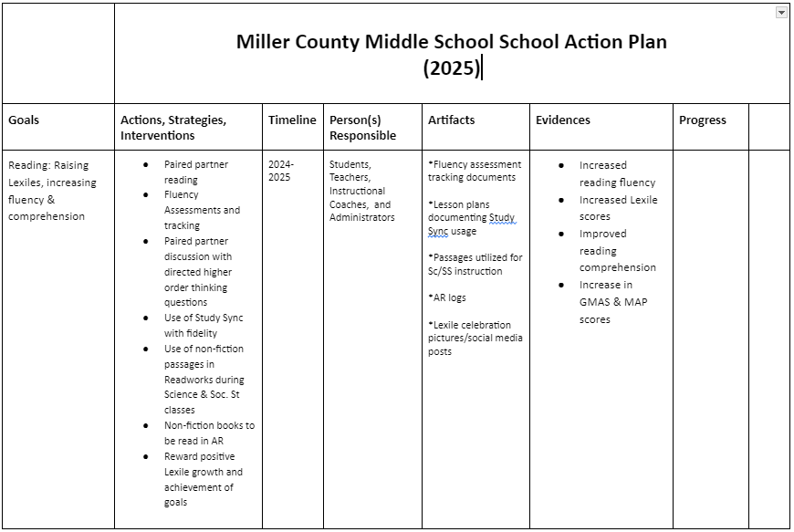

Slide 18
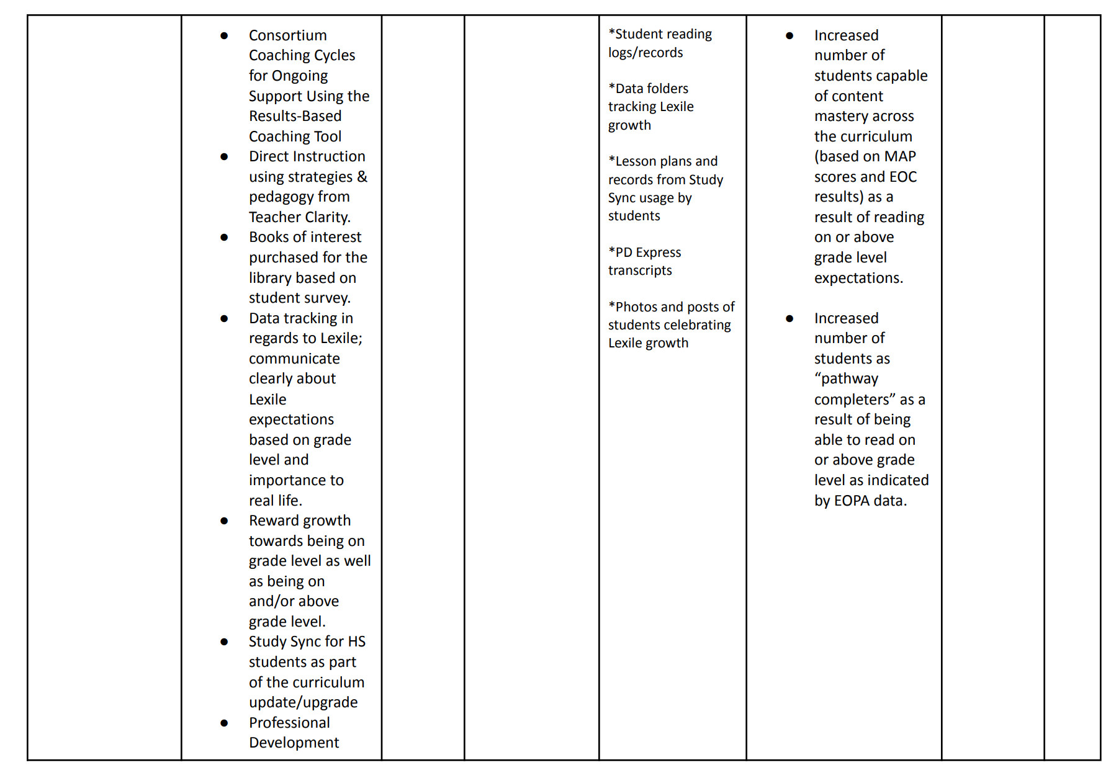
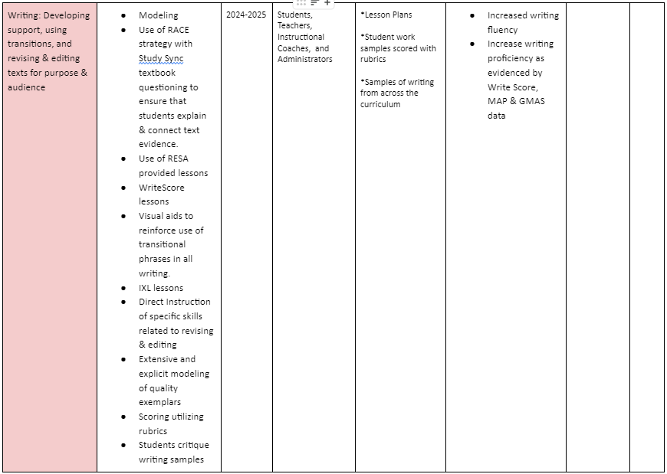

Slide 19
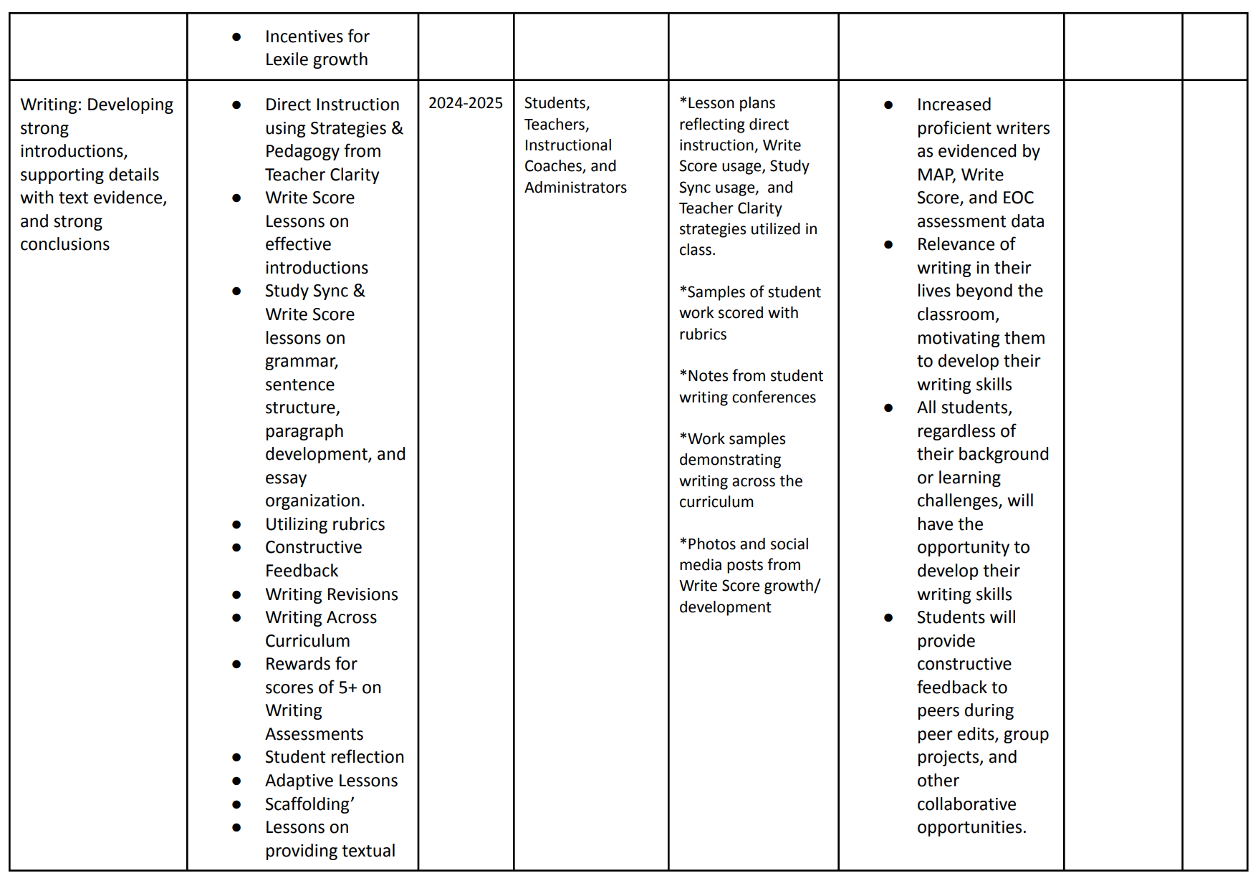
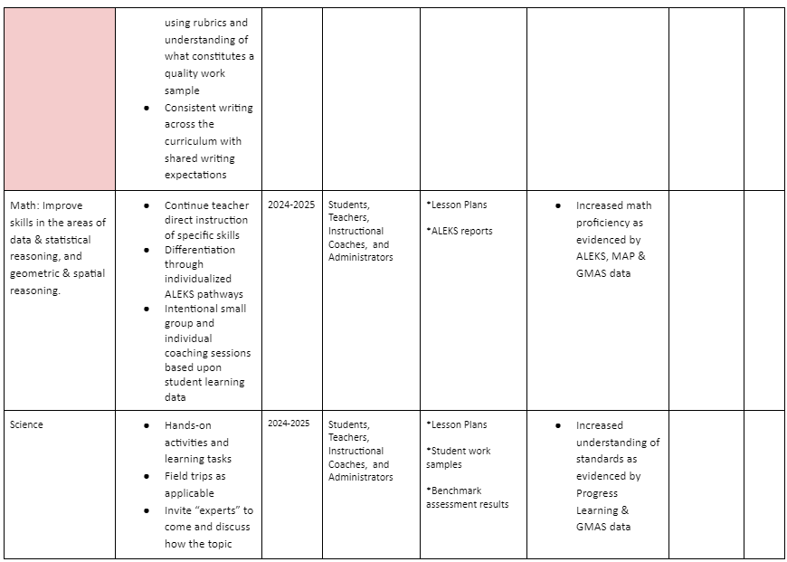

Slide 20
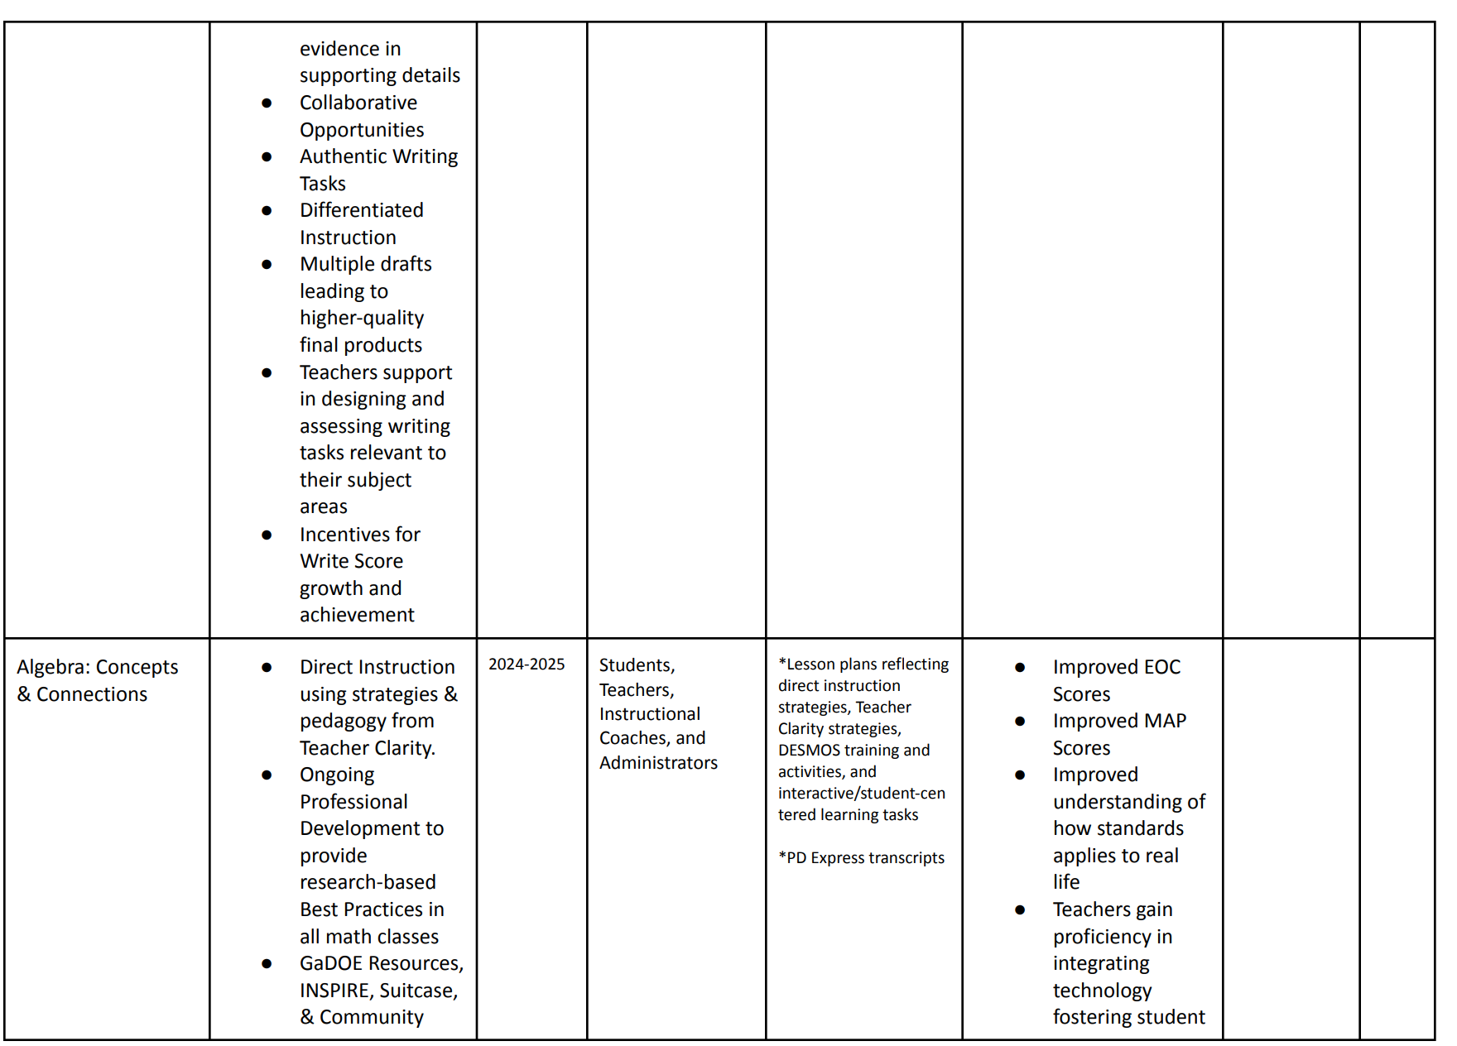
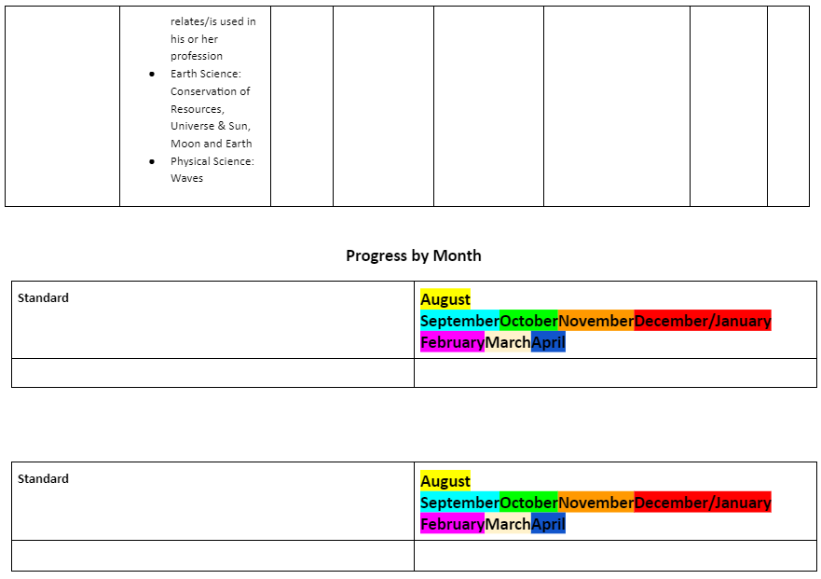

Slide 21
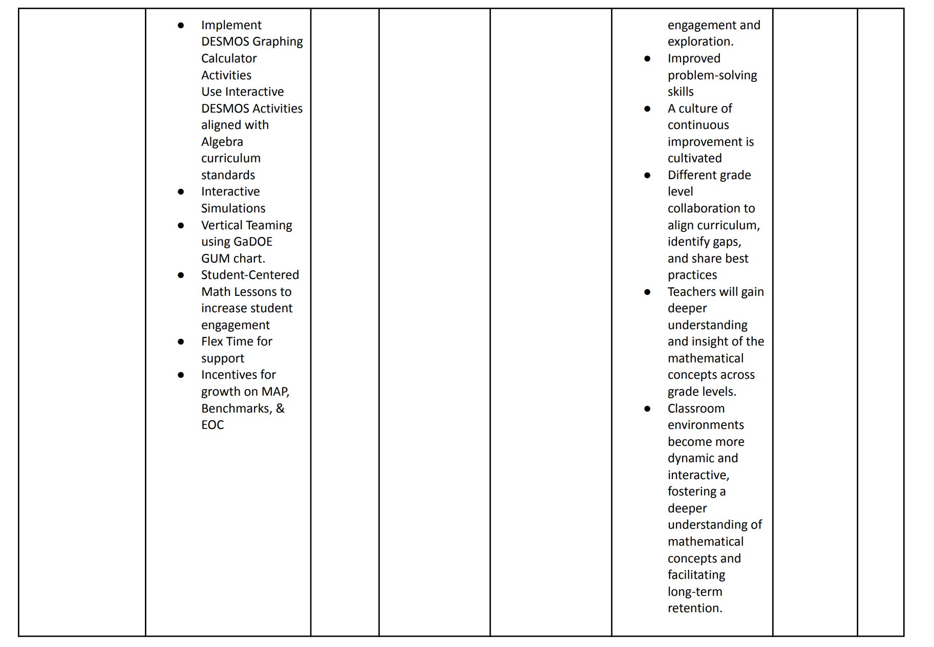
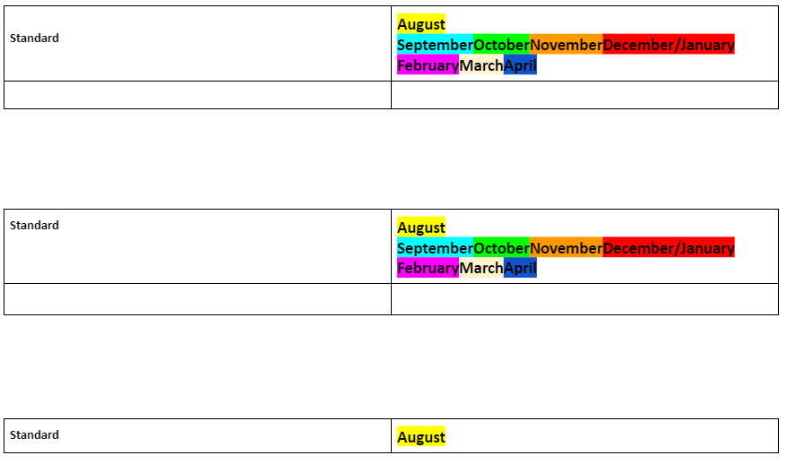

Slide 22
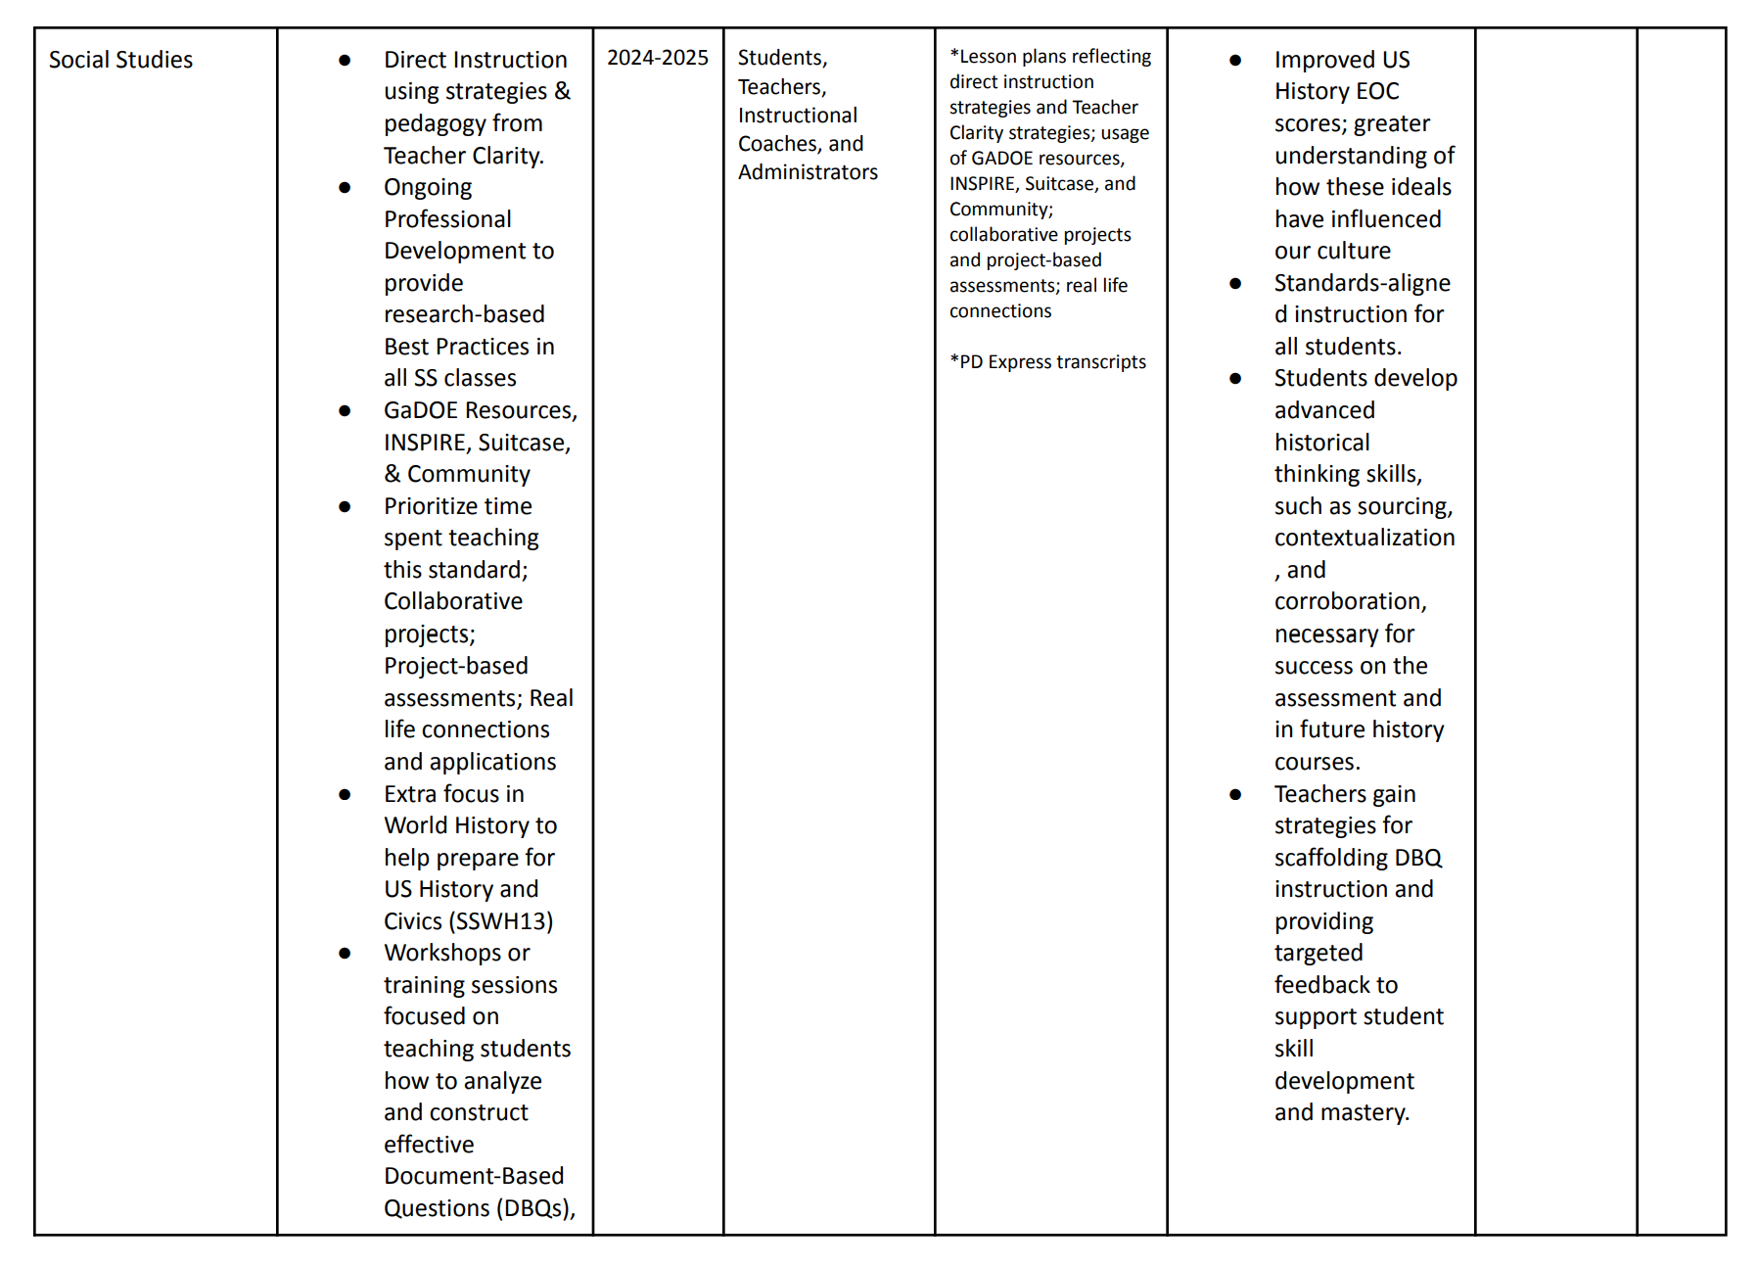
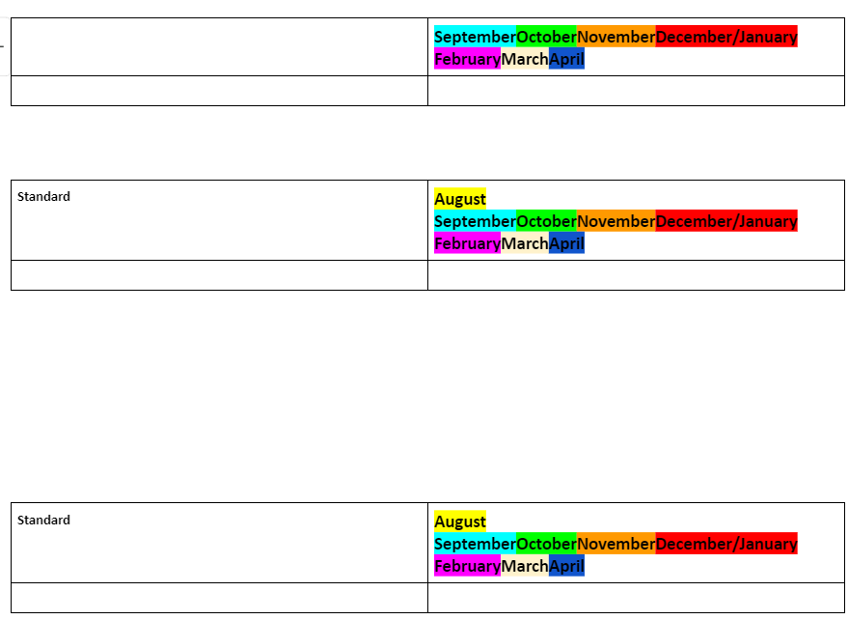

Slide 23
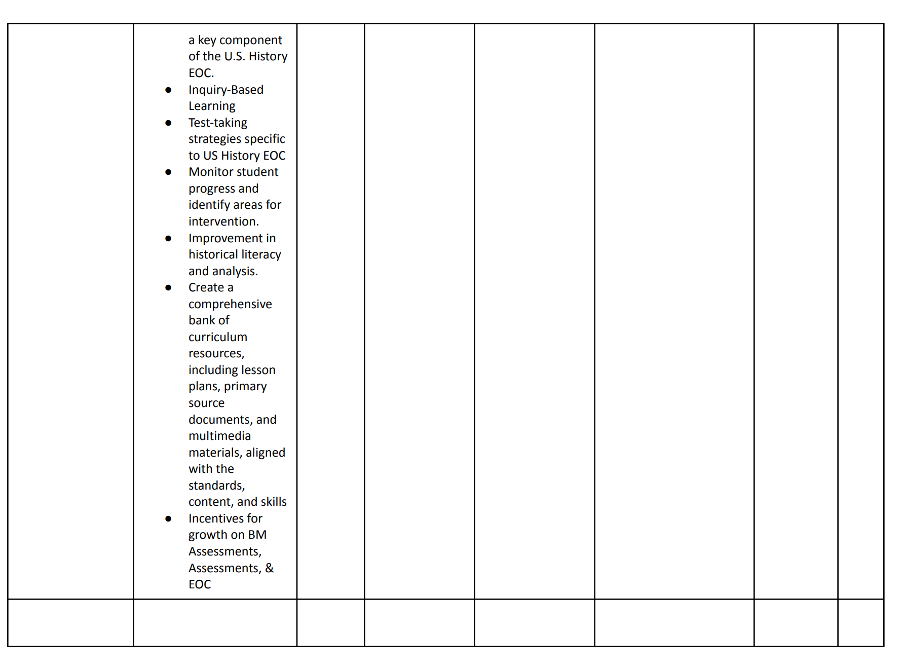

Slide 24
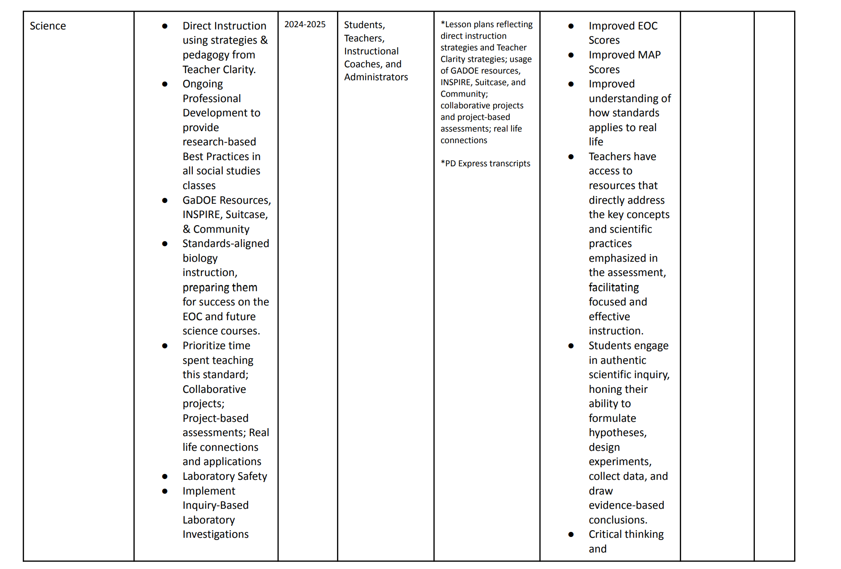

Slide 25
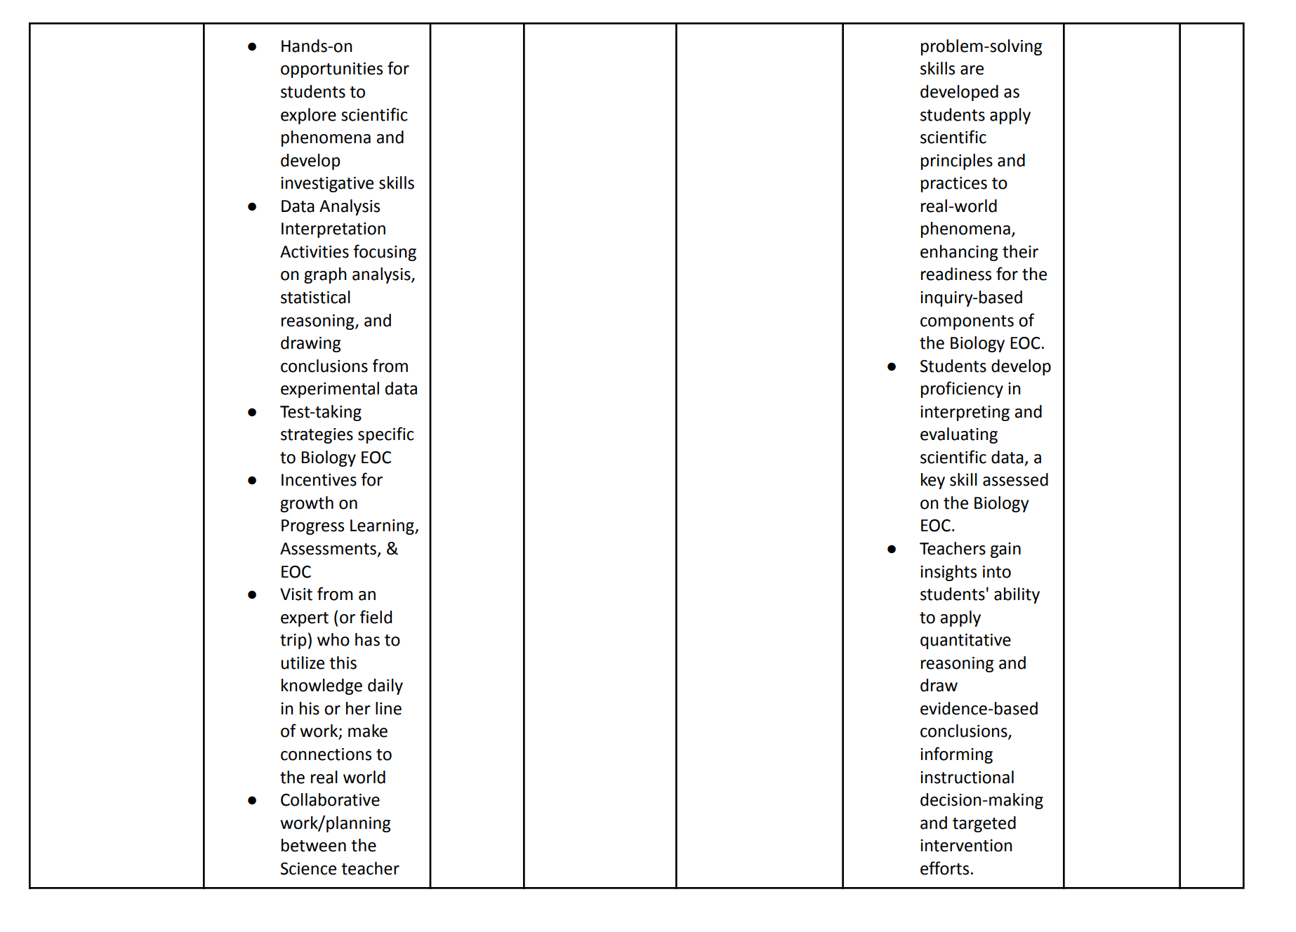

Slide 26
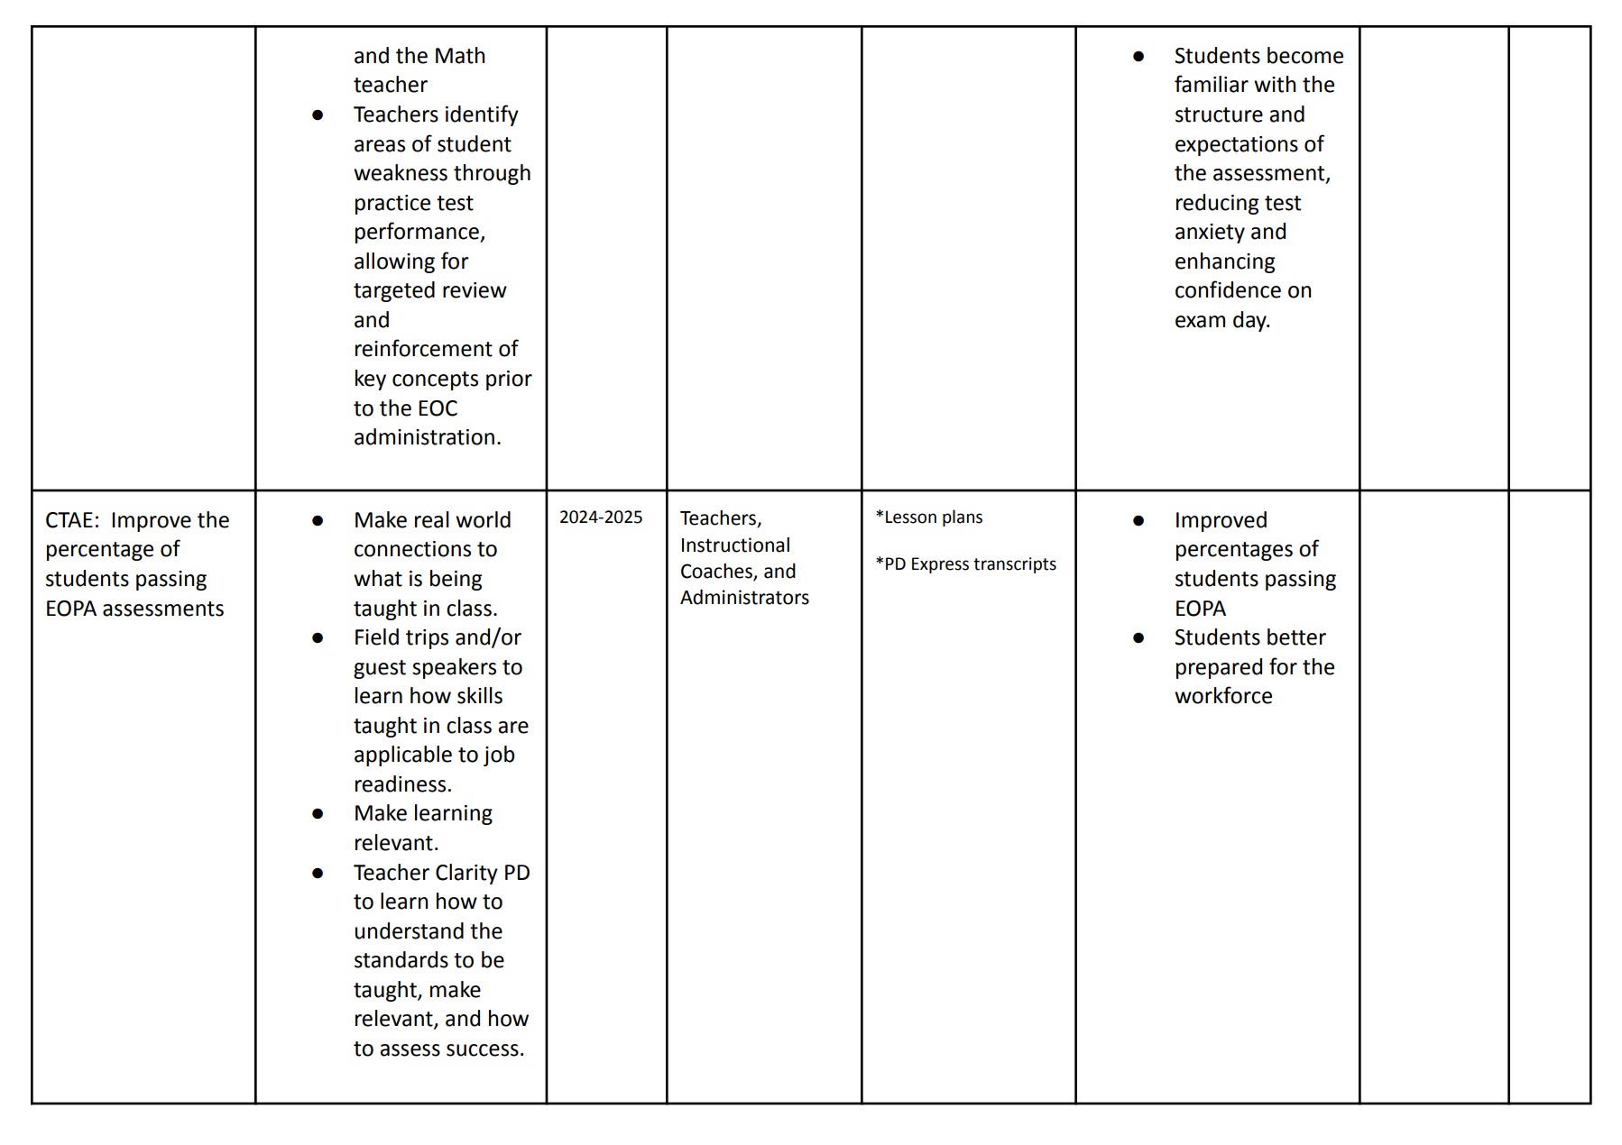

Slide 27
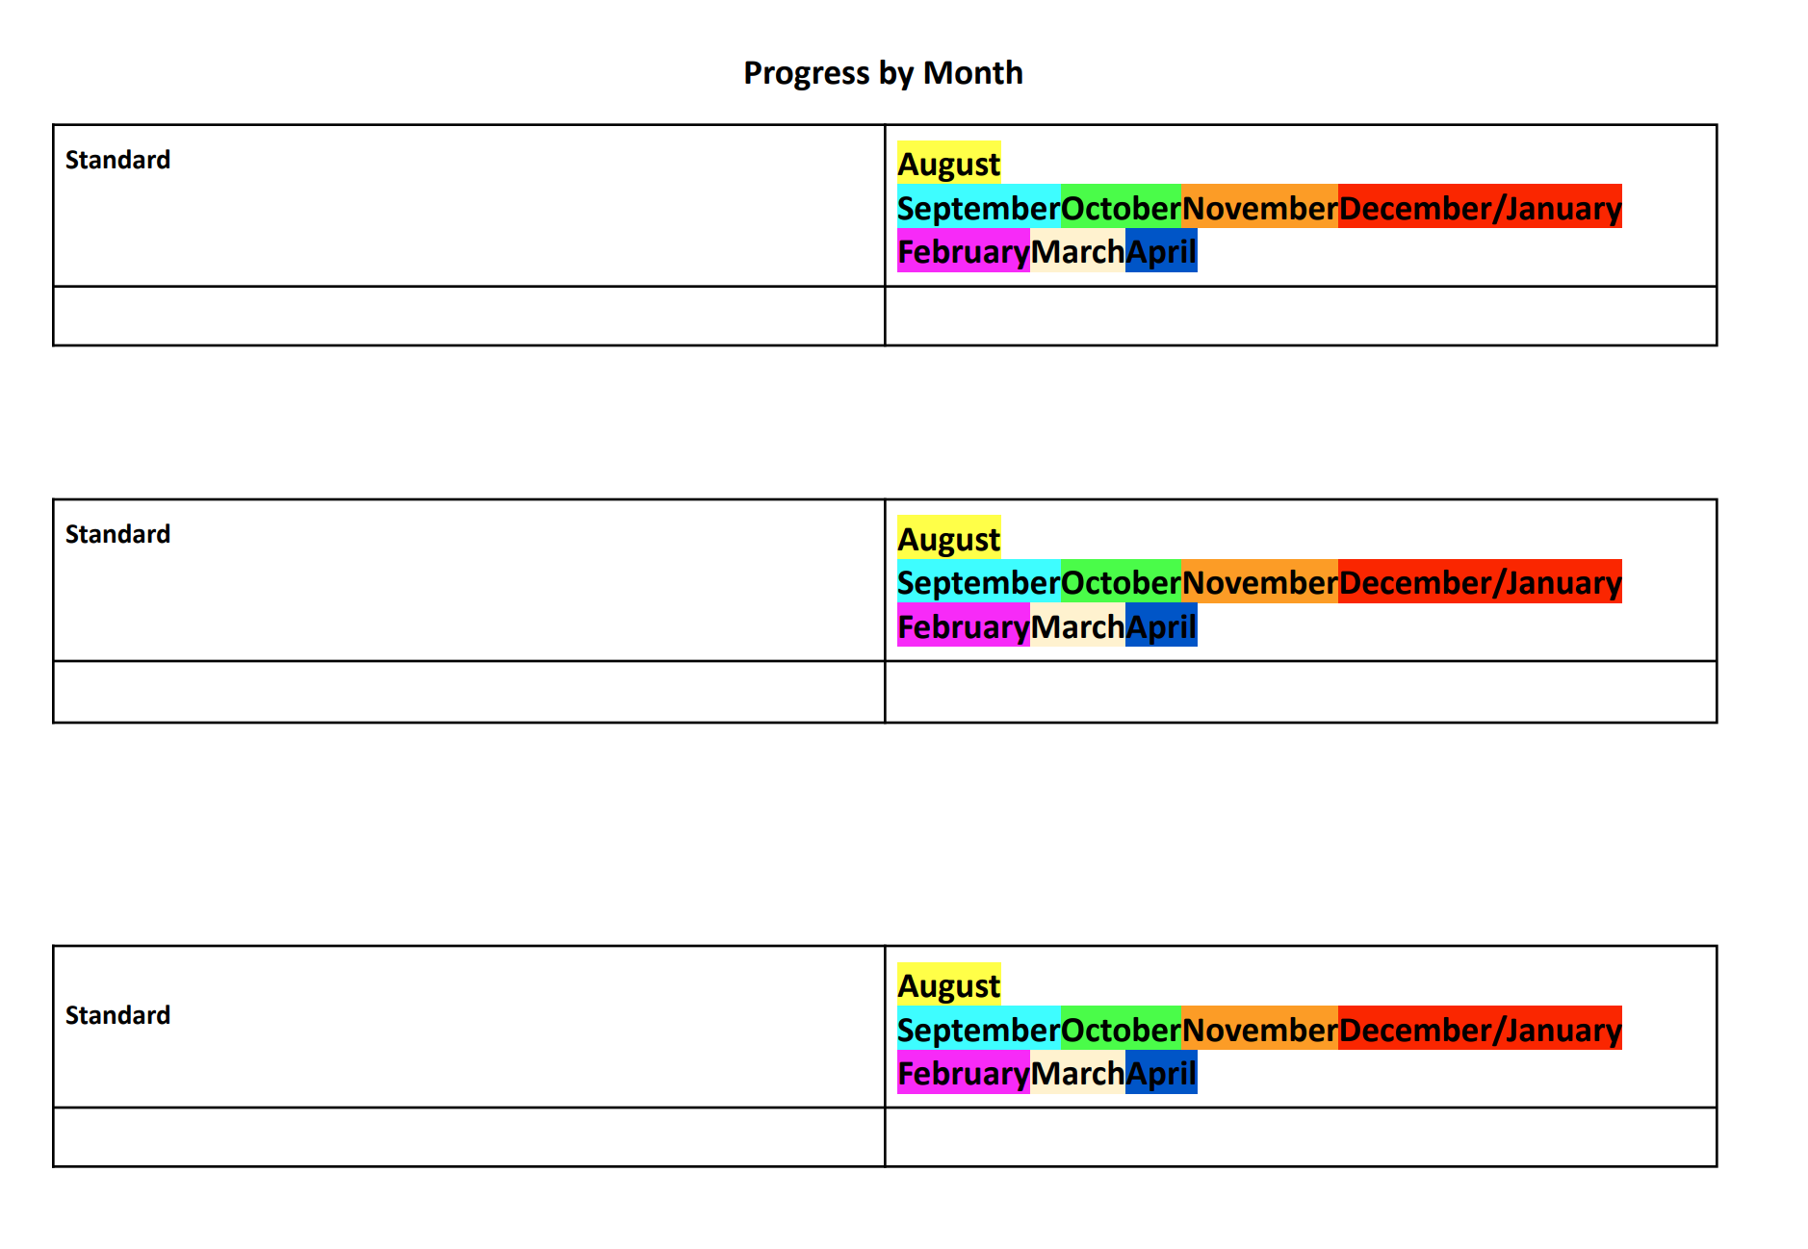

Slide 28
Family & Community Engagement
Family Engagement Policy - Miller County School District
https://www.miller.k12.ga.us/annualmeetingforparents
School Parent and Family Engagement Policy Miller County Schools (MCES, MCMS, MCHS) 2023-2024 Revised

Slide 29
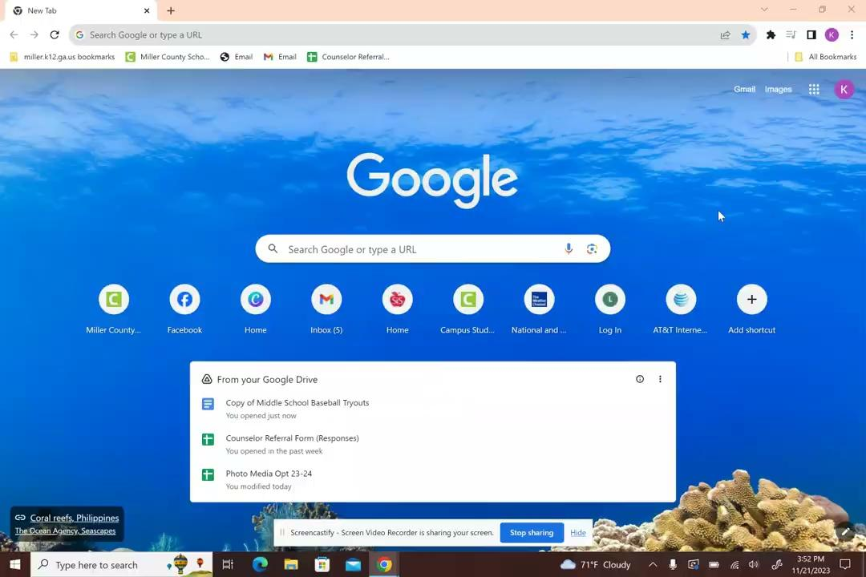
Infinite Campus- Parent Portal

Slide 30
Infinite Campus for Parents
MCHS Benefits of Infinite Campus

