Slide 1
Daily Math Review
8th Grade
Benchmark 4
Week 1

Slide 2
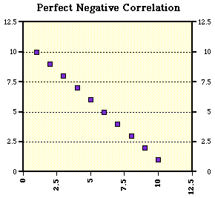
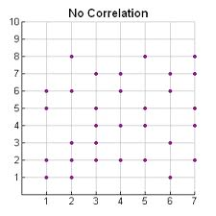
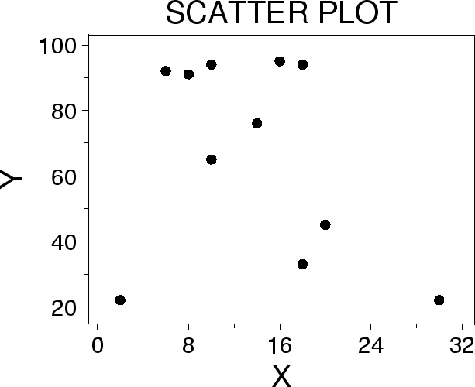
Week 1, Day 1
Would a scatter plot from the table below be a positive or negative correlation?
Does this scatter plot display a positive or negative association?
What kind of correlation does this scatter plot have?
Based on the number of hours a week spent watching TV, is there a correlation to the test score at the end of the week?
x | 1 | 2 | 3 | 4 | 5
y | 3 | 4 | 7 | 8 | 11

Slide 3
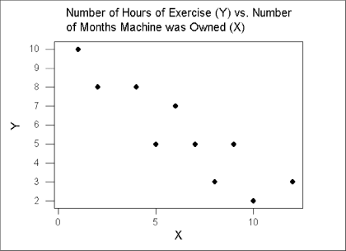
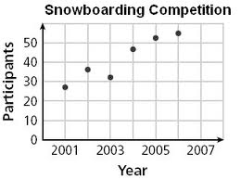
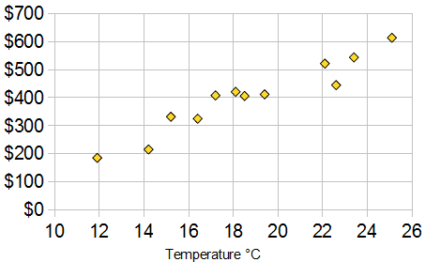
Week 1, Day 2
Based on the scatter plot, what type of correlation can be drawn?
Does the scatter plot have a positive or negative correction?
What does “no correlation” mean?
Does this graph show a positive correlation?
Based on the scatter plot, is there a positive or negative correlation?

Slide 4
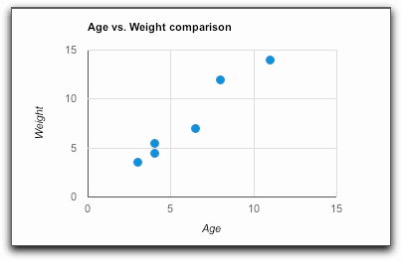
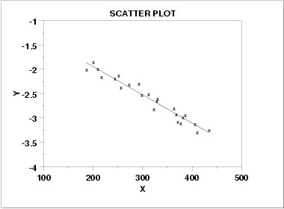
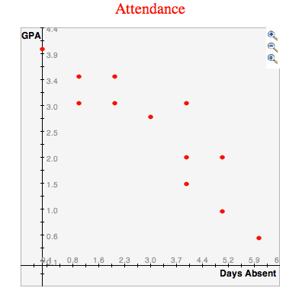
Week 1, Day 3
Graph A
How is the data in the two scatter plots (A & B) different?
Using the “Attendance” graph below, describe the correlation.
Then using the same graph, describe the situation in words.
What type of correlations are these?
As the number of students increases, so does the class size.
As the number of absences decreases, the pass rate increases.
Graph B

Slide 5
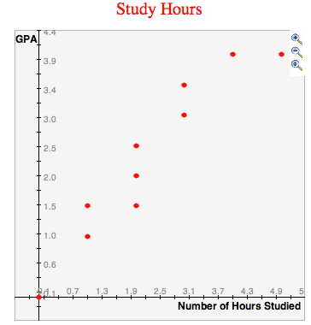
Week 1, Day 4
What type of correlation do the following scenarios have?
The number of hours a car is on the road and the number of miles traveled.
The number of miles a car travels and the amount of gas in the tank.
The speed of a car and the color of the car.
Use the graph at the right to describe the correlation
Then using the graph, describe the situation in words.

Slide 6
Friday Five
What type of correlation does this graph have?
What type of correlation is this?
“As the number of absences decreases, the pass rate increases.”
Based on the scatter plot, is there a positive or negative correlation?
What does “no correlation” mean?
Would a scatter plot from this table have a positive or negative correlation?
x | 1 | 2 | 3 | 4 | 5
y | 3 | 4 | 7 | 8 | 11

Slide 7
Daily Math Review
8th Grade
Benchmark 4
Week 2

Slide 8
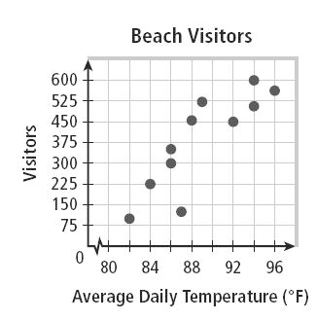
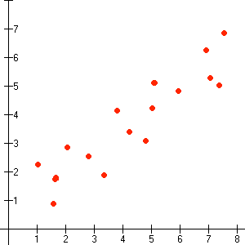
Week 2, Day 1
Draw line of best fit on the Beach Visitors scatterplot.
Which linear equation represents the line of best fit: y=x+0.25 or y=3x+1
Is line A or line B the line of best fit?
Which graph shows the line of best fit?
Graph A
Graph B
A
B

Slide 9
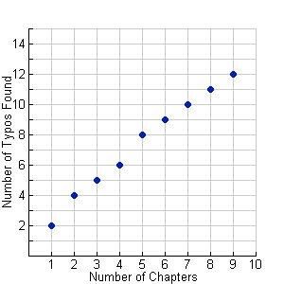
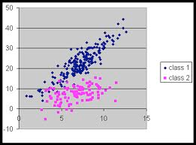
Week 2, Day 2
Graph A
Graph B
Which graph shows the best line of fit?
According to the best line of fit, which linear
equation represents the line? y=1.5x+0.75 or y=x+4
List two observations about the scatter plot below.
What does “positive correlation” mean?
What does “negative correlation” mean?

Slide 10
Week 2, Day 3
Given the data in the table at the right, graph the scatter plot.
Draw the line of best fit on the graph.
Write the equation of the line you drew.
State the type of correlation.
Are there any outliers?
x | y
5 | 7
2 | 8
1 | 3
5 | 8
4 | 6
3 | 5
4 | 8
1 | 4
6 | 9
3 | 6

Slide 11
Week 2, Day 4
Given the data in the table at the right, graph the scatter plot.
Draw the line of best fit on the graph.
Write the equation of the line you drew.
State the type of correlation.
Are there any outliers?
x | y
1 | 35
2 | 75
3 | 85
4 | 130
5 | 150
6 | 175
7 | 220

Slide 12
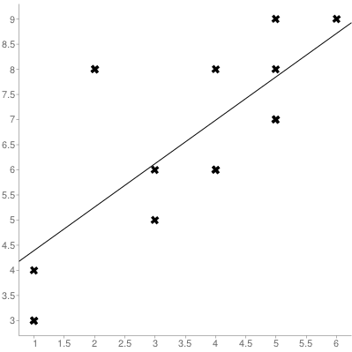
Friday Five
Write the equation of the line of this graph:
Are there any outliers?
What does “negative correlation” mean?
Is line A or line B the line of best fit?
Draw line of best fit on the Beach Visitors scatterplot.
A
B

Slide 13
Daily Math Review
8th Grade
Benchmark 4
Week 3

Slide 14
Week 3, Day 1
If the slope of the line is 4 and the x-intercept is (6,0), what is the equation of the line?
A) y = 4x + 24 B) y = 4x - 24
Solve the following inequality and graph its solution.
If the slope of a line is 5 and the x-intercept is (2,0), what is the equation of the line?
A) y = 5x + 2 B) y = 5x - 10
A gym class charges $25/month, plus a one-time membership fee of $50. Write an equation for the cost in dollars as c and number of months, m.
Which numbers are missing from the function table?
x | y
2 | 8
4
7 | 28
 | 40

Slide 15
Week 3, Day 2
Each visit to the amusement park is at a reduced rate of $25/visit, with a yearly membership fee of $100. Write an equation for the rate.
An apartment charges $400/month, plus a one-time deposit fee of $150. Write an equation for the cost in dollars, c and the number of months paid, m.
Graph the function y = 2x.
Write an equation for go-kart rentals in the format:
c(cost) = ____h + ____
A jet rental company charges $1,200 a day, plus a deposit fee of $2,500. Write an equation for the cost in dollars, c and number of days paid, d.
Hourly Rate | Go-kart Deposit
12 | 30

Slide 16
Week 3, Day 3
A bowling alley charges $7 for each game, plus a one-time shoe rental charge of $9. Write an equation for the cost in dollars, c and number of games played, in g.
A dog boarder charges $22/day, plus a first-timer fee of $50. Write an equation for the cost in dollars, c and number of days paid, d.
Write an equation for costume rentals in the form
c(cost) =___ d +___
Each seat at each basketball game is $15/game, with a yearly membership fee of $100. Write an equation for the rate.
Solve the following inequality and graph its solution.
Halloween Costumes
Daily Rate | Costume Fee
50 | 25

Slide 17
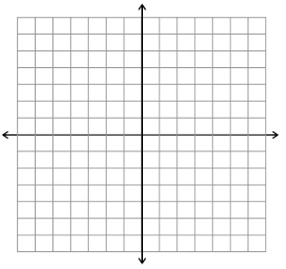
Week 3, Day 4
Ex. 1
Ex. 2
y = 15x
x | y
15 | 1
30 | 2
45 | 3
60 | 4
If a rate of $15/hour were being considered for a job, which example,
1 or 2, would be correct?
A restaurant charges $27 for each dinner, plus a patio table charge of $10. Write an equation for the cost in dollars, c and number of dinners paid, d.
Write an equation for ski rentals.
c(cost) = ____ d +_____
If a rate of 7 miles/hour was an average for biking, which
example would represent the rate if x is the number of hours
biked?
Each rental RV costs $150/day, with a non-refundable deposit for the rental of $300. Write an equation for the rate.
Ski Fees
Ex. 1
Daily Rate | Ski Deposit
75 | 150
y = 7x
Ex. 2

Slide 18
Friday Five
Ski Fees
Daily Rate | Ski Deposit
75 | 150
Write an equation for ski rentals. c(cost) =____d +____
Each seat at each basketball game is $15/game, with a yearly membership fee of $100. Write an equation for the rate.
If the slope of a line is 5 and the x-intercept is (2,0) what is the equation of the line? A) y = 5x + 2 B) y = 5x - 10
Solve the following inequality and graph its solution.
Which numbers are missing from the function table?
x | y
2 | 8
4
7 | 28
 | 40

Slide 19
Daily Math Review
8th Grade
Benchmark 4
Week 4

Slide 20
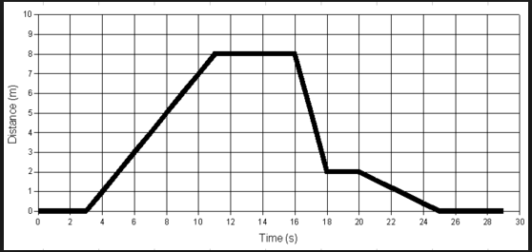
Week 4, Day 1
Use the graph given to answer the following questions:
Name a scenario that could be represented by the graph.
Between which values is the slope increasing?
Between which values is the slope decreasing?
Between which values is the slope zero?
Using your scenario and the breakdown of slopes describe what could be happening at each part of the graph.

Slide 21
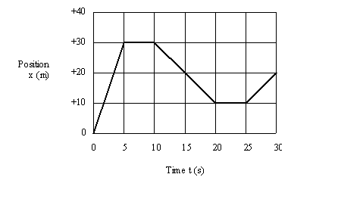
Week 4, Day 2
Use the graph given to answer the following questions:
Name a scenario that could be represented by the graph.
Between which values is the slope increasing?
Between which values is the slope decreasing?
Between which values is the slope undefined?
Using your scenario and the breakdown of slopes describe what could be happening at each part of the graph.

Slide 22
Week 4, Day 3
Use the table given to answer the following questions:
What does the number 14 represent in the graph?
Which subject is most popular among 7th and 8th graders?
How many students like math and science best?
How many students (total) participated in the survey?
What does the number 45 represent in the graph?

Slide 23
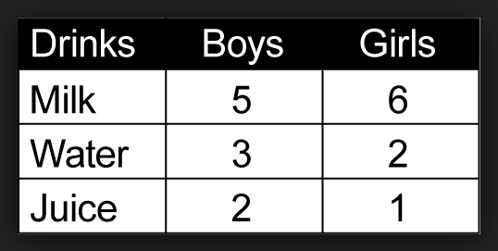
Week 4, Day 4
Use the table given to answer the following questions:
Is there an association between gender and preferred drink?
Which drink is most popular among boys and girls?
How many children like juice best?
How many children (total) participated in the survey?
What does the number 3 represent in the graph?

Slide 24
Friday Five
Use the table & graph given to answer the following questions:
For Questions 1 - 3
How many children like juice best?
How many children (total) participated in the survey?
What does the number 3 represent in the table?
Between which values is the slope increasing?
Between which values is the slope decreasing?
For Questions 4 & 5

Slide 25
Daily Math Review
8th Grade
Benchmark 4
Week 5

Slide 26
Week 5, Day 1
1) Solve for b: 9b + 4(b + 1) < 17
2) Solve for x: 2(x - 4) = 6
3) Compare the 2 linear functions and choose which has the greater y intercept.
a) Function 1 b) Function 2
Function 1
Function 2
y = 2x + 4
x | -1 | 0 | 1 | 2
y | 0 | 2 | 4 | 6
___
3 1
64
√
4) Solve:
=
5) Determine whether the function is linear or nonlinear and explain why. y = -3x² - 7

Slide 27
Week 5, Day 2
1) √15 is between the whole numbers __ and __.
2) Compare the 2 linear functions and choose which has negative slope.
a) Function 1 b) Function 2
Function 1
Function 2
y = 3x + 4
x | -2 | 0 | 2 | 4
y | 2 | -2 | -6 | -10
1
16
√
3) Solve:
=
4) Determine whether the function is linear or nonlinear and explain why. y = 0.26 + 0.5(x + 4)
5) Solve for n: 3n - 4 = 4n - 6

Slide 28
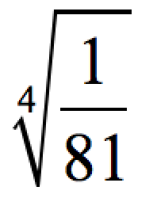
Week 5, Day 3
1) Solve the inequality and graph on a number line.
2) Solve:
3) Solve for x: 9x - 7 = 6x - 1
4) Determine whether the function is linear or nonlinear and explain why. y = -5x² - 7
Function 1
Function 2
5) Compare the 2 linear functions and choose which has the greater slope.
a) Function 1 b) Function 2
x | y
-2 | -3
0 | -2
2 | -1
4 | 0

Slide 29
Week 5, Day 4
1) Determine whether the function is linear or nonlinear and explain why. y = 3x + 7
2) Solve for x: 4(x + 3) = 6x + 6
3) √87 is between the whole numbers __ and __.
4) Solve: x² = 9
Function 1
Function 2
5) Compare the 2 linear functions and choose which has negative slope.
a) Function 1 b) Function 2
y + 6x = 3

Slide 30
Friday Five
1) Solve for x:
x³ = 64
3 1
64
√
2) Solve:
3) Compare the 2 linear functions and choose which has the greater y intercept.
a) Function 1 b) Function 2
Function 1
Function 2
y = 2x + 4
x | -1 | 0 | 1 | 2
y | 0 | 2 | 4 | 6
4) Solve the inequality and graph on a number line.
5) Solve for x: 4(x + 3) = 6x + 6

Slide 31
Daily Math Review
8th Grade
Benchmark 4
Week 6

Slide 32
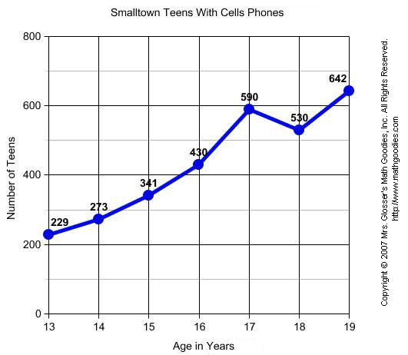
Week 6, Day 1
Between which two points is the slope the greatest?
Between which two points is the slope the least?
Between which two points points is the slope negative?
Are the first 3 points collinear?
Are the 2nd, 3rd, and 4th points collinear?

Slide 33
Week 6, Day 2
Solve the system by graphing: y = 2x - 3 y = 4x + l
Solve the following by combination OR elimination:
2. 2x - y = 5 x - 3y = 0
3. 5x - y = -5 x - y = 3
4. 2x + y = -ll x + 2y = -l
5. x + 3y = 7 3x + 9y = 2l

Slide 34
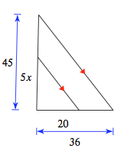
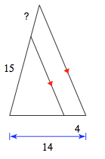
Week 6, Day 3
Question 1
Solve for x in the triangle to the right.
Find the value of the question mark in the triangle to the lower right.
If a dice is rolled and a coin is tossed then what is the probability of getting a heads and a 6?
8x + 5y = 7 5. -5x + 2y = 22 -x - y = l -3x + 2y = 6
Question 2
Solve:

Slide 35
Week 6, Day 4
The numbers 4 through 14 are placed in a bowel and drawn at random then replaced after being drawn. What is the probability of drawing the number 14 and then a number less than 12?
x + y = 3 3. x + y = 0
2x + 2y = 6 2x - 11y = 39
Are the following sets of points collinear?
4. (4,5) (6,7) (8,9)
5. (-2,4) (-2,9) (-2,l00)

Slide 36
Friday Five
Solve the following by combination/elimination:
2x - y = 5 x - 3y = 0
If a dice is rolled and a coin is tossed then what is the probability of getting a head and a 6?
Solve for x in the triangle to the right.
Are the following sets of points collinear?
(4,5) (6,7) (8,9)
Solve the following system of equations:
x - y = 3 x - y = 2

Slide 37
Daily Math Review
8th Grade
Benchmark 4
Week 7

Slide 38
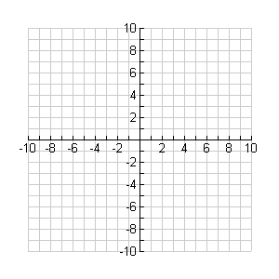
Week 7, Day 1
Determine the length of a diagonal of a rectangle that is 5 inches by 7 inches.
Is a triangle with sides lengths 2 cm, 4 cm, and 5 cm a right triangle? Why or why not?
Given points at (0,0) and (6,8) find the distance of the diagonal.
Given the points (-9,2) and (-3,10) find the length of the line that connects them.
Solve for a: a² + 4² = 25

Slide 39
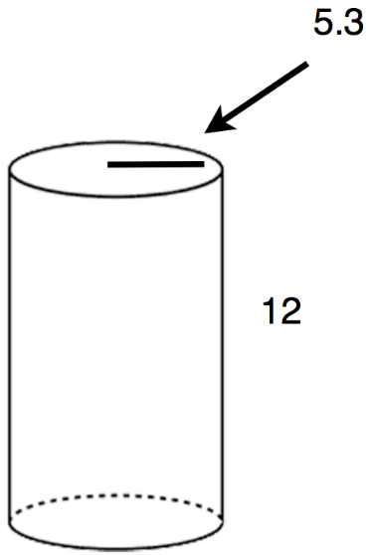
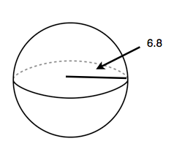
Week 7, Day 2
Question 1
Find the volume of the cylinder (use 3.14 for pi).
Find the volume of the sphere (use 3.14 for pi).
Is the triangle with side lengths 4 cm, 5 cm, and 7 cm a right triangle? Why or why not?
If line DF is 5 units long and line EF is 13 units long, how long is line DE if <DFE is 90 degrees?
What is the Pythagorean Theorem?
Question 2

Slide 40
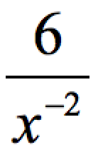
Week 7, Day 3
Simplify
Simplify (3x⁻²)²
Write in standard notation: 4.0 x 10⁻⁴
The distance between Earth and the moon is approximately 384, 000 km. Write this in scientific notation.
Simplify: (3 x 10⁵) x (1.5 x 10⁻⁵)

Slide 41
Week 7, Day 4
Simplify: (2.3 x 10³) x (4 x 10⁻²)
Simplify: 1.67 x 10⁵
6x²y⁴ 4. 7x²y⁻⁴ 3y² x⁴
5. 7³(7⁻³)

Slide 42
Friday Five
Is the triangle with side lengths 4 cm, 5 cm, and 7 cm a right triangle? Why or why not?
Given points at (0,0) and (6,8) find the distance of the diagonal.
Find the volume for the cylinder.
7³(7⁻³)
The distance between Earth and the moon is approximately 384,000 km. Write this number in scientific notation.

