Slide 1
Welcome
to the Annual Meeting of Title I Parents
2023 - 2024
Coosada Elementary School

Slide 2
Why are we here?
The Every Student Succeeds Act of 2015 requires that each Title I School hold an Annual Meeting of the Title I parents for the purpose of….
Informing you of your school’s participation in Title I
Explaining the requirements of Title I
Explaining your rights to be involved

Slide 3
What you will learn…
What does it mean to be a Title I school?
What is the 1% Set-Aside for parent and family engagement
What is the LEA Title I Plan
What is the LEA Parental Engagement Plan?
What is a CIP?
What is the School-Parent Compact?
How do I request the qualifications of my child’s teacher?
How is the Annual Evaluation of the Parent and Family Engagement Plan conducted?
Evaluations need to target 3 key components: barriers, ability to assist learning, successful interactions.
How can I be involved in all of the things I’m learning about?

Slide 4
What does it mean to be a Title I School – Federal Funding?
Being a Title I school means parent and family involvement and know their rights under Every Student Succeeds Act of 2015. (ESSA)

Slide 5
Coosada Elementary School is a Title I School.

Slide 6
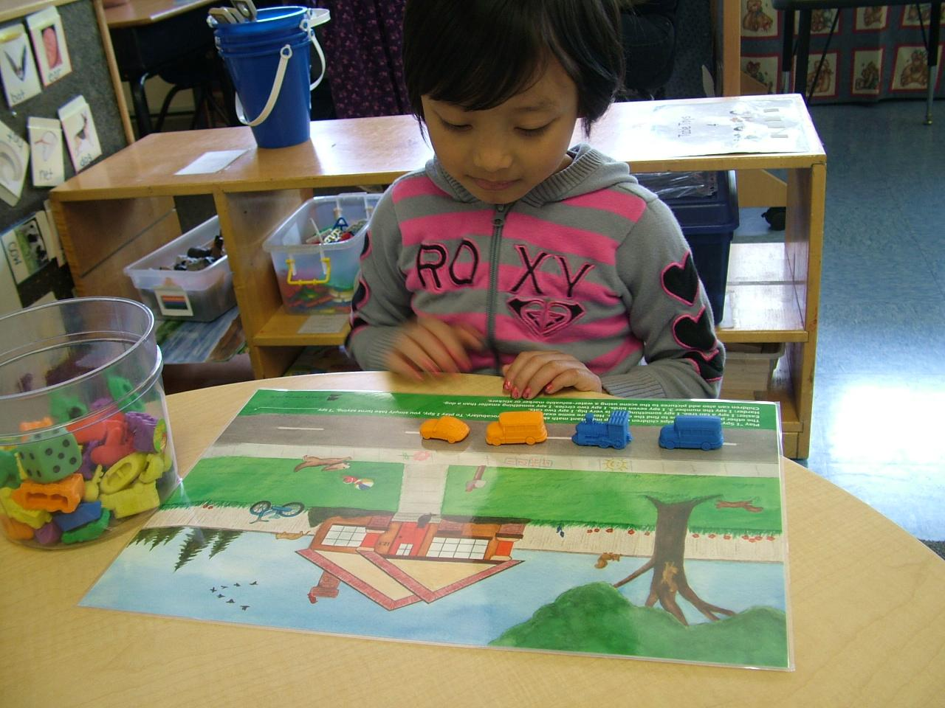
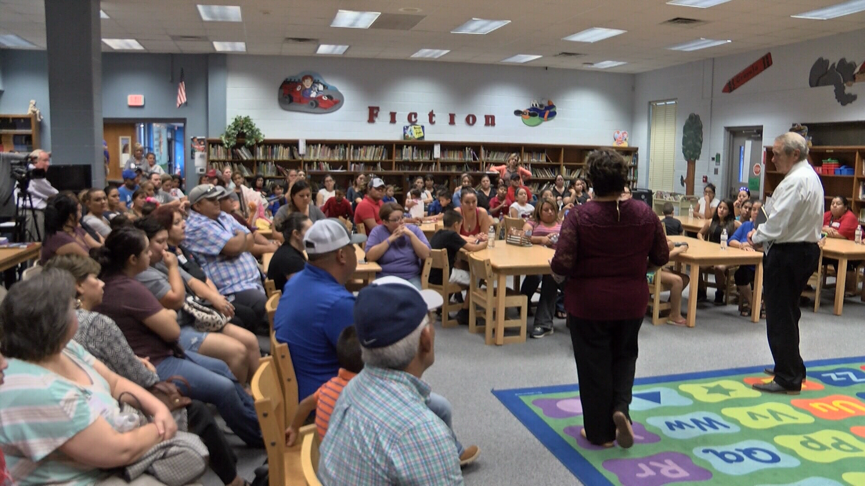
Federal funding is used to supplement Coosada’s programs.
Identifying students with academic difficulties and providing assistance to help them.
Purchasing supplemental materials to help needs of students.
Conducting parent meetings and trainings.
Being a Title I school means parent and family involvement and know their rights under Every Student Succeeds Act of 2015. (ESSA)
*pictures were taken pre-Covid*

Slide 7
How are Title I funds used?
salaries
computers
software
Instructional supplies

Slide 8
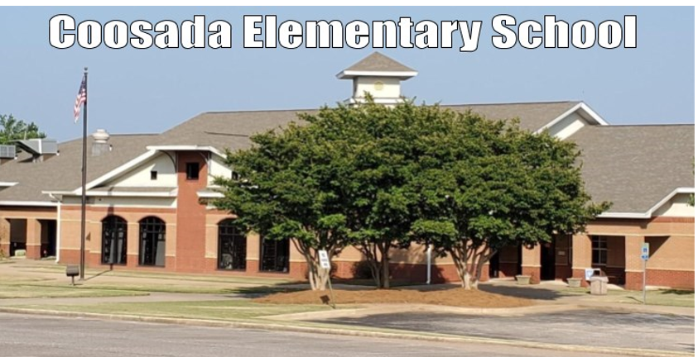
1% Set-Aside How are parents involved?
Title I allocation - $2,911,748
1% = $29,117
Local Education Agency - LEA
Allocation - $3,941 (Based on % of free and reduced lunch.)
You, as Title I parents, have the right to be involved in how this money is spent.

Slide 9
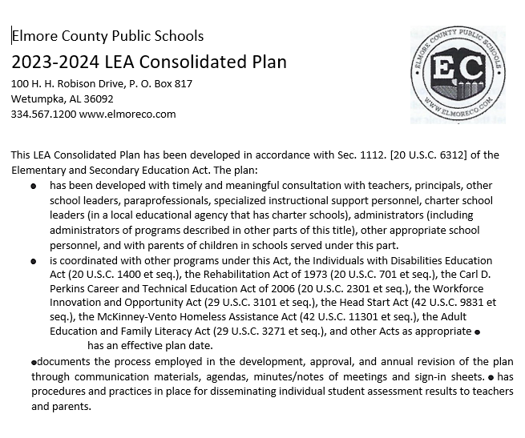
LEA Consolidated Plan
The plan explains how Elmore County will use Title I funds throughout the system:
*Student assessments
*Additional assistance provided struggling students
*Coordination of federal funds and programs
*School Programs: EL, homeless
*Parent and Family Engagement Strategies
The entire LEA Consolidated Plan can be found: elmoreco.com – Departments – Federal Programs – Publications/Plans
You, as a Title I Parent, have the right to be involved in the development of the LEA Consolidated Plan.

Slide 10
LEA Parent and Family Engagement Plan
The plan explains how the LEA will implement the parent and family engagement requirements of Every Student Succeeds Act.
*The LEA’s expectations for parents and families
*How the LEA will involve parents in decision-making
*How the LEA will work to build the school’s and parents’ capacity for strong parental involvement to improve student academic achievement
The LEA Parent and Family Engagement Plan can be found:
elmoreco.com – Departments – Federal Programs – Publications/Plans
You, as Title I parents, have the right to be involved in the development of this plan.

Slide 11
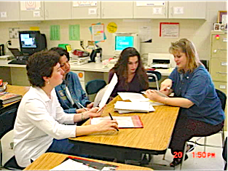
What is a CIP?
The CIP is Coosada’s Continuous Improvement Plan and includes:
Needs Assessment and Summary of Data
Goals and Strategies to Address Academic Needs of Students
Professional Development Needs
Coordination of Resources/Comprehensive Budget
The School’s Parent and Family Engagement Plan
You, as Title I parents, have the right to be involved in the development of this plan.

Slide 12
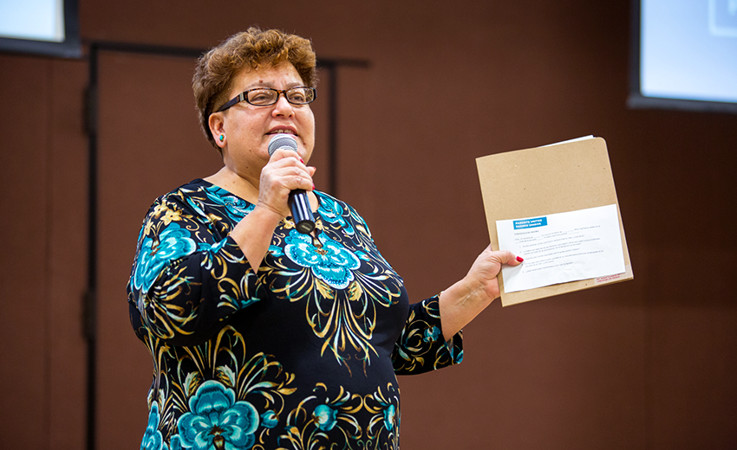
Coosada Elementary’s Parent and Family Engagement Plan
This plan addresses how the school will implement the parent and family engagement requirements of Every Child Succeeds Act of 2015:
How parents can be involved in decision-making and activities
How parental and family engagement funds are being used
How information and training will be provided to the parents
How the school will build capacity in parents and staff for strong parental and family engagement through “evidence based” strategies
You, as Title I parents, have the right to be involved in the development of Coosada Elementary’s Parent and Family Engagement Plan.

Slide 13
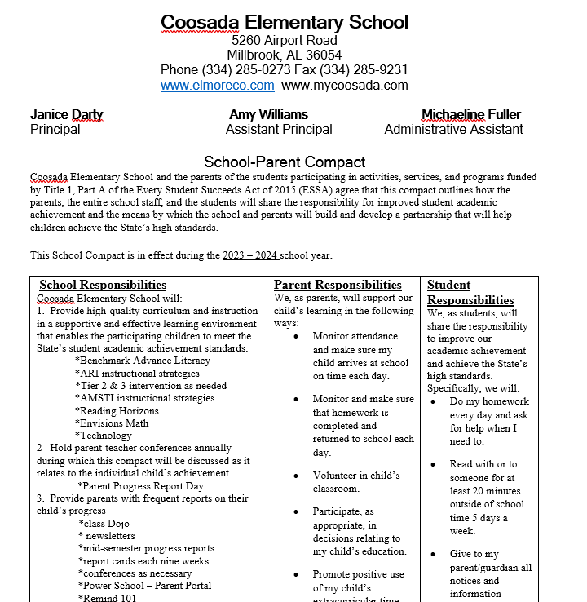
Coosada Elementary School’s
School-Parent Compact
You can find your copy of the Compact in the
Coosada Elementary School handbook.

Slide 14
School-Parent Compact: School Responsibilities
*The Compact is a commitment from the school, the parent, and the student to share in the responsibility for improved academic achievement.
*You, as Title I Parents, have to the right to be involved in the development of the School-Parent Compact.
*School section MUST include the following 6 components
- Provide high-quality curriculum and instruction.
Hold parent-teacher conferences.
Provide parents with reports on their child’s progress.
Provide parents reasonable access to staff.
Provide parents opportunities to volunteer
Ensure regular two-way, meaningful communication between family members and school staff and to the extent practicable, in a language that family members can understand.
*Distribution of the Compact

Slide 15
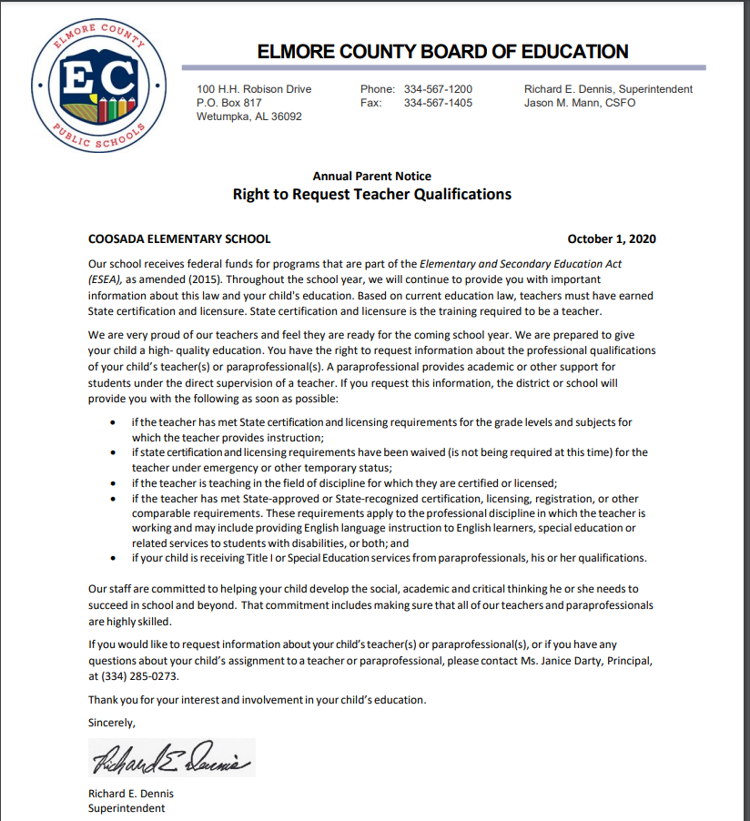
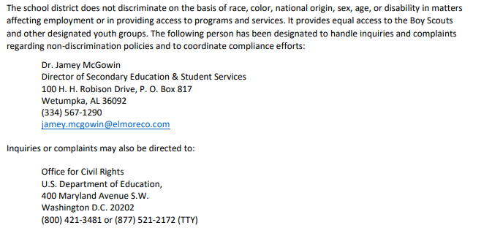
How do I request qualifications of my child’s teacher?
You, as Title I Parents, have the right to request the qualifications of your child’s teachers. elmoreco.com - publications
Parent’s Right to Know - process

Slide 16
How is the evaluation of the LEA Parent and Family Engagement Plan Conducted?
Evaluation Requirements – Every Student Succeeds Act requirement
LEAs and schools must actively outreach to all parents and families reaching beyond barriers of culture, language, disabilities, and poverty.
Conduct annually
Conduct with Title I parents
Analyze content and effectiveness of the current plan
Identify barriers to parental involvement
Data/Input may include: Parent Surveys, Focus Groups, Parent Advisory Committees

Slide 17
How is the evaluation of the LEA Parent and Family Conducted?
Process and Timeline
Parent Surveys are administered in the Spring
Compilation of survey data
Parent participation in school activities
Parent input in advisory meetings
How the evaluation informs next year’s plan
-Revised goals are stated based on needs.

Slide 18
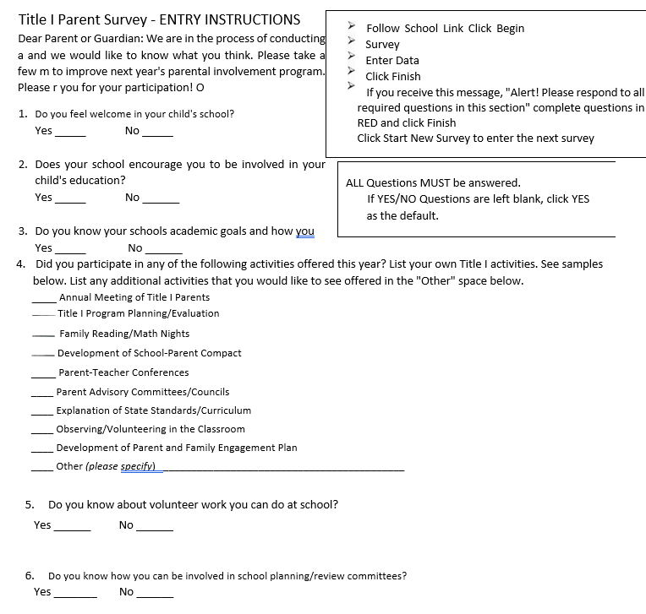
Title I Parent Survey
Sample copy of the Title I
Parent Survey you will
receive in February/March.

Slide 19
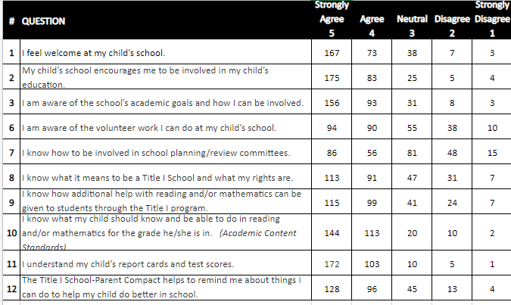
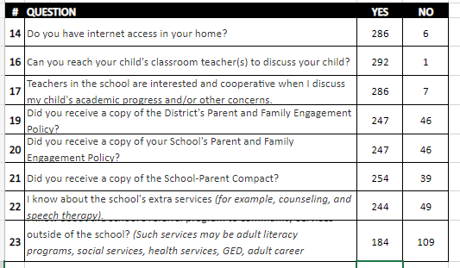
Coosada Elementary School Title I Survey Results
elmoreco.com – Federal Programs
coosadaelemelmoreal.schoolinsites.com
Coosada Handbook
Coosada Counselors

Slide 20
Coosada Elementary School’s Referral Program - Counselors
Survey Results: 306 surveys completed
Mrs. McClendon
Ms. Winchester
Adult Literacy
Abuse
GED
Social Services

Slide 21
Who are the parent leaders at my school
Janice McKenzie, Principal: janice.mckenzie@elmoreco.com
Amy Williams, Assistant Principal: amy.williams@elmoreco.com
Michaeline Fuller, Assistant Principal: michaeline.fuller@elmoreco.com
Gretchen Crim, Instructional Coach: Gretchen.crim@elmoreco.com
Lanaye Stokes, Title I: layne.stokes@elmoreco.com
Kimberly Graham, Title I: kimberly.graham@elmoreco.com
Debra Murphy, ESL Coordinator, Title III, debra.murphy@elmoreco.com

Slide 22
Thank you for your participation! *Please send a remind message or note to your child’s teacher with the word: Coosada. This documents that your read the PowerPoint. Your child will get a GOTCHA.*
Click here if you have any questions or concerns.

