Slide 1
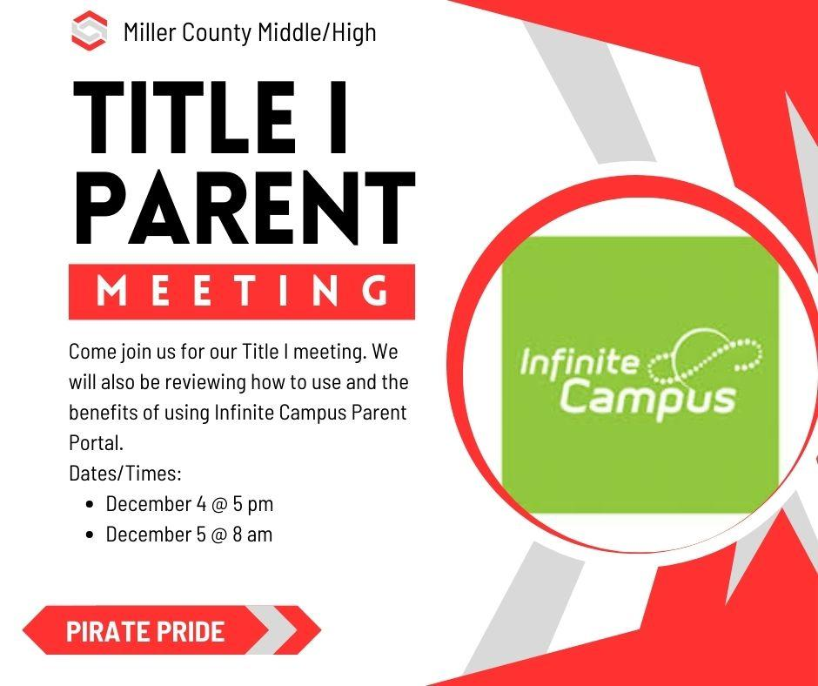

Slide 2
Agenda
Annual Title I Parent Meeting
MCHS Library - December 5, 2023 – 5:00 PM
Agenda
Jamie Dixon, Principal MCHS – Welcome
Parent Engagement Activity:
Infinite Campus with Mrs. Keumele Keown, MCMS Counselor
Annual Title I Parent Meeting
Robert Green, Federal Programs Director
What is a Title I school?
How does our school spend Title I money?
How is Title I Parent and Family Engagement money spent?
What are our school’s Title I requirements?
What is required by law for parent and family engagement?
Does my child’s teacher meet professional qualifications?
Jamie Dixon HS Principal, Dr. Susan Grubbs MCHS Academic Coach
What are our school wide goals?
Review School Improvement Plan/Goals
What curriculum does our school use?
Review curriculum used at MCHS
What tests will my child be taking?
MAP, Progress Learning, Write Score, Georgia EOC
What opportunities does the school provide for family engagement?
Parent Transition Night, FAFSA Night, Title 1 Annual Meeting
Jointly developed School Compact
School, Parent and Family Engagement Policy
How responsive will the school be to my questions when staff is contacted?
Question/Answer session
Adjourn Title I Meeting
This meeting was not used to collect input, but provided as an opportunity to disseminate information.

Slide 3
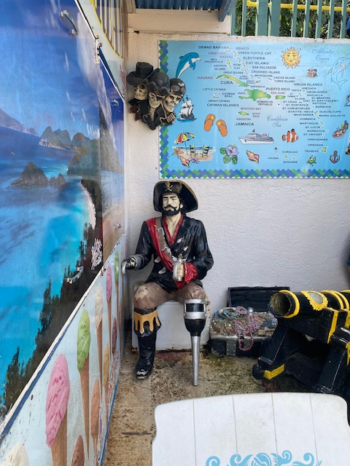
MCHS
Title 1 Annual Parent Meeting
School Improvement Plans/Goals
December 4th & 5th, 2023

Slide 4
MCHS School Improvement Plan Goals
Increase Student Engagement
Flexible Groups
Student Centered Activities
Student Collaboration
Rigor Adjusted to Needs
Increase Use of Technology
Data Driven Instructional Decisions
Pre/Post Assessments in Science & Social Studies
MAP Assessment
Data Digs
Curriculum Use with Fidelity
Increase/Improve Numeracy Skills
Professional Development
Checks for Understanding
Formative and Summative Data Comparison
Increase/Improve Literacy Skills
Professional Development
Checks for Understanding
Formative and Summative Data Comparison
Targeted Lexile Group Interventions
Increase Daily Attendance
Taking Attendance is Required Every Day – Every Class
Attendance will be Monitored and Interventions will be Set in Place.
State Policy will be Enforced. GEORGIA COMPULSORY ATTENDANCE LAW
Positive Reward and Incentives

Slide 5
MCHS
Title 1 Annual Parent Meeting
(Curriculum and Assessment Information)
December 4th & 5th, 2023

Slide 6
MCHS CURRICULUM
Georgia's K-12 Mathematics Standards (gadoe.org)
GA Standards of Excellence

Slide 7
MCHS CURRICULUM
McGraw Hill Curriculum:
Reveal Math
Inspire Science
Spanish
Social Studies
Dave Ramsey-Ramsey Education
My Perspectives - ELA
Online Programs used to supplement the curriculum:
ALEKS (used for filling in learning gaps and to determine growth)
IXL (used for filling in learning gaps and to determine growth)
Progress Learning (Science & Social Students)

Slide 8
Aligns to MCMS’ SIP Action of improving student proficiency in mathematics
ALEKS is a research-based, online learning program that offers course products for our math students.
Rooted in 20 years of research and analytics, ALEKS is a proven, online learning platform that helps educators and parents understand each student's knowledge and learning progress in depth, and provides the individual support required for every student to achieve mastery.
ALEKS is the most effective adaptive learning program.
Constantly adapting to update each student’s knowledge state, ALEKS guides students to precisely what they are ready to learn at all times.
ALEKS helps students master course topics through a continuous cycle of mastery, knowledge retention, and positive feedback. Each student begins a new course with a unique set of knowledge and prerequisite gaps to fill. By determining the student's baseline of knowledge, ALEKS creates an individual and dynamic path to success where students learn and then master topics. ALEKS has helped over 25,000,000 students and counting.
ALEKS has patented a machine learning technology called ALEKS Insights to promptly alert educators to at risk students.
ALEKS Insights provides email notification to instructors calling attention to students
(a) who are not succeeding
(b) who cease succeeding
(c) who are excessively procrastinating
(d) who are learning unrealistically fast.
These formative insights enable instructors to take timely action to help the students that need it the most.
The bottom line: ALEKS is a personalized way for students to learn at their own pace.

Slide 9
IXL is a personalized learning platform that is proven to improve learning outcomes for all students. IXL’s comprehensive K-12 curriculum, Real-Time Diagnostic, personalized guidance, and actionable Analytics work together seamlessly to give teachers everything they need to differentiate instruction and help students grow.
IXL offers comprehensive coverage of pre-K through 12th grade curriculum, with more than 8,500 skills aligned to the Common Core and all state standards.
Each IXL skill automatically differentiates learning by generating questions based on students’ understanding of the material.
The IXL Real-Time Diagnostic assesses students at a deep level, providing reliable insights on students’ grade level proficiency on key math and language arts strands.
With this portrait of student knowledge always in hand, teachers can make smarter decisions about how to reach every student where they are.
IXL uses insights from student work in the curriculum and the Real-Time Diagnostic to power personalized guidance for every learner.
IXL’s personalized action plans seamlessly link students to the skills that will help them build on their current knowledge as well as remediate any gaps in understanding.
IXL Analytics is an essential daily tool that helps teachers deliver data-driven instruction and support every student at the right level.
Analytics uncovers insights that help teachers use their limited class time more effectively, respond to individual needs quicker, and ultimately make better instructional decisions every day.
Taken from https://www.ixl.com/press/IXL-Product-Facts-Sheet.pdf

Slide 10
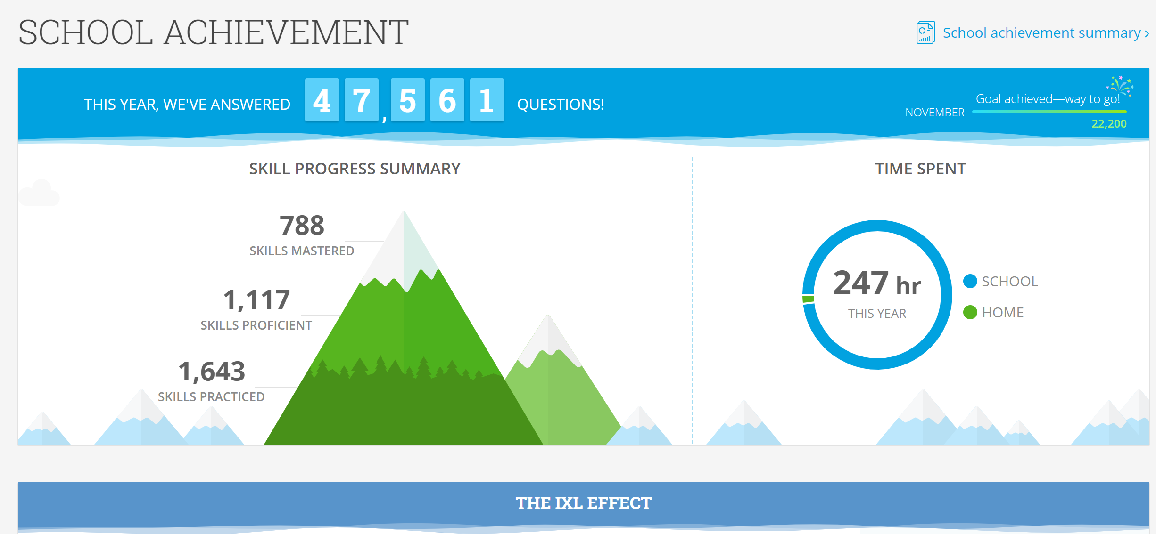
Students MAP RIT scores are entered into IXL to create personalized individual skills plans
Teachers create assignments to support instruction and reinforce standard-based skills
IXL is accessible to students from home

Slide 11
MAP ASSESSMENT

Slide 12
PURPOSE MAP
MAP stands for Measures of Academic Progress® (MAP®)
MAP is a suite of assessments that deliver data you need to make a difference in student progress; assessments are given three times throughout the school year (beginning of year, mid-year and end of year).
MAP® Growth™—measures areas that are related to our math and ELA standards
MAP® Skills™—identifies gaps and helps students to master specific skills within a hierarchy of foundational skills

Slide 13
How does the MAP assessment work?
Adaptive assessment that adjusts to students’ knowledge
Administered in math, reading, and language usag.
Norm referenced comparing students in the same grade across the country
Assigns projected achievement for Georgia Milestones
Assigns a RIT score
A specific RIT score represents the level where a student is ready to learn. The test finds that level by pinpointing where a student would just as likely answer incorrectly as correctly, the point between knowing and not knowing answers.
RIT scores are entered into Exact Path in order to assign Learning Paths to fill in gaps
Exact Path identifies individual weaknesses and provides acceleration for students working beyond grade level
RIT scores are also entered into IXL where individualized skill plans are developed
IXL skills are aligned to the NWEA® MAP™ Growth assessment.

Slide 14
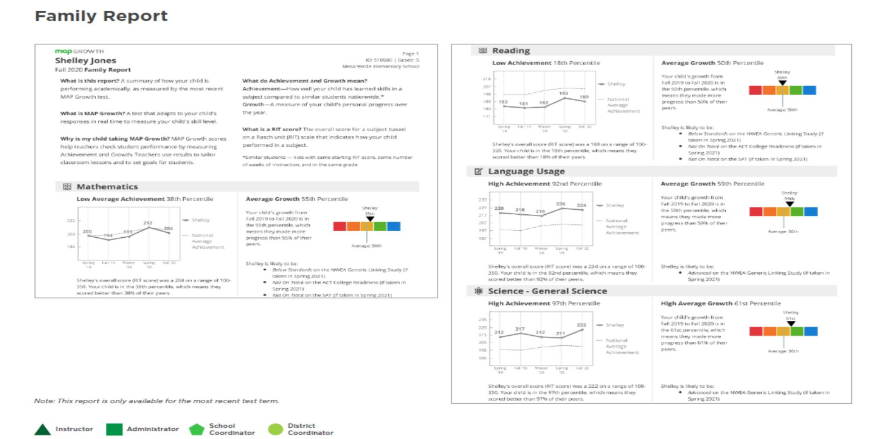
MAP Family Report

Slide 15
Georgia Milestones Assessment
MCHS EOC’s
Who & What are Assessed?
All Students in Algebra: Concepts and Connections
All Students in American Literature B
All Students in Biology B

Slide 16
Parent/Student Resources for EOC
GADOE
GA Connects

Slide 17
Family & Community Engagement
Family Engagement Policy - Miller County School District
Handout
MCHS Title 1 Annual Meeting
School-Parent Compact
Handout:

Slide 18
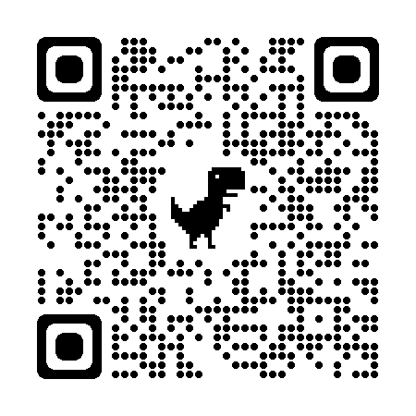
Title 1 Annual Evaluation

