Slide 1
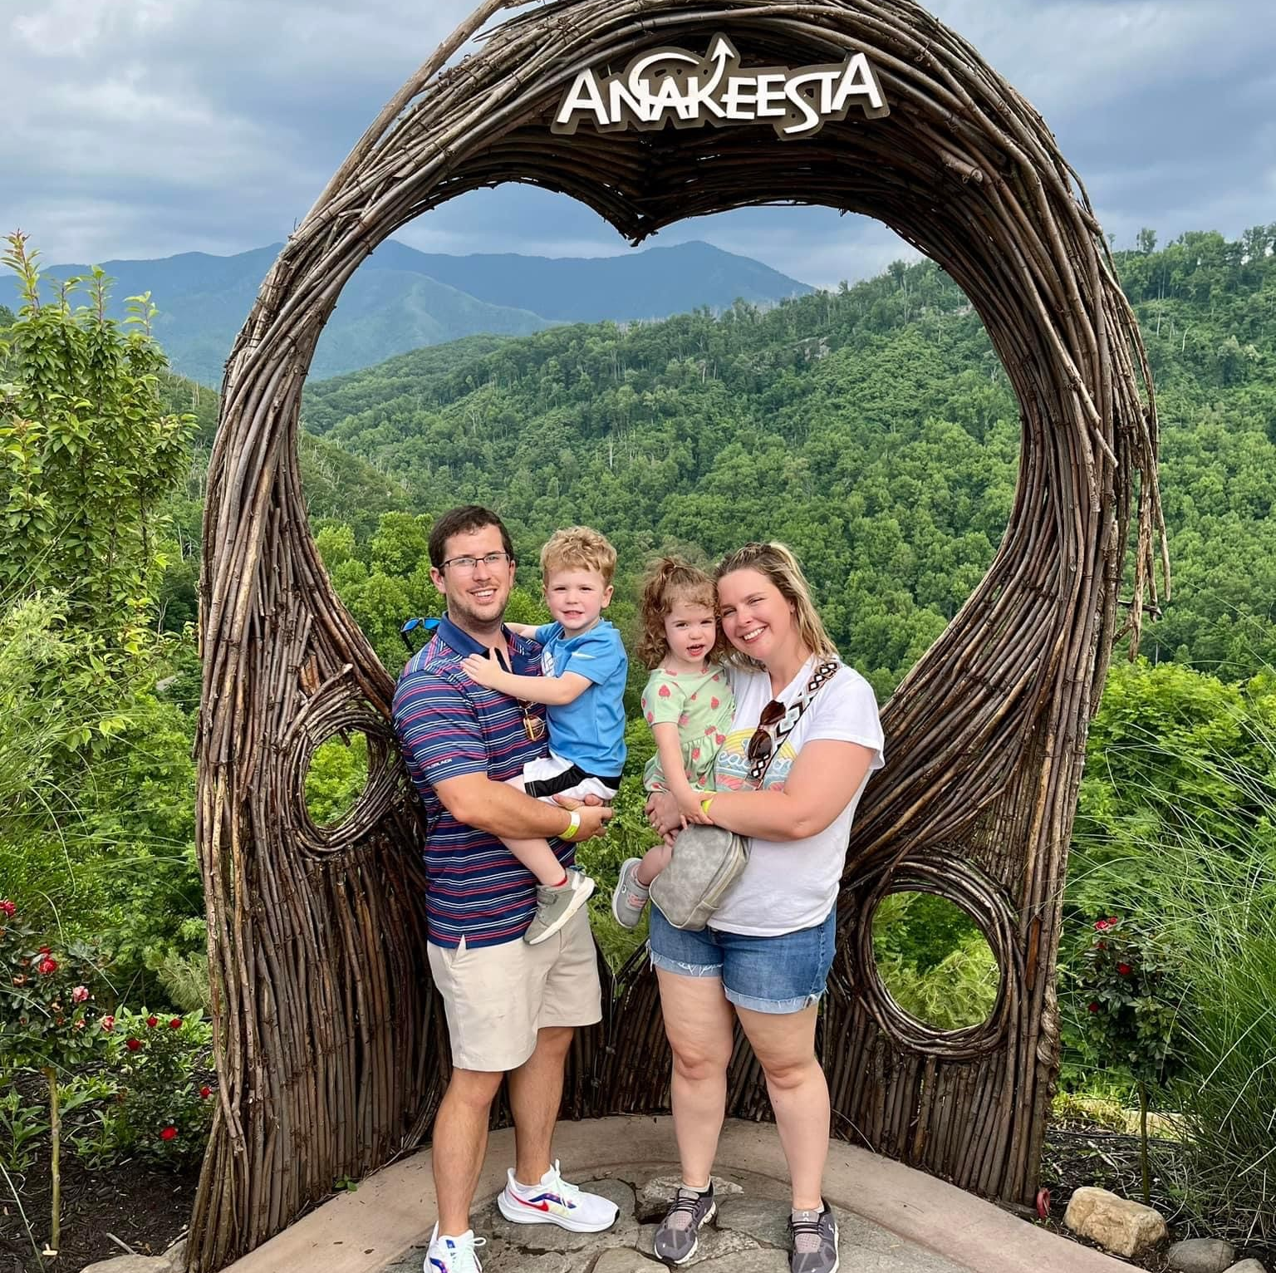
About Mrs. Murrell
I have been teaching for 9 years
I have been married for 6 years
I have a four year old son, Ethan, and a two year old daughter, Macie
I have two dogs, Izzy and Dexter
I love to read, spend time with my family, and exercise
I am SO excited for this school year!

Slide 2
Our Daily Agenda
Welcome Work: Every single day when you come in the classroom, you will have SOMETHING to do. You should come in, unpack, and get busy immediately
Journaling: We write for 5-10 minutes every day
Independent Reading: We read daily for 20 minutes. Each day, you are expected to have a book with you either from my library, the school library, or home. During this time, I will also conference with you or pull small groups.
Minilesson: My lesson for the day typically only lasts 15-20 minutes
Active Engagement/Independent Practice: This is when you will either work in your groups or independently to practice the skill I teach in my minilesson
Wrap up: This will consist of an exit ticket or other activity to check your understanding of our skill lesson

Slide 3
PAUSE FRIDAYS
This year, I am starting what I am calling PAUSE FRIDAYS. This is where we will pause our typical lessons, and our day will look like this:
Welcome Work
Author’s Chair/Free Write Friday
First Chapter Friday
Independent Vocabulary Lessons
Small Groups with Mrs. Murrell

Slide 4
Arriving to Class
When you get to class, you will need to get the following things out of your backpack:
Binder
Pencil
Laptop
Independent Reading book
Journal
Once you have those things out, hang your backpack on a hook and go to your seat.
Every single day, you will have welcome work. You are expected to get started immediately.

Slide 5
Leaving Class
Unless there is an emergency, you will need to stay in class. Our time together is very important, and every minute counts!
Restroom
We will take DAILY restroom breaks halfway through class. Because of this, you SHOULD be able to stay in class without taking a break. If there is an emergency, I will obviously allow you to go. If you can go all week without going outside of our class break, you may listen to music while you work on Fridays.

Slide 6
Make up work
If you are absent, any notes or work that you missed will be in your class’s make up work slot with your name on it. You are responsible for getting it and turning in anything that is a graded assignment.
Any assignments you are missing will be a 0 in the gradebook until they are turned in.
Notes:
Schoology preview

Slide 7
Classroom Library
You always have access to any of the books in my library. We will take a look at a few of them later in class. I am always here to help with recommendations.
I work on a loyalty system. This means you do not have to “check” books out or sign them out. Just take them and return them when you’re done.
Please return books in the book return basket, and I will put them away.
Books are organized by genre. They are:

Slide 8
Genres
Realistic Fiction: fiction books that have story lines that can happen in real life.
Realistic sub-genres: romance, mystery, sports
Fantasy Fiction: fiction books that have story lines that are not possible in real life.
Fantasy sub-genre: horror
Historical Fiction: books that have fiction stories, but are based around a true historical event.
Poetry/Verse Novels: books that are written in verse
Graphic Novels: comic books
Nonfiction Memoir/Biography: Nonfiction books about a person’s life, either written by themselves or another person
Nonfiction Informational: Nonfiction book giving you information about a topic
Book Club sets: These are just books that I have at least 4 copies of and will use as book club options. You are still welcome to read them at any point.
This Photo by Unknown Author is licensed under CC BY-SA

Slide 9
Procedures
Be prepared
Be positive
Be productive
Be polite

Slide 10
Independent Reading
This is a sacred time in our classroom.
You will sit silently and productively read. Sometimes you will have an assignment to complete as you read.
If you don’t like your book, TELL ME. I would much rather spend time helping you find something you like, than you sit and pretend to read.
I will conference with you one on one often during independent reading, or I will pull small groups.

Slide 11
Reasons you can interrupt my conferences or small groups…
This Photo by Unknown Author is licensed under CC BY-SA
This Photo by Unknown Author is licensed under CC BY-SA-NC

