Slide 1
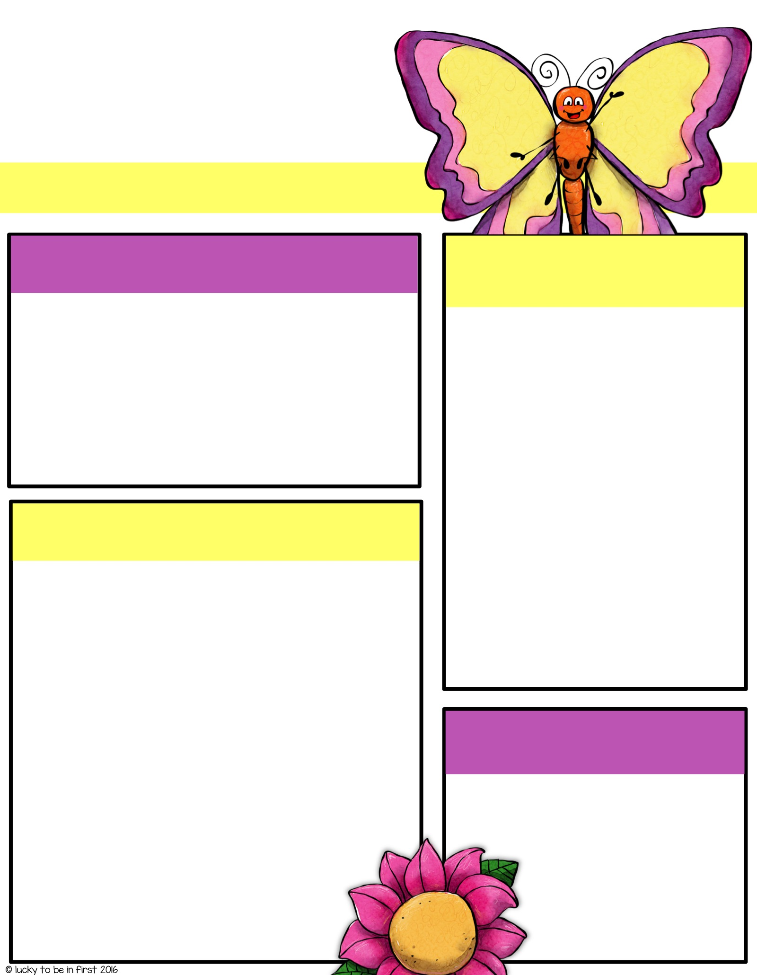
Mrs. Gaines
4th Grade ELA/SS
Oak Grove Central Elementary School
April 2-5, 2024
reminders
Spelling words
April 4 → Mrs. Lovell’s birthday
April 8 → Eclipse Day // 4th Grade Knowledge Bowl
April 11 → VSG 4.2
April 12 → Hat/PJ Day
April 18 → RC Test 4.2
April 19 → Preschool’s St. Jude Trike-a-Thon
April 19 → OGCE celebrates Earth Day
April 25 → Popsicle Day // VSG 4.3
State Testing: April 29 (ELA-1), April 30 (ELA-2), & May 7 (Math)
Rule:
Words commonly used in writing with transitions
Result | Conclusion
Finally | Several
Additionally | Difference
Although | Because
Vocabulary Words
Academic Vocabulary:
quotation – a group of words taken from a text or speech and repeated by someone other than the original author or speaker
dialogue – conversation between two or more people as a feature of a book, play or movie
evidence – something that provides proof
support – to give assistance, to back up, to hold up
predict – to say, guess, or estimate what will happen in the future
persuade – to cause someone to do something through reasoning or argument
point – a detail included to direct someone’s attention to something
Homework
Complete grammar/reading homework for this week.
Study spelling/vocab. Words!
Read daily!!!
Extra help / practice can be found on my website!

