Slide 1
Slide 1
Diagnostic Review
for i-Ready
JMS
School Improvement Council
2022-2023
Mirandi Squires
January 23, 2023

Slide 2
Agenda
Welcome
Slide Presentation
i-Ready Scores for ELA /fall to winter
i-Ready Scores for Math/fall to winter
i-Ready Goals
i-Ready Stretch Goals
strategies to Improve
3. Slide Presentation on Upcoming Events
4. Slide Presentation on Student Celebrations
5. Questions

Slide 3
JMS ELA i-Ready Progress

Slide 4
Fall 2022 ELA

Slide 5
Look at the great progress JMS has made in ELA!
48% (15% decrease) Tier 3 AT RISK
22% Tier 2
30% (11% increase) Tier 1

Slide 6
Comparing JMS ELA Growth in Each Grade Level
FALL DIAGNOSTIC
WINTER DIAGNOSTIC

Slide 7
FALL TO WINTER Grade Level Placement

Slide 8
Overall Typical Growth Accomplishments for ELA
Grade | Typical Growth Goal Reached Number of Students | Percentage Typical | Stretch Goal Reached Number of Students | Percentage Stretch
5 | 53 | 62% | 20 | 24%
6 | 52 | 56% | 18 | 19%
7 | 53 | 58% | 15 | 16%
8 | 55 | 57% | 18 | 19%
Notes:
5th Grade- 85 tested
6th Grade-93 tested
7th Grade- 92 tested
8th Grade -96 tested

Slide 9
Overall Typical Growth Accomplishments for JMS in ELA
Grades | JMS Percentage Met Typical ELA Growth Goal for the School Year | JMS Percentage Met ELA Stretch Goal for the School Year
5-8 | 58% | 19%
Notes:
5th Grade- 85 tested
6th Grade-93 tested
7th Grade- 91 tested
8th Grade -96 tested
Total Typical Growth
`213 students met Typical Growth Target out of 366 students assessed= 58% of Students have already met typical growth for the year
Stretch Goals
71 students met stretch goals ourt of 366 students = 19%

Slide 10
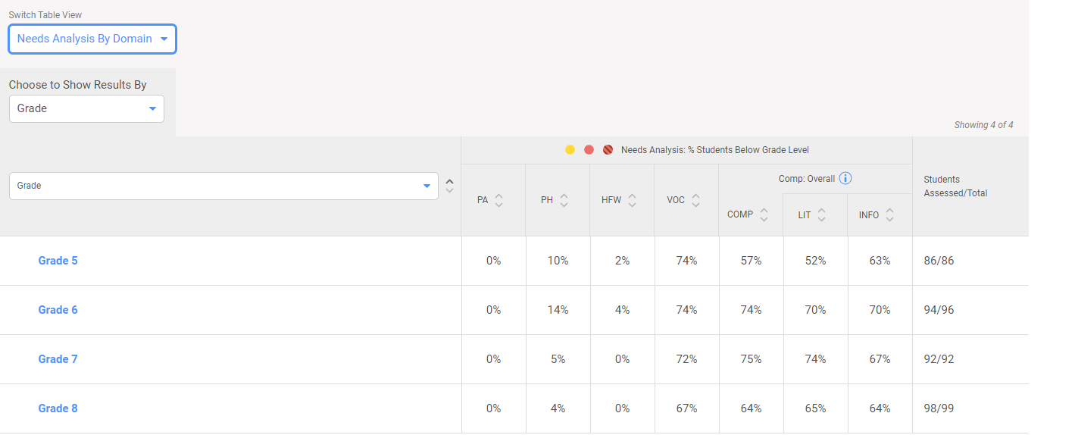
Current Areas of Refinement for ELA
Notes:
ELA
Vocabulary Mini-Lessons (Reading Coach is working on some ideas)
i-Ready Lessons

Slide 11
JMS Math i-Ready Progress

Slide 12
Fall 2022 MATH

Slide 13
Look at the great progress JMS has made in Math!
42% (14% decrease) Tier 3 AT RISK
39% Tier 2
19% (10% increase) Tier 1

Slide 14
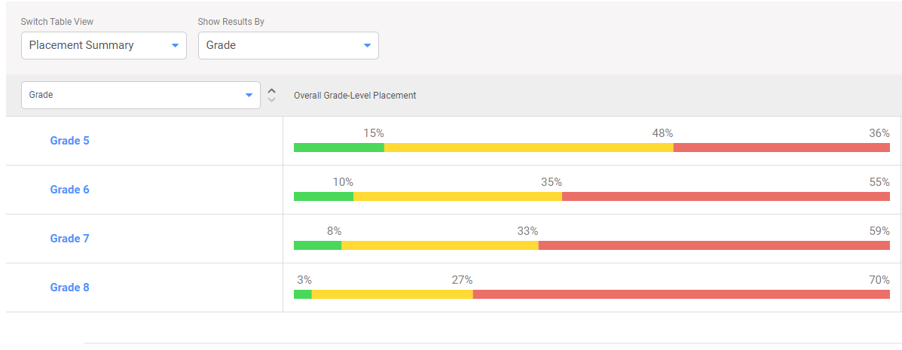
Comparing JMS Math Growth in Each Grade Level
FALL DIAGNOSTIC
WINTER DIAGNOSTIC

Slide 15
Fall to Winter Grade Level Placement

Slide 16
Overall Typical Growth Accomplishments for Grade Levels in Math
Grade | Met Typical Growth Goal Reached Number of Students | Percentage Typical | Met Stretch Goal Reached Number of Students | Percentage Stretch
5 | 24 | 28% | 7 | 8%
6 | 46 | 49% | 8 | 9%
7 | 35 | 38% | 11 | 12%
8 | 42 | 44% | 13 | 14%
Notes:
5th Grade- 85 tested
6th Grade-93 tested
7th Grade- 91 tested
8th Grade -96 tested
Total Typical Growth
`147 students met Typical Growth Target out of 365 students assessed= 40% of Students have already met typical growth for the year
Stretch Goal
39 students out of 365 students= 11%

Slide 17
Overall Typical Growth Accomplishments for JMS in Math
Grades | JMS Percentage Met Typical Math Growth Goal for the School Year | JMS Percentage Met Math Stretch Goal for the School Year
5-8 | 40% | 11%
Notes:
5th Grade- 85 tested
6th Grade-93 tested
7th Grade- 91 tested
8th Grade -96 tested
Total Typical Growth
`147 students met Typical Growth Target out of 365 students assessed= 40% of Students have already met typical growth for the year

Slide 18
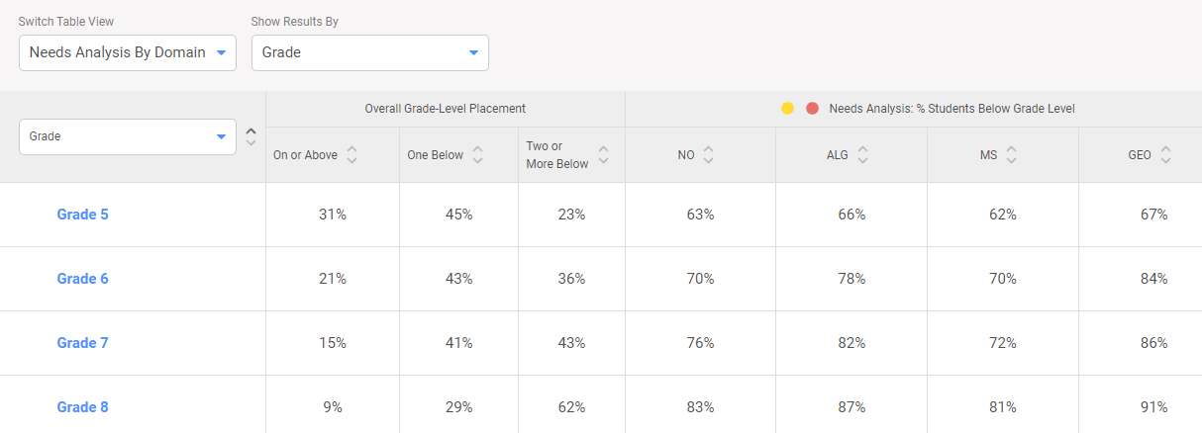
Current Areas of Refinement for Math
Notes:
Math
Geometry Front Loading with I-Ready lessons (They can assign these lessons)
Side Note: 5th and 6th Grade does more with Dream Box so this could explain higher percentages with Geometry

Slide 19
Slide 1
Making Progress on Diagnostics
for i-Ready in all Grade Levels!!!
JMS
2022-2023

Slide 20
JMS EVENTS and
CELEBRATIONS

Slide 21
Crazy Socks and Hat Day Friday, January 27 Safety Drill and Club Pictures Tuesday, January 31 MISS JMS Pageant Thursday, February 16 No School Friday, February 17

Slide 22
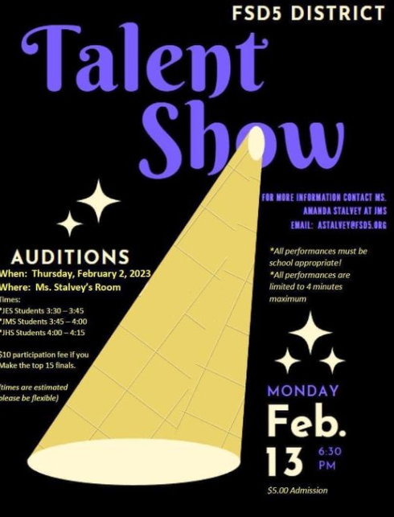
Spring Musical - "The Little Mermaid"
Show Dates: Saturday, April 1st @ 6:00 pm and Sunday, April 2nd @ 3:00 pm
Admission $5.00

Slide 23
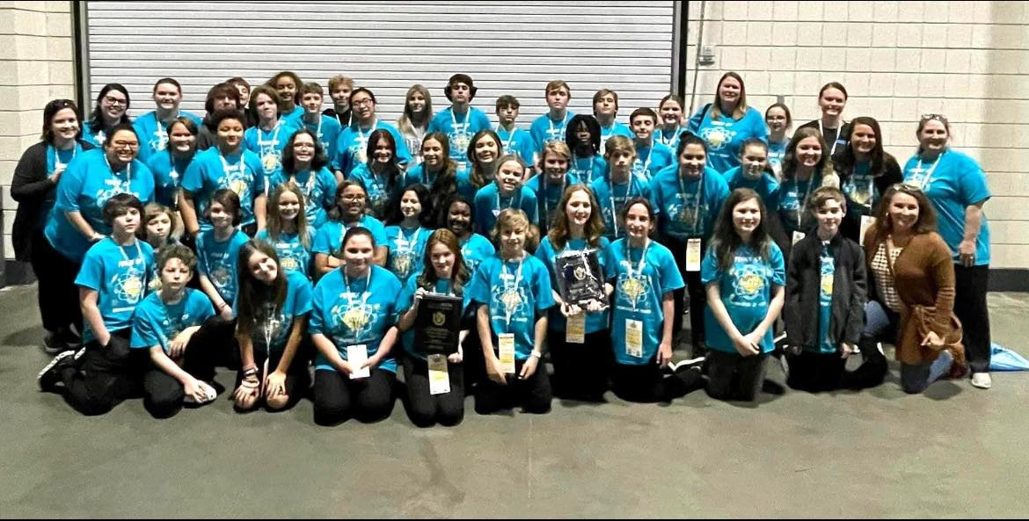
The JMS Jr. Beta Club showed off all of their amazing talent this week at Convention, and we are so proud! Thank you to our wonderful sponsors for making this possible for our students! Nationals here they come!! Won- Large Group Talent 5th Sculpture-Violet Glisson Placed top 5 T-Shirt- Quinn Harris 3rd place wood working- Gavin Marlow Won-Recyclable Art-Quinn Harris 3rd place Spanish Test- Alexandra Ortiz-Rodriguez 11 students chosen as Premier Performers to perform at Nationals as a part of a larger group.

Slide 24
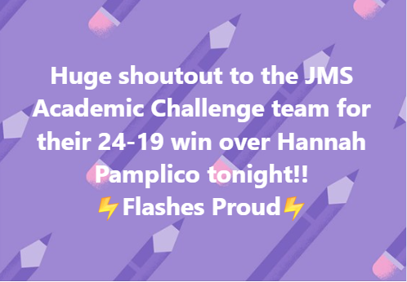
Join us in celebrating the middle school boys basketball regular season champs….the JMS Boys Basketball Team!!
They won tonight, 50-48, against Rosemary Middle School to finish the regular season with a 9-1 record.
The girls team ended with a 27-22 loss to Rosemary to finish their season with a 5-5 record.
We are so incredibly proud of both teams and their hard work, both on and off the court.

Slide 25
Questions? Thank You SIC

