Slide 1
NEW MILFORD PUBLIC SCHOOLS
25-26 TECHNOLOGY
BUDGET PRESENTATION

Slide 2
NEW MILFORD PUBLIC SCHOOLS
MISSION STATEMENT
AND IDEAS WE LIVE BY
The mission of the New Milford Public Schools, a collaborative partnership of students, educators, family and community, is to prepare each and every student:
To compete and excel in an ever-changing world;
To embrace challenges with vigor;
To respect and appreciate the worth of every human being, and contribute to society by providing effective instruction and dynamic curriculum, offering a wide range of valuable experiences, and inspiring students to pursue their dreams and aspirations.

Slide 3
New Milford Public Schools
IT Mission Statement
The NMPS IT department enhances teachers and students ability to provide a wide range of educational experiences using technology
The NMPS IT department allows students and teachers to have a safe environment to research, discuss and create using technology
The NMPS IT Department works collaboratively with all stakeholders to enhance teaching and learning

Slide 4
Instructional Technology Department Staff 9.0 FTE
4
Tech 1 Positions
1
Secretary to Tech Director
1
District Database administrator
1
Tech 2
1
Network System Analyst
1
IT Director

Slide 5
Return on Investment 25-26
1
2
3
4
Continuation of our 1 to 1 program. Grades 3-12 use devices at home and school for school work. K-2 use chrome books only in classrooms
Update Northville Gymnasium for sound and Bluetooth. Reimagine Hill & Plain's stage and cafeteria for various events.
Continued use of Grants and E-rate funding for Audio Visual projects and infrastructure hardware. ECF and Pegpetia grants since 2022 have been 1.4 Million
Using Budget and Capital Improvement funding to replace 8 year old desktops in all schools over a 2 year period giving teachers a choice on devices

Slide 6
Infrastructure Updates
Infrastructure Updates rely on budget, capital improvement funding and grants to have a continuous upgrade cycle
*Switches
*Access Points
There are 86 switches IT oversees. IT has replaced 90 percent since 2022
262 Access Points in our buildings providing internet to students and Staff
Servers
Phones
We oversee 47 Servers both physical and Virtual to keep software and systems running daily
Currently there are 600 plus phones in use in our buildings,. We will start discussions this summer to replace current system during the 26-27 school year
*E-Rate Savings for 2025 will be 60%

Slide 7
New Milford Public Schools Software
Core software programs are cloud based and feed all of our teaching and learning programs with information regarding demographics, classes, etc. using a single sign on to make ease of use for students and staff.

Slide 8
Communication Upgrades
Our upgrade to ParentSquare has led to much better data and reporting for parents, students and staff. We have weekly updates on our reachability for all New Milford Public Schools constituents.

Slide 9
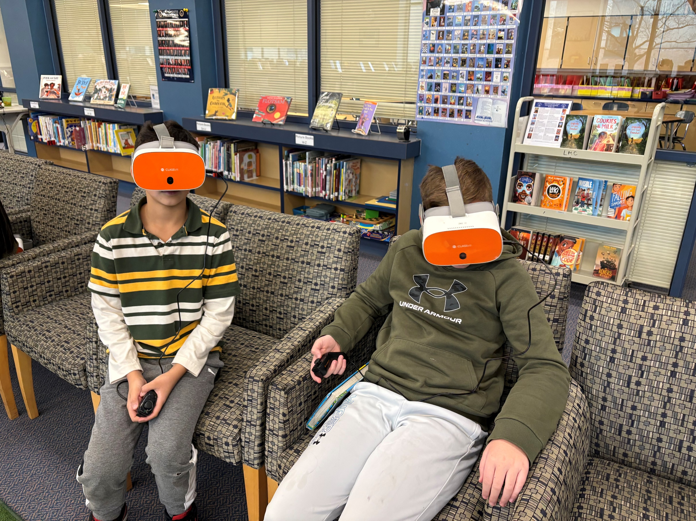
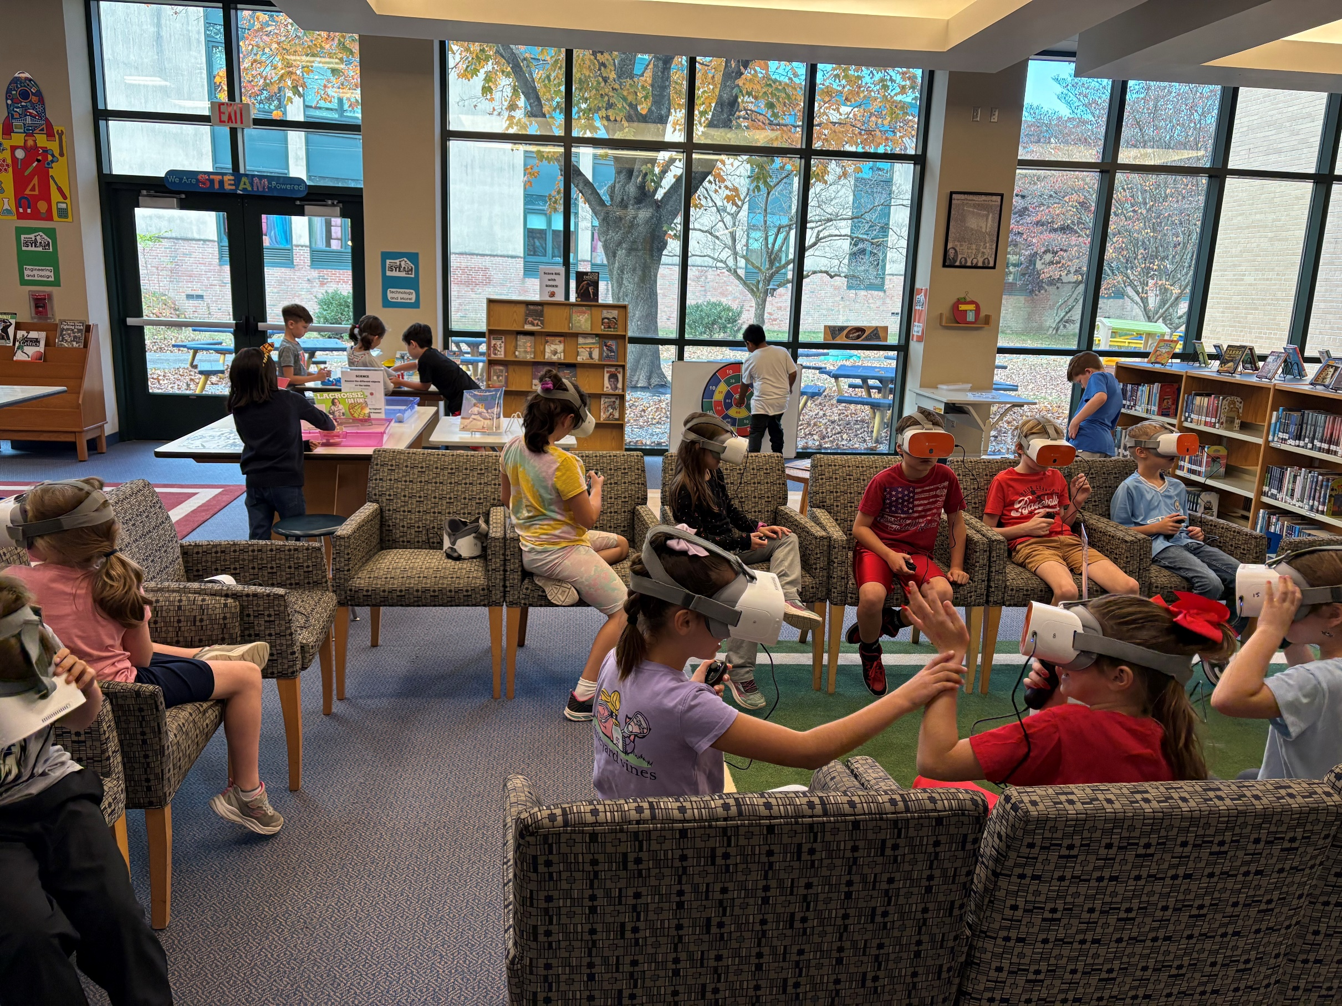
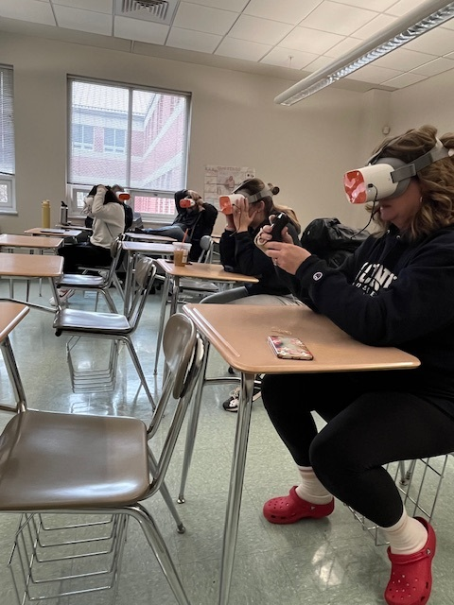
Virtual Reality Goggles
Virtual Reality Goggles are being used in classrooms for students and teachers. SNIS library is leading the way in their STEAM stations along with various staff using them K-12. We added New Milford Public School drone footage for students this year using Facilities videos.

Slide 10
AI TOOLS
AI is coming to New Milford Public Schools. We are starting conversations with teachers and with the curriculum department on best practice, uses of, and how to teach using AI as a teaching and research tool. Programs such as Canva, Gemini (Google), Adobe are presently available.

Slide 11
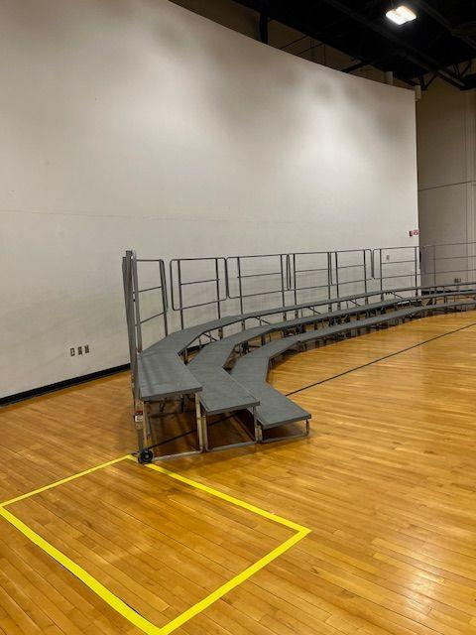
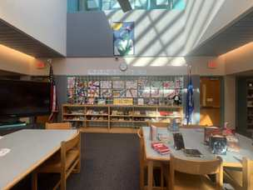
Audio Visual Project Timeline
2024-2025 Upcoming Projects
Sarah Noble Multipurpose Room
and **Schaghticoke Middle School Library (Spring of 2025)
Planetarium (Spring of 2025)
2025-2026 AV Projects
Northville Gymnasium
Hill & Plain Stage/Cafeteria
Completed AV Projects 2022-2024
Hill and Plain Gym
SMS Cafeteria
NMHS Theatre (ongoing)
**SNIS LIbrary (Streaming Studio)
Future AV Projects 2026+
Hill & Plain Cafeteria/Stage
Northville Cafeteria
Sarah Noble Cafeteria/Stage
Schaghticoke Middle Gyms/Stage
New Milford High School Gyms
New Milford High School Cafeteria
**Via use of Pegpetia Funds

Slide 12
Technology Department Questions?

Slide 13
