Slide 1


English
Language
Learners
ESOL Parent Communication

Slide 2

What is ESOL?
How do you qualify for ESOL?
What are the ESOL program models?
What is the role of the ESOL teacher? What does my child do in ESOL?
How do I know when my child is proficient in English? What is the ACCESS test?
What are the Language Proficiency Levels?
How can I help my child be successful at school?
Who are my ESOL contacts?

Slide 3

English Language Learning is an educational program for students who…
Speak or are exposed to more than one language.
Need support in understanding English used in the classroom and by peers.
What is ESOL?
English for
Speakers of
Other
Languages
What does ELL Stand for?
English
Language
Learners

Slide 4
What does the W-APT /Screener measure? It is used to measure the English language proficiency of students. It allows us to determine if a child needs English language instructional services, and if so, at what level. The tests were developed by the WIDA Consortium.
How does my child qualify for ESOL?
At registration, if the home language survey indicates that a language other than English is spoken in the home, the ESOL teacher will administer the W-APT (WIDA ACCESS Placement Test for Kindergarten) or WIDA Screener (1ˢᵗ-12ᵗʰ graders).

Slide 5
ESOL Models
Scheduled Class- Students are scheduled a class time with the ESOL teacher either in the classroom or the EL teachers' room.
Sheltered content-Students are taught the academic content directly through the EL teacher.
Consult-The ESOL teacher consults with the special education teacher to support the student.
What are the ESOL program segments?
Kindergarten-3ʳᵈ Grade students are served for 45 minutes daily.
4th-8th Grade students are served for 50 minutes daily.
9ᵗʰ-12ᵗʰ Grade students are served one block minimum per year.

Slide 6
What is the role of the ESOL teacher?
What happens in your child’s ESOL class?
Extended time for students to process information
Emphasis in vocabulary with visuals, reading & writing instruction.
Use of SIOP strategies & other instructional strategies.
Provides language support through academic content.
Addresses 4ESOL domains- Reading, Writing, Listening, and Speaking.
Supports students in meeting Georgia standards.

Slide 7
What is the purpose and use of the ACCESS test?
The ACCESS helps students and families understand students’ current level of English language proficiency.
It serves as one of multiple measures used to determine whether students are prepared to exit English language support programs.
It generates information that assists in determining whether ELLs have attained the language proficiency needed to participate meaningfully in content area classrooms without program support.
It provides teachers with information they can use to enhance instruction and learning in programs for their English language learners.
It provides districts with information to help them evaluate the effectiveness of their ESL / bilingual programs

Slide 8
What is the ACCESS test?
Accessing Comprehension and Communication in English State-to-State.
It assesses reading, writing, listening, and speaking.
Computer / paper based (1ˢᵗ-12ᵗʰ) Paper based (K)
Must score a 4.7 or above on a 6.0-point scale to exit ESOL.
How do I know when my child is proficient in English?
All ESOL students (grades K-12 & waived) are required to take the ACCESS test yearly. (testing window: January-March)
Parents will be given test results in May.
The results explain your child’s English proficiency level.

Slide 9
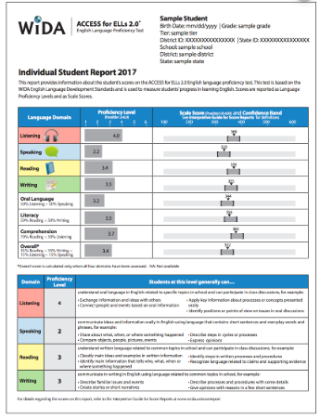

Explanation of ACCESS Student Score Report.
What are the English Language Proficiency Levels?
Stage 1: Entering
Stage 2: Beginning
Stage 3: Developing
Stage 4: Expanding
Stage 5: Bridging
Stage 6: Reaching

Slide 10

How can I help my child meet the challenging state academic standards?
Teach your child to read, write, listen, & speak in your home language.
Read to and with your child.
Come to school conferences & functions.
Go to the public library.
Communicate with your child’s teacher
Help with homework
Ask questions

Slide 11
Who are my ESOL contacts?
David A Perdue Primary School
Jacqueline Hill – ESOL Teacher
Central Registration Office
Sara Dean–ESOL Instructional Specialist
Jessica Perez – ESOL Parent and Student Liaison
Roslin Rodriguez – System Translator/Interpreter
Araceli Ulmer – Houston County Migrant Home/School Liaison

