Slide 1
2018-2019
Annual Report
Summary
Public Hearing February 17, 2020

Slide 2
2018-2019 Annual Report
The complete annual report will be available in electronic form on the FISD website.
http://www.frankstonisd.net/Content2/54

Slide 3
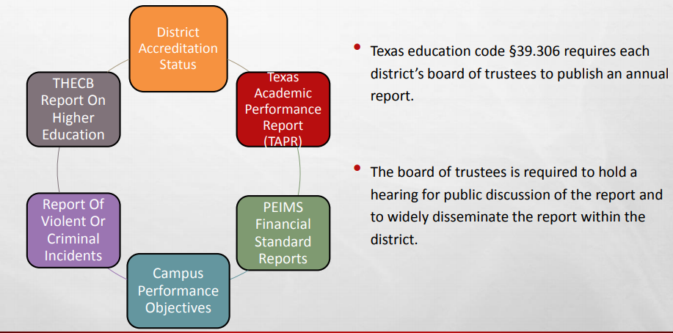
Components of the Annual Report

Slide 4

District Accreditation Status

Slide 5
District Accreditation Status
FIRST Rating: A- Superior
Accreditation Rating: Accredited
Accountability Rating: B/Met Standard
Special Education
Determination Status: Meets Requirements
http://tea4avcastro.tea.state.tx.us/accountability/accreditation/2018_2019_accreditation_statuses.html

Slide 6

Texas Academic Performance Report

Slide 7
Texas Academic Performance Report
2018-2019 State Accountability Ratings
Frankston ISD | B/Met Standard
Frankston Elementary | C/Met Standard
Frankston Middle School | B/Met Standard
Frankston High School | B/Met Standard
Source: https://rptsvr1.tea.texas.gov/perfreport/tapr/2019/index.html

Slide 8
Texas Academic Performance Report
Campus Distinction Designations
Frankston Elementary | Postsecondary Readiness
Frankston Middle School | Academic Achievement in Science Academic Achievement in Social Studies Top 25 Percent: Comparative Closing the Gaps Postsecondary Readiness
Frankston High School | Academic Achievement in ELA/Reading Academic Achievement in Mathematics Postsecondary Readiness

Slide 9
Texas Academic Performance Report
Board Goal #1
Increase on-grade-level performance in all subject areas

Slide 10
Texas Academic Performance Report
Board Goal #2
Every student will graduate with the knowledge and skills necessary to be successful
in college, career, or the military.

Slide 11
Texas Academic Performance Report
Board Goal #2
Every student will graduate with the knowledge and skills necessary to be successful
in college, career, or the military.
CCRM Data Class of 2018
Approved Industry-Based Certifications | 12.1%
U.S. Armed Forces Enlistment | 1.7%
TSI Criteria Met in ELA and Math | 39.7%
Dual Credit (9 ≥ hours any subject; 3 ≥ hours in ELA/Math) | 41.4%
Associate’s Degree | 0%

Slide 12
Texas Academic Performance Report
Board Goal #2
Every student will graduate with the knowledge and skills necessary to be successful
in college, career, or the military.
CCRM Data Class of 2018
AP Exam Participation | 6.2%
SAT/ACT Tested | 62.1%
Graduates Enrolled in TX IHE (Class of 2017) | 35.2%
Graduates in TX IHE completing 1 year w/o enrollment in developmental courses (Class of 2017) | 57.9%

Slide 13
Texas Academic Performance Report
Board Goal #4
Attract, develop, and retain world class educators dedicated to serving each student
in Frankston ISD.
Beginning teachers at FISD make $10,300 less than the state average.

Slide 14
Texas Academic Performance Report
Board Goal #4
Attract, develop, and retain world class educators dedicated to serving each student
in Frankston ISD.
Teacher Turnover Rate
 | District |  | State
2017-2018 | 37.3% |  | 16.6%
2018-2019 | 30.5% | 16.5%
2019-2020 (Reported on 2019-2020 TAPR) | 23.8%
25% (4/16) of the teachers that left were tied to athletics.
Turnover rate decreased 7% from 18-19 to 19-20.

Slide 15

PEIMS Financial Report

Slide 16
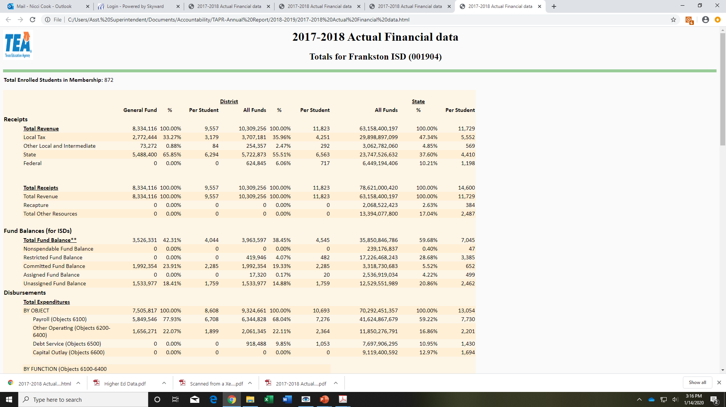

Slide 17
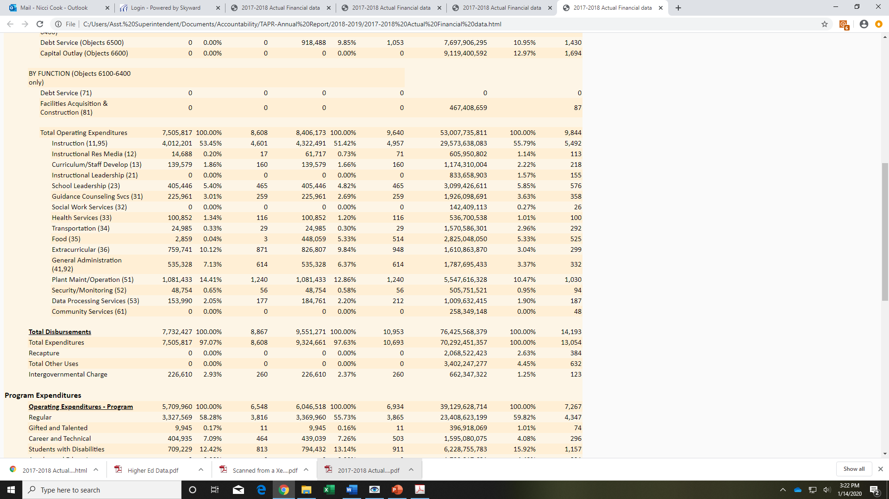

Slide 18
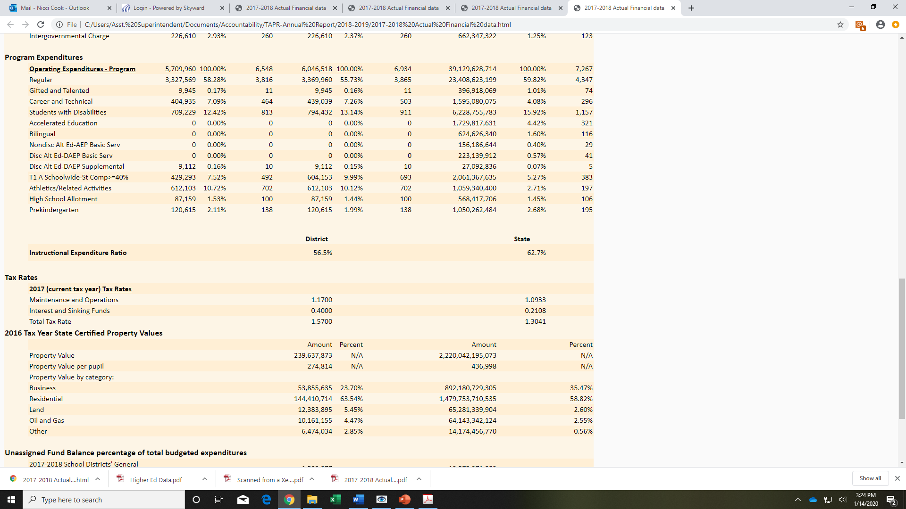
https://rptsvr1.tea.texas.gov/school.finance/forecasting/financial_reports/1718_FinActRep.html

Slide 19

Performance Objectives

Slide 20
Performance Objectives
FISD Strategic Goals
Increase on-grade-level performance in all subject areas.
Every student will graduate with the knowledge and skills necessary to be successful in college, career, or the military.
Provide a school culture & climate that promotes participation in extracurricular activities and the development of positive character traits.
Attract, develop, and retain world class educators dedicated to serving each student in Frankston ISD.
Strengthen strategic communication with students, families, employees, and community members to foster engagement and increase transparency, support, and confidence in FISD.

Slide 21

Violent/Criminal Incidents

Slide 22
Violent/Criminal Incidents
PEIMS Code | Type of Violation/ Criminal Incident | Elem | Middle School | High School | Total
04 | Controlled Substance/Marijuana | 0 | 0 | 1 | 1
21 | Student Code of Conduct Violations | 4 | 19 | 14 | 37
33 | Tobacco | 0 | 10 | 9 | 19
41 | Fighting | 0 | 10 | 5 | 15
 | Total by Campus | 4 | 39 | 29 | 72
--------- | -------------------------------------------- | -------------- | --------------- | ------------------ | ----------------
 | Number of DAEP Placements | 0 | 2 | 3 | 5

Slide 23
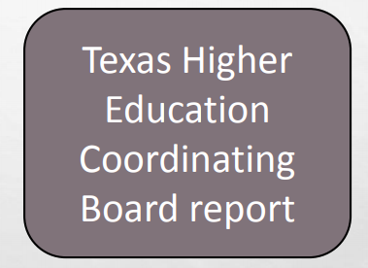
Higher Education Report

Slide 24
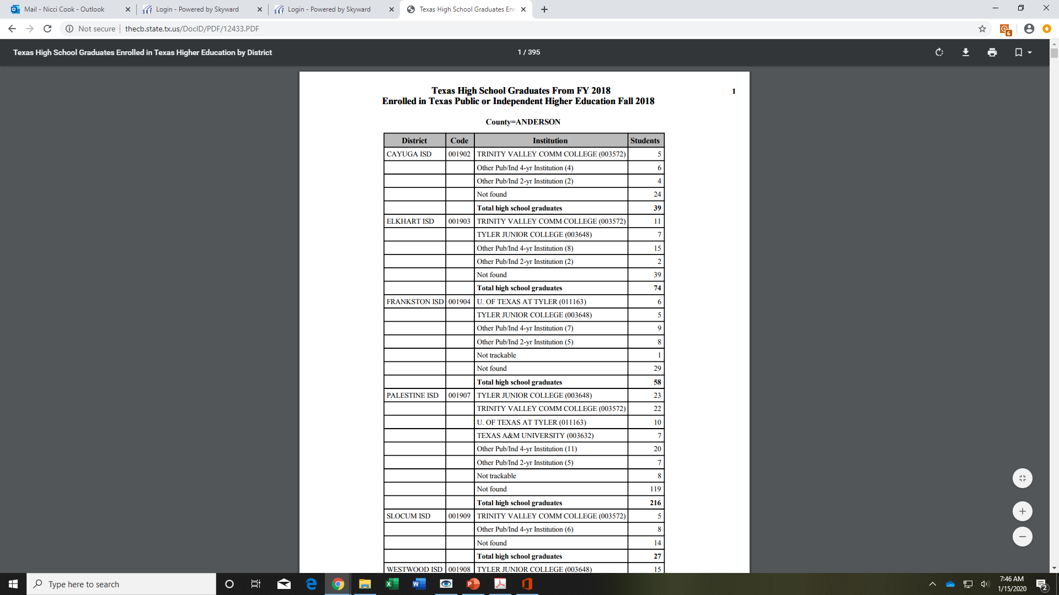
Higher Education Report

Slide 25
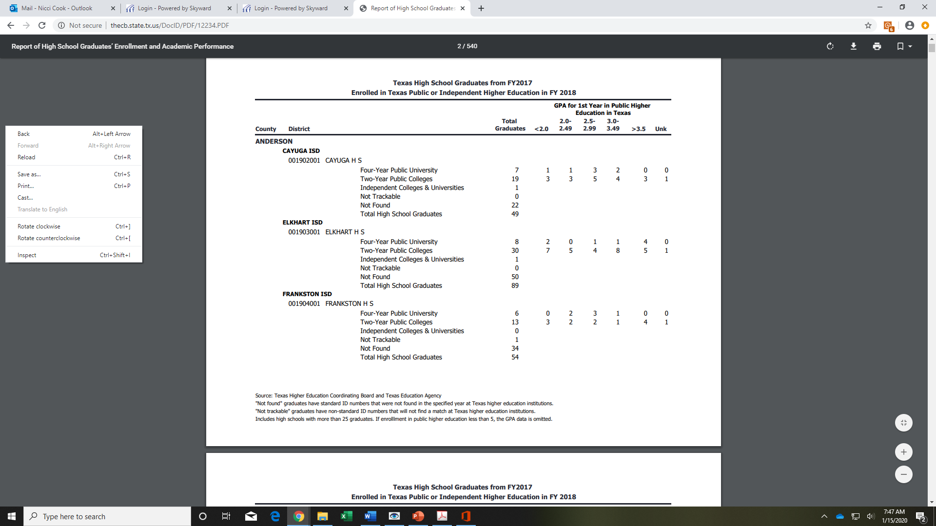
Higher Education Report

Slide 26


