Slide 1
Unit 3
Atoms: The building blocks of matter

Slide 2
In your notes…
Draw a model of an atom that best represents each component of that atom.

Slide 3
Foundations of Atomic Theory
Particle Theory of Matter
Democritus in 400 B.C.
Stated that nature’s basic particle was the atom (“indivisible” in Greek).
Aristotle
Believed all matter was continuous (could be divided forever), and did not believe in atoms.
Neither had experimental evidence to support their claims.

Slide 4
Fast Forward to the18th century
Three laws discovered due to improved instrumentation and carefully observed chemical reactions
Law of conservation of mass—Mass is neither created nor destroyed during an ordinary chemical reaction or physical change.
Law of definite proportions—A chemical compound contains the same elements in exactly the same proportions by mass regardless of the size of the sample or source of the compound.
Example: Table salt will always consist of 39.34 % Na and 60.66% Cl.
Law of multiple proportions—If 2 or more compounds are composed of the same two elements, the ratio of the masses of the second element combined with a certain mass of the first element is always a ratio of small whole numbers.
Example: Carbon and Oxygen can combine to form CO₂ or CO.

Slide 5
Dalton’s Atomic Theory
John Dalton—proposed Atomic Theory
Accounted for all three laws: conservation of mass, definite proportions, and multiple proportions.
Dalton’s Atomic Theory consists of the following statements:
All matter is composed of atoms.
Atoms of a given element are identical in size, mass, and all other properties.
Atoms cannot be subdivided, created, or destroyed.
Atoms of different elements combine in simple whole-number ratios to form chemical compounds.
In chemical reactions, atoms are separated, combined, or rearranged.

Slide 6
Modern Atomic Theory
Advances in instrumentation have allowed some aspects of Dalton’s theory to be proven incorrect.
Example: The thoughts that atoms are not divisible into smaller particles and have the exact same mass are incorrect.
The two most important aspects of Dalton’s theory still hold true
All matter is composed of atoms.
Atoms of any one element differ in properties than atoms of another element.

Slide 7
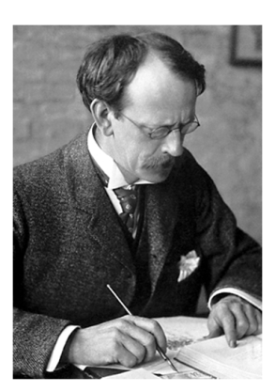
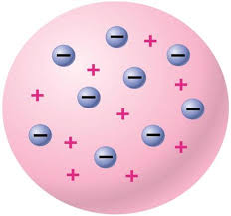
JJ Thomson, 1900
Discovered the charge to mass ratio for the electron
Concluded that the electron has a very large charge-to-mass ratio
Conducted Cathode-ray experiments to prove that atoms are divisible.
Proposed plum pudding model for the atom.
http://www.youtube.com/watch?v=2xKZRpAsWL8

Slide 8
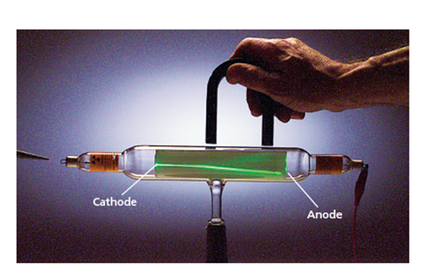
Charge of Cathode Ray

Slide 9
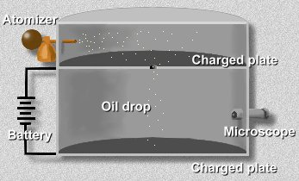
Milikan and the oil drop experiment
Meaured mass of droplets
Applied charge to droplets through x-rays.
Applied electric voltage to top and bottom plates
Measured the amount of voltage it took to keep the oil droplets suspended.
Was able to measure the charge of a single electron!

Slide 10
Ernest Rutherford
Discovered the nucleus of an atom with his gold-foil experiment.
http://www.youtube.com/watch?v=XBqHkraf8iE
Concluded that the volume of the nucleus was very small compared to the total volume of the atom.

Slide 11
Section 2
Counting Atoms

Slide 12
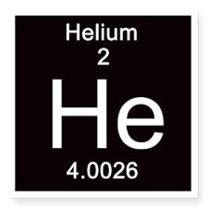
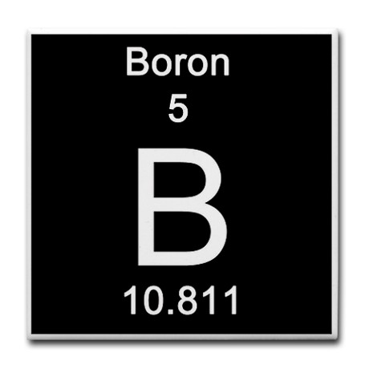
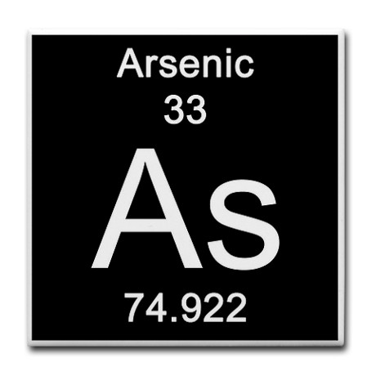
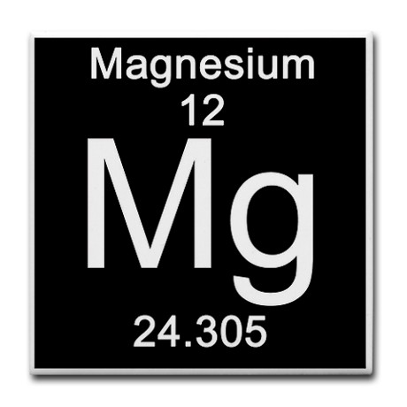
Atomic Number
The number of protons in each atom of a given element
Unique to each element and does not change
Used to identify elements.

Slide 13
Practice
1. How many protons and electrons are in each atom?
Radon
Titanium
2. An atom of an element contains 66 electrons. Which element is it?
3. An atom of an element contains 14 protons. Which element is it?

Slide 14
Isotopes and Mass Number
The amount of protons and electrons are constant in all neutral atoms of an element, but the number of neutrons can vary
Isotopes– atoms of the same element that have different numbers of neutrons
Example: Hydrogen atoms have three different isotopes.
Protium—1 proton/0 neutrons (accounts for 99.985% of all hydrogen atoms).
Deuterium—1 proton/1 neutrons (0.015%)
Tritium—1 proton/2 neutrons (radioactive, and can be produced artificially)
Most elements contain mixtures of isotopes. Tin (Sn) has 10 stable isotopes, the most of any element.
Mass Number--The number of protons and neutrons that make up the nucleus of an isotope. Since electrons are so small, their mass is considered insignificant.

Slide 15
Designating Isotopes
Isotopes are usually identified by their mass number.
Two Methods:
Hyphen notation—has hyphen after name of element, followed by the mass number.
Example: Tritium is hydrogen-3 since it has 2 neutrons and 1 proton.
Example: Uranium-235
Nuclear symbol
Mass number written as superscript
Atomic number written as subscript
Followed by element symbol

Slide 16
In both methods…
The number of neutrons is found by subtracting the atomic number from the mass number.
Example: Uranium-235 or ²³⁵₉₂U
(Mass #) – (Atomic #) = (# of neutrons)
235 (protons + neutrons) – 92 protons= 143 neutrons

Slide 17
Notation Practice
Determine the number of protons, neutrons, and electrons in each of the following:
Neon-22
Iron-57
${}_{30}^{64}{Zn}$
Write each of the following in hyphen notation:
p = 12 n = 14 e = 12
p = 28 n = 25 e = 28
Write each of the following in nuclear symbol notation:
p = 38 n = 39 e = 38
p = 4 n = 4 e = 4

Slide 18
Relative Atomic Masses
Masses of subatomic particles = very tiny, so…
Scientists created a new unit
Atomic mass units (amu) – based on a standard of carbon-12 that has a mass of 12 amu
Neutron – 1.008665 amu
Proton – 1.007276 amu
Electron – 0.0005486 amu
Important to note that the masses are slightly different between protons and neutrons.

Slide 19
Average Atomic Mass
Avg. atomic mass – the weighted average of the masses of the isotopes of that element
Avg. atomic mass = (mass x abundance)_{isotope1} + (mass x abundance)_{isotope2} + …
To find abundance – divide the percentage by 100 (all abundances must be decimals)
Atomic mass can help you determine which isotopes of that element is the most abundant.

Slide 20
Atomic Mass Practice
Nitrogen has two naturally occurring isotopes, N-14 and N-15. Its atomic mass is 14.007. Which isotope is more abundant? Explain.

Slide 21
Calculate the average atomic mass of lithium, which occurs as two isotopes that have the following atomic masses and abundances in nature: 6.017 amu, 7.30% and 7.018 amu, 92.70%.

Slide 22
Recall
What is the atomic mass of hafnium if, out of every 100 atoms, 5 have a mass of 176, 19 have a mass of 177, 27 have a mass of 178, 14 have a mass of 179, and 35 have a mass of 180.0?
Iodine is 80% ¹²⁷I, 17% ¹²⁶I, and 3% ¹²⁸I. Calculate the average atomic mass of iodine.

Slide 23
Relating Mass to Number of Atoms
The Mole (mol)
Same as 1 dozen = 12 donuts
Mole = SI unit for amount of substance.
The amount of substance that contains as many particles as there are atoms in exactly 12 g of carbon-12.
Avogadro’s number
The number of particles in exactly 1 mol of a pure substance.
6.022 × 10²³ atoms in 1 mol of any substance.

Slide 24
Practice
How many atoms are in 5.76 moles of a pure substance?
How many moles are in 8.56 × 10²⁶ atoms?

Slide 25
Molar Mass
The mass (in grams) of 1 mol of a pure substance.
Units are g/mol
Equal to the sum of the atomic masses of each element of a compound.
Examples:
K₂CO₃
Cu(NO₃)₂

Slide 26
Find the molar masses of the following compounds:
SrCO₃
C₁₃H₁₈O₂
Sn₂(SO₄)₄

Slide 27
Gram/Mole Conversions
Use molar mass to convert moles to grams and vice versa.
Practice:
Convert 7.00 g of He to moles.
Convert 5.67 mol of Xe to grams.
Convert 65.4 g of K₂CO₃ to mol.
Convert 5.21 mmol of NaCl to grams.

Slide 28
Mass to Number of Atoms/Molecules
Need 2 conversion factors!!!
Always go through moles.
1. How many atoms are contained in 4.33 g of Br₂?
2. What mass of carbon contains exactly 2.10x10²⁴ atoms?

Slide 29
Finding atoms of mass of one element in a compound…
Subscripts are mole ratios!
In order to change substances, you must go through moles first!!
Determine the mass of iron in 4.32 g of Fe₂O₃

Slide 30
More Practice
How many atoms of sodium are in 4.56 g of Na₂CO₃?
What mass of oxygen is in 5.91 g of phosphate?

