Slide 1
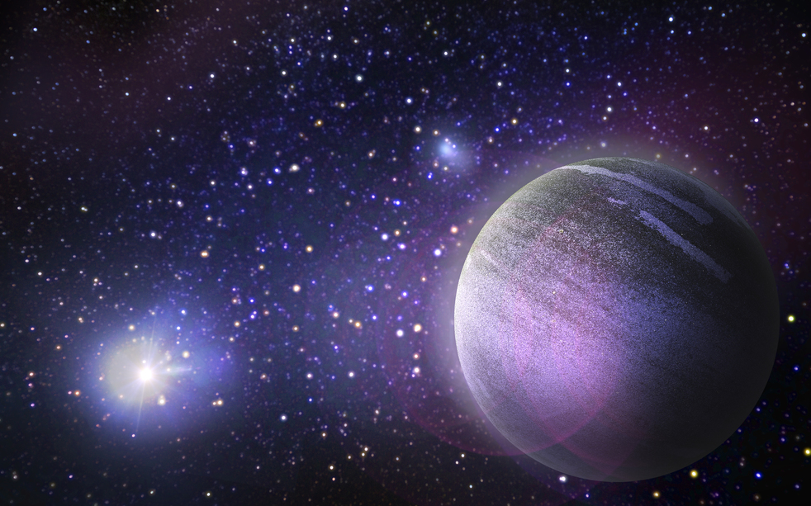
SPACE TOURISM
3RD GRADE SPOTLIGHT
This Photo by Unknown Author is licensed under CC BY

Slide 3
Roberts/Scarberry
https://dcsms-my.sharepoint.com/:v:/r/personal/stephanie_sartain_dcsms_org/Documents/Attachments/Outofthisworld.mp4?csf=1&web=1&e=TswHzm
Io
commercial for blue neptune

Slide 4
Stigler/Gentry
EliAriannaKenyaJD
LillyWinterLaney
PiperLiamBrylee
EllaPaytonJackson

Slide 5
Palmertree/Moses
KytziaJuneSadieJacob
GabrielAnnaMaddieAustyn
WaylonBrayleeNoah

Slide 6
Stubblefield
Stubblefield

Slide 7
Barnhill/Carr/Rittmann
PeytonVeraAinsley
OllieLGNoahW
EvieAllieLogan
CharlotteJordanAria
NoahHBraydenHarperKyle

