Slide 1
Chapter 1
The Science Of Biology

Slide 2
1.1 What is Science?
Science: an organized way of gathering and analyzing evidence about the natural world.
A way of knowing
A process
Natural world not supernatural
Organized gathering of information
Evidence-based information not beliefs
Test information

Slide 3
The Scientific Method

Slide 4
Scientific Method
Used all the time!
No single “scientific method”
Scientific methodology: involves observing and asking questions, making inferences and forming hypotheses, conducting controlled experiments, collecting and analyzing data, and drawing conclusions

Slide 5
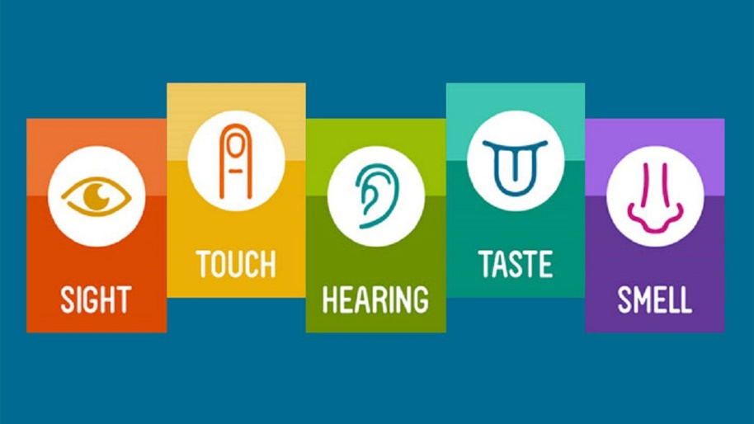
Observing and Asking Questions
Observation: the act of noticing and describing events or processes in a careful, orderly way.
More than just “looking” at things.
Involves all 5 senses.
Ask questions! Why? How? Where? What?

Slide 6
Observing and Asking Questions

Slide 7
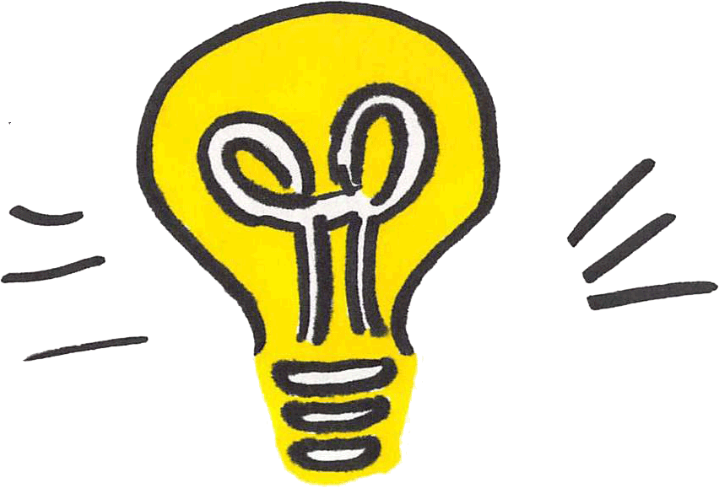
Inferring and Forming a Hypothesis
Inference: a logical interpretation based on what scientists already know
Inference + Imagination → Hypothesis
Hypothesis: a scientific explanation for a set of observations that can be tested in ways that support or reject it

Slide 8
Inferring and Forming a Hypothesis

Slide 9
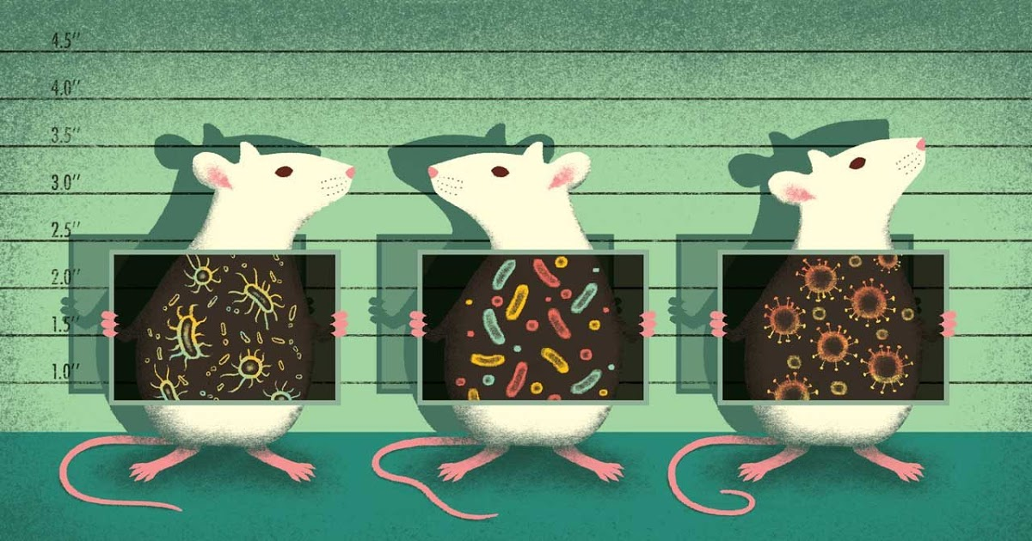
Designing Controlled Experiments
A controlled experiment should test the hypothesis while changing only 1 variable.
Examples of variables: temperature, light, time, nutrient availability, etc.

Slide 10
Designing Controlled Experiments
Why control variables?
Independent variable: (manipulated variable) the variable that is deliberately changed
Dependent variable: (responding variable) the variable that is observed and that changes in response to the independent variable

Slide 11
Designing Controlled Experiments
Control Group: exposed to the same conditions as the experimental group except for 1 independent variable
Reproduce and Replicate Results!

Slide 12
Collecting and Analyzing Data
Data: detailed records of experimental observations, gathering information
Quantitative (#s) vs Qualitative (words)
Use appropriate tools to gather and analyze data
Avoid sources of error: other explanations for your findings, limitations in equipment, etc.
Larger sample sizes are more reliable

Slide 13
Collecting and Analyzing Data

Slide 14
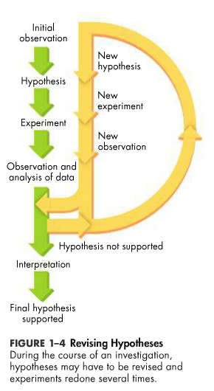
Drawing Conclusions
Data is evidence to support, refute, or revise hypothesis or to draw a valid conclusion.
“I have not failed. I've just found 10,000 ways that won't work.” -Thomas Edison

Slide 15
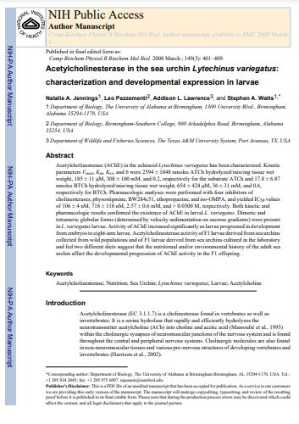
Communicating Results (1.2)
Collection and analysis can be a long process.
Communicating results is vital!
Peer Review
Sharing knowledge leads to new ideas.

Slide 16
Scientific Theories
Theory: a well-tested explanation that unifies a broad range of observations and hypotheses and enables scientists to make accurate predictions about new situations.

Slide 17
Science and Society
Pure science does not include ethical and moral viewpoints.
These are limitations when studying and evaluating science.
Science can be affected by bias.
Bias: a particular preference or point of view that is personal, rather than scientific.
Science is objective.

Slide 18
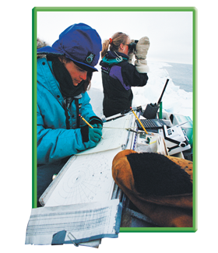
Studying Life (1.3)
Biology: the science that studies life.
Bios = life
-logy = study of
Biosphere: a planet of Life

Slide 19
Characteristics of Life

Slide 20
Characteristics of Life
Characteristics of Life
Cells
Universal genetic code
Require energy
Growth
Reproduction
Maintain stable environment
Change over time

Slide 21
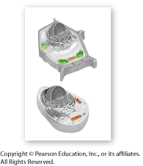
Characteristics of Life
Cells
Living things are made up of one or more cells.
Smallest unit of life.
Complex and highly organized

Slide 22
Characteristics of Life
Living things are based on a universal genetic code.
DNA: complex information organisms need to live, grow, and reproduce.

Slide 23
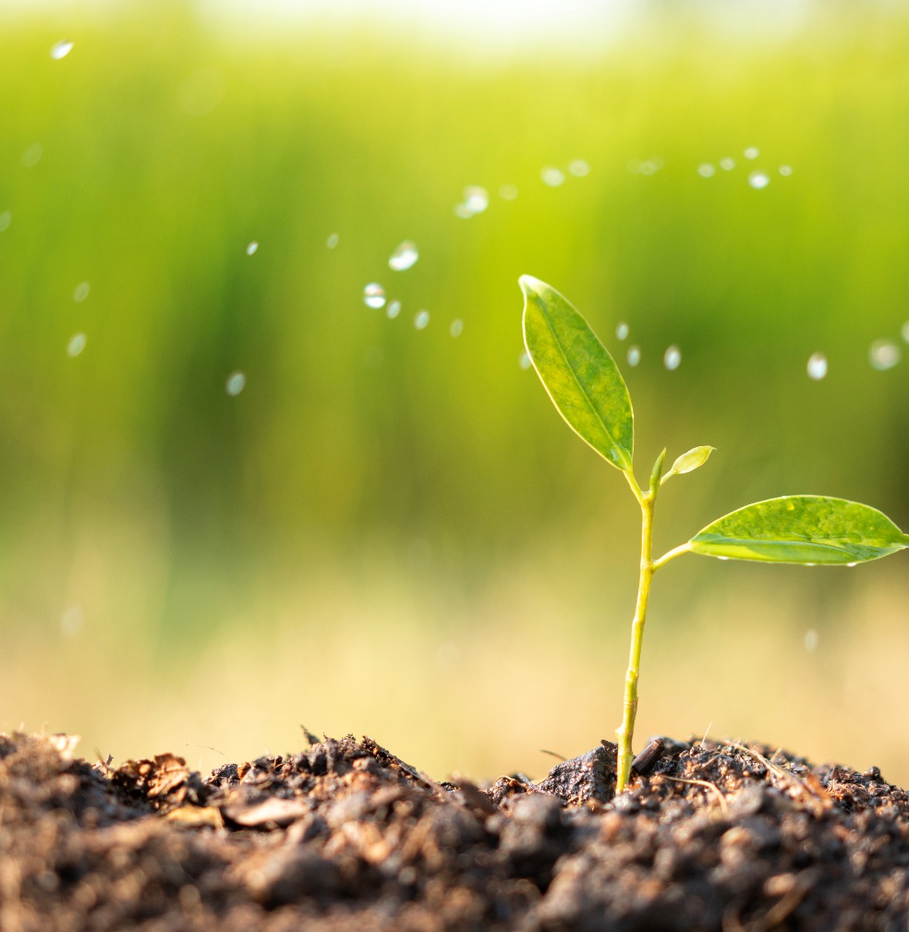
Characteristics of Life
Living things grow and develop.
Living things respond to their environment.
Stimulus: a signal to which an organism responds.

Slide 24
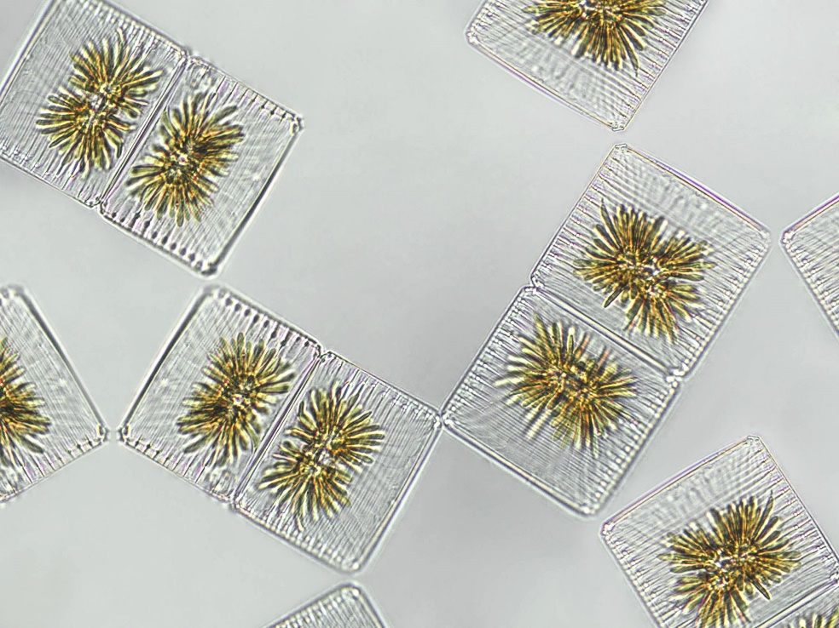
Characteristics of Life
Living things reproduce.
Sexual reproduction: cells from 2 parents unite to form the first cell of a new organism.
Asexual reproduction: a single organism produces offspring identical to itself.

Slide 25
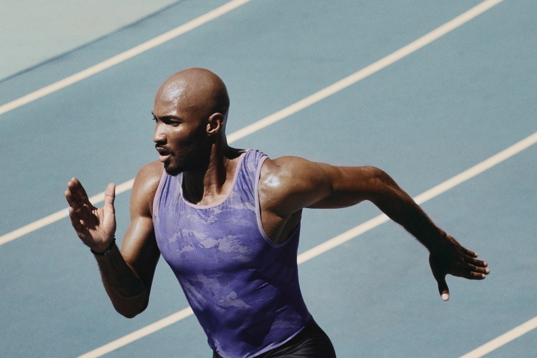
Characteristics of Life
Living things maintain a stable internal environment.
Homeostasis: maintain a relatively stable internal environment despite changes in external environment.

Slide 26
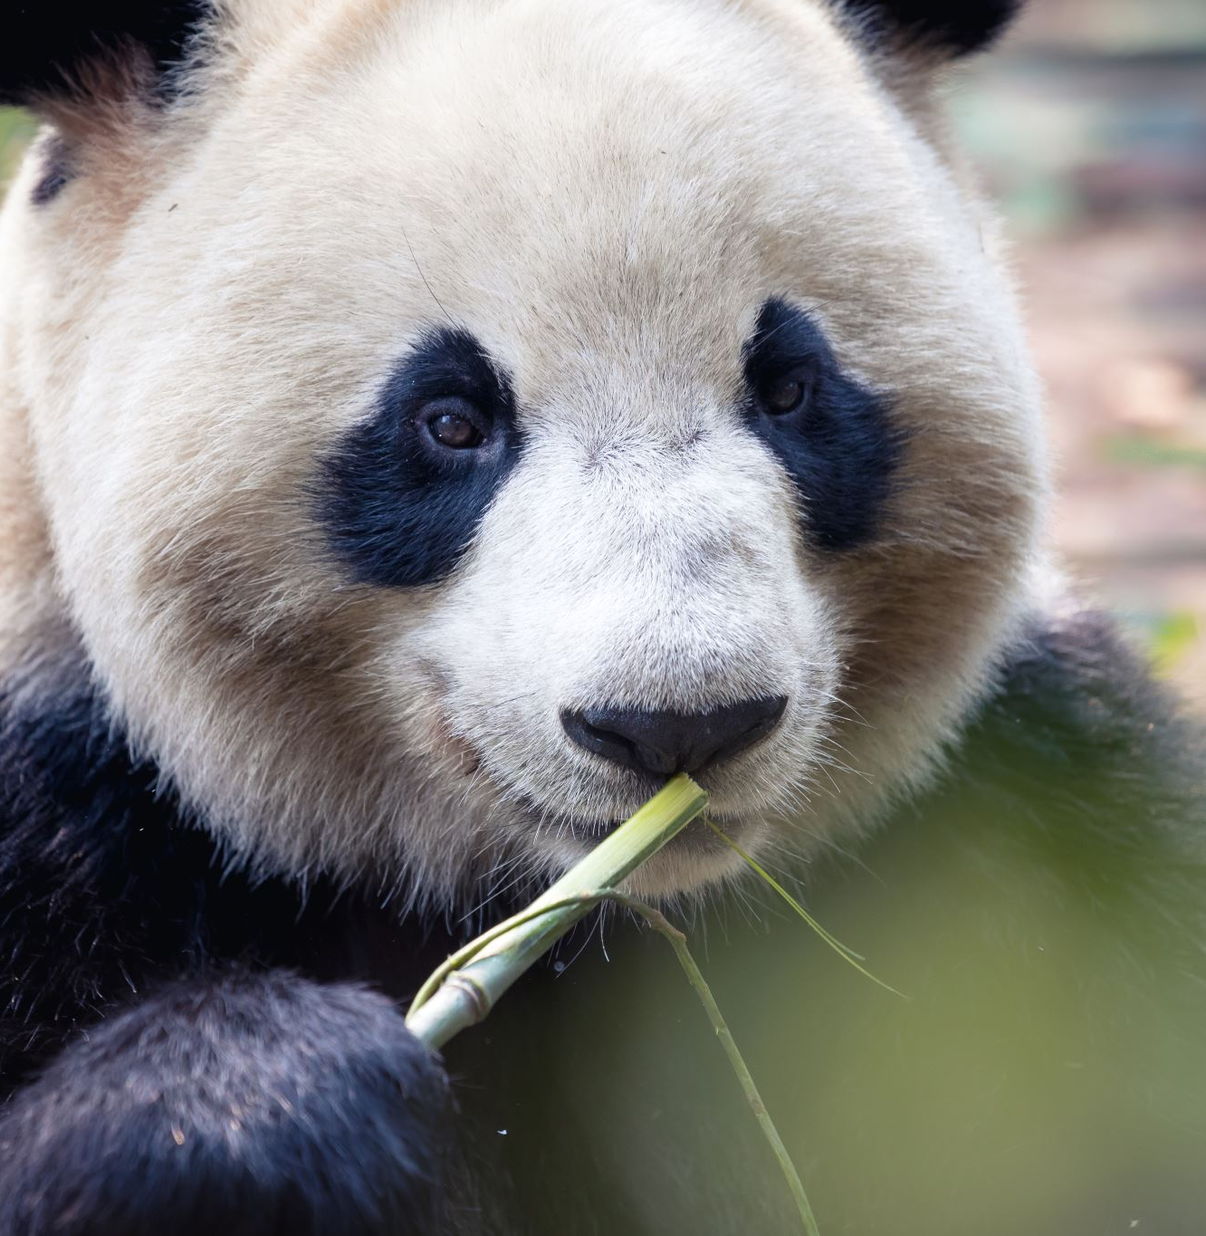
Characteristics of Life
Living things obtain and use material and energy.
Metabolism: combination of chemical reactions through which an organism builds up or breaks down materials.

Slide 27
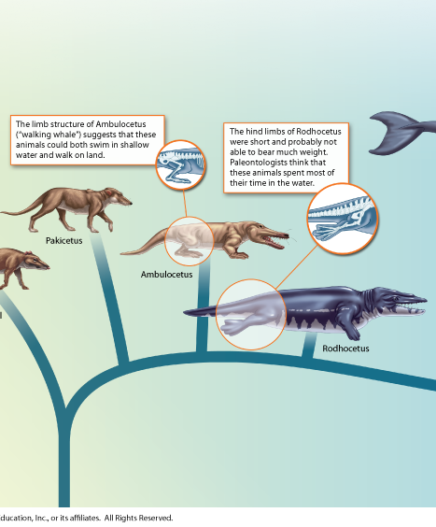
Characteristics of Life
Taken as a group, living things evolve.

Slide 28
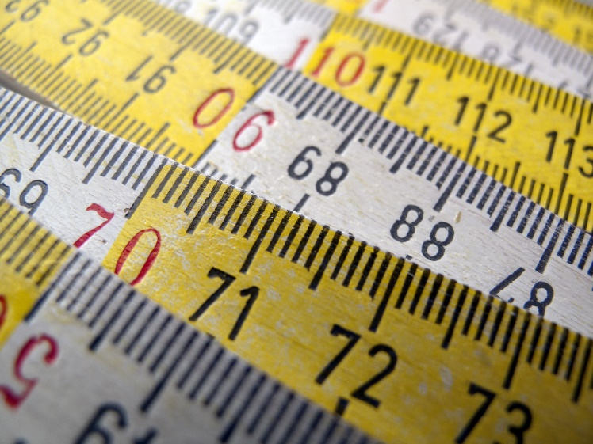
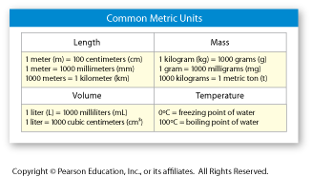
Scientific Measurement
Metric System
Based on multiples of 10.

Slide 29
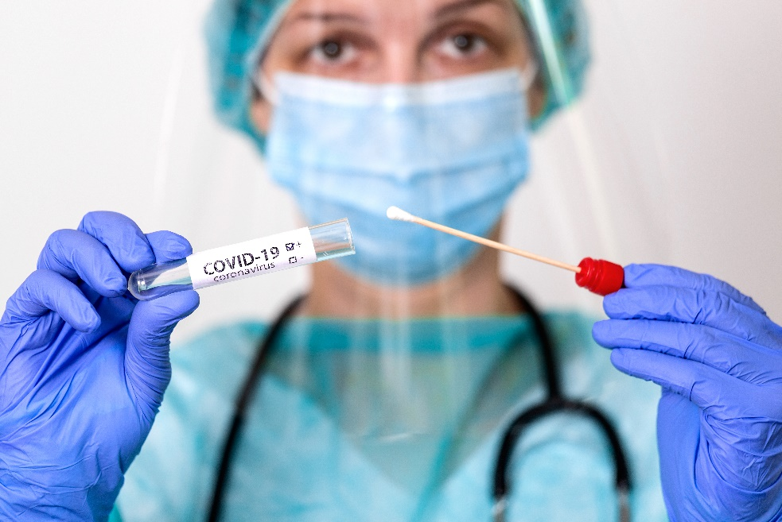
Safety
Scientists must practice safety when working in the laboratory or the field.

