Slide 2
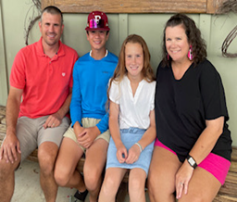
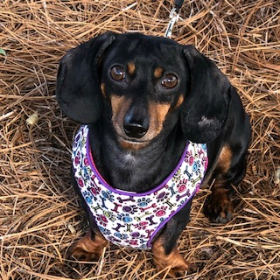
I’ve been married to my husband, Jason, for 20 years. We have 2 kids: Jaxson (14) and Carleigh (11). My husband teaches at Marbury High School where Jaxson will be a freshman! I will get to spend Carleigh’s 6th grade year with her at DPES! Our family pet is a miniature dachshund named Holly.

Slide 3
Education:
Bachelor’s Degree in Education- Auburn University
Played in the marching band at Auburn
Experience:
Kindergarten, 1st, and 5th- Catoma Elementary (in Montgomery)
K3 and Kindergarten- First Presbyterian Kindergarten (in Prattville)
First year teaching 2nd grade- Daniel Pratt

Slide 4
Click here to view our schedule.
We have Reading, Writing, and Language Arts in the morning, Lunch and P.E., then Math in the afternoon. Science and Social Studies is at the very end of the day.

Slide 5
Students will be Respectful
Students are kind to each other
Our class will be like a family

Slide 6
Green tags-please fill these out. They will need keep this tag on their backpacks for the first few weeks of school.
Student Info Sheet-(mailed to you) please complete front and back and leave with me today.
Water Bottles- Please send a refillable water bottle each day. (labeled with their name) We keep our water bottles in the classroom and can access them throughout the day.
Headphones- each student will need a good pair headphones (not wireless) to use daily. These will be used daily here at school.

Slide 7
Basic supplies like crayons, pencils, and glue have been provided. A few other items are needed. Please see supply list. As the year goes on, I may ask for extra items like paper towel or tissues if we run out.

Slide 8
Spelling words and vocabulary words need to be studied each week, unless we aren’t testing that week..
Math Study guides will be given before a test to help prepare.
Other homework will be given as needed.

Slide 9
Email: carrie.mattox@acboe.net
Notes are best for transportation changes.Please allow at least 24 hours for me to respond. If there is an emergency, call the school.
*ParentSquare- be sure to download this app!

Slide 10
Use kind words and actions.
Follow directions quickly.
Always raise your hand to speak.
Complete your work neatly and on time.
Keep your classroom clean.

Slide 11
Behavior Plan
In our classroom, we are learning to be respectful, kind, and ready to learn. Unwanted behaviors do not arise often, but when they do I will work with the student and provide many chances. I will keep a record in Class Dojo. This will be for my personal records.
3 lost Dojo points or 3 REDs will result in a message or email sent to parent.
6 lost Dojo or 6 REDs will result in a parent/teacher conference.
9 lost Dojo points or 9 REDs will in an office referral or possible time spent in ISS.

Slide 12
Our Lunch time is 10:47-11:10.
Family Lunch days will happen once each semester for parents to join their kids for lunch. Menus are typically posted on our school website.
This year, as part of a program that ACBOE is piloting, Breakfast and Lunch will be FREE for ALL Students.

Slide 13
Reading:
Reading Tests major grades- 60%
Minor Grades- 40% (word reading assessments, practice pages, fluency passages
Language Arts:
Not weighted, spelling tests, writing activities, worksheets
Math:
Topic Tests- 60%
workbook pages, fluency checks- 40%
Science/Social Studies/Handwriting:
S, N, U

Slide 14
Make up work will be sent home for excused absences. Students will be responsible for making up graded assignments when they return.
Always remember to send in a doctor’s note or hand-written parent note.

Slide 15
We sing and recognize birthdays in this class. If you ever want to send in a treat for your child to celebrate with their class, please let me know in advance.

Slide 16
2:50- Walkers and Daycare dismissed
2:52- Car Riders dismissed
3:00- First Load bus riders dismissed
3:05- Second load bus drivers dismissed
3:07- YMCA dismissed
**Car line will now run in front of the school. Please make sure you watch the video on Parent Square for an explanation.
https://www.youtube.com/watch?v=BD1N16_vHtI

Slide 17
Parking Lot Info
Carpool will be in front of the school now due to the new PKS school being built.
The bus line will now be on the side near the gym.
If your child is a “walker”, you are not allowed to park in front of the school or wait under the breezeway for your child. You may park on Tara Dr.
If you need to visit the office, please do not park in the front parking lot until after 7:55.

Slide 18
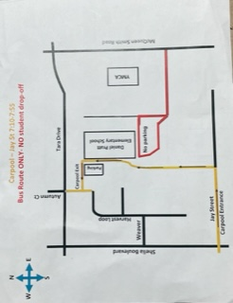

Slide 19
Field Trips
Water Safety Course- YMCA- Sept. 6th
Penton Farms -mid October (TBA)
Shakespeare- winter (TBA)
Animal Safari Park- 4th nine weeks (TBA)
Please Note: ALL money MUST be turned in with permission slips no later than 8 am on deadline days. No late money will be accepted, nor will the office accept it,
Please label ALL money sent to school with child’s name and purpose for the money.

Slide 20
Get Connected
POWERSCHOOL- be sure to connect to the app to see grades and attendance. (see handout)
Weekly Call Out- Mrs. Finch will do an weekly call out on Sundays to keep everyone informed. Be sure your phone number in powerschool is correct and is the primary contact’s number. (also important for emergency purposes)
Parent Square- Be sure to download the app and check regularly for messages from our school and/or ACBOE. This will be my primary method of communication.

Slide 21
Other business
You will find the following in the lunchroom today during Open House:
-Carpool Accounts (new electronic system)
-Bus Transportation
-Parent volunteers sign ups
-School T-shirt sales
-School Supply Sales
-YMCA aftercare
-DPES Water Bottle Sales
-Snack Shack Envelope Sales

Slide 22
Volunteers
If you would like to be a parent volunteer at school, you must first fill out and sign a DPES Volunteer Guidelines and Confidentiality Agreement form.

Slide 23
Money
Please make sure all money is labeled with name, teacher, and purpose for money.
When turning in money for field trips, please adhere to due dates as the office will not take up any money. All money must go through the teacher.
*** Water Safety field trip money is due by August 16th!**

Slide 26
YOUR TEXT

Slide 27
YOUR TEXT
YOUR TEXT

Slide 28
YOUR TEXT
YOUR TEXT

Slide 29
YOUR TEXT
YOUR TEXT

Slide 30
YOUR TEXT

