Slide 1
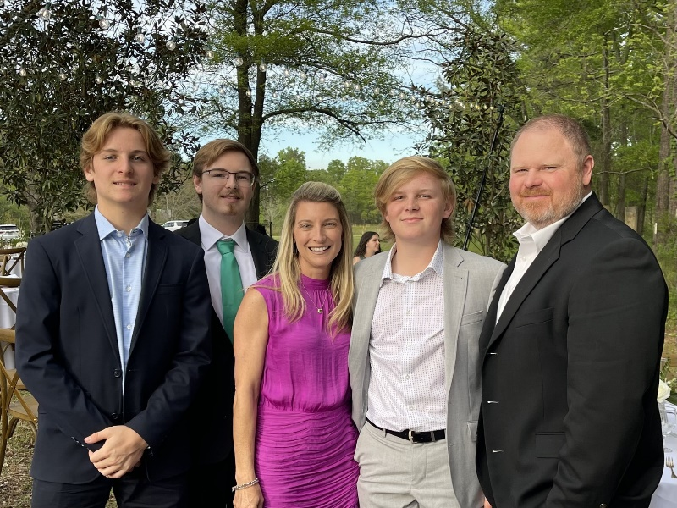
I’m Mrs. Peters
Welcome to second grade! I am so glad that I am going to be your teacher this year. I can’t wait to watch you learn and grow. I know we will have a great year together! Before we begin our
year together, I thought you might
like to know a little bit about me.
This is my 21st year teaching and 6th year at Kings Chapel. I have taught 1st, 2nd, 3rd and 4th grade in different
school systems around Georgia.
This will be my second year in second grade at KCES.
I graduated from Valdosta State University in 2000, and I received my Master's Degree in 2004. I recently earned my Specialist Degree in Curriculum and Instruction.
I have been married to my husband, Derek, for 23 years. We are the proud parents of three sons, Spence (20), Eli (17) and Ty (15). We love to spend time together and travel. We love to go to the beach and mountains as well as play baseball, pickelball and golf, and play with our dog (Bo), as well as spend time with our extended family.
Sweets: Choc Chip Cookies & PB M&M’s
Drink: Sweet tea & Starbucks
Fast Food: Chick-fil-a & Tropical Smoothie
Restaurant: Any steakhouse and Shane’s
Color: Anything bright
Places to shop: Amazon, Target
Places to go: The BEACH and MOUNTAINS!
Sports Teams: Georgia Bulldogs, Perry Panthers & Atlanta Braves

