Slide 1



Classroom Rigor in Bracken County Schools
2015-2016

Slide 2
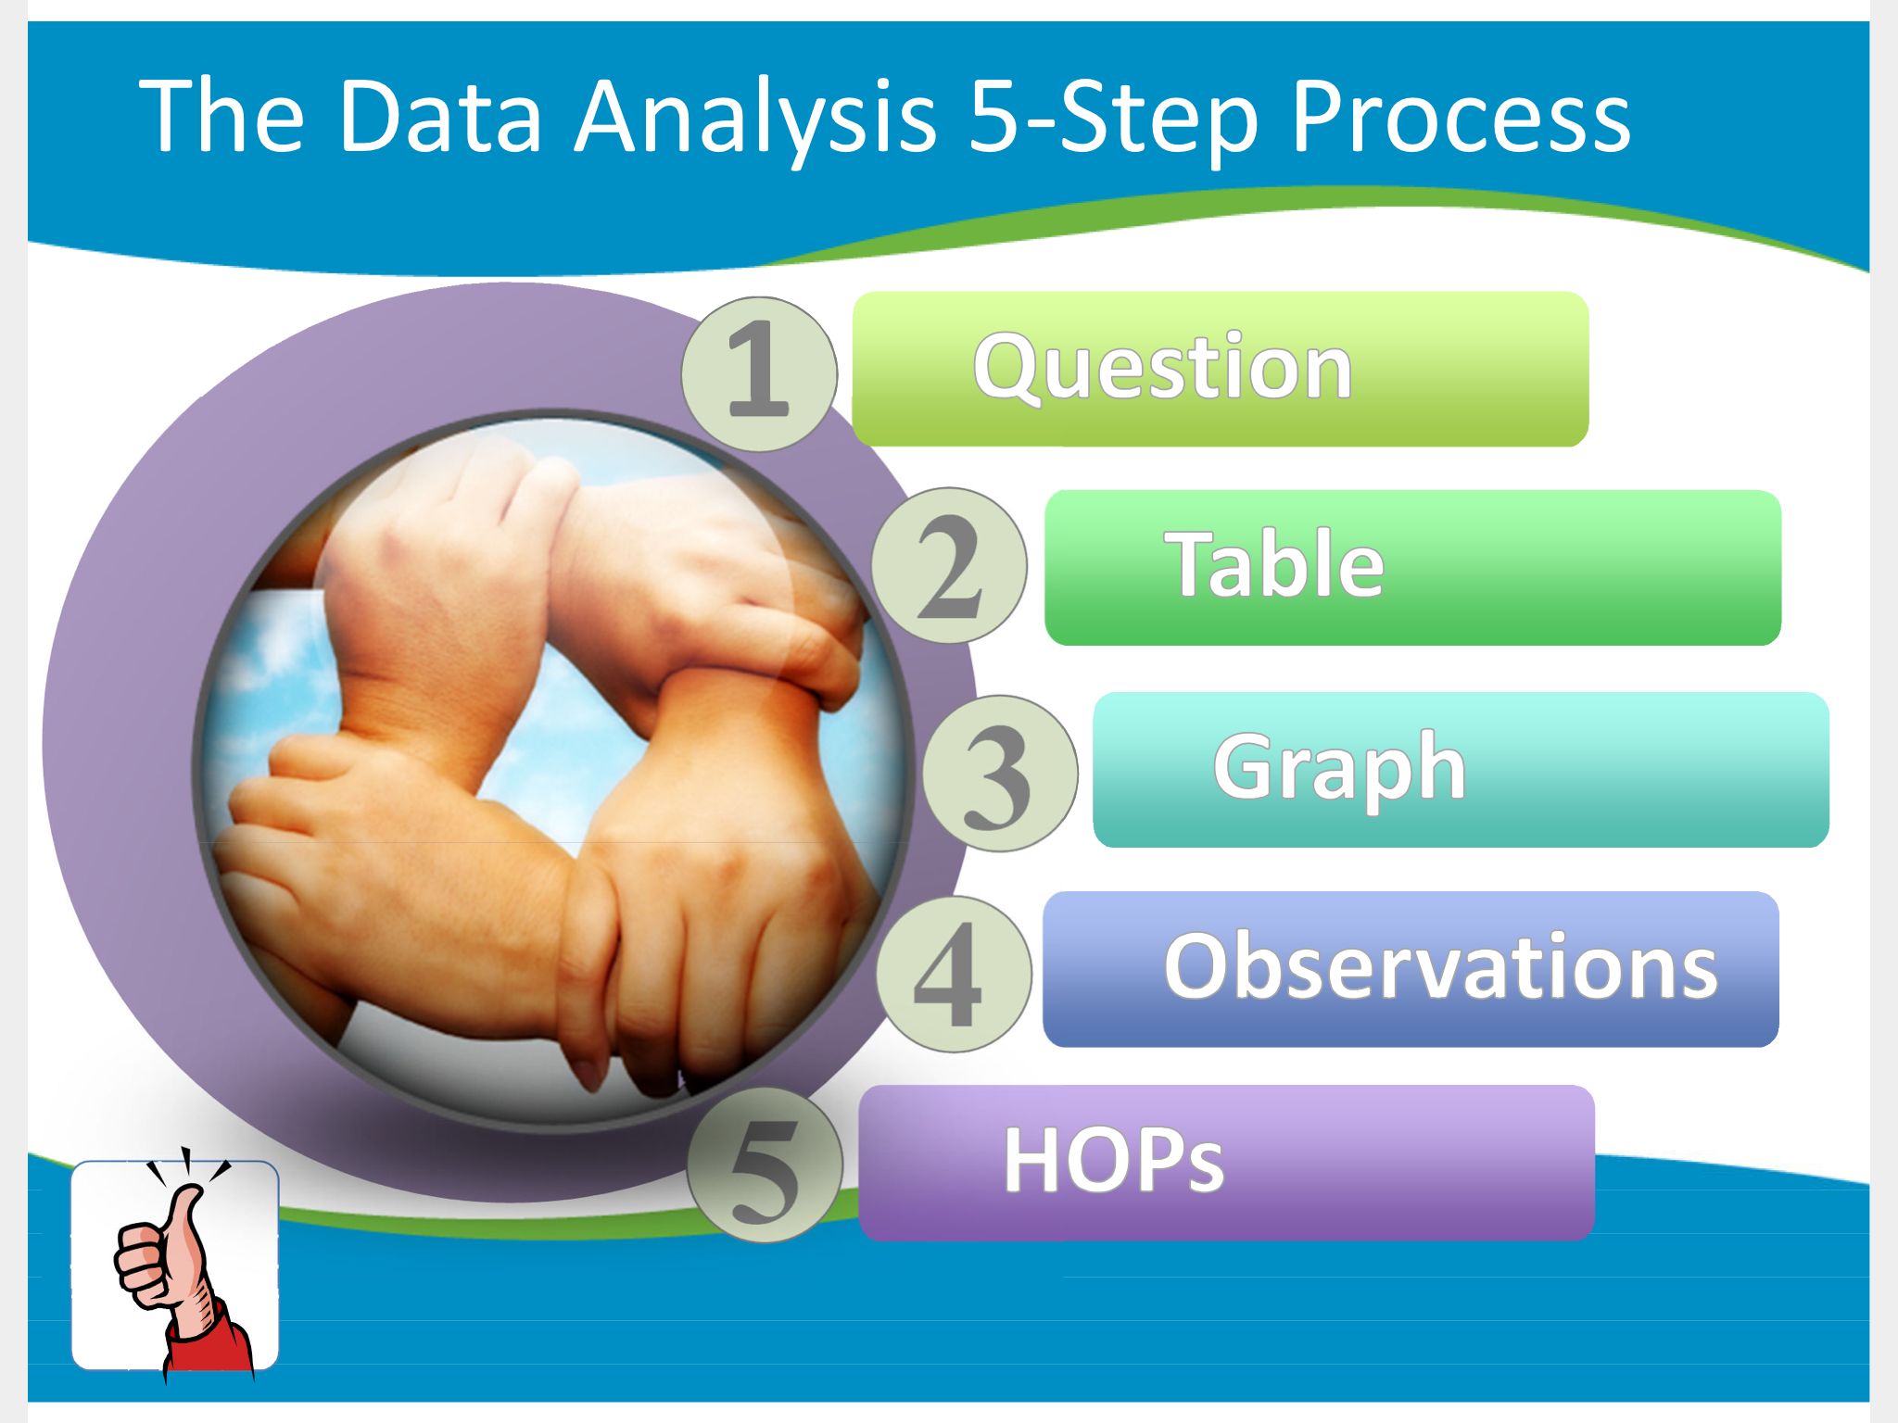
DATA Retreat: July 21st and 22nd-- 2015
> http://youtu.be/kcnyMHNt_Bg
Notes:
I will have to go out to the You Tube site and actually play the link. It is not active within the PowerPoint.

Slide 3
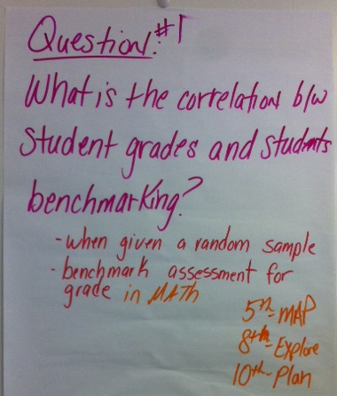
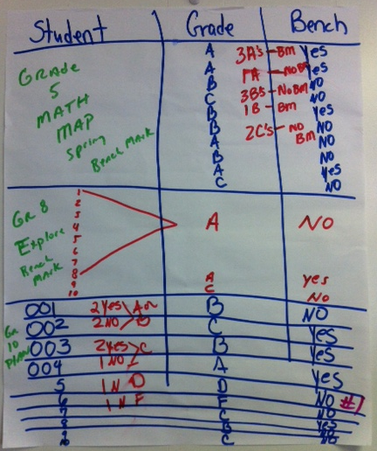
Our Road to Rigor---
Our Question, Table & Graph

Slide 4
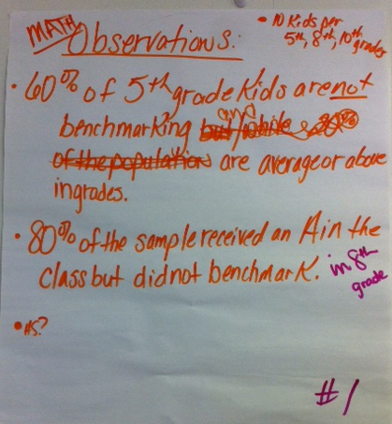
Our Road to Rigor--- Our observations

Slide 5
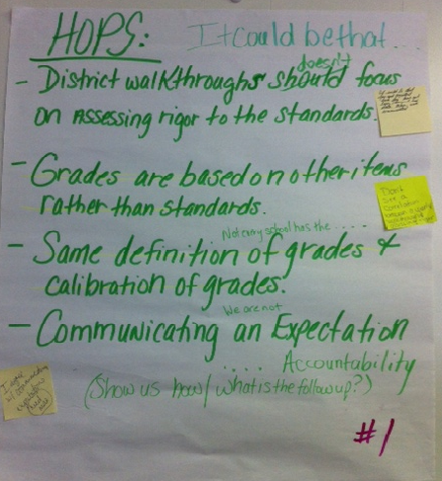
Our Road to Rigor---
Our hops– District Hypothesis of Practice
Don’t
It could be that clear and consistent “Look fors” have not been/have not had data taken and communicated
Don’t see a correlation between yearly walk through and assessing rigor
I agree with communication of expectations- need more

Slide 6

Our Road to Rigor---
Our Initial concern-- focus
What message are we sending to students and parents when our students are receiving A’s and B’s for their course work grades , but yet, students are NOT meeting the required ACT/ASPIRE/K-PREP/MAP benchmarks for their grade level content standards for state level testing, school accountability, and for individual student college and career readiness?
What are the beliefs, practices, and policies for grading among our schools and district?
What was your school team’s Primary Concern at Data Retreat?

Slide 7
Bracken County rigor defined:
Academic rigor is learning through …
      strategically, intentionally planned curriculum
      focused and aligned standards
      diverse and multiple learning styles, needs, and experiences
      immersing students as workers, investigators, and problem solvers
      utilizing critical, creative, and higher order thinking skills
      generating student self-discovery and intellectual engagement through new ideas, meanings, and knowledge
      working with challenging text and mediums that pose dilemmas, conduct inquiry, take positions, examine multiple meanings, and apply to current life situations.
Focus Areas for Year 1 Implementation:
Questioning and Engagement

Slide 8
questioning –how will I know I am successful?
Teachers will:
Students will:
Intentionally and strategically plan questions and how to ask them at the right time to be a catalyst for powerful, exciting, and memorable learning.
Frame their questions around knowledge, skills, and big ideas that students needs to learn.
Choose the right type, kind, and level of questioning to reinforce and intensify different kinds of learning.
Formulate questions and initiate topics.
Initiate discussion participation through self or teacher direction.
Build upon the contributions of others through relevant and meaningful responses/ questions.
Effective questioning puts learning ahead of activities.

Slide 9
Questioning resources
1. Corwin- High Impact Instruction: Video 2.1– Wendy Hopf- Content Planning–
http://www.corwin.com/highimpactinstruction/videos.htm
2. Corwin- High Impact Instruction: Video 3.1-- Chris Korinek- Talks about questions
http://www.corwin.com/highimpactinstruction/videos.htm
3. Corwin- High Impact Instruction: Video 5.1-- Wendy Hopf– Thinking Prompts
http://www.corwin.com/highimpactinstruction/videos.htm
4. Checking in with Questions Video-- Keep asking your students the right questions. If you continually ask students questions, you can check their level of understanding and if they are ready to move on to the next task or concept. https://www.teachingchannel.org/videos/checking-in-with-questions
5. Writing Higher Order Questions-- Having students develop better questions, or even higher order questions, allows for a deeper understanding of a subject. Watch as Ms. Francisco uses a variety of strategies to encourage higher order questioning from her students. https://www.teachingchannel.org/videos/developing-better-questions
6. Designing Leveled Questions -- When teachers take time to design good questions for their students that consider learning goals, student understanding improves. Watch one teacher discuss how she designs questions for her classroom. https://www.teachingchannel.org/videos/designing-questions
7. Using Questioning to Develop Understanding -- Develop effective questioning techniques for your lessons. Teachers can assess understanding and lead students to find answers on their own with effective questioning strategies. https://www.teachingchannel.org/videos/questioning-in-the-classroom
8. The Power of Effective Questioning.-- https://www.youtube.com/watch?v=1dO0dO__wmE
9. Questioning and Discussion Techniques for the learner centered classroom--
https://www.youtube.com/watch?v=y1QVIcDsnEg
10. Questions in the Classroom-- https://www.youtube.com/watch?v=uxomuepN38o
11. Corwin- High Impact Instruction Toolkit: - http://www.corwin.com/highimpactinstruction/toolkit.htm
- Figure 2.1 How to Create Guiding Questions - Figure 4.17 Learning Map and Guided Questions
- Resource: Attributes of Eff. Thinking Prompts Cklist - Figure 4.21 Daily Use of Learning Map/Guided Ques.
Copy and paste the URL into an Internet browser to view resource.

Slide 10
Planning and observation tool
 | Teacher: Building: Date: | Who | Type | Kind | Criteria | B. Level | Wait Time | Planned Ahead | Celebrate Mistakes | All Students Called
 | Question Scripting pg. 1 Team Member: | T, St. | (R,W,O) | (C,O) | (K, U, D) | (R, U, Ap, E, C) | Y, N | Y, N | Y, N | Y, N
1
2
3
4
5
6
7
8
9
10
11
12
13
14
15
16
17
18
19
20
21
22
23
24
25
26
27
28
29
30
Turn over to complete Question scripting and Legend information for columns feedback
 | Teacher: Building: Date: | Who | Type | Kind | Criteria | B. Level | Wait Time | Planned Ahead | Celebrate Mistakes | All Students Called
 | Question Scripting pg. 2 Team Member: | T, St. | (R,W,O) | (C,O) | (K, U, D) | (R, U, Ap, E, C) | Y, N | Y, N | Y, N | Y, N
1
2
3
4
5
6
7
8
9
10
11
12
13
14
15
16
17
18
 | Type: Right or Wrong; Opinion (R, W, O)
 | Right/Wrong--Asked to confirm whether or not some has the correct understanding of knowledge, skills, big ideas
 | Opinion-- Asked for someone's perspective on a topic; catalyst for conversation
 | Kind: Closed ended; Open ended (C, O)
 | Closed-- Limited SHORT responses; Used to check for understanding; usually a higher number asked
 | Open-- Unlimited LONG responses; Used to push thinking, to prompt deeper thought, and to provide a setting where students can make personal connections with learning; usually a small number asked
 | Criteria: Know, Understand-Big Idea, Do- Skill (K, U, D)
 | Knowledge- explore what a student knows about a topic | Skill- explore how well a student can do something
 | Big Idea- explore concepts, themes, content structures, and broad topics
 | Bloom's Taxonomy |  |  |  |  |  |  |  | Level
 | Rembering, listing, describing, identifying, retrieving, naming, locating, finding, highlighting, searching the internet |  |  |  |  |  |  |  | Remember (R)
 | Interpreting, summarizing, inferring, paraphrasing, classifying, comparing, contrasting, inferring, explaining, blogging, commenting, annotating |  |  |  |  |  |  |  | Understand (U)
 | Implementing, carrying out, sorting, using, executing, running, operating, uploading |  |  |  |  |  |  |  | Apply (Ap)
 | Checking, hypothesizing, critiquing, experimenting, judging, testing, detecting, monitoring, reviewing |  |  |  |  |  |  |  | Evaluate (E)
 | Designing, constructing, planning, producing, inventing, devising, making, filming, animating, publishing, video casting, podcasting, directing |  |  |  |  |  |  |  | Create (C)
 | Discriminating, organizing, deconstructing, attributing, outlining, finding, struct-uring, integrating, dis-secting, sorting, taking apart |  |  |  |  |  |  |  | Analyze (A)

Slide 11
Engagement – how will I know I have it?
Students will:
Teacher will:
Strategically and intentionally utilize the questions planned for their instructional purpose.
Provide learning tasks that are relevant, meaningful, and important.
Provide a productive mix of different types of groupings and learning opportunities suitable for lesson objectives.
Be passionate about teaching.
Show an observable attraction to their work.
Persist in their work despite challenges and obstacles.
Show application of their work in real time connections.
Engagement is NOT just keeping students busy!
Notes:
Passionate: Be physically energized, emotionally connected, mentally focused, and purposeful.

Slide 12
engagement resources
Corwin- High Impact Instruction: Video 8.2– http://www.corwin.com/highimpactinstruction/videos.htm
2. Corwin- High Impact Instruction: Video 8.3-- http://www.corwin.com/highimpactinstruction/videos.htm
3. Corwin- High Impact Instruction: Video P2.1- Levels of Engagement
http://www.corwin.com/highimpactinstruction/videos.htm
4. https://www.teachingchannel.org/videos/big-brain-protocol
5. https://www.teachingchannel.org/videos/peer-learning-between-students
6. https://www.teachingchannel.org/videos/think-pair-share-lesson-idea
7. Morning Meeting: https://www.teachingchannel.org/videos/classroom-morning-meeting
8. 4. 11. Corwin- High Impact Instruction Toolkit: - http://www.corwin.com/highimpactinstruction/toolkit.htm
Figure 8.1- Success Factors - Figure 8.4- Think, Pair, Share Checklist
Figure 8.3- Turn to Your Neighbor Checklist - Figure s 8.5, 8.6, and 8.7
9. Student Engagement: Resource Roundup http://www.edutopia.org/student-engagement-resources
10. How to Keep Kids Engaged in Class http://www.edutopia.org/classroom-student-participation-tips
11. The 8 Minutes That Matter Most http://www.edutopia.org/blog/8-minutes-that-matter-most-brian-sztabnik
12. Art and Science of Teaching / The Many Uses of Exit Slips http://www.ascd.org/publications/educational-leadership/oct12/vol70/num02/The-Many-Uses-of-Exit-Slips.aspx
13. Engage me or Enrage me article: https://net.educause.edu/ir/library/pdf/erm0553.pdf
Corwin- High Impact Instruction: Video 7.1, Video 7.2, and Video 7.3 - Stories
http://www.corwin.com/highimpactinstruction/videos.htm
15. TESS (Teacher Excellence and Support System)- POSSIBLE STRATEGIES TO ENHANCE INSTRUCTIONAL PRACTICE
http://ideas.aetn.org/edweb/tess/next-steps/TESS%20Deeper%20Into%20Danielson%20Handout.pdf
Copy and paste the URL into an Internet browser to view resource.

Slide 13

District team commitment:
During the course of the school year, we will…..
Visit our schools and classrooms to collect data on implementation and impact of our focus areas identified throughout the school year.
Work monthly with our schools to provide additional support, training, practice, and resources for our identified focus areas.
Collaboratively grow with you from the improvement process to better direct instructional practices and training for our staff and our school district.
Analyze the data collected to inform our District team on our practices to determine improvements, next steps, and celebrations of all schools’ work.

Slide 14
Moving forward:
The District Team and Building principals will review data collected to determine additional training opportunities, dates, and times to provide staff.
Staff will receive training opportunities with a strategy of focus, see how the strategy works, practice the strategy, then receive feedback on their strategy implementation.
Staff will also be involved in the process of providing feedback on strategy implementation.
This process will be utilized monthly and repeated with another strategy of focus followed by training, practice, and feedback.
Time frame: December through April. Questioning will be trained and implemented with feedback through January.
Data Collected through this process will be utilized for our Summer 2016 data Retreat Analysis and improvement of practice.

Slide 15

After reviewing this Powerpoint and its examples, staff will participate by completing the task by November 24thby noon.
Task:
Staff will complete an on-line pre-assessment survey to direct additional training needs and resources within Questioning for our priority focus in December.
If you are scheduled to be out, please complete by Nov. 23rd.
Click link for Pre-Assessment survey: Use the link for the survey sent to you through e-mail. Complete it through Google. https://docs.google.com/forms/d/1YnBngPFPaC6AFsHUUfWNh1MzTkIfIQKV0KubasS0v3Y/viewform

