Slide 1

Tucker Elementary School
Title I Annual Parent Meeting
August 26, 2025

Slide 2
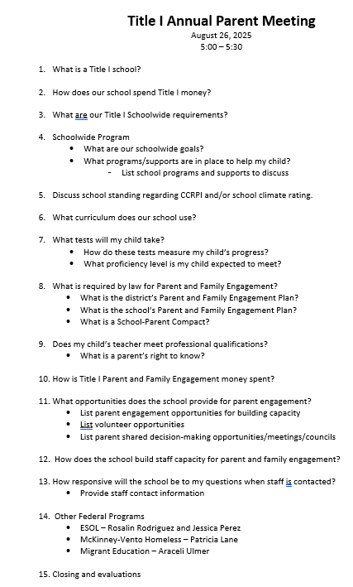

Notes:
To begin the meeting I have included an agenda for you to follow along throughout the meeting. The agenda covers all of the topics that will be discussed throughout the presentation.

Slide 3

What is a title I school?
The purpose of Title I under ESSA is to “ensure that all children have a fair, equal, and significant opportunity to obtain a high-quality education and reach at a minimum, proficiency on challenging state academic achievement standards and state academic assessments.”
A Title I school works to:
Identify students most in need of educational help
Set goals for improvement
Measure student progress and develop programs that add to classroom instruction
Involve parents in all aspects of the program

Slide 4
Purpose of Title I
Tucker Elementary is a Title I School.
TES receives additional federal funds for the purpose of improving teaching and learning for students.
All students in our school benefit from these funds.
Title I requires that these funds be used for programs that will improve student achievement and include ways to help parents help their children to succeed (parent engagement).
Title I school requirements include: Annual Title One Meeting, School-Parent-Student Compact, Joint Development and Decision Making, Parent based engagement events/activities

Slide 5
Title I Requirements
www. http://tes.hcbe.net/
District Family Engagement Plan
School Family Engagement Plan
School Parent Compact
Teachers Meet Professional Qualifications
Parents Right to Know
Building Staff Capacity

Slide 6
District & School wide goals
Increase by at least 2 percentage points the number of students performing at or above proficiency in core content areas in grades 3-11 as measured by Milestones assessment scores.
Increase the percentage of parents who feel their child’s school provides various opportunities for engagement.

Slide 7
What programs and supports are in place to help my child?
Positive Behavior Intervention (PBIS) program- Reinforces positive behavior
Community Partnerships, such as the BUG Award & The Summer Reading Program
Additional Paras
Early intervention program (EIP)
Differentiated and small group instruction
Remediation and enrichment

Slide 8
School Wide Program
CCRPI and Climate Star
College and Career Readiness Performance Indicators
TES CCRPI Score for 2024 77.1
School Climate Score- 4 out of 5 stars (94.10)
Curriculum www.GeorgiaStandards.org
Support Programs Include:
Early Intervention Programs
Multi-Tiered System of Support (MTSS)
Tutoring

Slide 9
E.S.S.A. (Every student succeeds act) public school choice
House Bill 251:
Gives parents/guardians the option to request that their children attend any school within the school system based on space availability.
School districts determine available classroom space after all assigned students have been enrolled.

Slide 10

Is my child’s teacher qualified? What is right to know?
All our teachers are highly qualified.
(Parent’s Right to Know*)

Slide 11
Dr. Watson
Assistant Principal of Instruction

Slide 12

Testing
GA Milestones Testing
In Spring 2023, students in 3rd-5th grade will be required to take the Georgia Milestones Assessment
MAP Testing (Measure of Academic progress)
Helps teachers, parents, and administrators improve learning for all students and make informed decisions to promote a child's academic growth
HCLI Testing (Houston County Literacy Inventory)
Checks reading fluency, comprehension, and determines the reading level of the student
GKIDS Testing (Georgia Kindergarten Inventory of Developing Skills)
Provide teachers with information about the level of instructional support needed by individual students entering kindergarten and first grade
Tests measure student achievement of the state content standards, student preparedness for the next course and help identify students who may need more support.

Slide 13
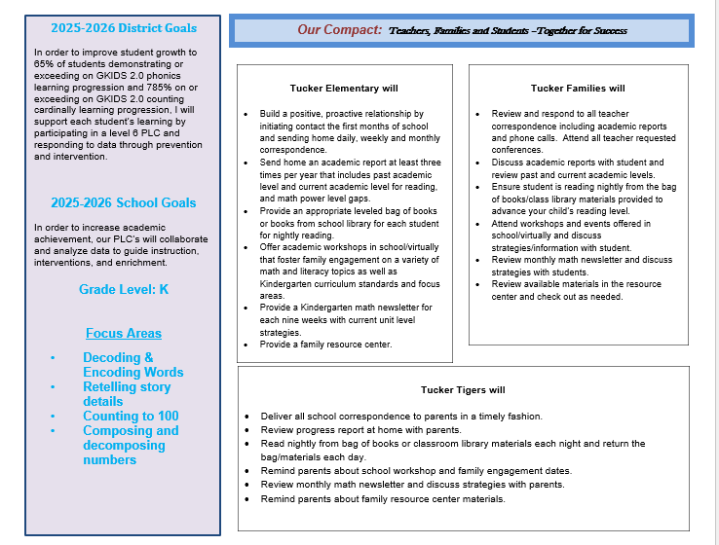
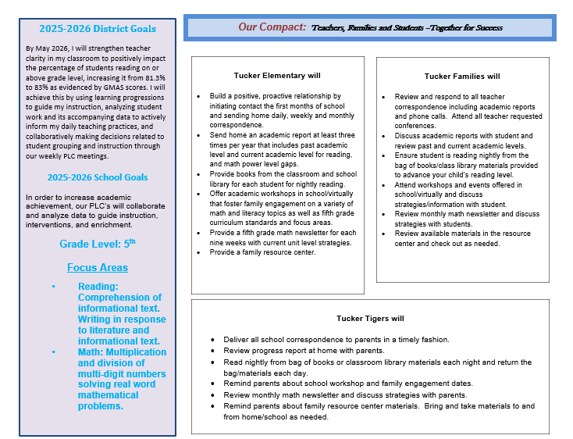
What is a School-Parent Compact?
A school-parent compact is an agreement that explains how parents, teachers, and students will work together to make sure all students reach grade-level standards.
This agreement is developed by stakeholders and is reviewed/revised annually based upon feedback from all stakeholders. During parent-teacher conferences the compacts will be discussed.

Slide 14
Mr. Jeffrey Whitaker Assistant Principal of Discipline

Slide 15
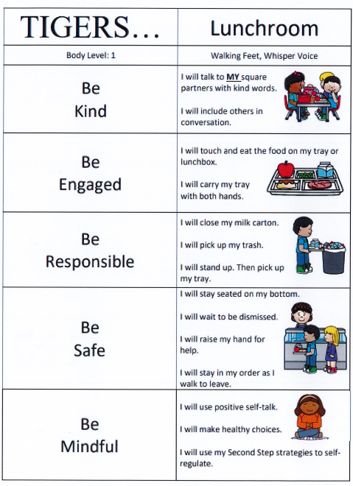
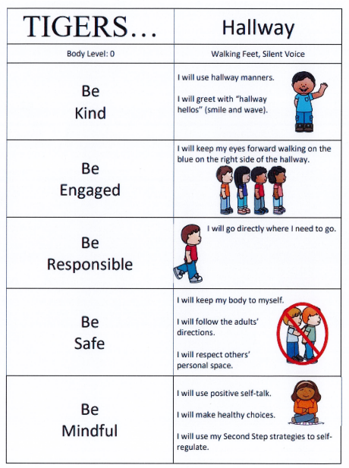

What is pbis?
The Positive Behavior Interventions and Support program is based on the idea of recognizing positive behavior of students. Students who take responsibility of their behavior will be recognized and rewarded in a variety of ways.

Slide 16
Dalas Wright
Family Engagement Liaison

Slide 17

Title I SPENDING
Family Engagement Coordinator
Parent Events and Workshops
Parent Newsletter
Parent Resource Center
Technology
Instructional Supplies
Professional Development
Intervention Teacher

Slide 18


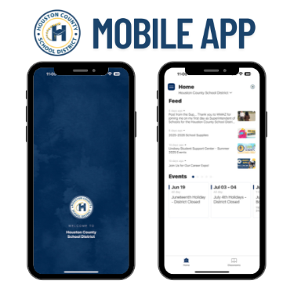

TES Parent Engagement OPPORTUNTITIES
Shared Decision Making:
Parent Action Team Meetings (November 3rd)
Shared Decision-Making Meeting for Parents (March 5th)
Parent Survey (January 2026)
Parent Engagement:
Monthly Newsletter
Parent Teacher Conferences
Tech & Testing Night
Family Math and Literacy Night
Family STEM Night
Family Fun Night
Bingo for Books!
Tigers Talent Show
Spring Read-Nic
Milestones Prep
Share your voice:
PTO
School Council
Be Sure to Follow Us on Facebook and Check our School Website and HCSD App!!

Slide 19
Federal Programs
ESOL – Jessica Perez
McKinney-Vento Homeless – Patricia Lane
Migrant Education – Araceli Ulmer
Located at the Central Office

Slide 20
CONTACT Information
Contact us with any questions you have, and we will address your concerns as quickly as possible.
Mrs. Eddie Williams, Principal
Dr. Grace Watson, Assistant Principal of Instruction
Mr. Jeffrey Whitaker, Assistant Principal of Discipline
Mrs. Lora Ostrat, Counselor
Mrs. Dalas Wright, Family Engagement Liaison
(478)-988-6278 ext. 3387 or via email at dalas.wright@hcbe.net

Slide 21




THANK YOU FOR BEING HERE AND SHARING YOUR VOICE!

