Slide 1

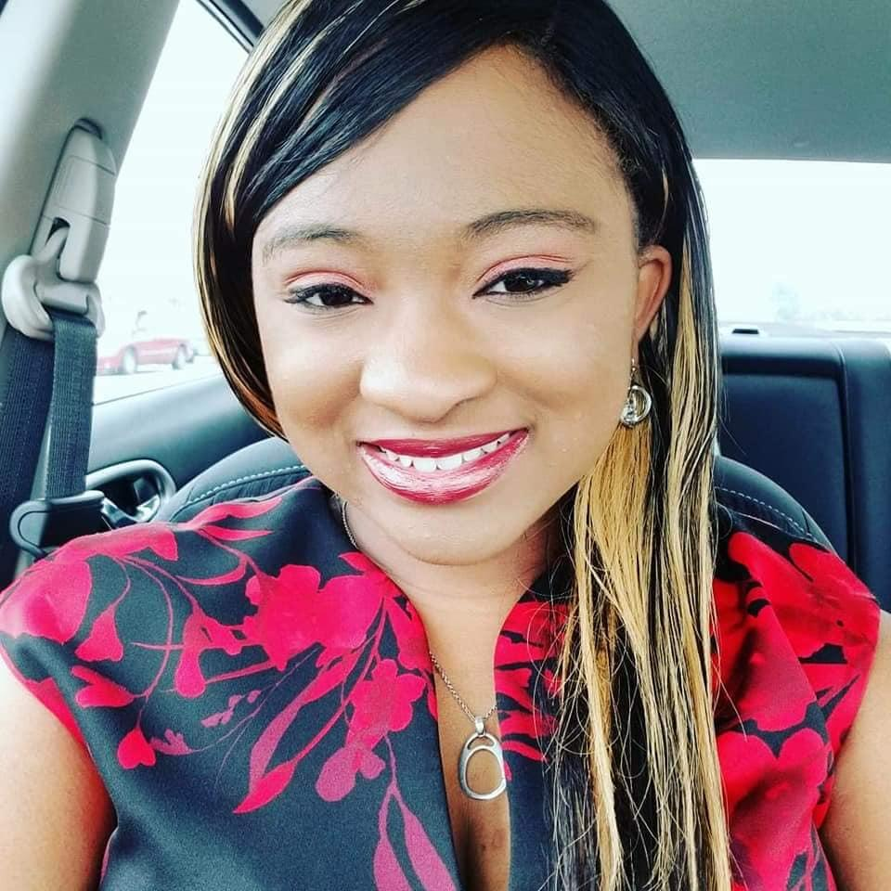
Place a photo of yourself here!
Suggested size: 200 px x 170 px
Hello, My name is Dominees Johnson, I am 33 years old. I have been married for 7 years to my wonderful husband and best friend Rondarius. We have two handsome little boys, Brian (10) and Jaydon (6) who are my entire world.
Color: Sky Blue
Food: Pork Chops & Rice
Drink: Sprite, Strawberry Fanta, V8 Energy Orange Pineapple
TV Show: WWE
Place to Visit: My Parents and Grandmother
Subject: Math & Science
Candy: Rolo and Turtles
Holidays: Christmas
Favorite Fast food Restaurant: McAlisters
ALLERGIES:
ONIONS
LAVENDER
I have my Bachelor’s degree in Information Technology with an Emphasis in Cybersecurity from South University, Savannah. I will be enrolling here, in the near future, for my Masters Degree in Elementary Education.
Primary e-mail:
dominees.johnson@elmoreco.com
Primary Contact Method: ParentSqure

