Slide 1

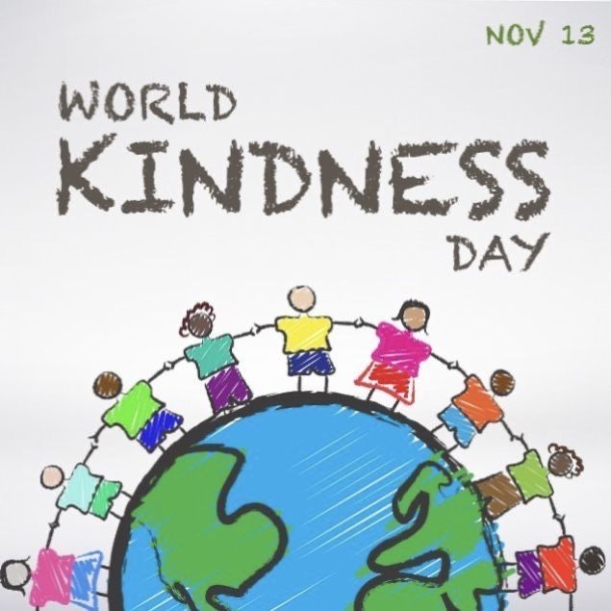

CONNECTING WITH THE
SCHOOL COUNSELOR
Children’s Grief Awareness Day
November 19, 2026 (wear blue)
During this time, individuals are encouraged to educate themselves, support grieving children by listening and validating their feelings, and participate in awareness activities, such as wearing the color blue to show solidarity.
World Kindness Day
November 13, 2026
Model the Kindness you want to see!
Wellness TIP:
Cultivate Resilience
This month, let’s focus on gratitude as a way to build resilience. Encourage your child to reflect on challenges they have overcome and find positives in their experiences—it’s a powerful way to grow stronger.
We are Learning!
Courage – when you are brave enough to do what is best for you and others when facing new or difficult circumstances.
Tattling – when you are choosing to try to get someone else in trouble
Reporting – when you are choosing to try to protect someone else or yourself from trouble
Let’s CONNECT!
Email:: veronica.hardy@acboe.net
Phone: 334-365-6277 ext. 1216

